Slide 1
Monitoring implementation of Terms and Conditions or Methodologies (TCMs)
Maria BARROSO GOMES
MESC – 10.02.2025
Restricted

Slide 2
Monitoring implementation
Under ACER Regulation and the Electricity Regulation, ACER is responsible for monitoring and analysing the implementation status of network codes and guidelines
The EU electricity guidelines require, in certain instances, the development of more detailed rules and procedures, known as ‘Terms and Conditions or Methodologies’ (TCMs).
TCMs are technical provisions that ensure the establishment of a common regulatory framework for the internal electricity market and contribute to the EU’s decarbonisation objectives.
TCMs:
are developed by TSOs or NEMOs and are approved by NRAs or ACER.
can apply at both European and Regional level
approximately 190 have been adopted since 2016
TCMs Implementation Monitoring page

Slide 3
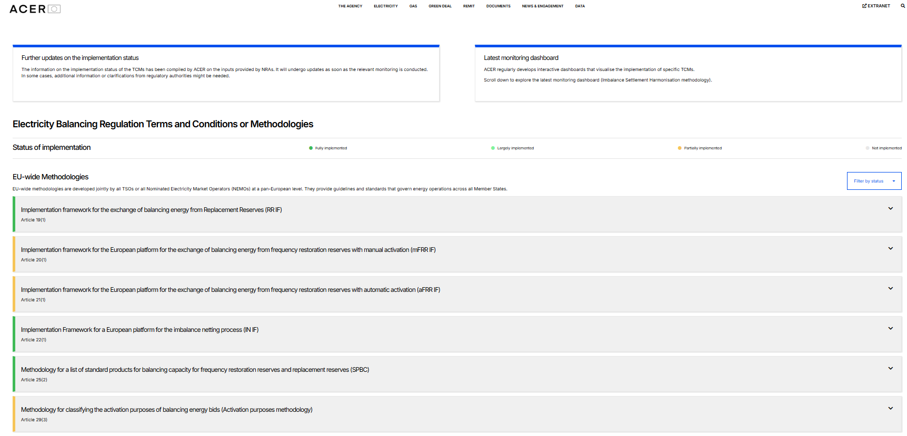
Monitoring implementation
To monitor and analyse the implementation status of each TCM, ACER gathers information on the implementation from NRAs and monitored entities
In dedicated webpages, ACER presents the implementation status of the TCMs under each of the regulations (CACM, FCA, EB, SO)
The TCMs can be filtered by status
The information on the implementation status has been compiled by ACER based on the inputs provided by NRAs. It will be updated as soon as the relevant monitoring is conducted.
Interactive dashboards will be published on ACER’s website on a rolling basis as soon as the information becomes available
Capacity Allocation and Congestion Management
Electricity Balancing
Forward Capacity Allocation
System Operation

Slide 4
Monitoring implementation
ACER has started to conduct detailed implementation monitoring of the obligations contained in each of the methodologies to obtain precise indications on their implementation status
Focus is to understand the status of implementation of the obligations of EU-wide TCMs first; regional TCMs to follow afterwards
During 2025 and 2026, every quarter, multiple monitoring requests on either CACM, FCA or EB EU-wide TCMs will be launched via a dedicated application – MONOCLE – directly to the relevant stakeholders.
ACER reporting will be periodically updated on the ACER website (e.g. ISH)
Stakeholders are informed of the monitoring plans

Slide 5
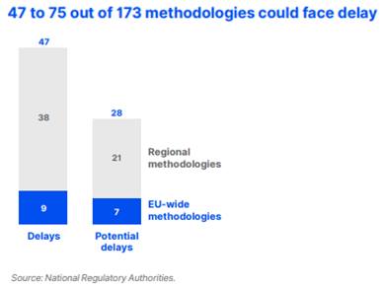
Implementation delays identified
Major delays have occurred in the implementation of methodologies defining market operations, both regional and EU-wide
27% of the methodologies could face implementation delays in 2024
Delays can greatly affect consumers’ cost, especially for projects with substantial welfare effects, hindering the EU energy market’s proper function
Some delays are due to the technical complexity of the methodologies; others occur because the methodologies are dependent on the full implementation of related methodologies
ACER 2024 Market Integration Report

Slide 6
Implementation delays identified – next steps
Delays are identified
NRAs agree to take action
Investigation / enforcement measures take place at national level
ACER/NRA discussion
ACER and NRAs are committed to improving the incentive and enforcement framework, in particular for regional and European-wide implementation projects
Commitment stated in recent reports (ACER/ CEER Report on Challenges of the Future Electricity System ; 39th European Electricity Regulatory Forum (‘Florence Forum’) conclusions)
NRAs are taking action at national level on some cases
Progress to be reported in the next Florence Forum and in the July MESC

Slide 7
Thank you. Any questions?
The contents of this document do not necessarily reflect the position or opinion of the Agency.

