Slide 1
ENTSO-E Annual Work Programme 2026
Public Webinar
04 July 2025, 14:00-15:30 CEST

Slide 2





Organisational details
Webinar planning: approx. 1.5 hours
Interactive (Q&A)
Recording/streaming is needed to ensure transparency. If you object, please let us know.
All participants must stay muted when not speaking
Speak only when given the floor by the moderator.
All the questions and comments in the MS Teams will be addressed preferably during the webinar via Q/A.
If questions remain open, they can be addressed offline bilaterally.
During the Q&A the participants can raise the hand to ask a question / make a comment
The moderator will give you the floor.

Slide 3
Agenda
Topic | Lead | Time
Welcoming participants AWP 2026: Introduction (structure, rules, focus, status) | Eva-Marie Kurscheid Rafael Carnicero Mazon | 14:00 -14:15
2. Presentations and Q&A: Network Codes/Guidelines – Implementation: Operations (SOGL/ Emergency and Restoration) Market (FCA,CACM, EBGL, NCDR) and Transparency Platform Network Code on Cybersecurity (NCCS) Connection Network Codes (CNCs) 3. Additional ENTSO-E tasks Operation Readiness and Resilience Electricity Market Design Economic Regulation and Finance Grid Development and Extension Innovation and Digitalization Preparing for the future Offshore system 4. General feedback and closing | James Hellinckx Ludivine Marcenac/ Nijat Gasimov Ron Wibbelink Mario Ndreko James Hellinckx Marco Foresti Ignacio Zubieta Ochoa Emil Tan Ioannis Theologitis/ Michele Dion-Demael Lea Dehaudt | 8 min/topic 14:00-14:08 14:08-14:16 14:16-14:24 14:24-14:32 14:32-14:40 14:40-14:48 14:48-14:56 14:56-15:04 15:04-15:12 15:12-15:20 15:20-15:30

Slide 4
1. Welcoming Participants/ AWP 2026 Introduction

Slide 5



AWP 2026: Introduction
ENTSO-E Annual Work Programme (AWP) 2026 is open for public consultation until 1 August 2025
Overview
ENTSO-E publishes every year an Annual Work Programme as required under REGULATION (EU) 2019/943 on the internal market for electricity.
AWP focuses on the legally mandated tasks given to Transmission System Operators (TSOs) and the European Network of TSOs (ENTSO-E) directly by European Union (EU) Regulations, Directives and Network Codes and Guidelines as well as the related terms and conditions or methodologies.
Why your views matter
The elaboration of the Annual Work ­Programme – 2026 and its successful implementation hinges on the input provided by our stakeholders.
Your comments are valuable to us in order to improve the draft found in the open public consultation.
AWP team will provide feedback to those who provided comments.
Public consultation open on ENTSO-E’s consultation hub until 1 August 2025 Consultation on the ENTSO-E Annual Work Programme 2026 - European Network of Transmission System Operators for Electricity - Citizen Space (entsoe.eu)

Slide 6
AWP 2026 – High-Level Timeline
AWP 2026 preparation foresees a consultation approach and approval process.
DRAFT AWP 2026 LIST & TEXT
FINAL AWP 2026
Publication
BD Guidance issued on Draft
Committee Review
Recommend for AS approval
AS approval of draft AWP
BD final approval
AS final approval
Submission to ACER
6
Mar
5
Jun
25
Jun
17 Sep
22
Oct
Nov
Jan 2025
AWP list of del. and text development
Public Consultation
1 Jul – 1 Aug
Dec 2025
Pre-consultation of list
Board (BD) meeting
Asssembly (AS) meeting
Public consultation
Annual AWP webinar
Today

Slide 7
2. Presentations and Q/A
Network Codes and Guidelines Implementation

Slide 8
Agenda
Topic | Lead | Time
Welcoming participants AWP 2026: Introduction (structure, rules, focus, status) | Eva-Marie Kurscheid Rafael Carnicero Mazon | 14:00 – 14:15
2. Presentations and Q&A: Network Codes/Guidelines – Implementation: Operations (SOGL/ Emergency and Restoration) Market (FCA,CACM, EBGL, NCDR) and Transparency Platform Network Code on Cybersecurity (NCCS) Connection Network Codes (CNCs) 3. Additional ENTSO-E tasks Operation Readiness and Resilience Electricity Market Design Economic Regulation and Finance Grid Development and Extension Innovation and Digitalization Preparing for the future Offshore system 4. General feedback and closing | James Hellinckx Ludivine Marcenac/ Nijat Gasimov Ron Wibbelink Mario Ndreko James Hellinckx Marco Foresti Ignacio Zubieta Ochoa Emil Tan Ioannis Theologitis/ Michele Dion-Demael Lea Dehaudt | 8 min/topic 14:00-14:08 14:08-14:16 14:16-14:24 14:24-14:32 14:32-14:40 14:40-14:48 14:48-14:56 14:56-15:04 15:04-15:12 15:12-15:20 15:20-15:30

Slide 9
Operations Network Codes and Guidelines (SOGL/ Emergency and Restoration)

Slide 10
AWP 2026 – Operations Network Codes and Guidelines
System Operation Guideline (SO GL)
Probabilistic Risk Assessment Methodology (pursuant to Art. 44 of CSAM)
  Building a proof-of-concept solution towards the development of a probabilistic risk assessment methodology.
  Data collection on grid disturbances is ongoing.
Publications:
  Annual reports on the Incident Classification Scale (ICS) and load-frequency control (LFC)(Art. 15 and Art. 16 of the SOGL).
Network codes, guidelines and methodologies:
  Ensuring consistency between SOGL and other network codes and guidelines
  Ensuring the European regulation is fit for purpose in a new changing energy landscape.
  Preparing for relevant regulation and methodologies amendments related to SOGL, Coordinated Security Analysis (CSA) and Common Grid Model (CGM) methodologies.
Emergency and Restoration (ER)
  Coordinating the implementation of the Network Code Emergency and Restoration (NC ER) by the TSOs.
  Ensuring consistency between the NC ER and other network codes and guidelines.
  Assessing potential amendment needs for NC ER.
Notes:
CACM
The CACM cost report for the cost incurred in 2024, will be delivered mid-2025 by the Market Coupling Steering Committee (MCSC) body, which has been established in 2022 by the NEMOs and the TSOs.
EBGL
In Mid-2025, based on individual SOR assessment, the parameters (reliability levels) for the Annex of the Regional Coordination Centers Procurement Proposal will need to be submitted to ACER by All TSOs via a Request for Amendment (RfA)

Slide 11
Agenda
Topic | Lead | Time
Welcoming participants AWP 2026: Introduction (structure, rules, focus, status) | Eva-Marie Kurscheid Rafael Carnicero Mazon | 14:00 – 14:15
2. Presentations and Q&A: Network Codes/Guidelines – Implementation: Operations (SOGL/ Emergency and Restoration) Market (FCA,CACM, EBGL, NCDR) and Transparency Platform Network Code on Cybersecurity (NCCS) Connection Network Codes (CNCs) 3. Additional ENTSO-E tasks Operation Readiness and Resilience Electricity Market Design Economic Regulation and Finance Grid Development and Extension Innovation and Digitalization Preparing for the future Offshore system 4. General feedback and closing | James Hellinckx Ludivine Marcenac/ Nijat Gasimov Ron Wibbelink Mario Ndreko James Hellinckx Marco Foresti Ignacio Zubieta Ochoa Emil Tan Ioannis Theologitis/ Michele Dion-Demael Lea Dehaudt | 8 min/topic 14:00-14:08 14:08-14:16 14:16-14:24 14:24-14:32 14:32-14:40 14:40-14:48 14:48-14:56 14:56-15:04 15:04-15:12 15:12-15:20 15:20-15:30

Slide 12
Market Network Codes and Guidelines and Transparency Platform

Slide 13


AWP 2026 – Market Network Codes and Guidelines
FCA - Forward Capacity Allocation - Long Term Timeframe
Long Term Flow Based capacity allocation implementation to be implemented by June 2026
Harmonised allocation Rules – biannual review, start of the work end of 2026
Assessment of the Long-Term Market and FCA regulation amendment preparation.
CACM - Capacity Calculation and Congestion Management (Day ahead and Intraday Timeframe)
Preparation of the work to implement CACM regulation amendment
Congestion Income Distribution (CID) methodology – cross CCR CID to cope with Advanced hybrid coupling and assessment of the methodology.
Capacity Calculation Region (CCR): assessment of the configuration of the CCRs by 3 months after the implementation of the first regional operational security coordination in Core.
Follow up on the bidding zone review and preparation for the data for the next technical report.
Intraday Gate opening and Gate Closure Time to be implemented in January 2026.
Notes:
CACM
The CACM cost report for the cost incurred in 2024, will be delivered mid-2025 by the Market Coupling Steering Committee (MCSC) body, which has been established in 2022 by the NEMOs and the TSOs.
EBGL
In Mid-2025, based on individual SOR assessment, the parameters (reliability levels) for the Annex of the Regional Coordination Centers Procurement Proposal will need to be submitted to ACER by All TSOs via a Request for Amendment (RfA)

Slide 14

AWP 2026 – Market Network Codes and Guidelines
EBGL – Electricity Balancing Guideline - Balancing Timeframe
Co-optimisation – Research & Development activities on integrating co-optimisation into the price coupling algorithm
Review of the rules for the settlement of intended and unintended exchanges of energy (FSkar) within Synchronous Area Continental Europe and between Synchronous Areas
Balancing platform Implementation Frameworks: Balance Service Provider Terms and conditions harmonisation (ACER Decision by mid-2026)
European Balancing Platforms – continuous implementation
Several important assessments planned, among others:
  Efficiency and effectiveness assessment of the European balancing platforms,
  Comparison of alternative control models for automatic frequency restoration reserve (aFRR) platform,
  Assessment of the need for further harmonisation of the imbalance settlement (See Ch. 10 of AWP for details).
Notes:
CACM
The CACM cost report for the cost incurred in 2024, will be delivered mid-2025 by the Market Coupling Steering Committee (MCSC) body, which has been established in 2022 by the NEMOs and the TSOs.
EBGL
In Mid-2025, based on individual SOR assessment, the parameters (reliability levels) for the Annex of the Regional Coordination Centers Procurement Proposal will need to be submitted to ACER by All TSOs via a Request for Amendment (RfA)

Slide 15



ENTSO-E | Network Code on Demand Response a tool to unlock flexibility
Pursuant to the mandate based on Article 59 (9) of Regulation (EU) 2019/943, ENTSO-E and DSO Entity submitted the Network Code Demand Response (NC DR) package (including the NC DR text, and amendments to the EB Guideline, the SO Guideline and the Demand Connection Network Code) on 8 May 2024 to ACER.
After the review of the proposal, ACER submitted its recommendation to the EC on 7 March 2025. Currently, the EC public consultation on NC DR package (summer 2025), the comitology process (Q4 2025) and entry into force (Q1 2026) are expected.
Objectives of NC DR:
In 2026:
ENTSO-E, in cooperation with the EU DSO Entity, will follow on the mandates stemming from the adopted NC DR, including but not limited to:
Drafting of the Union-wide methodologies;
Conducting the preparatory work for constitution of baselining methodology registry;
Cooperating closely with relevant organisations to draft, improve, and support the development of standards in the areas related to the implementation of this Regulation; and
Cooperate with ACER on the establishment of the European Stakeholder Committee on Demand Response.
Streamlined participation of distributed flexibility (e.g. electric vehicles, heat pumps, batteries) in TSO and DSO services
Enhanced harmonisation across EU, allowing Flexibility Service Providers to deploy their solutions in several countries
Accelerated decarbonisation of the power sector, by allowing more renewables to connect to the grid

Slide 16
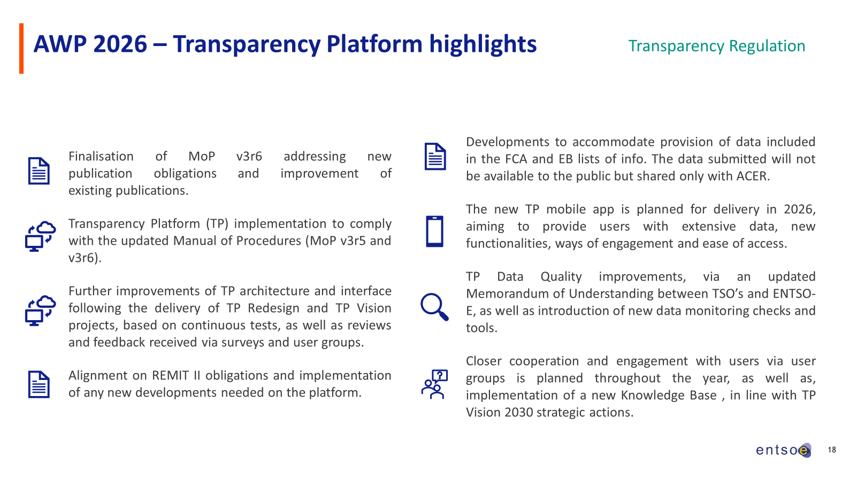
Slide on TP

Slide 17
Agenda
Topic | Lead | Time
Welcoming participants AWP 2026: Introduction (structure, rules, focus, status) | Eva-Marie Kurscheid Rafael Carnicero Mazon | 14:00 – 14:15
2. Presentations and Q&A: Network Codes/Guidelines – Implementation: Operations (SOGL/ Emergency and Restoration) Market (FCA,CACM, EBGL, NCDR) and Transparency Platform Network Code on Cybersecurity (NCCS) Connection Network Codes (CNCs) 3. Additional ENTSO-E tasks Operation Readiness and Resilience Electricity Market Design Economic Regulation and Finance Grid Development and Extension Innovation and Digitalization Preparing for the future Offshore system 4. General feedback and closing | James Hellinckx Ludivine Marcenac/ Nijat Gasimov Ron Wibbelink Mario Ndreko James Hellinckx Marco Foresti Ignacio Zubieta Ochoa Emil Tan Ioannis Theologitis/ Michele Dion-Demael Lea Dehaudt | 8 min/topic 14:00-14:08 14:08-14:16 14:16-14:24 14:24-14:32 14:32-14:40 14:40-14:48 14:48-14:56 14:56-15:04 15:04-15:12 15:12-15:20 15:20-15:30

Slide 18
Network Code on Cybersecurity

Slide 19
Network Code on Cybersecurity
Network Code on Cybersecurity (NCCS)
Network Code on Cybersecurity (NCCS) entered into force on 13th June 2024.
TSOs, with the assistance of ENTSO-E and in cooperation with the DSO Entity, are working on the deliverables stemming from the NCCS.
During 2026, the particular focus (but not exclusively) will be on:
Performing feasibility study to develop common incident sharing tool for all entities;
Developing procurement recommendation for substation gateways;
Developing procurement recommendation for SCADA systems;
Supporting ACER on cybersecurity european stakeholder committee;
Preparing union-wide cybersecurity risk assessments;
Preparing a template to perform cybersecurity exercises at entity and national level.

Slide 20
Agenda
Topic | Lead | Time
Welcoming participants AWP 2026: Introduction (structure, rules, focus, status) | Eva-Marie Kurscheid Rafael Carnicero Mazon | 14:00 – 14:15
2. Presentations and Q&A: Network Codes/Guidelines – Implementation: Operations (SOGL/ Emergency and Restoration) Market (FCA,CACM, EBGL, NCDR) and Transparency Platform Network Corde on Cybersecurity (NCCS) Connection Network Codes (CNCs) 3. Additional ENTSO-E tasks Operation Readiness and Resilience Electricity Market Design Economic Regulation and Finance Grid Development and Extension Innovation and Digitalization Preparing for the future Offshore system 4. General feedback and closing | James Hellinckx Ludivine Marcenac/ Nijat Gasimov Ron Wibbelink Mario Ndreko James Hellinckx Marco Foresti Ignacio Zubieta Ochoa Emil Tan Ioannis Theologitis/ Michele Dion-Demael Lea Dehaudt | 8 min/topic 14:00-14:08 14:08-14:16 14:16-14:24 14:24-14:32 14:32-14:40 14:40-14:48 14:48-14:56 14:56-15:04 15:04-15:12 15:12-15:20 15:20-15:30

Slide 21
Connection Network Codes

Slide 22
AWP 2026 – Connection Network Codes amendments
Link to the existing IGDs on ENTSO-E website
Amendment process of the Connection Network Codes (CNC)
Background:
December 2024: ACER published its recommendation to the European Commission on the Network Code High Voltage Direct Current Connection amendments.​​
Focus in 2026:
ENTSO-E waits for the "Have your say" consultation on the amended Network Code Requirement for Generators in 2026;
Focus on developing Implementation Guidance Documents (IGDs), especially on grid forming capability and forced oscillations.
Dependencies:
  ENTSO-E's work on CNC implementation depends on the adoption timeline from the European Commission.
The consultation on the amended Network Code on Demand Connection will follow the Requirement for Generators*.
CNC-related deliverables / action items in ENTSO-E AWP 2026
Implementation Guidance Documents (IGDs)
  Development of IGDs for new topics, e.g. on grid forming capability:
    Drafting, consultation and publication by 6 months after the entry into force of the amended Network Code Requirement for Generators.
  Update of the appx. 30 CNC-related IGDs that are already published on ENTSO-E website, according to the available resources.
Network Codes monitoring information:
  Collection and delivery of relevant information to ACER.
* The timeline of the European Commission has not yet been announced.

Slide 23
Agenda
Topic | Lead | Time
Welcoming participants AWP 2026: Introduction (structure, rules, focus, status) | Eva-Marie Kurscheid Rafael Carnicero Mazon | 14:00 – 14:15
2. Presentations and Q&A: Network Codes/Guidelines – Implementation: Operations (SOGL/ Emergency and Restoration) Market (FCA,CACM, EBGL, NCDR) and Transparency Platform Network Code on Cybersecurity (NCCS) Connection Network Codes (CNCs) 3. Additional ENTSO-E tasks Operation Readiness and Resilience Electricity Market Design Economic Regulation and Finance Grid Development and Extension Innovation and Digitalization Preparing for the future Offshore system 4. General feedback and closing | James Hellinckx Ludivine Marcenac/ Nijat Gasimov Ron Wibbelink Mario Ndreko James Hellinckx Marco Foresti Ignacio Zubieta Ochoa Emil Tan Ioannis Theologitis/ Michele Dion-Demael Lea Dehaudt | 8 min/topic 14:00-14:08 14:08-14:16 14:16-14:24 14:24-14:32 14:32-14:40 14:40-14:48 14:48-14:56 14:56-15:04 15:04-15:12 15:12-15:20 15:20-15:30

Slide 24
3. Additional ENTSO-E tasks
Operation Readiness and Resilience

Slide 25
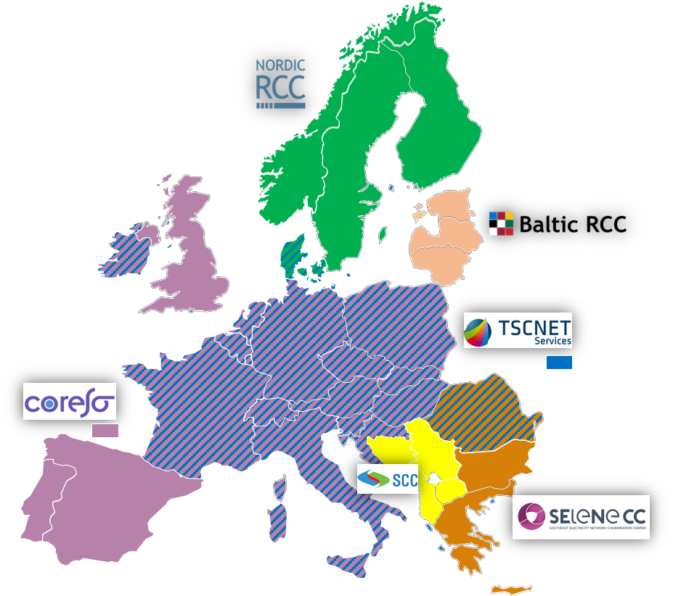
AWP 2026 – Operation Readiness and Resilience
Regional Coordination Centers (RCCs)
Regional coordination
  First a legal mandate in System Operations Guideline (SOGL) with 5 core tasks (Common Grid Model, Outage Planning Coordination, Short-Term Adequacy, Coordinated Security Analysis, Coordinated Capacity Calculation) performed by RCCs
  Expanded in the Clean Energy Package and Regulation (EU) 2019/943 to become 16 tasks.
6 RCCs :
  Owned/appointed by TSOs, deliver legally mandated tasks
  Provide recommendations to TSOs that contribute to minimise risks of wide-area events, and lower costs by ensuring the maximised availability of transmission capacity to market participants
In 2026, focus set on implementation of some of the remaining tasks under Art. 37 (1) of Regulation (EU) 2019/943
Common Grid Model (CGM)
CGM (model describing characteristics of the power system) and Operational Planning Data Environment (OPDE) ➔ key enablers of operational coordination & security of supply at European level.
Individual Grid Models (IGMs): provided by TSOs via OPDE to RCCs, who merge these into a CGM (covering timeframes from one year to one hour before real time).
CGM: key input for tasks delivered by RCCs (e.g CCC or CSA).
In 2026, focus on delivering a fit-for purpose CGMs for as input for pan-European and regional RCC tasks, with the support of the CGM action plan under System Operations Committee guidance.

Slide 26
AWP 2026 – Operation Readiness and Resilience
European Awareness System (EAS)
EAS has been enhanced with new functionalities, focusing on integration of data from the Wide Area Monitoring System (WAMS), providing operators with improved frequency maps and introduced new voltage and angle maps.
Future developments will include new functions based on WAMS data and an ex-post analytical platform for analysing operational events using WAMS data.
Implementation of grid incidents recommendations
Article 15(5) of the SOGL: all incidents at the operational security ranking scales 2 and 3 as per the incidents classification scale (ICS) are investigated by dedicated Expert Panels consisting of ENTSO-E, ACER and NRA.
2026: progress implementation of recommendations from 2021 ICS Scale 2 grid incidents and start implementation of recommendations derived from the 2024 ICS Scale 3 grid incident.
System Operations Stakeholder engagement
Coordination with Third Country TSOs:
  Synchronous Area Continental Europe: guidance will be provided to Moldeletrica for implementation of rules applicable in this area
  TEIAS: close cooperation to continue (Long-Term Agreement)
  KOSTT: close cooperation will continue to ensure the secure operation of the Continental Europe grid.

Slide 27
Agenda
Topic | Lead | Time
Welcoming participants AWP 2026: Introduction (structure, rules, focus, status) | Eva-Marie Kurscheid Rafael Carnicero Mazon | 14:00 – 14:15
2. Presentations and Q&A: Network Codes/Guidelines – Implementation: Operations (SOGL/ Emergency and Restoration) Market (FCA,CACM, EBGL, NCDR) and Transparency Platform Network Code on Cybersecurity (NCCS) Connection Network Codes (CNCs) 3. Additional ENTSO-E tasks Operation Readiness and Resilience Electricity Market Design Economic Regulation and Finance Grid Development and Extension Innovation and Digitalization Preparing for the future Offshore system 4. General feedback and closing | James Hellinckx Ludivine Marcenac/ Nijat Gasimov Ron Wibbelink Mario Ndreko James Hellinckx Marco Foresti Ignacio Zubieta Ochoa Emil Tan Ioannis Theologitis/ Michele Dion-Demael Lea Dehaudt | 8 min/topic 14:00-14:08 14:08-14:16 14:16-14:24 14:24-14:32 14:32-14:40 14:40-14:48 14:48-14:56 14:56-15:04 15:04-15:12 15:12-15:20 15:20-15:30

Slide 28
Electricity Market Design

Slide 29
Electricity Market Design
Capacity Mechanisms & Non-Fossil Flexibility Support Schemes
Follow-up of Clean Industry State Aid Framework implementation
Monitor developments at national level on development of Capacity Mechanisms, Non-Fossil Flexibility Support Schemes to share design best practices and implementation challenges
Assess interactions between Capacity Mechanisms and Non-Fossil Flexibility Support Schemes
Monitor and report implementation of cross-border participation to Capacity Mechanisms.
RES Support Schemes, Contracts for Differences (CfDs) & Power Purchasing Agreements
Reaction to EC Guidelines on CfDs & coexistence with PPAs
Monitor effects of RES support schemes and related regulation on market efficiency & system operation.
Market Integration, Congestion Management & Redispatch
ENTSO-E vision on congestion management tool-kit.
Other
Input to possible review of Electricity Directive and Regulation.

Slide 30
Agenda
Topic | Lead | Time
Welcoming participants AWP 2026: Introduction (structure, rules, focus, status) | Eva-Marie Kurscheid Rafael Carnicero Mazon | 14:00 – 14:15
2. Presentations and Q&A: Network Codes/Guidelines – Implementation: Operations (SOGL/ Emergency and Restoration) Market (FCA,CACM, EBGL, NCDR) and Transparency Platform Network Code on Cybersecurity (NCCS) Connection Network Codes (CNCs) 3. Additional ENTSO-E tasks Operation Readiness and Resilience Electricity Market Design Economic Regulation and Finance Grid Development and Extension Innovation and Digitalization Preparing for the future Offshore system 4. General feedback and closing | James Hellinckx Ludivine Marcenac/ Nijat Gasimov Ron Wibbelink Mario Ndreko James Hellinckx Marco Foresti Ignacio Zubieta Ochoa Emil Tan Ioannis Theologitis/ Michele Dion-Demael Lea Dehaudt | 8 min/topic 14:00-14:08 14:08-14:16 14:16-14:24 14:24-14:32 14:32-14:40 14:40-14:48 14:48-14:56 14:56-15:04 15:04-15:12 15:12-15:20 15:20-15:30

Slide 31
Economic Regulation and Finance

Slide 32
Economic Regulation and Finance
Inter TSO Compensation (ITC) Mechanism
Tariffs
Agreement between ENTSO-E and member TSOs in addition to KOSTT, National Grid ESO and Ukrenergo:
  Single framework for compensating TSOs for costs associated with hosting transit flows.
  2026: ITC parties to provide and check the values.
Transit Losses Data Report 2010/838 and Perimeter fee:
  Annual report on transmission losses incurred on the transmission system during relevant period.
Future Improvements and Changes to the ITC Mechanism:
  ENTSO-E and TSOs continue to discuss improvements to the ITC Mechanism.
2024 and 2025 TTO reports publication: compare TSO tariffs across Europe, study TSO cost component and how different tariff systems allocate costs to transmission users.
Continue to provide input to the EU Grid Action Plan Action 8 on tariffs design and implementation.
Financeability
Anticipatory Investments: continue EU Grid Action Plan Article 4.
Grid Action Plan: support policy and financial reforms to invest in grids.
Finance Advisory Group to raise awareness of TSOs financial challenges and opportunities.

Slide 33
Agenda
Topic | Lead | Time
Welcoming participants AWP 2026: Introduction (structure, rules, focus, status) | Eva-Marie Kurscheid Rafael Carnicero Mazon | 14:00 – 14:15
2. Presentations and Q&A: Network Codes/Guidelines – Implementation: Operations (SOGL/ Emergency and Restoration) Market (FCA,CACM, EBGL, NCDR) and Transparency Platform Network Code on Cybersecurity (NCCS) Connection Network Codes (CNCs) 3. Additional ENTSO-E tasks Operation Readiness and Resilience Electricity Market Design Economic Regulation and Finance Grid Development and Extension Innovation and Digitalization Preparing for the future Offshore system 4. General feedback and closing | James Hellinckx Ludivine Marcenac/ Nijat Gasimov Ron Wibbelink Mario Ndreko James Hellinckx Marco Foresti Ignacio Zubieta Ochoa Emil Tan Ioannis Theologitis/ Michele Dion-Demael Lea Dehaudt | 8 min/topic 14:00-14:08 14:08-14:16 14:16-14:24 14:24-14:32 14:32-14:40 14:40-14:48 14:48-14:56 14:56-15:04 15:04-15:12 15:12-15:20 15:20-15:30

Slide 34
Grid Development and Extension

Slide 35
AWP 2026 – Grid Development and Extension
Legal Mandates
The Ten-Year Network Development Plan (TYNDP) 2026
Q2: Scenarios: Central scenario aligned with National Energy and Climate Plans and EU targets, and two economic variants
Q4: Future System Needs Study: Integrated view of cross-border transmission, storage, and hybrid offshore needs; focus year 2040 & 2050.
Q4: Cost-Benefit Analysis of transmission and storage infrastructure projects
European Resources Adequacy Assessment (ERAA) 2026 (Release: November 2026)
Regulation (EU) 2024/1747 mandates revision of ERAA methodology – consultation in summer 2025, implementation expected for ERAA 2027.
Seasonal Outlooks
Summer 2026 & Winter 2026–2027: Reflect updated risk-based methodology (ACER-approved); integrated with ERAA climate and demand tools. Enhanced probabilistic modelling and TSO review of past seasonal performance.
Data and Models
2026: Further integration of market, grid, and climate datasets across all studies (ERAA, Seasonal Outlooks, TYNDP).
Launch of a project to develop a tool to generate Flow-Based domains for adequacy studies.
Focus Areas
Grid infrastructure and supply chains
Joint Supply Chain Roadmap (Future Proof Grids, June 2025) with EU DSO Entity, T&D Europe, Europacable to address asset lead times, factory testing, public procurement rules revision, skilled workforce.
Notes:
CACM
The CACM cost report for the cost incurred in 2024, will be delivered mid-2025 by the Market Coupling Steering Committee (MCSC) body, which has been established in 2022 by the NEMOs and the TSOs.
EBGL
In Mid-2025, based on individual SOR assessment, the parameters (reliability levels) for the Annex of the Regional Coordination Centers Procurement Proposal will need to be submitted to ACER by All TSOs via a Request for Amendment (RfA)

Slide 36
Agenda
Topic | Lead | Time
Welcoming participants AWP 2026: Introduction (structure, rules, focus, status) | Eva-Marie Kurscheid Rafael Carnicero Mazon | 14:00 – 14:15
2. Presentations and Q&A: Network Codes/Guidelines – Implementation: Operations (SOGL/ Emergency and Restoration) Market (FCA,CACM, EBGL, NCDR) and Transparency Platform Network Code on Cybersecurity (NCCS) Connection Network Codes (CNCs) 3. Additional ENTSO-E tasks Operation Readiness and Resilience Electricity Market Design Economic Regulation and Finance Grid Development and Extension Innovation and Digitalization Preparing for the future Offshore system 4. General feedback and closing | James Hellinckx Ludivine Marcenac/ Nijat Gasimov Ron Wibbelink Mario Ndreko James Hellinckx Marco Foresti Ignacio Zubieta Ochoa Emil Tan Ioannis Theologitis/ Michele Dion-Demael Lea Dehaudt | 8 min/topic 14:00-14:08 14:08-14:16 14:16-14:24 14:24-14:32 14:32-14:40 14:40-14:48 14:48-14:56 14:56-15:04 15:04-15:12 15:12-15:20 15:20-15:30

Slide 37
Innovation and Digitalisation

Slide 38
AWP 2026 – Innovation and Digitalisation
Research, Development and Innovation Roadmap - Report Cycle
2026 RDI Monitoring Report
Detailed statistical analysis of TSOs’ RDI activities and alignment with RDI Roadmap 2024-2034.
Digitalisation
ENTSO-E continues to drive the digital transformation of TSO operations
Charting a clear roadmap for AI and Digital Twin implementation,
Phasor Measurement Unit/Wide Area Monitoring System (PMU/WAMS) integration into Energy Management Systems,
Fostering vendor-agnostic solutions through transparent communication with technology providers.
EU Action Plans and EU DSO Entity collaboration
Action 7: DSO/TSO Technopedia
Show implementation of technologies that can enhance the utilisation, stability, security, and resilience of the grid.
External stakeholders contribute with information on specific grid technologies and their use cases.
Action 6: Grid Hosting Capacity “Capacitypedia”
Central platform that will aggregate national information about grid hosting capacity.
Provide main definitions and assumptions and good practices.
Notes:
- 2022 Monitoring Report screened 11 7 projects for their alignment with the RDI Roadmap, Key Exploitable Results, Technological Readiness Level at the end of the project, impact, and financing that enabled development.
charting a clear roadmap for AI implementation,
foundational position on Digital Twins encompassing data, interoperability, and governance,
Phasor Measurement Unit/Wide Area Monitoring System (PMU/WAMS) integration into Energy Management Systems,
Fostering vendor-agnostic solutions through transparent communication with technology providers.

Slide 39
AWP 2026 – Innovation and Digitalisation
Towards a sustainable transmission grid infrastructure
Methodologies to integrate eco-design principles and lifecycle assessment (LCA) into transmission asset planning and operation.
Exploring the integration of circular economy approaches into asset management
Advancing stability management for a resilient European grid
Re-assessing short-medium and long-term actions to improve stability management
Identifying needs for targeted R&D&I cooperation
Innovation in HVDC systems
Identifying and bridging stakeholders’ critical research and innovation gaps in HVDC systems into a dedicated roadmap for HVDC projects
  Elaborating on yet-to-be-explored stability issues in DC networks to ensure robust HVDC system operation.
  Enhancing HVDC reliability
Notes:
based on key environmental and sustainability data at the product and component level of grid-equipment across their entire asset lifecycle
focusing on environmentally friendly components, refurbishment, and reuse strategies.
Re-assessing the stability management position paper and the outlined short-medium and long-term actions to advanced and adapt to the evolving dynamics of modern power systems, particularly the increasing share of inverter-based resources via the need R&D&I cooperation and funding program: addressing challenges such as reduced system inertia and complex dynamic interactions, while enhancing cross-border coordination.
understanding, and facilitating knowledge sharing among TSOs.

Slide 40


AWP 2026 – Implementing acts on data interoperability and access
2025 Plans
Q3: Entry into force of implementing act on data access for customer switching
Q4: Joint Working Group to submit draft act on data access for demand response
Q3: Launch of public Repository for national practice reports and interoperability.
Joint Working Group
Background
In 2023, EC adopted the First Implementing Regulation on interoperability requirements and non-discriminatory and transparent procedures for access to metering and consumption data.
Established in 2023 by ENTSO-E and EU DSO Entity
Advises the European Commission on monitoring and developing implementing acts
Collaborates with National Regulatory Authorities, consumer groups, retailers, standardisation bodies, tech providers, and manufacturers.
2026 Plans
Develop guidance for Member States on reporting national practices
Collect and publish national reports in the Repository (jointly managed by ENTSO-E & EU DSO Entity)
Support EC in monitoring and evolving the reference model
Assist in drafting future implementing acts upon EC request.

Slide 41
AWP 2026 – Implementing acts on data interoperability and access
2026 Priorities
Extend the Common Information Model (CIM) and implementation guides to support Network Codes and Clean Energy Package
Collaborate on international standards and update CGMES and Regional Coordination Services data exchange profiles
Maintain the harmonised role model and participate in the Joint Working Group on data interoperability
Contribute to Common Energy Data Space and Digital Twin discussions under Digitalisation of the Energy System Action Plan (DESAP)
Implement provisions of Art. 55(2)(a, b, c) of Regulation (EU) 2019/943 and Art. 24 of Directive (EU) 2019/944
Deliver training activities for the TSO–RCC community.
Data Standardization
ENTSO-E responsibilities:
Maintains the Electronic Data Interchange (EDI) and Common Grid Model Exchange Standard (CGMES) libraries
Provides standardised electronic data exchange harmonisation
Develops and maintains tooling for data exchange harmonisation
Contributes to interoperability requirements and data access procedures under Regulation (EU) 2019/943, Art. 30(1)(k).

Slide 42
Agenda
Topic | Lead | Time
Welcoming participants AWP 2026: Introduction (structure, rules, focus, status) | Eva-Marie Kurscheid Rafael Carnicero Mazon | 14:00 – 14:15
2. Presentations and Q&A: Network Codes/Guidelines – Implementation: Operations (SOGL/ Emergency and Restoration) Market (FCA,CACM, EBGL, NCDR) and Transparency Platform Network Code on Cybersecurity (NCCS) Connection Network Codes (CNCs) 3. Additional ENTSO-E tasks Operation Readiness and Resilience Electricity Market Design Economic Regulation and Finance Grid Development and Extension Innovation and Digitalization Preparing for the future Offshore system 4. General feedback and closing | James Hellinckx Ludivine Marcenac/ Nijat Gasimov Ron Wibbelink Mario Ndreko James Hellinckx Marco Foresti Ignacio Zubieta Ochoa Emil Tan Ioannis Theologitis/ Michele Dion-Demael Lea Dehaudt | 8 min/topic 14:00-14:08 14:08-14:16 14:16-14:24 14:24-14:32 14:32-14:40 14:40-14:48 14:48-14:56 14:56-15:04 15:04-15:12 15:12-15:20 15:20-15:30

Slide 43
Preparing for the future Offshore system

Slide 44
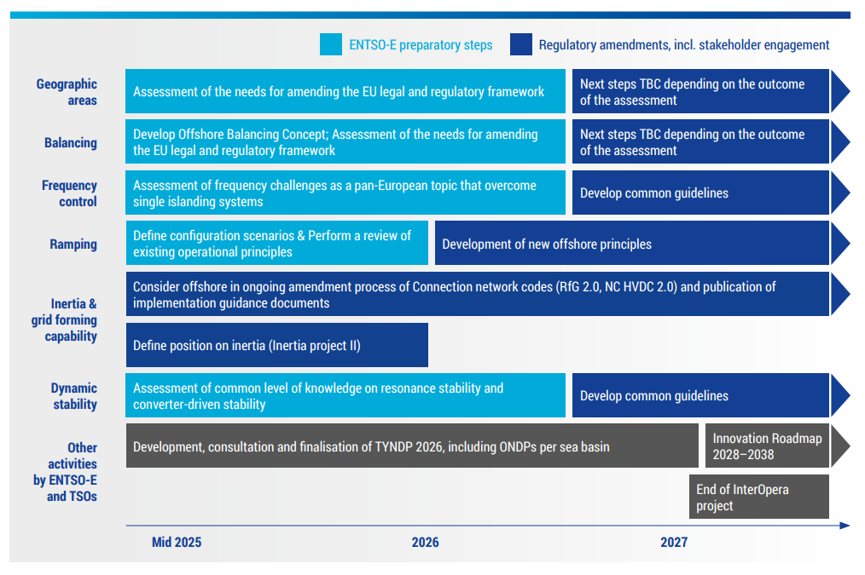
ENTSO-E’s main ongoing and upcoming activities under the Offshore Roadmap

Slide 45
Agenda
Topic | Lead | Time
Welcoming participants AWP 2026: Introduction (structure, rules, focus, status) | Eva-Marie Kurscheid Rafael Carnicero Mazon | 14:00 – 14:15
2. Presentations and Q&A: Network Codes/Guidelines – Implementation: Operations (SOGL/ Emergency and Restoration) Market (FCA,CACM, EBGL, NCDR) and Transparency Platform Network Code on Cybersecurity (NCCS) Connection Network Codes (CNCs) 3. Additional ENTSO-E tasks Operation Readiness and Resilience Electricity Market Design Economic Regulation and Finance Grid Development and Extension Innovation and Digitalization Preparing for the future Offshore system 4. General feedback and closing | James Hellinckx Ludivine Marcenac/ Nijat Gasimov Ron Wibbelink Mario Ndreko James Hellinckx Marco Foresti Ignacio Zubieta Ochoa Emil Tan Ioannis Theologitis/ Michele Dion-Demael Lea Dehaudt | 8 min/topic 14:00-14:08 14:08-14:16 14:16-14:24 14:24-14:32 14:32-14:40 14:40-14:48 14:48-14:56 14:56-15:04 15:04-15:12 15:12-15:20 15:20-15:30

Slide 46
4. General Feedback and closing

