Slide 1
ENTSO-E workshop on 2-way Contracts for Difference
17 May 2024, Brussels & Online

Slide 2
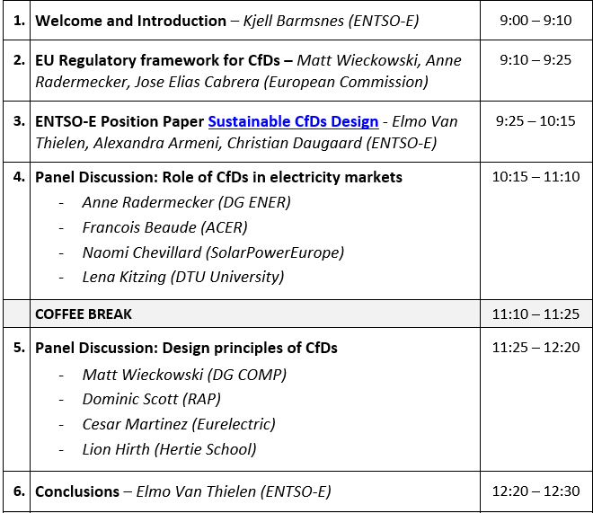
Agenda

Slide 3
Introduction
Kjell Barmsnes, ENTSO-E Market Committee Chair

Slide 4

  Housekeeping rules
    Online participants to keep microphones and cameras off
    Ask questions only via Slido & vote the most interesting ones. -> Go to slido.com and enter code #2cfd or scan this QR code
      We will select some questions for speakers & panellists among the most voted on slido. Questions from the audience in the room may also be selected if time allows
    MS Teams chat and “raise hand” function will not be used. You may only signal technical problems via chat
    Slides will be available after the workshop on the event page on our website

Slide 5
EU Regulatory Framework for 2-way CfDs
European Commission

Slide 6
Contracts for difference
Anne Radermecker – DG ENER
Matt Wieckowski – DG COMP
ENTSO-E
Personal views, not the position of the European Commission
17.05.2024

Slide 7
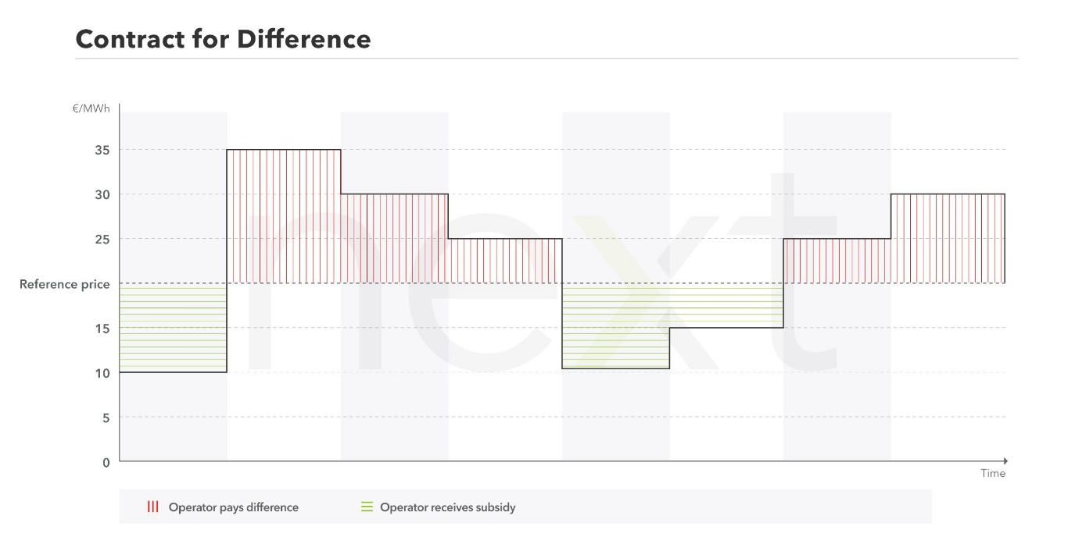
Contracts for difference (CfDs)
Two-way CfDs required for ‘direct price support schemes’ for new generation in nuclear and most renewables (from 2027 onwards).
‘two-way contract for difference’ means a contract signed between a power generating facility operator and a counterpart, usually a public entity, that provides both minimum remuneration protection and a limit to excess remuneration.
One type of contract for difference
Source: next Kraftwerke
Source: next Kraftwerke

Slide 8
CfDs – new design principles
(a) preserve incentives for efficient market participation;
(b) prevent any distortive effect of the support on operation, dispatch and maintenance decisions or on bidding behaviour in electricity and ancillary services markets;
(c) ensure that the strike price is aligned with the cost of the new investment, the market revenues, to guarantee the long-term economic viability of the power generating facility while avoiding overcompensation;
(d) avoid undue distortions to competition and trade in the internal market by determining remuneration amounts through a competitive bidding process. Where no competitive bidding process can be conducted, measures shall be designed to ensure that the distribution of revenues to undertakings does not create undue distortions to competition and trade in the internal market;
(e) avoid distortions to competition and trade in the internal market resulting from the distribution of revenues to undertakings; and
(f) include penalty clauses applicable in the case of undue unilateral early termination of the contract.

Slide 9
More CfDs raises questions from a competition perspective
Does the design of CfDs need to shift to avoid further market distortion? If yes, how?
  Note: not a new concern – EEAG 124, CEEAG 123. But increased volumes changes the context
How should the costs and revenues of CfDs be allocated? What impacts on competition in energy and in other markets?
Generators under CfD
State
Distribution of (costs and) revenues
Consumers
2-way CfD

Slide 10
CfD design questions
Can capability / financial CfDs reduce market distortions without unduly increasing risks/costs or complexity?
Are some CfD designs better suited to some technologies, and why?
How should beneficiaries of CfDs be selected?
  Should we try to compare offers based on overall system cost/benefit?
  Should locational investment incentives come from electricity prices, CfDs, both?
Can clear recommendations be developed regarding CfD designs, and are there elements of CfD design that could/should be harmonised?

Slide 11

Thank you
© European Union 2020
Unless otherwise noted the reuse of this presentation is authorised under the CC BY 4.0 license. For any use or reproduction of elements that are not owned by the EU, permission may need to be sought directly from the respective right holders.
Slide xx: element concerned, source: e.g. Fotolia.com; Slide xx: element concerned, source: e.g. iStock.com
Notes:
Update/add/delete parts of the copy right notice where appropriate.
More information: https://myintracomm.ec.europa.eu/corp/intellectual-property/Documents/2019_Reuse-guidelines%28CC-BY%29.pdf

Slide 12
ENTSO-E Position Paper on Sustainable Contracts for Difference Design
ENTSO-E

Slide 13
Overview
Introduction
CfD Design
Cost-Benefit Reallocation
PPA Coexistence
Conclusions
Q&A
Elmo Van Thielen
Alexandra Armeni
Christian D. Mikkelsen
Christian D. Mikkelsen
Elmo Van Thielen
All
8 min.
20 min.
5 min.
5 min..
2 min.
10 min.
    Ask questions only via Slido & vote the most interesting ones. -> Go to slido.com and enter code #2cfd or scan this QR code

Slide 14

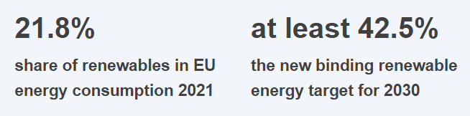
Motivation for ENTSO-E policy paper on 2-sided CfDs
Ambitious RES Targets for EU
Electricity Market Design Reform
Promote PPAs to foster renewable investments
Contracts for Difference for new investments requiring state aid
High uptake of new RES capacity needed in the coming years
Uncertain if commercial interest can follow => potentially high share of capacity under CfD
If CfDs give wrong incentives to benefiting generators, this poses a risk to system operation

Slide 15

Without subsidy, market prices drive efficient market party behavior
Long-term markets
Investment
PPAs
Short-term markets
Day-Ahead
Intraday
TSO Services
Balancing reserves
Congestion management
Futures
Balancing
MARKETS

Slide 16




Support schemes can cause conflicting incentives and inefficient behavior as a result
Long-term markets
Investment
PPAs
Short-term markets
Day-Ahead
Intraday
TSO Services
Balancing reserves
Congestion management
Futures
Balancing
Subsidy
MARKETS
  Maximize production
  Artificial pricing of bids

Slide 17
Restoring exposure to market prices should ensure system-beneficial behavior and is therefore considered good support scheme design
Long-term markets
Investment
PPAs
Short-term markets
Day-Ahead
Intraday
TSO Services
Balancing reserves
Congestion management
Futures
Balancing
SUBSIDY
MARKETS
  Maximize production
  Artificial pricing of bids

Slide 18


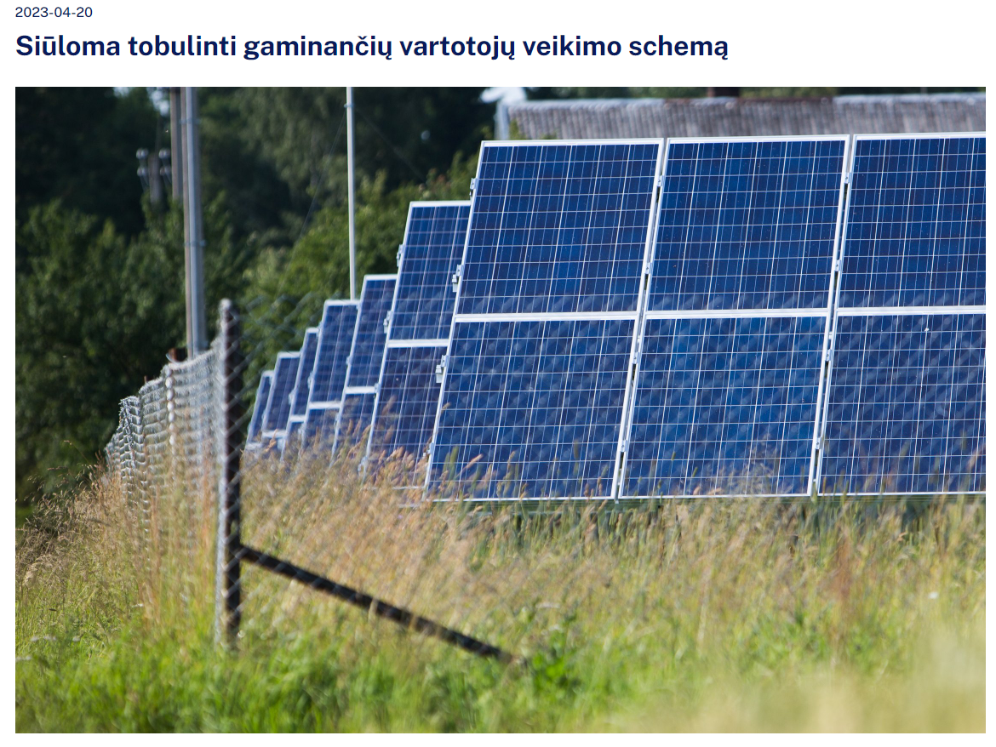



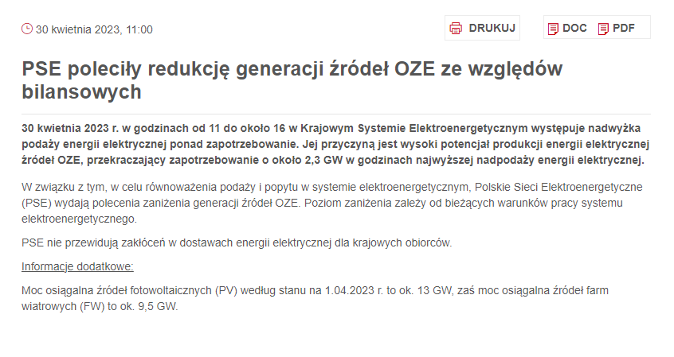
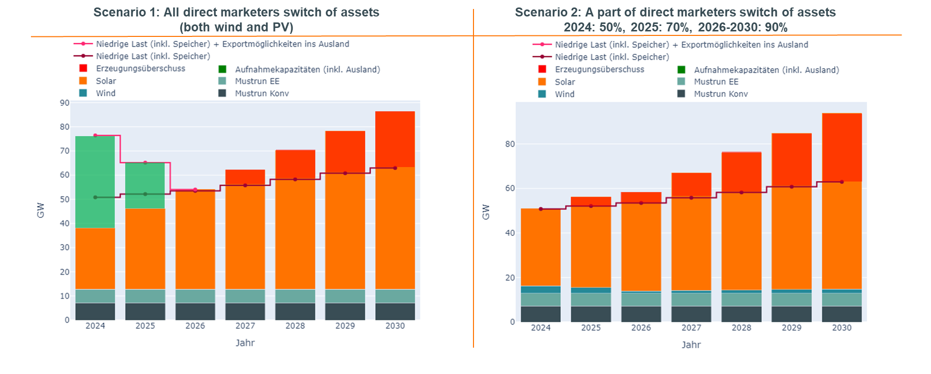
System operators already experience issues with excess generation today and expect more in the future with current policies

Slide 19

What is a two-sided CfD?
Key principles:
Strike Price: included as a tender cost parameter, the price ensured by the support mechanism and for which the project should be “in the money” (~=LCOE)
Reference Price: reference for the “real” market price the generator owner managed to secure in the electricity market
Settlement: $premium \left[\frac{€}{MWh}\right]=p_{ref}\left[\frac{€}{MWh}\right]−p_{strike}\left[\frac{€}{MWh}\right]$ & $payment\left[€\right]=premium\left[\frac{€}{MWh}\right]∗reference volume [MWh]$
Market prices above the strike price are paid back to the state counterparty
Market prices below the strike price are paid out by the state counterparty
Figure 1: Illustration of CfD with strike price of 70 €/MWh for a å period of 1000 hours in NO2 in 2021 (assuming hourly reference, see below)

Slide 20
Three main topics of investigation
1.
Non-Distortive CfD Design
How to design the contract with generators in a way that avoids market distortions?
2.
Cost-Benefit Reallocation to Consumers
How to reallocate cost-/benefits from state to electricity consumers with minimal impact to markets?
3.
Coexistence with PPAs
How to leave a chance for commercial PPAs alongside the option for CfDs?

Slide 21




Assessment framework for CfD Design Options
Bidding behaviour and dispatch
To what extent are efficient incentives provided for participation in the day-ahead, intraday and balancing market?
Asset design and siting
To what extent are efficient incentives provided to maximise the market value of electricity?
Risk hedging
to what can extent price and volume risks for generators be hedged?
Regulatory risk
to what extent do changes in the design of support schemes/instruments bring about changes for market parties?

Slide 22
TOPIC 1: CfD Design
Towards a least-distortive scheme
Avoiding market Distortions
Considered designs:
Production-based
  With hourly reference price
  With yearly reference price determined ex-ante
  With yearly/monthly reference price determined ex-post
  Cap/floor on strike price
  Cap/floor on revenues
Non-Production-based
  Capability-based CfD
  Financial RES CfD

Slide 23
Taxonomy of CfD models
Contract for Difference
Y
N
Use injection as key volume metric?
Production-based
Non-Production Based
Single strike price, reference price and volume per settlement period?
Asset-Specific volume definition?
N
Y
N
Y
Capability-Based
Financial RES
Different reference price models
Cap/Floor models
Hourly market price
Price Cap/Floor
Revenue cap/floor
Yearly ex-ante
Yearly ex-post

Slide 24
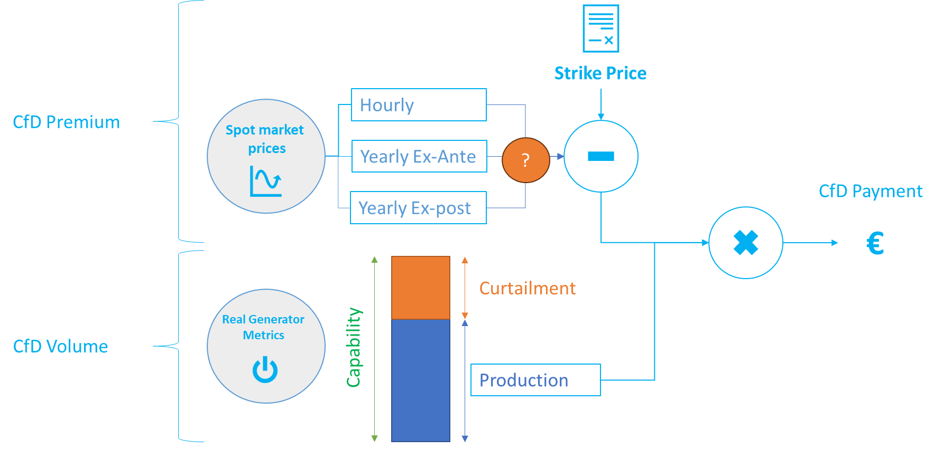
Production-based CfDs - Different Reference Prices
ENTSO-E Identified a high number of distortions for Hourly and Yearly ex-ante reference price models:
  Hourly: premium is known before ID/balancing market and will be priced in those markets
  Yearly ex-ante: premium is known for the entire year and priced in each subsequent market
Yearly ex-post leads to distortions insofar the premium can be predicted and is therefore preferable
Even then distortions are likely to remain

Slide 25
Production-based CfDs - Different Reference Prices
Hourly reference price:
  No incentive to produce high-value electricity but rather maximise production (“produce-and-forget” effect)
  No incentive to plan maintenance at system optimal times (i.e. when demand is low)
  Premium known before ID/balancing market and will be priced-in leading to underproduction/ overproduction
  No incentives for system-friendly asset design and siting (e.g. east/west facing PV)
Yearly reference price (ex-ante or ex-post):
  Incentives for investing in system-friendly asset design & siting
  More incentives to plan maintenance at system-optimal periods
Yearly ex-ante:
  premium is known for the entire year and priced in each subsequent market → leading to dispatch distortions
Yearly ex-post:
  More efficient dispatch incentives and therefore preferable
  Still distortions insofar premium can be predicted (i.e. end of reference period)

Slide 26
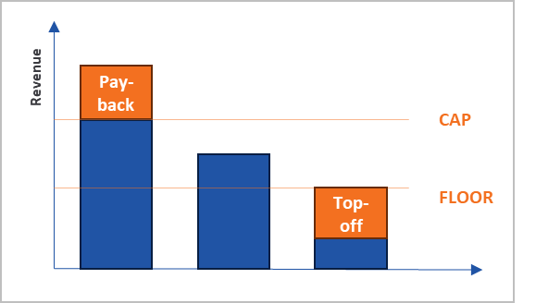
Production-based CfDs - Cap/floor models
Both models aim to leave a revenue “band” between cap and floor where both profit and loss are possible
The band further incentivizes design/maintenance planning/… to maximize market value
The “width” of the band determines the strength of the incentive
The Strike Price cap/floor determines a maximum and minimum strike price:
  Revenues below the minimum are topped off; above the maximum are paid back
  Still based on a single reference price
  Less distortions, but only so long as the minimum/maximum price is not reached
The revenue cap and floor puts a maximum and minimum value the benefiting asset earns per MWh produced
  For each settlement, either revenues are topped off if they were below the minimum or paid back if they were above the maximum
  Less distortions as the CfD considers all market timeframes
  Complex to enforce, as it requires visibility on revenues in all markets (incl. OTC)

Slide 27
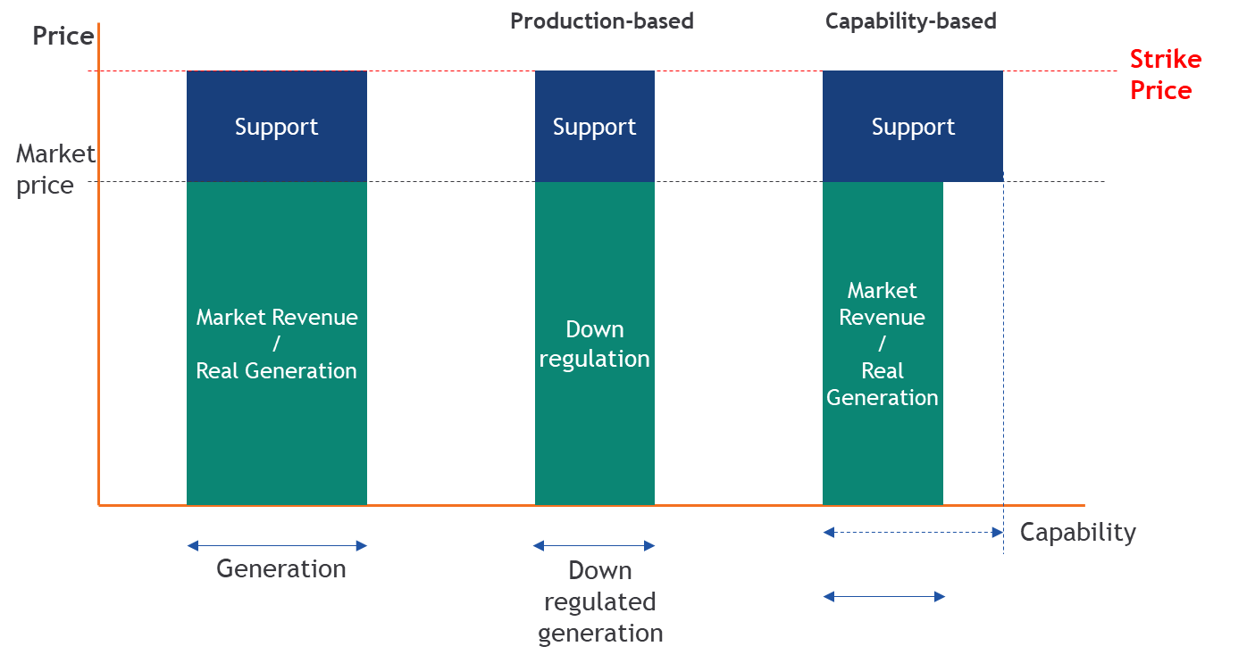
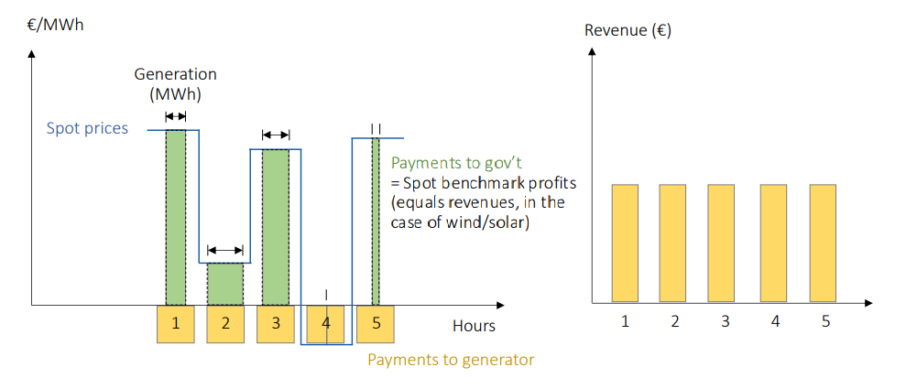
Non-production based CfDs
Decoupling of production and subsidy-level is the most secure way to eliminate dispatch distortions
Two considered designs provide different advantages/disadvantages
Capability-based CfD
CfD volume defined at the individual asset level
Financial RES CfD
CfD volume defined as a generic reference plant
Source: Hirth et al. (2023)
Avoids dispatch distortions in DA, ID and balancing
Incentives for system-friendly asset design & siting depend on reference price (i.e. longer reference period)
Correspondence to asset-level revenues should provide improved risk coverage
Avoids dispatch distortions in DA, ID and balancing
Incentives in system-friendly asset design and siting to beat the generic reference plant
Abstraction from real asset revenues increases risk under this model

Slide 28
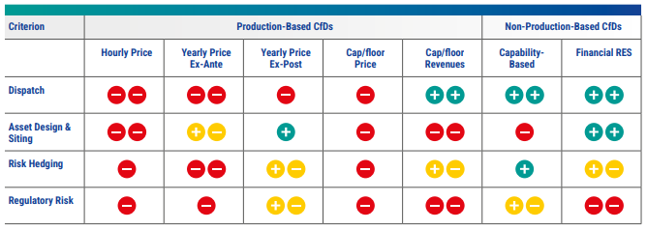
Key recommendations of the paper
CfDs Design - Assessment Table
Efficient dispatch is considered the most important criterion from a TSO perspective: inadvertent dispatch increases costs and reduces system security
ENTSO-E recommends a move towards non-production based CfDs
A trade-off between capability-based and financial RES CfD persists:
  Capability-based CfDs provide better risk and financial coverage
  Financial RES CfDs provide incentives for system-friendly asset design and siting
CfD design preference may depend on context
Further discussion is needed on reference plant definition and measuring capability

Slide 29
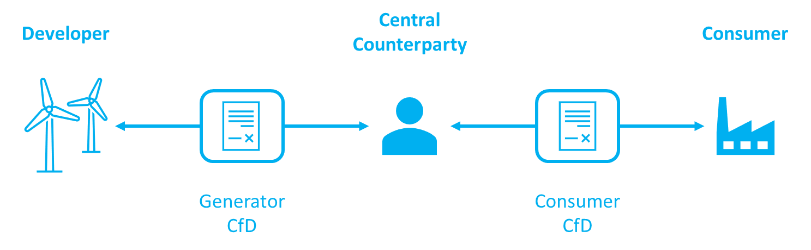
TOPIC 2: Cost-Benefit Reallocation
Risk of distorting demand side and forward markets
1) Administrative reallocation (payouts to consumers or additional tax)
  Concept: State assesses and decides which tax-payers should bear the costs and receive the benefits.
  Potential issue: The specific implementation may distort the market on the demand side. If it affects consumer power prices directly, it could hamper demand response. It could distort the market and lead to higher consumption when electricity is scarce and lower consumption when there's plenty of RES in the system.
  Recommendation: States need to keep social policies separated from electricity market functioning -> give/take money to/from its population independent of power consumption
2) Market-based reallocation (resell CFD volumes to consumer)
  Concept: State resells previously bought CfDs to the market in competitive auctions; can be segmented in shorter-term/smaller-volume contracts. Should increase hedging opportunities for consumers and potentially decrease the budgetary risk for the State.
  Potential issue: could remove part of the ask curve if consumers instead buy state supported CFD’s and PPA opportunities for RES not on state supported CFD can decrease as a result. The generation profile the state sells can have a major impact on state budget and forward prices changes all the time.
  Recommendation: Concept to be further investigated regarding potential impact on forward/PPA markets prior to its application.

Slide 30
TOPIC 3: PPA Coexistence
Leaving a chance to the market
CfDs are incompatible with long-term PPAs, whereas PPAs without (any form of) state aid should be free from distortions and provide direct firmness to consumers
From a system perspective, it is beneficial to retain a space for commercial PPAs where possible
Considered designs for PPA/CfD coexistence:
Carve-Out
  A candidate bidder can choose to apply the CfD only to a certain percentage of the capability of the wind park.
  This frees up a part of the park’s potential output for a commercial PPA: as the difference under the CfD is only settled on part of the volume, the remainder can also be sold at a fixed price to hedge the full output.
  The margin on the commercial part can lead to strike price reductions in the CfD tender, allowing the strike price to continue to be used as a primary selection criterion
Two-Stage Tender
  Hold a CfD tender in two rounds: first for purely commercial PPAs then contract remainder under CfD
  CfDs would only complete the volume up to the political target for which there were no candidate commercial projects
  It is important to consider how the physical development space can be segmented for separate bidders to develop
  Poor segmentation risks that the remaining space after the first tender stage attracts little interest for other candidates and only those that were victorious in the first tender stage retain an interest, which could result in high strike prices for the CfD part

Slide 31
Conclusion and key recommendations
ENTSO-E recommends: To move away from production-based CfDs and towards non-production based CfDs Justification: as increased amount of renewable/low-carbon is introduced into the system and we cannot know whether they will be supported or not, support schemes need to be designed so that such assets follow market price signals (and therefore system needs) at true marginal cost. Where production-based continues to be applied despite the above recommendation, to at least make them as least-distortive as possible accounting for the detailed considerations in this paper (e.g. technology-specific yearly/monthly reference price determined ex-post, definition on full-load hours…) To continue an open discussion on the precise definition of the capability of capability-based CfDs and the reference generator of the financial RES CfDs Not to allocate CfD costs and benefits on the basis of actual MWhs consumed, but rather look for non-consumption based allocation mechanisms To further investigate the potential impact on existing forward/PPA markets of the market-based reallocation concept prior considering its implementation To integrate options for fully commercial (i.e. without any form of support) PPAs into CfD tenders To appropriately assess the implications of Carve-Out and Two-Stage Tender mechanisms in the specific context of a CfD tender (particularly for gaming risks and desired outcome)

Slide 32












Thank you!
Drafting team:
Alexandra Armeni
TenneT
Joris Besseling
TenneT
Gerard Doorman & Halvor Bakke
Statnett
Evelyn Horn
CREOS
Christopher Koch
50 Hz
Sandra Torras Ortiz
Transnet BW
Elmo Van Thielen
Elia
Henrik Winkler &
Christian Daugaard Mikkelsen
Energinet
Marco Foresti
ENTSO-E
Maria Kotofolou
ENTSO-E

Slide 33
Panel Discussion 1: Role of 2-way CfDs in electricity markets
Anne Radermecker (DG ENER)
Francois Beaude (ACER)
Naomi Chevillard (SolarPowerEurope)
Lena Kitzing (DTU University)
    To ask questions go to slido.com and enter code #2cfd or scan this QR code

Slide 34
Coffee Break

Slide 35
Panel Discussion 2: Design principles of 2-way CfDs
Matt Wieckowski (DG COMP)
Dominic Scott (RAP)
Cesar Martinez (Eurelectric)
Lion Hirth (Hertie School)
    To ask questions go to slido.com and enter code #2cfd or scan this QR code

Slide 36
Conclusions

Slide 37
Thank you for your participation!
    Workshop slides will soon be available on our website (https://www.entsoe.eu/events/2024/05/17/public-workshop-on-2-way-contract-for-differences/)

