Slide 1
System Operation European Stakeholder Committee
3 March 2026

Slide 2
Agenda
Subject | Timing | Lead
Lunch | 12.00 - 13.00
Opening Review of the agenda, approval of last meeting minutes Review of actions | 13.00 – 13.15 | Uros Gabrijel, ACER Cherry Yuen, ENTSO-E
Update on the implementation actions at pan-EU level | 13.15 - 13.20 | Cherry Yuen, ENTSO-E
Report on CGM implementation | 13.20 – 13.30 | Habir Paré, ENTSO-E
Frequency related topic (Tmin LER for FCR provision) | 13.30 – 13.35 | Luca Ortolano, ENTSO-E
Updates from the DSO Entity | 13.35 – 14.10 | Florentien Benedict, DSO Entity
ENTSO-E's preparatory work for SO GL 2.0 | 14.10 - 14.25 | Ignacio Iriarte Ramirez, ENTSO-E
ICS methodology | 14.25 - 14.40 | Donna Kearney, ENTSO-E
Update on DfDs | 14.40 – 14.55 | Jens Albrecht, ENTSO-E
AOB | 14.55 – 15.10
Coffee break | 15.10 - 15.30
Joint SO ESC/GC ESC session
Czech Republic Incident Investigation | 15.30 - 15.45 | Donatas Matelionis, ENTSO-E

Slide 3
1. Review of actions
ENTSO-E, Cherry Yuen

Slide 4
TOP. 1 - Review of actions SO ESC
ACTION | Comments | STATUS
ENTSO-E will present the next update on DFD at the meeting of September. | Materials to be provided separately after RGCE approval. This should be ready for March 2026 See topic #8 | Ongoing
Implementation of Art.39 of SO GL and follow-up of RoCoF discussion: ACER will liaise with GC and SO ESC members to establish the Terms of References of the new Expert Group (topic: a macro-economic study is provided by TSOs for adapting system operators to a net zero emissions power system) | EC will initiate a consultation on a forthcoming study which the new EG under GC and SO ESC will aim to support. | Ongoing
ACER to come back to stakeholders with additional information on the NRA request for extension of the decision on Tmin LER. | Additional information is provided in the letter for the extension request, available in the meeting folder. | Done

Slide 5
2. Updates on the implementation actions at pan-EU level
ENTSO-E, Cherry Yuen

Slide 6
Pan-European or regional deliverables 2024: SOGL/NCER
PRA Biennial report 2025 published in December - link
SO GL
(Article 75)
CSAm (article 44)

Slide 7
3. Report on CGM implementation
Habir Paré Nsangou, ENTSO-E

Slide 8
CGM action plan progress
CGM focus areas and successes
Restructuring and reorganization
  Centralized governance, streamlined decision process, establishment of a Facilitators Group
  Focusing of resources in common groups allows TSO experts to invest more time in individual activities
Common and transparent targets
  Focus on day-ahead models and the respective questions
  “Global” process quality as clear goal (as opposed to individual targets)
Issue tracker tool
  “Go-live” of the IGM/CGM modelling issue tracker
  Bi-monthly IOPs to follow up on the highlighted issues
EMF harmonization
  Extensive work to analyze the merging process and tools resulted in harmonized requirements
  Implementation of the requirements in processes
“OPDE 2.0” - approval of the target solution architecture and business requirement specification documents
Communication
  Dedicated CGM landing page supporting onboarding of CGM members, quarterly dedicated engagement with ACER and NRAs highlighting the challenges and successes of the CGM BP
  Release of the improved CGM performance dashboard showcasing progress of CGM Building process
+ Many other improvements by TSOs and RCCs!

Slide 9
Capacity Calculation Regions – Roadmap for go-live of CGMES based tasks
Last update February 2026
2025
2026
2027
2028
2029
2030+
TIMEFRAMES
LT = Long Term (YR, MO)
YR = Year-Ahead
WK = Week-Ahead (3D to 7D)
2D = Two days-ahead
DA = Day-Ahead
ID = Intraday
REGIONS
BAL = Baltic
COR = Core
CE = Central Europe
GRT = GRIT
HAN = Hansa
ITN = Italy North
NOR = Nordic
PAN = Pan-European /common delivery
SEE = South East Europe
SWE = South West Europe
s.2024
SEE-DA
SWE-DA
NOR-ID*
GRT-DA/ID
NOR-DA
SWE-ID
SEE-ID
CE-DA
CE-Full
HAN-DA/ID
BAL-DA/ID*
CE-ID
CSA
CROSA
BAL-LT/DA/ID
SWE-DA/ID
CE-IDCCb
2030+
s.2024
SWE-LT
SWE-B
CE-IDCCc/d
CE-DA
CE-LT
CE-BT
BAL-B
GRT-DA/ID/B
NB
Nordic DA Regional Security Analysis operational since 2024. ID RSA* moved to 2027. No specific target for full ROSC incl. RAO
CSA HAN-DA/ID go live date within 12 months after respective Go-Live in Core & Nordic CCR
HAN DA/ID CC within 12M after application of pan-European DA/ID CGM in CGMES format in Hansa ROSC
CE stepwise DA/ID CROSA go-live is subject to the decision whether there will be a go-live with DA CROSA only
ITN to be merged with Core to form CE.
SEE in the process of defining a new timeline.
Pan-EU STA does not rely on CGMs in CGMES.
OPC PAN-R10 - Next evolution of CIM/CGMES migration on Pan-EU level, starting with //run and switch of underlying data format
NOR-DA
CE-IDCCe
HAN-DA/ID
CCC
Regional Capacity Calculation
(LT / DA / ID / B)
Pan-European process
s.2024
PAN
STA
s.2024
Regional
PAN
s.2024
PAN-R10
Pan-European process
PAN-R6
SEE-WK
SEE-YR
COR-CorNet
OPC
ITN-CorNet
GRT-YR
GRT-WK
SWE-CorNet
Region-specific process
BAL- WK
BAL-YR

Slide 10
4. Frequency related topics
Roberto Puddu, ENTSO-E

Slide 11
TminLER
The approval process of the “TminLER proposal” is currently ongoing.
Ad hoc meetings between CE TSOs and NRAs are being held to discuss the details.

Slide 12
5. Update from the DSO Entity
Florentien Benedict, DSO Entity

Slide 13
ESC SO 3th March 2026
EU DSO Entity
Florentien Benedict

Slide 14
Agenda Topics
1. Views and Recommendations on the 2026 ICS Methodology
2. Updates on DSO Entity Works on Iberian Black Out
3. Recommendations for SOGL
4. Recommendations for NC E&R

Slide 15
1. Views and Recommendations on the 2026 ICS Methodology (1/3)
General Background
As of now ENTSO-E manages ICS and maintains the Incident Classification Scale and consulted on ICS in November 2025
DSO Entity actively engaged in the 2025 consultation, actively engaging with ENTSO-E
In January 2026, ICS methodology was updated, with DSO Entity explicitly mentioned in Article 7.2.
DSO Entity is exploring collaboration with EU associations on future ICS revision initiatives in 2026

Slide 16
1. Views and Recommendations on the 2026 ICS Methodology (2/3)
B. Key Points
Key point of the 2025 consultation
DSO Entity welcomes the opportunity to contribute to ENTSO-E’s future investigations and stresses its importance in ICS methodology, but express the concerns on:
  Rejection of DSO Entity proposal mandatory participation of affected DSOs in the 2026 ICS update.
  Non-acceptance of the DSO Entity’s proposed thresholds for scale criteria by ENTSO-E.

Slide 17
1. Views and Recommendations on the 2026 ICS Methodology (3/3)
C. Recommendations and Asks
Recommendations & Asks:
Include both affected and non-affected System Operators (SOs) in Expert Panels to ensure comprehensive incident analysis.
Apply lessons from the Iberian Blackout and other incident investigation to value full DSO Entity expert participation.
Early and full involvement of the EU DSO Entity will ensure that the distribution perspective is fully represented in the investigation

Slide 18
2. Updates on DSO Entity works on Iberian black out (1/3)
General overview
Overview of the meetings of the DSO Entity Ad Hoc Expert Group Iberian Blackout with Expert Panel Iberian Blackout;
three meetings with expert panel in 2025
  30 October,
  12 November and
  3 December.
One meeting scheduled 2026
  One extra meeting scheduled, following ESC March 2026
Data exchanges
  DSOs sent all the required data and also requested the details of disconnection of generators at distribution level to provide the best information.

Slide 19
2. Updates on DSO Entity works on Iberian black out (2/3)
Preliminary views
Preliminary lessons learned are drawn at high level and related to next steps for existing network codes, see next slides
Main: there were no disconnections of distribution generation and voltage levels at distribution level were always within margins.
Final report – DSO Entity expect the panel to adapt the final report to the above.

Slide 20
2. Updates on DSO Entity works on Iberian black out (3/3)
Next steps
Final report – DSO Entity expects the panel to adapt the final report to the findings from the cooperation with the Ad Hoc Taskforce Iberian black out
Next steps on high level and related to general findings for existing network codes, see next slides

Slide 21
3. Recommendations for SOGL (1/1)
High level and related to next steps for existing network codes
Currently DSO Entity is working on an internal document on SOGL recommendations
Revision of SOGL aims to enhance the role of DSOs
Main points of attention:
  DSOs' role is growing in significance in SOGL due to renewables and other technologies (EVs, heat pumps).
  SOGL expected to remain unchanged for ~10 years → must address current and future challenges.
  Any new revision of SOGL must include DSOs’ rights and obligations to avoid gaps in system stability and resilience
  Key extension needed: enable DSOs to manage systems and fully coordinate with TSOs
  DSOs need to control reactive power/voltage control
  DSOs prefer binding national collaborative training

Slide 22
3. Recommendations for E&R (1/1)
The rationale behind this directive is that the system will reach its limits under certain (unforeseen) circumstances (ALERT) and could fail if no immediate action is taken (EMERGENCY), requiring a controlled rebuild.
Given that significant amounts of generation and demand response are located in the DSO systems, these types of system risks could also arise regionally.
In those cases, DSOs would want regulatory resources, rather than just a generic emergency button that still needs to be activated.

Slide 23
Thank you for your attention
Questions?
Please contact us!

Slide 24
6. ENTSO-E's preparatory work for SO GL2.0
Ignacio Iriarte Ramirez, ENTSOE

Slide 25
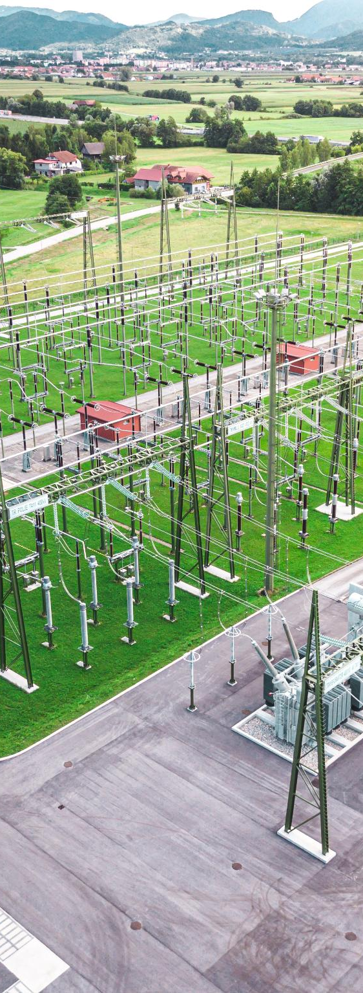
Introduction
The system evolution accompanied by the EU policies to drive RES integration, electrification, and consequently decentralization, poses many challenges like variability, forecast volatility, grid flexibility, complex system management → This leads to a need for an SOGL revision.
Inclusion of new technologies (storage, prosumers, flexible demand) reshapes the ways systems are operated → SOGL must adapt to maintain security and efficiency.

Slide 26
ENTSO-E Key Areas for SOGL revision
Expand SOGL Scope
  Include storage (BESS,EVs), Type A generators, large demand facilities connected to distribution grid, offshore systems.
Operational Security Enhancements
  Voltage control, frequency stability, dynamic performance.
Regional Grid Model (RGM)
  Allow regional/process-specific grid models for efficiency.
LFCR-Update
  Probabilistic reserve dimensioning, harmonized ramping rules, flexible balancing.
Cross-Regulation Consistency
  Align with new codes, amendments of existing codes, Brexit, Baltic sync, among others.
Organization structure, accuracy and consistency
  Clearer, more coherent legal text.

Slide 27
ENTSO-E Preparatory work – Overarching timeline
Q4 2025
Q4 2026
ENTSO-E paper "Key areas to be considered for the revision of SOGL"
ACER publishes policy paper on the revision of SOGL.
Q2 2026
Q2 2027
ENTSO-E paper "Key areas to be considered for the revision of SOGL" updated following grid incident report publications.
Potential launch of the revision of SOGL (TBC)
Ignacio Iriarte Ramirez

Slide 28
7. ICS Methodology
Donna Kearney, ENTSOE

Slide 29
Incident Classification Scale
The work on the next revision of the Incident Classification Scale Methodology (ICSM) has started.
In parallel
Additions being worked at
Oscillations
Improvements being worked on within the current methodology
Processes for recording ICS voltage violations
Assist Task Forces/SOGL 2.0
Consider establishing permanent monitoring of the implementation of recommendations from incident investigations
Legally mandated requirements as they arise (recommendations)
Provision of real-time snapshots for incident investigations
Preliminary
Timeline
2026
Summer
Autumn
2027
Commence ICSM revision
Examine oscillation system impact in sample TSOs
Experimental data collection on oscillations to provide data-based guidance
Stakeholder engagement and revision of timelines

Slide 30
8. Update on DfDs
Jens Albrecht, ENTSO-E

Slide 31
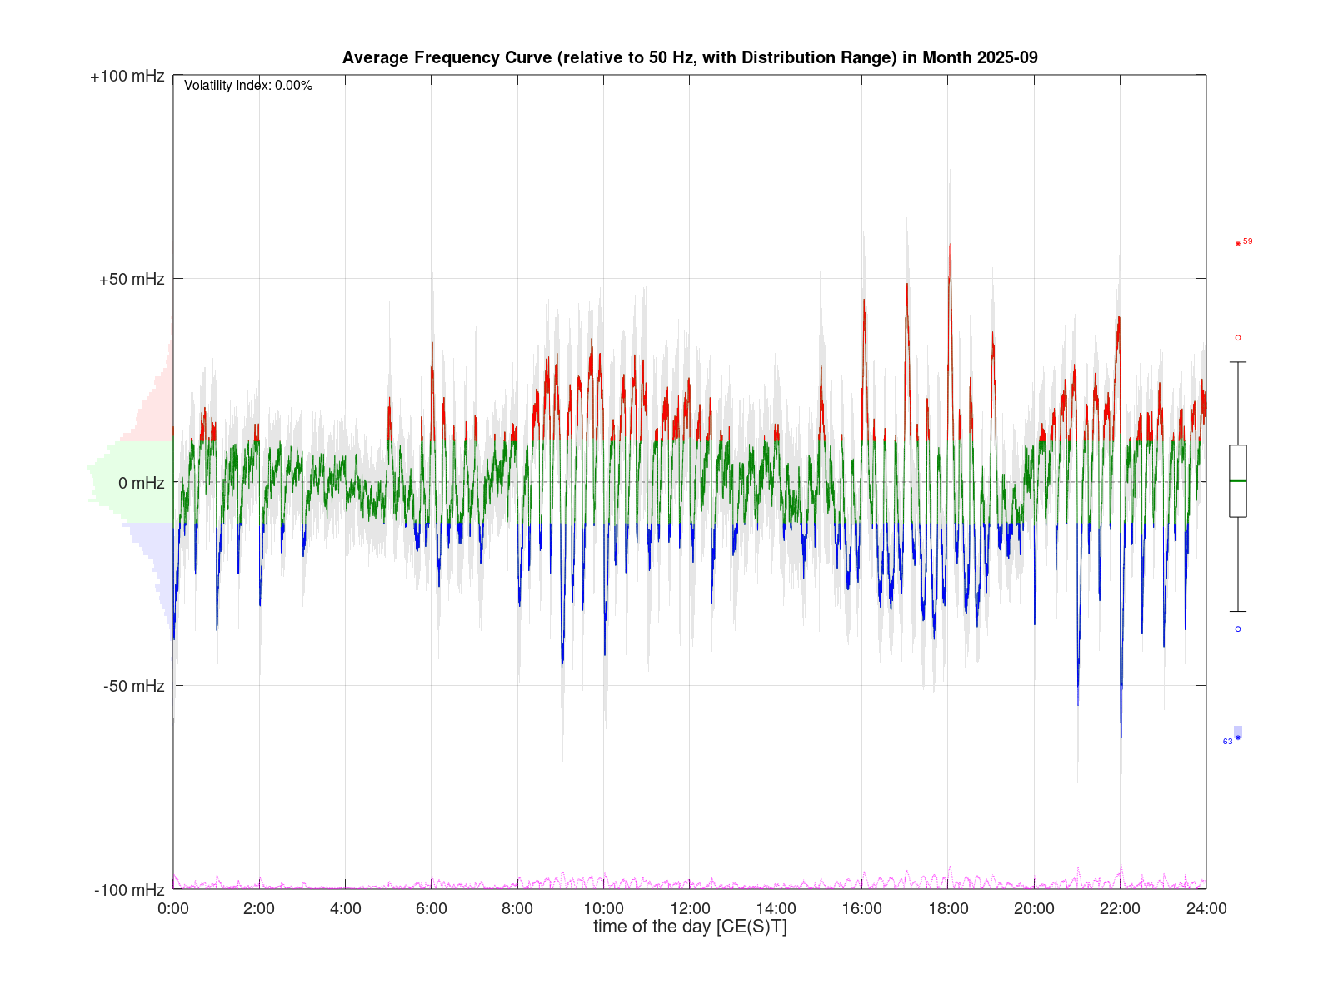
ESC: Deterministic Frequency Deviations (DFDs) in CE
“Safety margin eating effect” in CE, update from 2025
Repetitive frequency patterns (dependent on season of the year and time of the day), existing since many years usually during the change of the hour and sometimes even driving the frequency out-of-normal range
are closely monitored for their occurrences, long-term trend and operational impact
are visible in 24-hour frequency-average curves of complete months and in the number of DFD events
cannot be mitigated by means of load-frequency-control in operation
year-by-year slowly increasing the volatility of the frequency
in 2025 changed from hourly to dominant 15-minute patterns

Slide 32
9. AOB

Slide 33
10. Czech Republic Incident Investigation
Donatas Matelionis, ENTSO-E

Slide 34
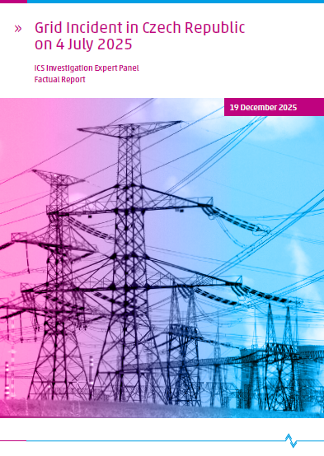
4 July 2025 incident in Czech Republic
Status:
Factual report was published on 19 December 2025
Expert panel continuous work on Final report to be published by June 2026
4 July grid incident in the Czech Republic: Expert Panel releases factual report

Slide 35
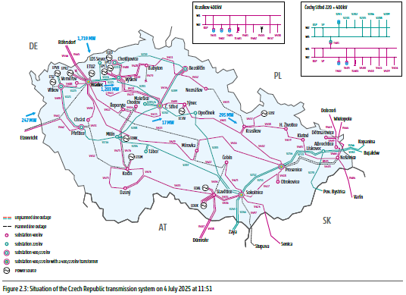
Evolution of system conditions during the event
Pre‑incident system state (before 11:51)
Czech transmission system operated N‑1 secure despite extensive planned outages.
High north–south power flows. V411 line was loaded ~1,200 MW.
Initiating event (11:51:08)
V411 400 kV line tripped after unsuccessful autoreclosure due to phase conductor failure.
Power flow redistributed to remaining connections (V208, Krasíkov busbar coupler, 400/110 kV transformer).
System deterioration (11:51–11:59)
By 11:52, the ČEPS estimated system lost between 340 and 440 MW of active power.
At 11:52:45, the Ledvice unit 6 lost all remaining active power output.
Observed overloads of 220 kV line V208 at 142.9 %;
Separation and collapse (11:59:44–11:59:48)
Manual disconnection of overloaded V208.
Protection tripping of Krasíkov busbar coupler and 400/110 kV transformer, creating a ~1,800 MW deficit island.
Rapid frequency collapse (RoCoF up to ~3.5 Hz/s); LFDD insufficient → island collapse
The total production loss in the affected area 1,200 - 1,400 MW. The total loss of load was about 2,300 MW, or 28 % of the ČEPS control area’s consumption.

Slide 36
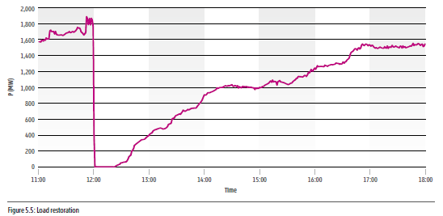
Restoration process
Immediate response:
After island collapse (11:59) system state set to Emergency;
dispatchers initiated a top‑down restoration strategy from unaffected parts of the grid.
Grid re‑energisation:
Progressive energisation of 400 kV and 220 kV substations from Krasíkov (400 kV) and Čechy Střed (220 kV), with strict sequencing to avoid ferroresonance.
Priority loads: Early focus on Prague supply (Malešice, Chodov substations) and stabilisation of voltage levels.
Generation recovery:
Synchronisation of units operating in house‑load mode (Chvaletice, Počerady), followed by start‑up of CCGT Počerady 2, enabling further load pickup.
Completion of restoration:
All transmission substations energised by 14:09;
DSOs confirmed re-energisation of lost load at 17:35;
Repair works of V411 line finished and line returned to service at 23:13.

Slide 37

Next steps of the Expert panel
Further analysis of relevant factors
Development of fault tree analysis and root causes
Development of recommendations
Final report publication by June 2026

