Slide 1
System Operation European Stakeholder Committee
17 September 2025

Slide 2
Draft Agenda
Subject | Timing | Lead
Opening Review of the agenda, approval of last meeting minutes Review of actions | 13.00 – 13.15 | Uros Gabrijel, ACER Cherry Yuen, ENTSO-E
Update on the implementation actions at pan-EU level | 13.15 - 13.30 | Cherry Yuen, ENTSO-E
Report on CGM implementation | 13.30 – 13.45 | Habir Paré, ENTSO-E
Frequency related topic (FCR probabilistic dimension and Tmin LER for FCR provision) | 13.45 – 14.00 | Luca Ortolano, ENTSO-E
Updates from the DSO Entity | 14.00 – 14.10 | Florentien Benedict, DSO Entity
Coffee Break | 14.10 - 14.25
Iberian Peninsula Incident Investigation | 14.25– 14.45 | Klaus Kaschnitz, ENTSO-E Richárd Balog, ENTSO-E
North Macedonia Incident Investigation | 14.45 - 15.00 | Ana Cigaran Romero, ENTSO-E
Czech Republic Incident Investigation | 15.00 - 15.15 | Donatas Matelionis, ENTSO-E
9. Methodology on minimum inertia levels for CE | 15.15 - 15.30 | Joao Moreira, ENTSO-E
10. AOB Updating the list of members | 15.30 – 15.45

Slide 3
1. Review of actions
ENTSO-E, Cherry Yuen

Slide 4
TOP. 1 - Review of actions SO ESC
ACTION | Comments | STATUS
ENTSO-E will present the next update on DFD at the meeting of September. | Materials to be provided separately after RGCE approval. | Ongoing
Implementation of Art.39 of SO GL and follow-up of RoCoF discussion: ACER will liaise with GC and SO ESC members to establish the Terms of References of the new Expert Group (topic: a macro-economic study is provided by TSOs for adapting system operators to a net zero emissions power system) | EC will initiate a consultation on a forthcoming study which the new EG under GC and SO ESC will aim to support. | Ongoing
ENTSO-E to provide more detailed answers to Eurelectric on the questions raised related to the Wind Eclipse project. | Answers provided via email
ENTSO-E to consider the question on the different voltage limits in the Baltic States and provide insights in the next SO ESC meeting.

Slide 5
2. Updates on the implementation actions at pan-EU level
ENTSO-E, Cherry Yuen

Slide 6
Pan-European or regional deliverables 2024: SOGL/NCER
Annual report on operational security indicators (for year 2024) to be published shortly
Annual report on regional coordination assessment (for year 2024) to be published shortly.
Annual report on load-frequency control (for the year 2024) to be published shortly
SO GL
(Article 15)
SO GL
(Article 16)
SO GL
(Article 17)

Slide 7
3. Report on CGM implementation
Habir Paré Nsangou, ENTSO-E

Slide 8
Achievements, Challenges and on-going actions
Main achievements during the period (June 2025 – August 2025)
CGM action plan:
  New QoCDC version with the appropriate severity level on certain rules has been deployed.
  Approved Business Case for Operational Planning Data environment (OPDE) 2.0. Next step is launching the re-architecture phase.
  A gap analysis between the Interoperability session and Operational process conducted to identify lessons learned and best practices.
CGM completeness and TSOs/RCCs Inter-Operability Sessions:
  Continuous maintenance of TSO and RCC issue tracking within dedicated JIRA system.
Challenges (June 2025 – August 2025)
Unstable OPDE release 11 which lead to inconsistent IGMs and CGMs availability
  The availability of IGMs models have been improved over the past weeks, however, the OPDE performance issues limiting the entire process are currently under investigation under the development and release management team.
On-going actions (June 2025 – August 2025)
Dedicated work on EMF benchmarking tasks (e.g. harmonising load flow parameters, replacement strategy).
Notes:
Feb – May
Updated Terms of Reference for the streamlined governance.
Approved Re-architecture option to support OPDE platform 2.0 (link with the challenge on OPDE acceptability and use).
Approved new Boundary data management application needs to facilitate joint boundary management between Operations and System development needs.
Successful change of the new CGM building process gate timing
CGM completeness and TSOs/RCCs Inter-Operability Sessions:
Success on including 32 out of 32 published IGMs into merged CGMs on May Interoperability Testing session.
Successful launch and maintenance of TSO and RCC issue tracking within dedicated JIRA system.

Slide 9
Capacity Calculation Regions – Roadmap for go-live of CGMES based services
Last update May 2025
2025
2026
2027
2028
2029
2030+
REGIONS
BAL = Baltic
COR = Core
CE = Central Europe
GRT = GRIT
HAN = Hansa
ITN = Italy North
NOR = Nordic
PAN = Pan-European/common delivery
SEE = South East Europe
SWE = South West Europe
TIMEFRAMES
LT = Long Term (YR, MO)
YR = Year-Ahead
WK = Week-Ahead (3D to 7D)
2D = Two days-ahead
DA = Day-Ahead
ID = Intraday
NB
Nordic CSA-based simplified version without RAO; full ROSC scope to be added later; Nordic IGMs in CGMES, not on OPDE
CSA HAN-DA/ID* go live date within 12 months after respective Go-Live in Core & Nordic CCR
HAN DA/ID CC within 12M after application of pan-European DA/ID CGM in CGMES format in Hansa ROSC
Pan-EU STA does not rely on CGMs in CGMES.
CE stepwise DA/ID CROSA go-live is subject to the decision whether there will be a go-live with DA CROSA only
ITN to be merged with Core to form CE.
SEE in the process of defining a new timeline.
s.2024
SEE-DA
SWE-DA
GRT-DA/ID
NOR-DA
NOR-ID
SWE-ID
CE-DA
CE-Full
HAN-DA/ID
BAL-DA/ID*
SEE-ID
CE-ID
CSA
CROSA
BAL-LT/DA/ID
SWE-LT
SWE-DA/ID
CE-IDCCb
CE-DA
2030+
s.2024
SWE-B
CE-IDCCc/d
CE-LT
CE-BT
NOR-DA
BAL-B
GRT-DA/ID/B
CE-IDCCe
HAN-DA/ID*
CCC
Regional Capacity Calculation
(LT / DA / ID / B)
Pan-European process
s.2024
PAN
STA
s.2024
Regional
PAN
s.2024
Pan-European process
PAN-R6
SEE-WK
SEE-YR
OPC
COR-CorNet
GRT-YR
GRT-WK
ITN-CorNet
Region-specific process
SWE-CorNet
BAL- WK
BAL-YR
Notes:
- EMF benchmarking
- Quality of models

Slide 10
4. Frequency related topics
Luca Ortolano, ENTSO-E

Slide 11
FCR probabilistic dimensioning & FCR by LER

Slide 12
Update on Probabilistic FCR dimensioning and TminLER proposal
On 17 January 2025, the CE NRAs approved the proposal by the CE Transmission System Operators (TSOs) for probabilistic dimensioning of Frequency Containment Reserves (FCR), in line with Article 153(2) SO GL.
The approval process of the Probabilistic FCR Dimensioning methodology at national level is ongoing.
The CE TSOs remain available toward the NRAs and the Stakeholders for any further detail or information on the TminLER proposal.

Slide 13
5. Update from the DSO Entity
Florentien Benedict, DSO Entity

Slide 14
Overview
1. Update Grid Forming Roadmaps – advice for DSOs
2. Expert Group on Certification EV, EVSE and HPs
  (Electric Vehicle, Electric Vehicle Supply Equipment, Heat Pumps)
3. DSO entity’s view of the expected timeline NC RfG and NC DC 2.0
4. DSO Entity participation-on the Iberian incident investigation
5. Consultation of NC DR by EC related to NC DC
6. LV-FRT Internal Survey

Slide 15
1. Grid Forming Roadmaps – advice for DSOs (1)
Supporting Document for DSOs on Grid Forming Roadmaps
Version 28 July 2025
Advice on DSO Risk-Assessment Input to national Roadmaps, for adapting Distribution Systems to high penetrations of Grid Forming Power Park Modules
This document has been written by the EU DSO Entity with the aim of assisting DSOs, assess the risks and issues associated with accommodating grid forming power park modules (GFC PPM) within distribution systems.

Slide 16
1. Grid Forming Roadmaps – advice for DSOs (2)
Intention is to disseminate the document officially along DSOs, member states and stakeholders
To do so, we first need the approval of the Board of the DSO Entity
At 18th September EU DSO Entity Board meeting will take place
Assuming green light we will disseminate the report and come back to you for help for informing the right departments, regulators, authorities etc.

Slide 17
Overview
1. Update Grid Forming Roadmaps – advice for DSOs
2. Expert Group on Certification EV, EVSE and HPs
  (Electric Vehicle, Electric Vehicle Supply Equipment, Heat Pumps)
3. DSO entity’s view of the expected timeline NC RfG and NC DC 2.0
4. DSO Entity participation-on the Iberian incident investigation
5. Consultation of NC DR by EC related to NC DC
6. LV-FRT Internal Survey

Slide 18
2. Expert Group on Certification EV, EVSE, HPs
Expert group Certification EV, EVSE and Heat Pumps:
  Mike Kay, chair. Erno Levaniemi and Florentien Benedict, co-chairs. 61 experts
The draft NC RfG 2.0 includes the mandatory certification of V2G EVs and associated EV supply equipment
Similarly, the draft NC DC 2.0 requires the mandatory certification of V1G EVs and associated EV supply equipment and heat pumps
Lot of effort from the members from the expert group; discussions, detailed information exchanges, contact with three Directorate General from European Commission
An annex will likely be added to the NCs.

Slide 19
Overview
1. Update Grid Forming Roadmaps – advice for DSOs
2. Expert Group on Certification EV, EVSE and HPs
  (Electric Vehicle, Electric Vehicle Supply Equipment, Heat Pumps)
3. DSO entity’s view of the expected timeline NC RfG and NC DC 2.0
4. DSO Entity participation-on the Iberian incident investigation
5. Consultation of NC DR by EC related to NC DC
6. LV-FRT Internal Survey

Slide 20
3. DSO entity’s view of the expected timeline (1)
In June 2025 at ESC SO, Mr. Christof Lessenich from DG ENER outlined the Directorate's current priorities and explained that amending the two Grid Connection Network Codes 2.0 had to be deprioritized
On July 16th EU DSO Entity wrote a letter to European Commission
In the letter you can find EU DSO Entity’s view of the extended and expected timeline for entry into force of the Grid Connection Network Codes 2.0.

Slide 21
3. DSO entity’s view of the expected timeline (2)
General
As well as the mandate for DSO Entity under Regulation (EU) 2019/943, Articles 52 (1) and 55 (1) to facilitate the integration of renewable energy sources and to promote the operation and planning of distribution networks;
As well as the functioning of the internal market as a whole;
DSO Entity has identified several technical challenges facing DSOs, the distribution grid, and ultimately consumers
DSO Entity sees 4 risks.

Slide 22
3. DSO entity’s view of the expected timeline (3)
Risk 1: Increased system costs
As new technologies rapidly expand, system operators are forced to develop country-specific solutions in the absence of an overarching harmonized European framework.
This fragmented approach requires manufacturers to design and certify different versions of their technologies for each market, increasing production costs, administrative burden, lack of cross-border interoperability, and ultimately leading to higher costs for system operators and consumers
Additionally, connecting new technologies without clear harmonized requirements creates a risk of future retrofits or replacements to comply with eventually updated codes.

Slide 23
3. DSO entity’s view of the expected timeline (4)
Risk 2: Unfair energy transition
The absence of a unified approach creates an uneven playing field across the EU, undermining the fairness of the energy transition
Divergent technical requirements mean that project developers and manufacturers face different obligations depending on the country
Which incentivizing them to choose locations with lower compliance costs and weaker standards.

Slide 24
3. DSO entity’s view of the expected timeline (5)
Risk 3: Delayed integration of renewable energy sources
The lack of harmonized network codes deters manufacturers from developing and introducing new technologies in the EU market
Risk 4: Lower System stability
Given that the system stability risks from new technology are currently inexorably rising, containment by the new codes should be arranged as soon as possible

Slide 25
3. DSO entity’s view of the expected timeline (6)
Final remarks
To reduce these risks, it is essential to finalise and implement the amended codes as soon as possible, and we ask the European Commission to prioritise the revision on the grid network codes.
DSO Entity remains fully committed to supporting this important work and stands ready to provide technical input and expertise wherever needed.

Slide 26
Overview
1. Update Grid Forming Roadmaps – advice for DSOs
2. Expert Group on Certification EV, EVSE and HPs
  (Electric Vehicle, Electric Vehicle Supply Equipment, Heat Pumps)
3. DSO entity’s view of the expected timeline NC RfG and NC DC 2.0
4. DSO Entity participation-on the Iberian incident investigation
5. Consultation of NC DR by EC related to NC DC
6. LV-FRT Internal Survey

Slide 27
4. DSO Entity participation-on the Iberian incident investigation (1)
Joint workshop of GC ESC and SO ESC
18 July 2025
EU DSO Entity presentation

Slide 28
4. DSO Entity participation-on the Iberian incident investigation (2)
Request and proposal
DSO Entity requests a formal invitation to actively participate in preparation of both the factual and final Expert Panel (EP) reports for this incident, including contributing to the analysis and recommendations.
All the Iberian DSOs are already engaged in providing key data to the EP.
DSO Entity proposes future discussions with ENTSO-E and stakeholders to revise the Incident Classification Scale protocol to formally involve DSO Entity.
Such revision would support a more comprehensive, integrated approach to system resilience, aligning with DSO Entity’s mandate under Article 55 of Regulation (EU) 2019/943.

Slide 29
Overview
1. Update Grid Forming Roadmaps – advice for DSOs
2. Expert Group on Certification EV, EVSE and HPs
  (Electric Vehicle, Electric Vehicle Supply Equipment, Heat Pumps)
3. DSO entity’s view of the expected timeline NC RfG and NC DC 2.0
4. DSO Entity participation-on the Iberian incident investigation
5. Consultation of NC DR by EC related to NC DC
6. LV-FRT Internal Survey

Slide 30
5. Consultation of NC DR by EC related to NC DC
The EC is consulting “have your say” on the new NC Demand Response (NC DR)
The consultation was open until 12 September 2025
Apart from the new NC DR, there are consequential changes to the Electricity Balancing Guidelines, the System Operation Guidelines and the NC Demand Connection (NC DC).
The version of the NC DC included in the consultation is the NC DC 2.0 version – which seems odd as this is not yet enacted, and we assume the changes are proposed to the existing NC DC 1.0.

Slide 31
5. Consultation of NC DR by EC related to NC DC
In other words
NC DR is consulted
Reference to changes in NC DC is related to NC DR, which we understand
We don’t understand why it is in the NC DC 2.0*) version, with completely black text
Consulting on the NC DC 2.0 version can give the impression to stakeholders that the NC DC 2.0 version will be introduced alongside the NC DR, or even in advance of it.
*) you can find V1G and HP, for example.
TITLE XXX CONNECTION OF V1G ELECTRIC VEHICLES AND ASSOCIATED V1G ELECTRIC VEHICLE SUPPLY EQUIPMENT, POWER-TO-GAS DEMAND UNITS AND HEAT-PUMPS CHAPTER 1 General requirements Article XX Specific provisions for V1G electric vehicles and associated V1G electric vehicle supply equipment, power-to-gas demand units and heat-pumps 1. Etc etc.

Slide 32
Overview
1. Update Grid Forming Roadmaps – advice for DSOs
2. Expert Group on Certification EV, EVSE and HPs
  (Electric Vehicle, Electric Vehicle Supply Equipment, Heat Pumps)
3. DSO entity’s view of the expected timeline NC RfG and NC DC 2.0
4. DSO Entity participation-on the Iberian incident investigation
5. Consultation of NC DR by EC related to NC DC
6. LV-FRT Internal Survey

Slide 33
6. LV fault ride through for Type A – and undervoltage protection (1)
The NC RfG 2.0 includes new low voltage fault ride through requirements (LV FRT) for Type A PGMs.
EU DSOs require Type A generation connected to their networks to have interface protection which includes undervoltage.
Many of the existing national setting requirements for interface protection (which includes undervoltage) conflict with the new LV FRT characteristic.

Slide 34
6. LV fault ride through for Type A – and under voltage protection (2)
The following two graphs give an anonymised illustration of the number of national conflicts found from a survey of 20 member states.
Many member states have two stages of undervoltage protection – so two settings per member state.
Those settings (ie dots) below the red line are not in conflict; those above the red line are.
There are many more conflicts than compatible settings.

Slide 35
Type A SPGM LV FRT

Slide 36
Type A PPM LV FRT
EV
Type A
Type B PPM (most extreme)

Slide 37
Implications and actions from LV-FRT (5)
The DSOs surveyed do not generally see an issue for them in changing the required settings for generation in order to remove the conflict.
The undervoltage settings in some cases will form part of the DSO’s safety case for minimising the risk of uncontrolled islands – so detailed analysis of the effects of the change in settings may be needed in these cases.
Some DSOs do not yet know what the solution will be in their case, which may lead to investment or changes in operating practice.
Many DSOs already had to perform the analysis and changes in 2016 when NC RfG 1.0 was introduced. This is an extension of that analysis.
Revised settings as a result of the new requirements will only be required to apply to new generation – so there is time to understand and resolve any issues this new requirement implies.
The national implementation of the RfG 2.0 will need to pay attention to this point.

Slide 38
6. Iberian Peninsula Incident Investigation
Klaus Kaschnitz, Richard Balog, ENTSO-E

Slide 39
Disclaimer
The information included in this presentation is considered as working document and is provided for general informational purposes only. This document is based on the most current information available to ENTSO-E and the Expert Panel at the time of its sharing. Thus, the information contained herein may be updated, modified, or replaced as new data becomes available or circumstances change.
ENTSO-E makes no representations or warranties, express or implied, as to the completeness, accuracy, reliability, or suitability of the information contained in this presentation.
By relying on this presentation, you acknowledge and accept that the content may be revised at any time without prior notice, and ENTSO-E shall not be held liable for any loss or damage arising from the use or reliance on the information provided.

Slide 40
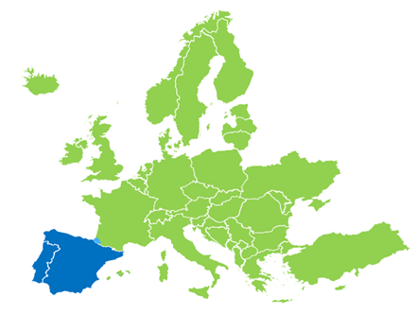


Introduction
On 28 April 2025, at 12:33 CEST, Spain and Portugal suffered a total blackout. A small area in the South of France (in the border with Spain) was also affected during a limited period of time.
The rest of the European power system did not experience any disturbance as a result of the incident.

Slide 41
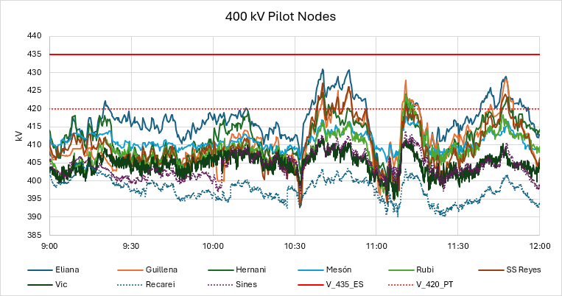
System conditions before the incident (9:00 - 12:00 CEST)
The voltage in the transmission system remained below the upper operational limits
In Spain, the following limits apply in accordance with the official Operational Procedure 1.4 (link), §3.2 (free translation): “Voltages at the nodes - Under normal operating conditions, the voltage at the 400 kV level at the connection nodes will be between 390 and 420 kV. At the 220 kV level, the voltage will be between 205 and 245 kV. Eventually, maximum values of up to 435 kV and minimum values of up to 375 kV may occur at the 400 kV level. At the 220 kV level, voltages may eventually drop to 200 kV. Any installation directly connected to the transmission network must be able to withstand the above values without damage or disconnection.”
The Expert Panel has formally asked CNMC, the Spanish NRA, to provide their interpretation on this rule
Voltage evolution from 9:00 to 12:00 in the main 400 kV transmission substations in Spain and Portugal [source: telemeasure every 4 sec. from Red Electrica and REN)]

Slide 42
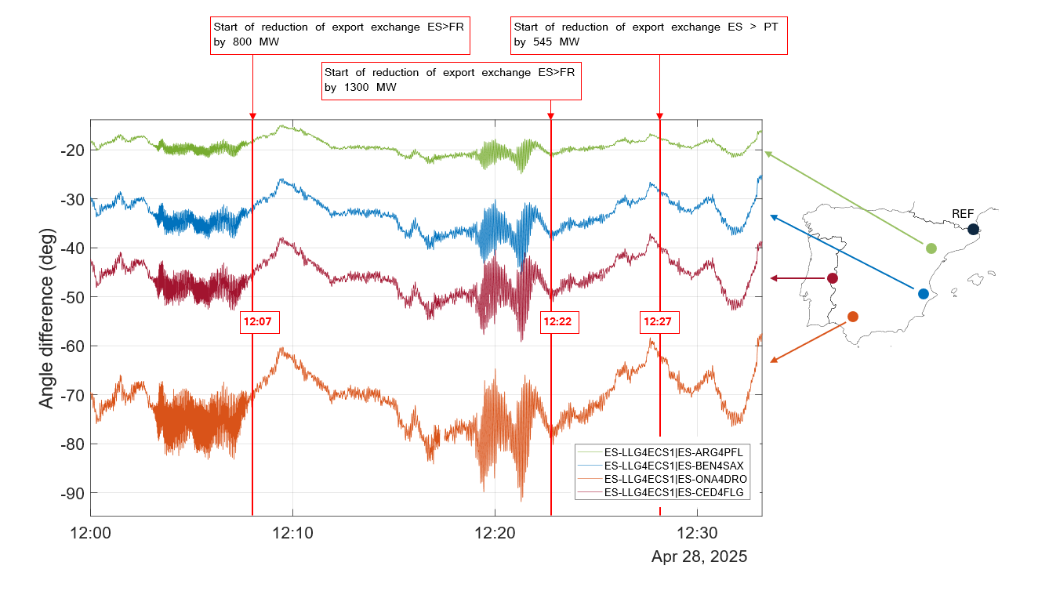
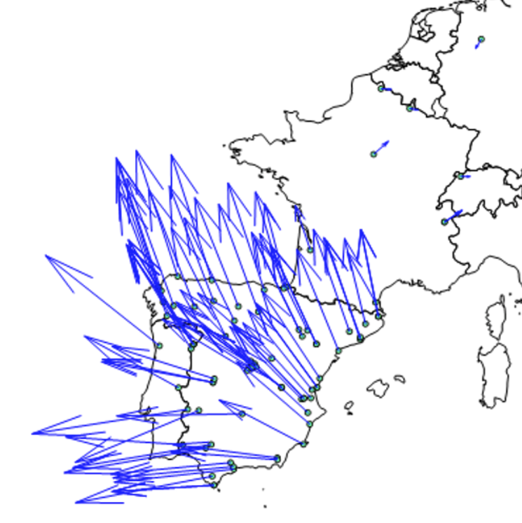
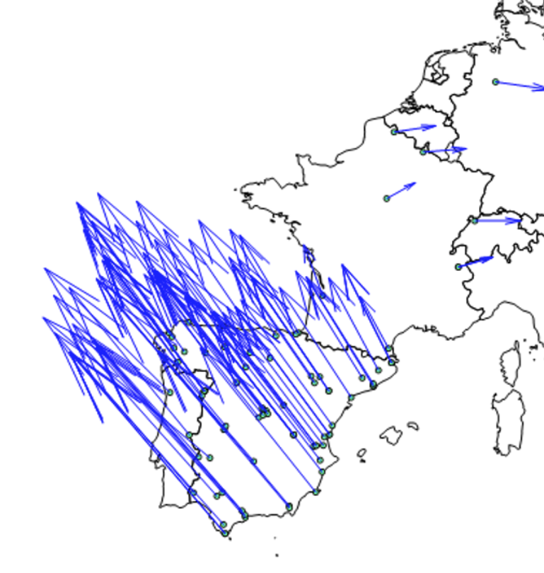
Oscillations and mitigation measures from 12:00
The operators in the control rooms of the relevant TSOs took several mitigating measures (defined in the stablished operation protocols):
lines were switched on to decrease the system impedance and improve the generators stability
fixed power operation mode was set up on the HVDC link between Spain and France as this is an effective measure to mitigate oscillations
the flow between Spain and France was reduced, as additional countermeasure to decrease Iberian centre of inertia angle against the rest of the Continental Europe power system.
Voltage angle difference evolution after 12:00 CEST, and the effect of the countermeasures, at 4 locations in the Iberian Peninsula (source: PMU data from Red Eléctrica)
Mode shapes of first and second oscillation

Slide 43
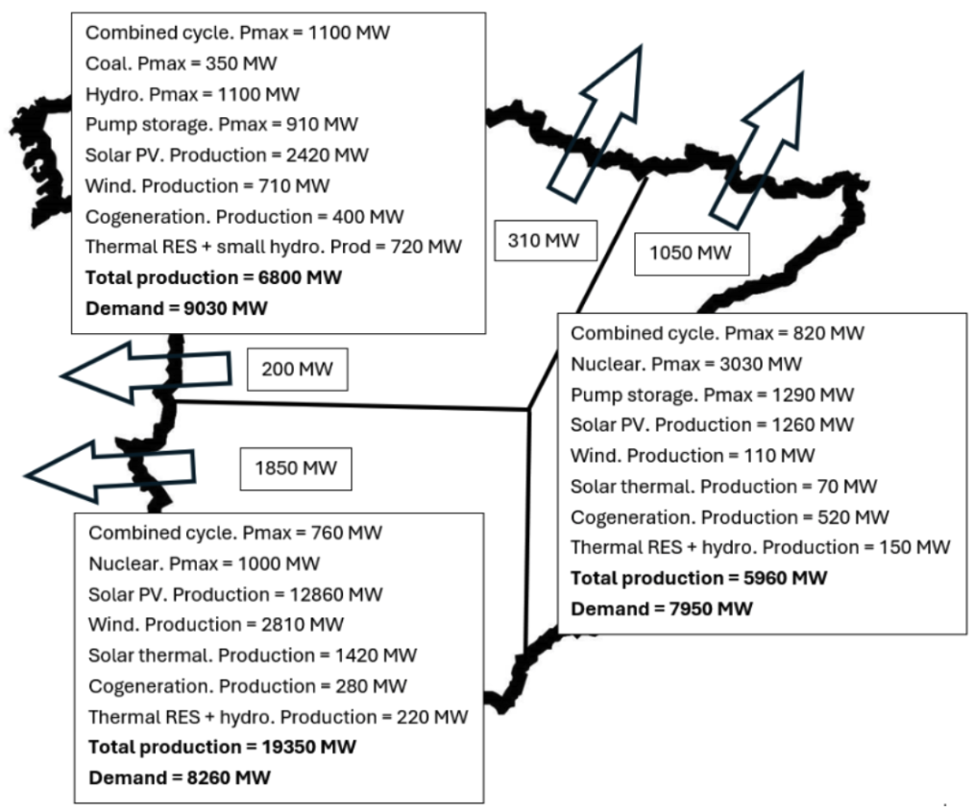
Geographic distribution of production and load in Spain at 12:32

Slide 44
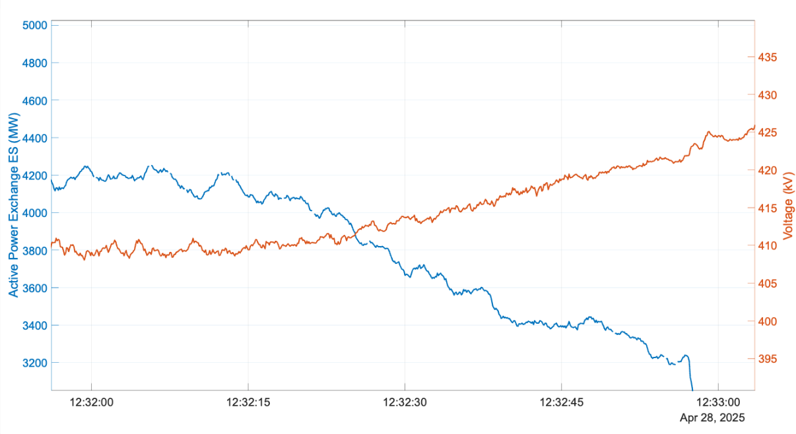
Evolution of system conditions from 12:32:00 until 12:32:57
A loss of more than 500 MW of numerous wind and solar generation units, connected to the distribution networks in Spain, is estimated as the main driver of this development. The cause of these trips remains unknown, due to the limited observability at the medium/low voltage level – both in spatial and temporal granularity
Evolution of the voltage in the Carmona substation and of the net active power exchange position of Spain in the minute preceding the blackout (source: PMU data from Red Eléctrica)

Slide 45
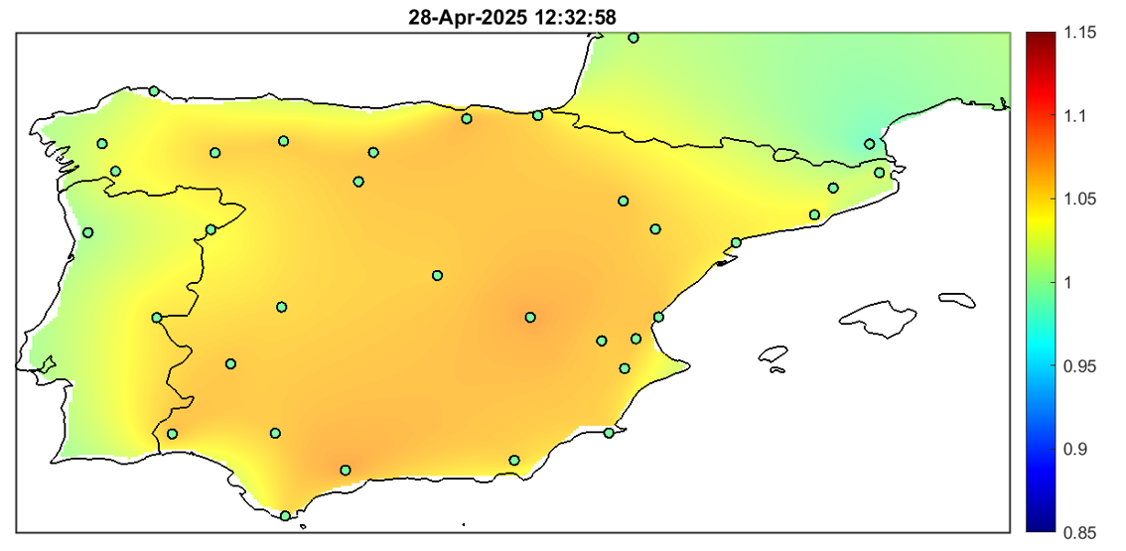
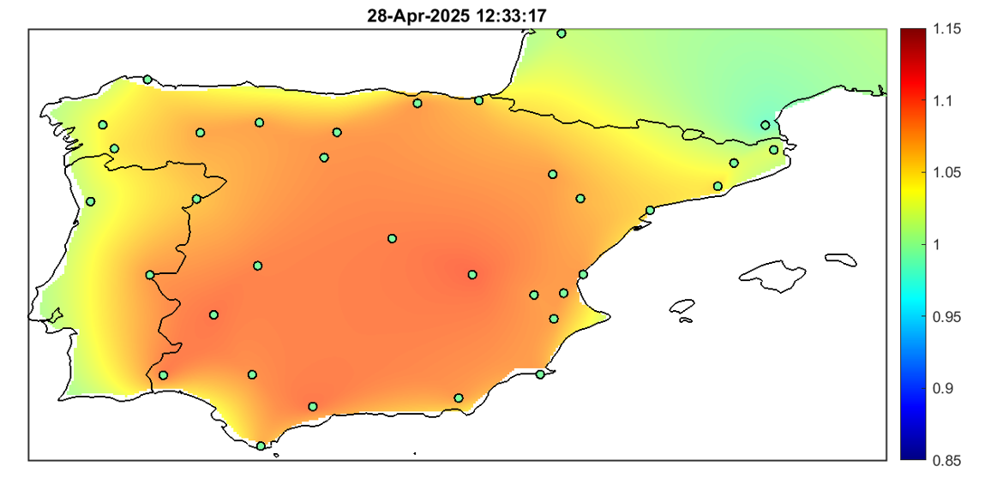
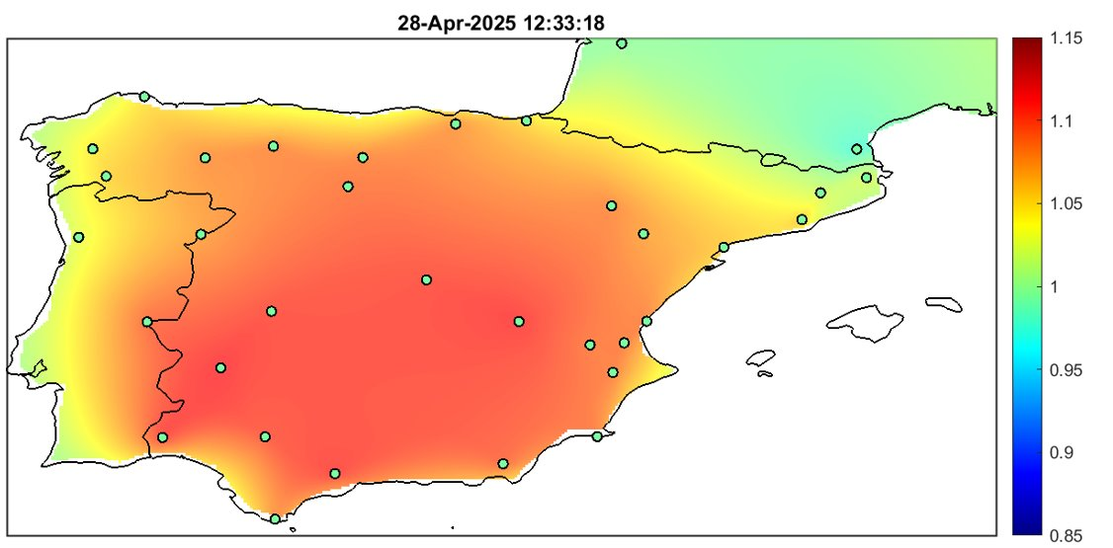
Sequence of events between 12:32:57 and 12:33:18
The first event was due to the tripping of a generation transformer, due to a problem in the lower voltage side, in the area of Granada, which connected different generation facilities (photovoltaic, wind and thermo-solar) to the transmission grid and which was injecting 355 MW. The tripping of the transformer and consequently the loss of infeed options also explains the disconnections of some of the generation units connected to this transformer due to over-frequency while others trip due to overvoltage, as reported by the operators of the power plants.
The second event included trips of PV and thermo-solar facilities connected to two transmission 400 kV substations, in the area of Badajoz, with a total interrupted injection of around 725 MW.
The third event included several trips, in different areas, in less than one second: wind farms in Segovia and Huelva, photovoltaic in Badajoz, Sevilla, Caceres and Huelva and thermo-solar in Badajoz, and other generators in different locations for a total of more than 1100 MW, as estimated by the variation of frequency. From this quantity, the Expert Panel was able to identify 930 MW of generation loss based on data provided by generators and from Red Eléctrica’s monitoring equipment
Figure: Heat maps of the voltage in the transmission grid in p.u. (source : PMU data from Red Electrica, REN and RTE)

Slide 46
Sequence of events from 12:33:18
Between 12:33:18 and 12:33:21 CEST
the voltage of the South area of Spain increased sharply, and consequently also in Portugal. The over-voltage triggered a cascade of generation losses that caused the frequency of the Spanish and Portuguese power system to drop.
At 12:33:19 CEST
the power systems of Spain and Portugal started to lose synchronism with the European System.
Between 12:33:19 and 12:33:22 CEST
the automatic load shedding and System Defence Plans of Spain and Portugal, elaborated in accordance with Commission Regulation (EU) 2017/1485 of 2 August 2017 establishing a guideline on electricity transmission system operation (SO GL), were activated but were unable to prevent the collapse of the Iberian power system.
At 12:33:20 CEST
the AC interconnection between Spain and Morocco tripped due to underfrequency
At 12:33:21 CEST
the AC overhead lines between France and Spain were disconnected by protection devices against loss of synchronism.
At 12:33:24 CEST
all system parameters of the Spanish and Portuguese electricity systems collapsed, and the HVDC lines between France and Spain stopped transmitting power.

Slide 47
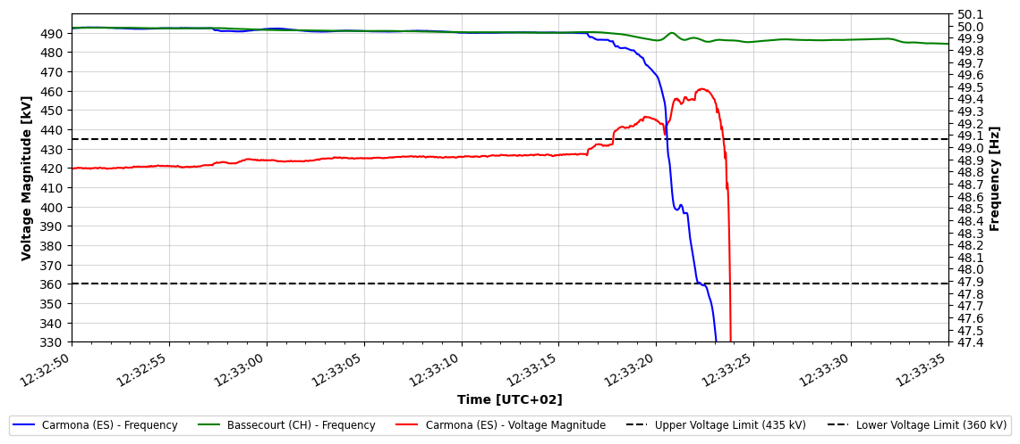
Voltage and frequency evolution during the incident
Evolution of the frequency and the voltage in the substation of Carmona (Spain) and of the frequency in the rest of Continental Europe (substation of Bassencourt, Switzerland) during the incident (sources : Red Electrica, Swissgrid)

Slide 48
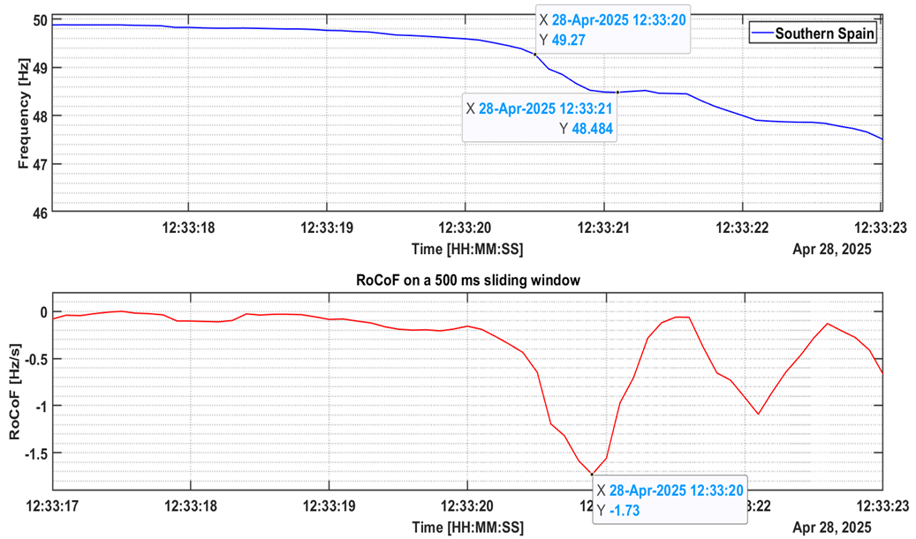
The evolution of RoCoF during the incident
The evolution of the Rate of Change of Frequency (RoCoF) in the moments before the blackout is illustrated below. It indicates that RoCoF in the area remains within the absolute range of 1 Hz/s up until 12:33:20.400 when the minimum frequency was already around 49 Hz. After that, the absolute value of RoCoF exceeded 1 Hz/s, when the system conditions were already degraded.
Evolution of the frequency and RoCoF in the seconds before the blackout (source : PMU data from Red Eléctrica)

Slide 49
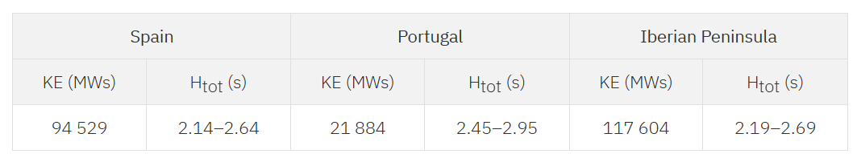
Inertia at 12:32
Inertia calculation is affected by significant uncertainty, mainly for these reasons:
The equivalent total inertia is a linearization of a process affected by several non-linearities
The rated inertia of generators, turbines and other rotating parts are in several cases estimated and not precisely calculated
The loads contribution can vary in a wide range depending on type of loads, aggregations etc

Slide 50
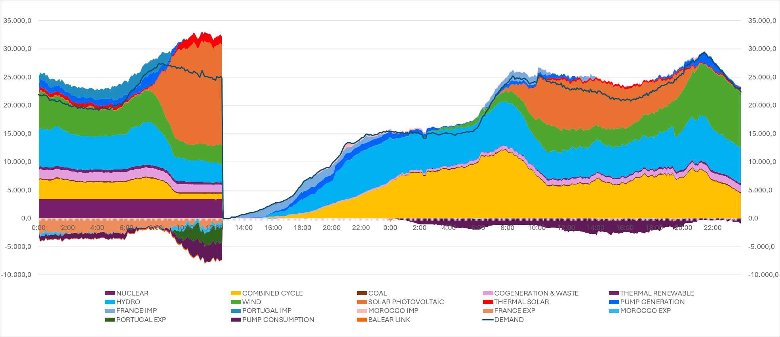
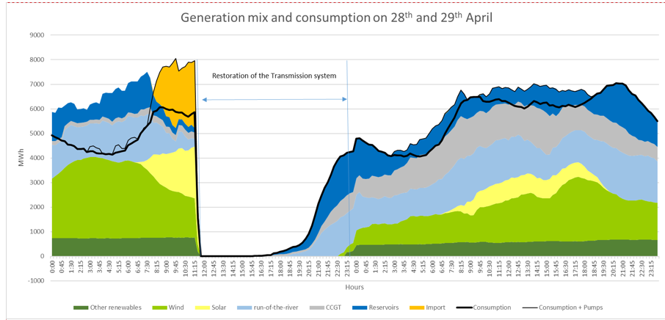
Restoration process
Power system restoration in some regions of the Portuguese and Spanish systems was facilitated, among others, by the activation of the power system resources such as black-start processes in certain power plants, as well as by the existing interconnections with France and Morocco.
The rapid restoration of supply in Spain and Portugal demonstrated the preparedness and efficiency of the affected TSOs, Red Eléctrica and REN with the support and collaboration of the French TSO RTE, as well as the Moroccan utility ONEE, in case of Spanish system
Generation mix and consumption in Spain and Portugal on 28 and 29 April 2025 [source: Red Electrica and REN]

Slide 51
Information used by the Expert Panel
The work of the Expert Panel is primarily based on data collected from the TSOs, generators and DSOs, in accordance with the ICS methodology.
Spanish TSO requested the data to be provided from all relevant parties, however the response was limited.
In light of that, the Expert Panel leaders contacted numerous entities (distributors, generators, control centers) within Spain directly, and requested the data to be submitted to the Expert Panel.
  More than 130 emails / letters exchanged with 3rd parties between end of June and mid-August
  Reminders were often necessary to receive an answer​
  Several parties were unable to deliver all the requested data (incl. fault records of generation trips)​
  A few parties did not answer at all to any request
The Expert Panel will also consider other reports :
  The public report of the Spanish government
  The report of the Portuguese government shared with ECG
  The public report of Red Electrica
  Confidential reports directly sent to the Expert Panel by third parties

Slide 52

Expert Panel: main deliverables
Establishment of the Expert Panel
Kick-off meeting on 12 May 2025
First deliverable: Factual report
Legal deadline for the factual report: 6 months after the incident
Second deliverable: Final report
Is prepared on the basis of the Factual report
Is expected to be delivered 3-4 months after the factual report
Presents the facts and data on the incident
Does not include analysis nor recommendations
Includes a detailed analysis of the incident
Includes a list of recommendations to be implemented in order to prevent similar incidents in the future
The Expert Panel intends to deliver the factual report earlier than the legal deadline
Next meetings planned on
19 September
14 October
30 October
18 November
10 December
6th meeting on 2 Sept 2025
Reporting at each Electricity Coordination Group meeting
Regular updates via dedicated website

Slide 53
7. North Macedonia Incident Investigation
Ana Cigaran Romero, ENTSO-E

Slide 54
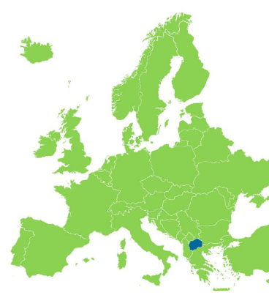

Update on 18 May 2025 Scale 3 incident
Incident Overview
On 18 May, starting at 04:59, a grid incident led to a blackout in the power system of North Macedonia. The blackout lasted approximately 1.5 hours.
Affected TSOs:
MEPSO (North Macedonia), ESO EAD (Bulgaria),
Incident Classification:
ICS Scale 3 Incident for MEPSO and ICS Scale 1 Incident for ESO EAD.
Preliminary Cause:
Initial observations indicate unexpectedly high voltages on the 400 kV network, combined with low consumption and very low cross-border power flows with neighbouring TSOs.
Factual Report:
Targeted to be published end of October 2025.
Final Report:
To be published by May 2026 at the latest.

Slide 55
Update on 18 May 2025 Scale 3 incident
Progress so far
Neighbouring TSOs have been contacted to verify the impact of the incident on their systems, being ESO EAD the only affected neighbour according to ICS methodology.
Investigation:
The focus so far has been on ensuring the proper data collection.
The quality of the all the data gathered so far has been assessed as adequate by the relevant experts.
The structure of the report aligns with that of the Iberian report.
The drafting teams have started work on the corresponding chapters of the factual report.
Expert Panel:
2 Expert Panels Meetings were held in the beginning of July and August
→ next Expert Panel is scheduled for end of September
Expert Panel consists of ACER, ENTSO-E, NRA and TSO representatives
  Involved NRAs: ANRE, ARERA, EI, ERC, ERU
  Involved TSOs: 50Hertz, ESO EAD, MEPSO, OST, PSE, REN, RTE, TERNA

Slide 56
8. Czech Republic Incident Investigation
Donatas Matelionis, ENTSO-E

Slide 57
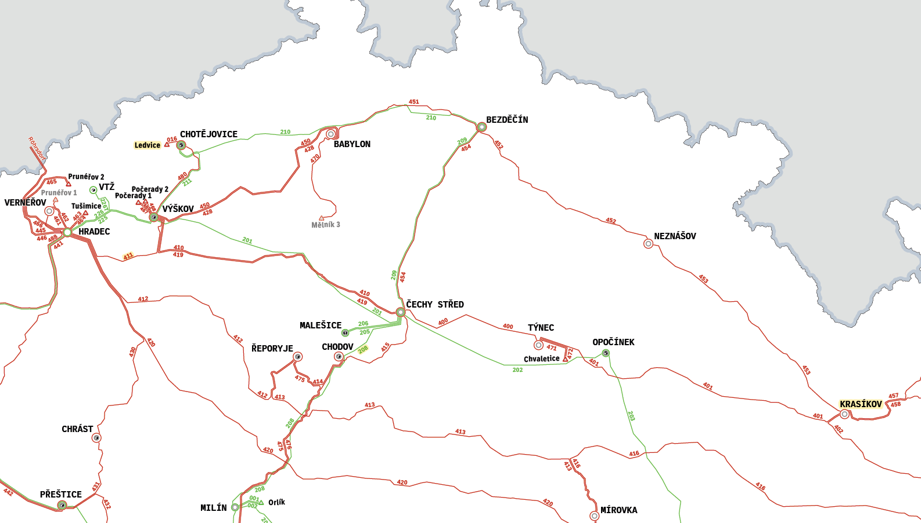
Czech Republic incident: timeline of the incident
11:51:06
Tripping out of internal line V411 Hradec – Výškov
Loss of distribution-connected generation
2
11:52:48
Loss of generation - Ledvice unit 6 (Coal-fired) connected to TS (approx. 290 MW before V411 incident)
1
11:59:44
Opening of overloaded line V208 Milín – Čechy střed
11:59:47
3
4
Tripping out of a part of substation Krasíkov leading to an unstable island and frequency collapse. Loss of voltage in the islanded area.

Slide 58
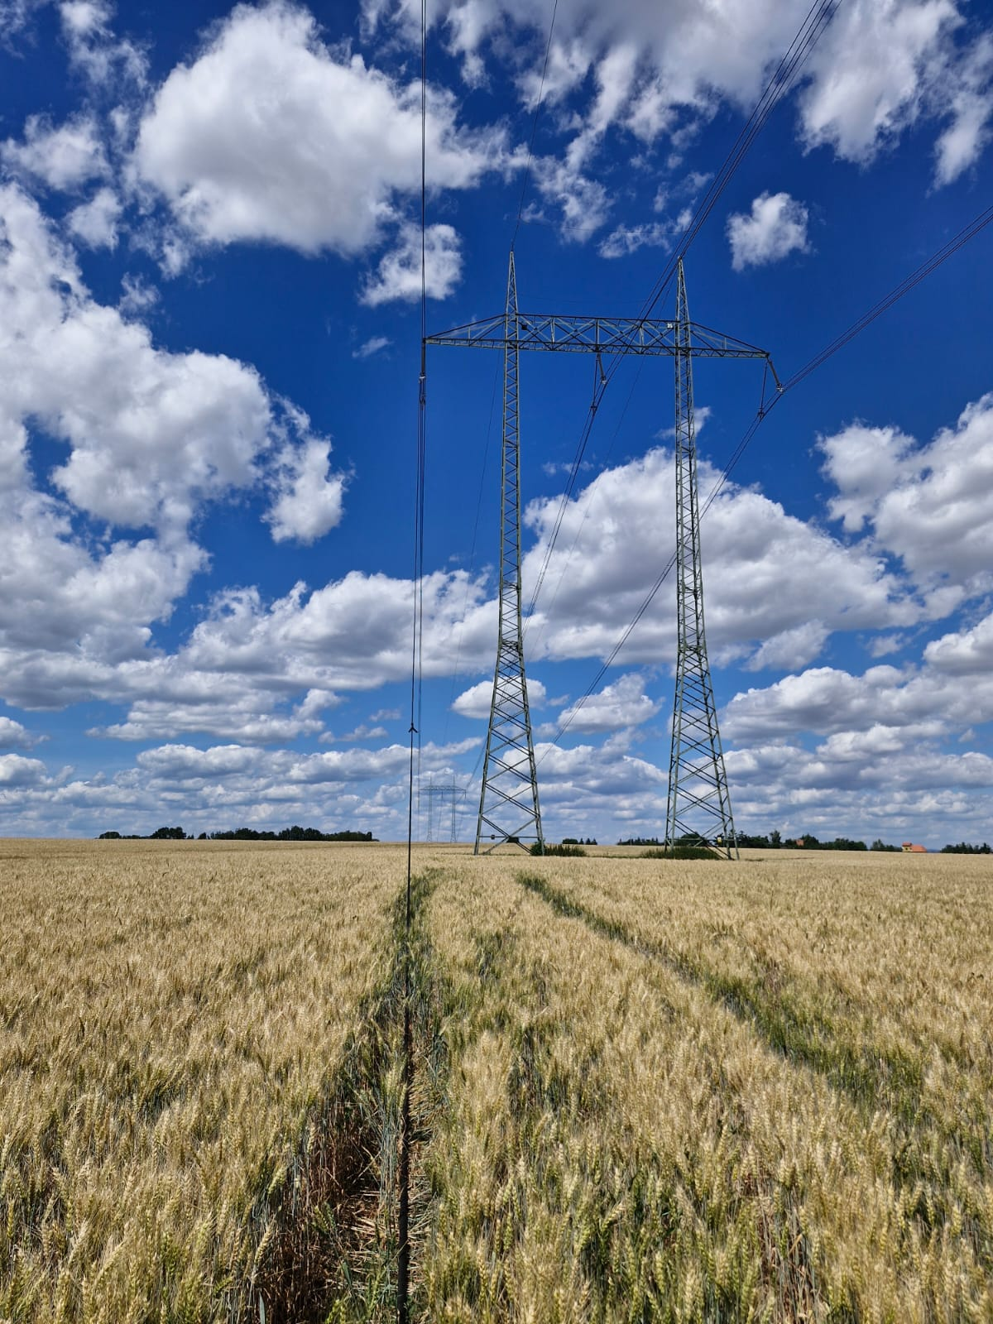
Czech Republic incident: timeline of restoration
12:09
Emergency state declared in EAS and national system EVS
12:24
Switching of line V208
until 14:00
Voltage restored in transmission substations Chodov and Malešice (supplying capital city Prague)
until 14:15
Voltage restored in all (7) remaning transmission substations
15:45
Declaration of the state of emergency according to Czech law effective from 12:00
15:18 – 16:12
Startup of CCGT Počerady 2 on ČEPS request
17:00
All parts of the distribution grid reenergized
22:15
Repairs of line V411 finished and line put into operation
24:00
Termination of the state of emergency according to Czech law

Slide 59

Czech Republic incident: general timeline
17.09.2025
26.09.2025
To be confirmed
Board meeting
Kick-off meeting Expert Panel
Publication
of the final report
14.08.2025
24.09.2025
04.01.2026
Kick-off meeting Internal Taskforce
SOC Meeting
Deadline for publication
of factual repot

Slide 60
9. Methodology on minimum inertia levels for CE
Joao Moreira, ENTSO-E

Slide 61

Introduction
  Project Inertia Phase II
  Milestone – Public Report
    updated the results and solution measures following the analysis of the impact of system splits on the future “low inertia” configuration of the Continental Europe Synchronous Area
    concluded on the need to define an intended level of resilience against system splits based on foundational measures, i.e. tackle the root cause, keep inertia above a certain limit
  Milestone – Position paper and supporting technical report
    external debate in order to trigger decision-making on the approach to a more resilient system, the way to allocate the inertia needs and the implementation framework, including ACER, EC and stakeholders
    Supporting information and a roadmap to deliver a secure and efficient future-ready decarbonised system as part of a step-by-step, no-regret approach
  Next steps: Milestone – Final report on agreed actions
    Planned to end of 2025
    Overall summary incorporating proposals, received feedback and agreed actions towards formal implementation

Slide 62
key messages
  Needed Implementation Framework and Roadmap
  Necessary a feasible and agreed roadmap with decision makers and stakeholders
  Resilience targets should be defined for the short/medium-term and long-term
  The process is a step-by-step approach, aiming at no-regret and achievable steps to gradually and sustainably recover system resilience while continuously reassessing system needs and suitable solutions.
  Project Inertia proposes:
As soon as possible
any device able to provide inertia like PPMs, STATCOMs, Synchronous Condensers shall provide inertia.
RfG 2.0 IGDs should support TSOs in defining adequate technical requirements to provide the identified needs. This also ensures a level playing field across Europe.
In parallel
always incentivise optimisation of enhanced response measures and preventive measures.
By 2035
reach Hmin= 2 sMW/MVA in 50 % of time in a year. For the first steps, part of the targets can be largely ensured with technologically available TSO assets.
In a long-term target, subject to reassessment based on the return of experience
all countries shall ensure Hmin = 2 sMW/MVA in 90 % of time in a year. Such total kinetic energy does not exceed the total kinetic energy levels available in the past for CE.

Slide 63
Aspects to take into account for the implementation framework
  Definition of minimum inertia and recovery of system resilience for CE SA
  Presently, in normal interconnected operation for Continental Europe Synchronous Area (CE SA), there are no issues with minimum inertia following the reference incident of 3,000 MW
  In the case of system splits there is a trending increase in the number of cases where the system may be subject to a partial blackout or total blackout of all resulting subsystems
  The cases of total area blackout after a system split are called Global Severe Situations (GSS), are regarded as the most severe and are used as the criteria for assessing the system resilience
  It is not possible to avoid all GSS or other split situations where one subsystem may experience a blackout
    Avoiding a significant number of GSS is not a complete solution or definitive metric per se, but rather constitutes a reference of the system’s resilience recovery that should be safeguarded
  Recovering system resilience means reducing the likelihood of GSS occurrences, rather than defining GSS as a design concept to be withstood
    System splits are categorised as out-of-range contingencies and do not define the maximum load imbalance the system must withstand without deploying defence plans, e. g. load shedding
    The load imbalance of 3,000 MW for CE SA remains the reference incident for dimensioning frequency containment reserves

Slide 64
Aspects to take into account for the implementation framework
  Additional kinetic energy
  Adding significant kinetic energy to the system as a foundational measure can be achieved via synchronous condensers (SCs) or inverter-based resources with grid-forming capability and storage
  Project Inertia defines a minimum level of inertia to be ensured in CE SA, supported by foundational measures
    Achieving this minimum inertia and corresponding resilience level depends on the allocation method of additional inertia in CE SA
      Since system split events cannot be anticipated, kinetic energy should always be well distributed throughout the system
      Binding support at the synchronous area (SA) level including all countries and regions is imperative.
    All CE SA countries must ensure their binding minimum levels of kinetic energy, defined by the equivalent inertia metric (H), to recover the resilience up to the agreed level and mitigate the occurrence of Global Severe Situations

Slide 65
Aspects to take into account for the implementation framework
  Assessment metric and framework
  The equivalent inertia metric (H) serves as a threshold for all TSOs to assess their additional inertia needs
    Consistent compliance with this metric is needed to ensure an overall availability of minimum energy for inertial response leading to a corresponding system resilience in the event of a system split
    The proposed ex-post assessment of yearly inertia levels in CE SA countries will not affect operational decisions
  The equivalent inertia metric, e.g. H above 2 sMW/MVA for a percentage of time means that:
    The additional kinetic energy needs are permanent and should be deployed permanently → the additional needs are part of the system foundation
    The system foundation requires a mix of technologies and solutions, including mature and new technologies deployed in a sustainable manner

Slide 66
Aspects to take into account for the implementation framework
  Assessment metric and framework
  Project Inertia proposes to implement the minimum inertia targets and continuously monitor its implementation and effectiveness
  Regular reassessment of needs and monitoring
    Long term needs and global resilience level: should be reassessed every two years in the regular TYNDP IoSN
    Country coverage of equivalent inertia year duration curve: should be assessed on a yearly basis via ex-post operational monitoring
    Support the necessary TSO investment decisions in terms of necessary assets (e. g. SCs or STATCOMs), specification of non-exhaustive grid connection requirements, and the mandatory application of such requirements, e. g. grid-forming convertors (GFMs) with stored energy

Slide 67
Aspects to take into account for the implementation framework
  Other aspects
  The GSSs approach focuses on the split cases that might affect all countries in the CE synchronous area
  In addition to problems caused by GSS, though, it should be noted that greater challenges and requirements may be present at the national level or between groups of TSOs due to other critical splits
    To manage the consequences of these other critical split events, additional inertia should be provided in the relevant region. These would then have to be investigated more deeply on a case-by-case basis by the relevant TSOs

Slide 68
Thank you!

Slide 69
7. AOB

