Slide 1
Cyber-Attack Classification Scale (CACS) – Public Consultation

Slide 2





Organisation details
Workshop planning: 1 hour
45 min presentations & 15 min Q&A session
All participants are muted and turn the camera on only when speaking
The session will be recorded
All the questions and comments received in the MT chat will be considered after the workshop
During the Q&A the participants can raise the hand to ask a question / make a comment

Slide 3
General Background
1

Slide 4
Why a network code on Cybersecurity (NCCS)?
1
Electricity is vital for European citizens and businesses
2
The interconnected European electricity grid is unique
3
The digitalisation is creating new risks and vulnerabilities
Notes:
Why do we need a network code on cybersecurity?
Firstly, security of electricity supply has an outstanding importance for all European citizens, societies and industrial sectors. The ongoing transition of the electricity sector towards decarbonization, decentralization and digitization requires additional measures to safeguard security of electricity supply in the years to come.
Secondly, the intercontinental European electricity grid has a unique characteristic, as through cascading effects in case of a cyber-attack, each EU Member State could be affected by the weakest actor.
Finally, the digitalization of legacy systems used in the electricity sector is creating new risks and new vulnerabilities in an increasingly complex environment. It is therefore clear that prevention and management of electricity crises related to cyber-attacks require a common framework of rules and coordinated procedures, allowing EU Member States and other actors of the electricity sector to coordinate their cybersecurity efforts and solidarity across borders.
In this context, the EU adopted the NCCS, which is part of a wider EU effort to promote digitalized, green and resilient energy systems.

Slide 5

What is the NCCS' Regulatory Background?
Delegated Act by the European Commission → directly applicable and legally binding in all EU Member States.
NCCS lays down sector-specific rules for cybersecurity aspects of cross-border electricity flows.
NCCS complements other European cyber security legislations
(e.g. NIS-2), whenever cross-border
electricity flows are concerned.
Notes:
It is a directly applicable and legally binding regulation that complements other European cybersecurity legislations, such as the NIST 2 Directive, whenever cross-border electricity flows are concerned.

Slide 6
Which entities are in scope of the NCCS?
(Article 2)
NIS 2
Producers
The code shall apply to:
  High-impact entities:
  entity that carries out a process with a high electricity cybersecurity impact
  Critical-impact entities:
  entity that carries out a business process with a critical electricity cybersecurity impact
Suppliers
DSOs
No measures
TSOs
NEMOs
Aggregators
Classification
by National
Competent
Authority
(Article 24)
Demand response providers
Storage providers
High-impact entities
Operators of recharging points
Electricity
Balancing responsible parties
Organized market places
ENTSO-E
DSO entity
RCCs
Critical-impact entities
ICT
Critical ICT service providers
MSSPs
Others through delegation
Notes:
The NCCS’ obligations apply to entities defined as “high-impact” or “critical-impact entities” the classification of which depends on how severely a potential cyber-attack affecting the entity’s processes and related assets could compromise cross-border electricity flows.
To assess this impact, the NCCS provides the basis for specific methodologies with thresholds and parameters in order to identify the processes, supporting assets and operating entities that could possibly affect cross-border electricity flows.
Potential actors from the electricity sector that might, in principle, qualify as high-impact or critical-impact entity are listed in Art. 2.(Read some of them out loud) The entities involved in the delivery of those processes will then be obliged to implement the obligations set out in the NCCS.

Slide 7
Who is responsible for the governance of the NCCS?
National Level:
Regional Level:
EU Level:
National Competent
Authorities (NCCS-NCA)
Regional Coordination
Centers (new)
ENTSO-E
DSO ENTITY
National Regulatory
Authorities (NRA)
ACER
NIS Competent Authorities
ENISA
Competent Authorities for Risk Preparedness (RP-NCAs)
Dg energy
Competent Authorities Responsible for Cybersecurity (CS-NCAs)
Dg connect
Computer Security Incident Response Teams (CSIRTs)
NEMOS
Energy related bodies
Cybersecurity related bodies
Notes:
The implementation and execution of the NCCS involves various authorities and institutions at national and European level.
Each EU Member State must designate a national authority in charge of the NCCS. This authority is called the NCA (National Competent Authority for the NCCS). The respective NRA (National Regulatory Authority) for energy acts as NCA by default and may delegate powers to other national authorities. All 27 NCAs will jointly approve the Terms, Conditions and Methodologies foreseen under the NCCS, such as the High-impact and Critical-impact processes.
At regional level, the Regional Coordination Centers will be involved in the NCCS tasks.
At European level, ENTSO-E and DSO Entity are responsible for proposing Terms, Conditions and Methodologies foreseen in the NCCS, as well as prepare reports and cybersecurity exercise scenarios. ACER, supported by ENISA, monitors the proposals approved by all NCAs together.

Slide 8
Who are National Competent Authorities (NCCS-NCAs)?
A national governmental or regulatory authority responsible for carrying out the tasks assigned to it in the NCCS (Art. 5).
Designated by each member state six months after entry into force (Art. 5).
They shall coordinate and cooperate with cybersecurity competent authorities, NRAs, RP-NCAs, CSIRTs and other authorities determined by each Member State to ensure fulfilment of NCCS and avoid duplication of tasks (Art. 5).
The competent authorities may delegate tasks to other national authorities (Art. 4).
They may perform inspections of critical-impact entities according to national law to verify their compliance to the NCCS (Art. 25)

Slide 9

development of the cross-border electricity cybersecurity risk assessment report
development of the common electricity cybersecurity framework
development of the cybersecurity procurement recommendation
development of the cyber-attacks classification scale methodology
development of the cybersecurity risk assessment methodologies
development of guidance on European cybersecurity certification schemes
performance of the Union-wide/ regional cybersecurity risk assessment
ENTSO-E and
DSO Entity cooperate in:
(Art. 16)

Slide 10
How and until when will the NCCS be implemented?
2024 | 2025 | 2026 | 2027 | 2028 | 2029 | 2030 | 2031 | 2032 | 2033
YEAR 1 |  | YEAR 2 |  | YEAR 3 |  | YEAR 4 |  | YEAR 5 |  | YEAR 6 |  | YEAR 7 |  | YEAR 8 |  | YEAR 9
DEVELOP
Provisional documents (ECII, Processes and standards) –Art. 48
Competent authority designation -Art.4
DEVELOP
APPROVE
Risk assessment methodologies –Art.18(1)/8
DEVELOP
APPROVE
Union-wide risk assessment (including ECII & Thresholds) –Art.19
HI/CI entities notification –Art.24(6)
Entity risk assessment –Art.27(1)
Member State risk assessment –Art.20(2)
Regional risk assessment –Art.21(2)
APPROVE
Regional risk mitigation plan –Art.22(1)
APPROVE
Cross border risk assessment report –Art.23(1)
APPROVE
Minimum and advanced cybersecurity controls –Art.29(1)
included supply chain controls –Art.28(4)
APPROVE
Proposal for the ECSMM –Art.34(1)
Implement minimum and advanced cybersecurity controls – Art.29(1) + supply chain
DEVELOP
APPROVE
CACS methodologies –Art.37(8)
Cybersecurity management system – Art.32(1)
Demonstrate compliance – Art.31(1)
X
European level
SCENARIO
PREPARATION
EXERCISE
Entity or national exercises -Art.43
X
NATIONAL LEVEL
SCENARIO
PREPARATION
EXERCISE
Regional or cross-regional exercises -Art.44
X
Entity level
Tool
Feasibility Study –Art.37(9)
Notes:
The NCCS will introduce robust cybersecurity measures and effective methodologies to mitigate the risks related to cross-border electricity flows.
These are the main milestones of the NCCS’ implementation process:
Before the end of 2024 the NCAs should be designated in each EU Member State. And at the beginning of 2025, the provisional ECII & thresholds should let them designate the first high-impact & critical-impact entities. These entities can on voluntary basis, start applying the NCCS.
In 2028, high-impact & critical-impact entities will be officially notified, according to the result of the first Union wide risk assessment.
These entities will then have to start reporting cyber-attacks according to the cyber-attack classification scale methodology. They will also have to perform during the first year a risk assessment, that NCAs will use as input to consolidate a national risk assessment. In 2027, minimum and advanced cybersecurity controls will be defined and approved by NCAs and high-impact & critical-impact entities will have to implement them in 2028 through a cybersecurity management system that will have to be verified for critical-impact entities in 2030.
Cybersecurity exercises will be organised at entity or national level in 2028, and at regional or cross-regional level in 2029 and every three years thereafter.

Slide 11
How and until when will the NCCS be implemented?
DEVELOP
Provisional documents (ECII, Processes and standards) –Art. 48
Competent authority designation -Art.4
DEVELOP
APPROVE
Risk assessment methodologies –Art.18(1)/8
DEVELOP
APPROVE
Union-wide risk assessment (including ECII & Thresholds) –Art.19
HI/CI entities notification –Art.24(6)
Entity risk assessment –Art.27(1)
Member State risk assessment –Art.20(2)
Regional risk assessment –Art.21(2)
APPROVE
Regional risk mitigation plan –Art.22(1)
APPROVE
Cross border risk assessment report –Art.23(1)
APPROVE
Minimum and advanced cybersecurity controls –Art.29(1)
included supply chain controls –Art.28(4)
APPROVE
Proposal for the ECSMM –Art.34(1)
Implement minimum and advanced cybersecurity controls – Art.29(1) + supply chain
DEVELOP
APPROVE
CACS methodologies –Art.37(8)
Cybersecurity management system – Art.32(1)
Demonstrate compliance – Art.31(1)
X
European level
SCENARIO
PREPARATION
EXERCISE
Entity or national exercises -Art.43
X
NATIONAL LEVEL
SCENARIO
PREPARATION
EXERCISE
Regional or cross-regional exercises -Art.44
X
Entity level

Slide 12
How and until when will the NCCS be implemented?
DEVELOP
Provisional documents (ECII, Processes and standards) –Art. 48
Competent authority designation -Art.4
DEVELOP
APPROVE
Risk assessment methodologies –Art.18(1)/8
DEVELOP
APPROVE
Union-wide risk assessment (including ECII & Thresholds) –Art.19
HI/CI entities notification –Art.24(6)
Entity risk assessment –Art.27(1)
Member State risk assessment –Art.20(2)
Regional risk assessment –Art.21(2)
APPROVE
Regional risk mitigation plan –Art.22(1)
APPROVE
Cross border risk assessment report –Art.23(1)
APPROVE
Minimum and advanced cybersecurity controls –Art.29(1)
included supply chain controls –Art.28(4)
APPROVE
Proposal for the ECSMM –Art.34(1)
Implement minimum and advanced cybersecurity controls – Art.29(1) + supply chain
Cybersecurity management system – Art.32(1)
Demonstrate compliance – Art.31(1)
X
European level
SCENARIO
PREPARATION
EXERCISE
Entity or national exercises -Art.43
X
NATIONAL LEVEL
SCENARIO
PREPARATION
EXERCISE
Regional or cross-regional exercises -Art.44
X
Entity level

Slide 13
How and until when will the NCCS be implemented?
DEVELOP
Provisional documents (ECII, Processes and standards) –Art. 48
Competent authority designation -Art.4
DEVELOP
APPROVE
Risk assessment methodologies –Art.18(1)/8
DEVELOP
APPROVE
Union-wide risk assessment (including ECII & Thresholds) –Art.19
HI/CI entities notification –Art.24(6)
Entity risk assessment –Art.27(1)
Member State risk assessment –Art.20(2)
Regional risk assessment –Art.21(2)
APPROVE
Regional risk mitigation plan –Art.22(1)
APPROVE
Cross border risk assessment report –Art.23(1)
APPROVE
Minimum and advanced cybersecurity controls –Art.29(1)
included supply chain controls –Art.28(4)
APPROVE
Proposal for the ECSMM –Art.34(1)
Implement minimum and advanced cybersecurity controls – Art.29(1) + supply chain
Cybersecurity management system – Art.32(1)
Demonstrate compliance – Art.31(1)
X
European level
SCENARIO
PREPARATION
EXERCISE
Entity or national exercises -Art.43
X
NATIONAL LEVEL
SCENARIO
PREPARATION
EXERCISE
Regional or cross-regional exercises -Art.44
X
Entity level

Slide 14
What is the timeline for the provisional documents (Art. 48)?
Entry into force
Deadline
M1 | M2 | M3 | M4 | M5 | M6 | M7 | M8 | M9 | M10 | M11 | M12
ENTSO-E &
DSO Entity
Provisional Electricity Cybersecurity
Impact Index (ECII)
Provisional Union-wide high-impact and critical-impact processes
Provisional list of European and international standards and controls
NCCS-NCAs
List of relevant
national legislation
Identification of candidates for high-impact and critical-impact entities
NCCS-NCAs must notify candidates for high-impact and critical-impact entities by month 9 after entry into force.
NCCS obligations are voluntary for the candidates for high-impact and critical-impact entities.

Slide 15
Terms, conditions, and methodologies (TCMs) to be developed
Cybersecurity risk assessment methodologies
Comprehensive Cross-border electricity cybersecurity risk assessment report
Minimum and advanced cybersecurity controls
Minimum and advanced cybersecurity controls in the supply chain
Cybersecurity procurement recommendations
Cyber-attacks classification scale methodology

Slide 16
What is the process behind the development of terms, conditions, and methodologies (TCMs)?
Development (Art. 6)
Consultation (Art. 9)
Voting (Art. 7)
TSOs unanimity, or qualified majority.
If still no decision – NCCS-NCAs to take the appropriate steps for the adoption of TCMs.
TSOs, with the assistance of ENTSO-E and in cooperation with DSO Entity to develop proposals for TCM
NCAs and ACER informed regularly
Approval (Art. 8)
NCCS-NCAs may prolong deadlines
TCMs submitted to ACER
ACER to consult with ENISA
NCAs to decide in 6m
May ask TSOs to amend (+2m)
TSOs, DSO entity & ENTSO-E to consult stakeholders, ACER & ENISA and NCCS-NCAs
Duration of at least one month
DSO Entity to provide reasoned opinion 3w before deadline
NCCS-NCAs may request ACER’s opinion
The process represents EU-level TCM development process. Regional TCMs development process may differ.
To contribute to the methodologies:
TSOs and DSOs can be part of working groups through ENTSO-E and EU DSO Entity
Other stakeholders can participate in the consultation round for TCMs

Slide 17
Cybersecurity Defense
2

Slide 18













Information Sharing subgroup team
Legal
CSIRT
Info sharing
Crisis management
CS exercises
Support, secretariat
Anders Ahlgren
DSO, Vattenfall, SE
Armin Selhofer
DSO, oesterreichs energie, AT
Daiga Dege
TSO, ENTSOE, EU
Thomas Bennett
TSO, Statnett, NW
Marco Sgorlon,
TSO, Terna, IIT
Davide Della Giustina
DSO, Unareti , IT
Pauli Laine
TSO, FinGrid, FI
Alexander Rehfeld
TSO, tennet, DE
Thibault Millien,
TSO, RTE, FR
Roman Rous
DSO, CEZ Distribucione, CZ
Weekly meetings
Monday, 11am
Olivier Clément
DSO, Enedis, FR
Thomas Krauhausen
DSO, E.ON SE, DE
Romana Kerec
DSO, SODO, SI

Slide 19






Reporting cyber-attacks
Event
~LESS THAN THREE DAYS
Find similar cyberattacks
High-impact and critical-impact entities
24h
Art.
37.1.e
  Classification sufficiently scoped: high or critical
  Cyberattack classification confirmed
CSIRT
SPOC
CSIRTs
Competent authorities
Reportable
cyber
-attacks
24h
Art.
37.1.d
4h
Art.38.3
Competent Authority
Sanitisation and anonymisation
24h
Art.
37.1.e
24h
Art.37.1.a
Art.
37.1.g
High-impact and critical-impact entities
Assess confidentiality
Entity
impacted
Art.
37.1.f
Disseminate information
to other entities
COUNTRY A
OTHER MEMBER STATES
Notes:
The definition of a cyberattack is a malicious incident caused by means of an attempt perpetrated by any threat actor to destroy, expose, alter, disable, steal or gain unauthorised access to or make unauthorised use of an asset.
A reportable cyberattack in the context of the network code on cybersecurity is a cyberattack that the entity, with the support of the CSIRT of the entity considers as malicious, could have a serious impact on cross-border electricity flows, and are well advanced in the kill chain.
Note that in order to determine if it is reportable, the CSIRT will have to use the cyber-attack classification scale.
So what happens when a cyberattack is reportable?
As soon as an entity considers a cyberattack reportable, it has four hours to report the relevant information concerning the cyberattack to its national CSIRT and its national competent authority.
Once a cyberattack is reported, the national competent authority assesses the level of confidentiality and has 24 hours to inform the entity.
The National Competent Authority will then attempt to find other similar cyberattacks in the EU.
This is done to correlate and enhance existing information and to strengthen and coordinate cybersecurity responses.
After sanitization and anonymization, by which we mean removal of malicious or confidential information and any personal data, the National Competent Authority will share it with the National SPOCs Network, National CSIRTs and all competent authorities in all other member states within 24 hours.
The National Competent Authority will also share the cyber attack information with the high impact and critical impact entities in its country and provide regular updates.
The entire reporting cycle should take no longer than 32 hours.
The National Competent Authority can also ask the affected entity to provide the information directly to any other affected high impact and critical impact entity across Europe.
One of the main objectives of the Network Code on cybersecurity is to ensure that information travels quickly from one electricity entity to others across Europe, so they can react quickly and prepare a timely and active defence.

Slide 20
Cyber-Attack Classification Scale Methodology
3

Slide 21
Cyber-attack Classification Scale Methodology
Article 37 (8)
The TSOs, with the assistance of the ENTSO for Electricity, and in cooperation with the EU DSO entity shall develop a cyber-attack classification scale methodology by 13 June 2025. The TSOs, with the assistance of the ENTSO for Electricity and the EU DSO entity may request the competent authorities to consult ENISA and their competent authorities responsible for cybersecurity for assistance in the development of such classification scale.
4
1
The methodology shall provide the classification for the gravity of a cyber-attack according to five levels, the two highest levels being ‘high’ and ‘critical’. The classification shall be based on the assessment of the following parameters:
  (a) the potential impact considering the assets and perimeters exposed determined in accordance with Article 26(4), point (c); and
  (b) the severity of the cybersecurity incident.
2
3

Slide 22
Q#1 Malicious?
Article 4
Estimation of the root cause
Entities shall provide an estimation of the root cause of the event:
  A malicious root cause means that the origin of the event is any human intention to deliberately cause harm or damage and it is clearly determined.
  A not malicious root cause means that the origin of the event is without any human intention to deliberately cause harm or damage.
  An uncertain root cause means that the origin is not clear or cannot yet be categorised.
The event shall be considered a cyber-attack by the entity when it is estimated to have a malicious or an uncertain root cause.
In case the root cause is estimated as uncertain, the entity shall continue to evaluate the root cause.
In the case where a “not malicious” root cause is assessed without any doubt, the entity shall not consider the event as reportable according to article 38 (4) of the NCCS regulation.
Art.4
Malicious
Event
Yes or
Not sure
No
Cyber-
attack
Not reportable
To be repeated - every change (Art. 7.3)
Definitions
[NCCS]Art.3.11 ‘cyber-attack’ means an incident as defined in Article 3, point (14), of Regulation (EU) 2022/2554 [DORA]
[DORA] Art.3.14 ‘cyber-attack’ means a malicious ICT-related incident caused by means of an attempt perpetrated by any threat actor to destroy, expose, alter, disable, steal or gain unauthorised access to, or make unauthorised use of, an asset;
[CACS] Art.2(b) ‘estimation’ means the opinion of the affected entity based on internal and external information and findings gathered and available at a given time. The estimation reflects a subjective point of view of the Entity and is estimated for the sole purpose of scaling the cyber-attack and shall not be interpreted as binding or infringing any agency of any national authority or jurisdiction.

Slide 23
Cyber-attack Classification Scale Methodology
Article 37 (8)
The TSOs, with the assistance of the ENTSO for Electricity, and in cooperation with the EU DSO entity shall develop a cyber-attack classification scale methodology by 13 June 2025. The TSOs, with the assistance of the ENTSO for Electricity and the EU DSO entity may request the competent authorities to consult ENISA and their competent authorities responsible for cybersecurity for assistance in the development of such classification scale.
4
1
The methodology shall provide the classification for the gravity of a cyber-attack according to five levels, the two highest levels being ‘high’ and ‘critical’. The classification shall be based on the assessment of the following parameters:
  (a) the potential impact considering the assets and perimeters exposed determined in accordance with Article 26(4), point (c); and
  (b) the severity of the cybersecurity incident.
2
3

Slide 24
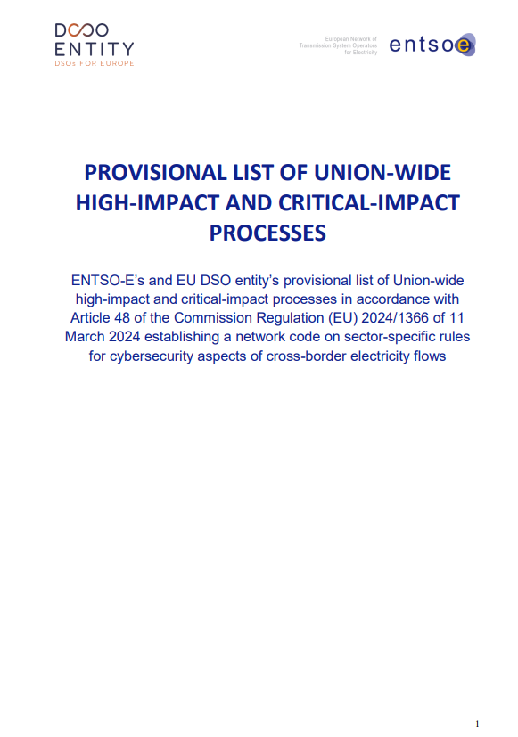
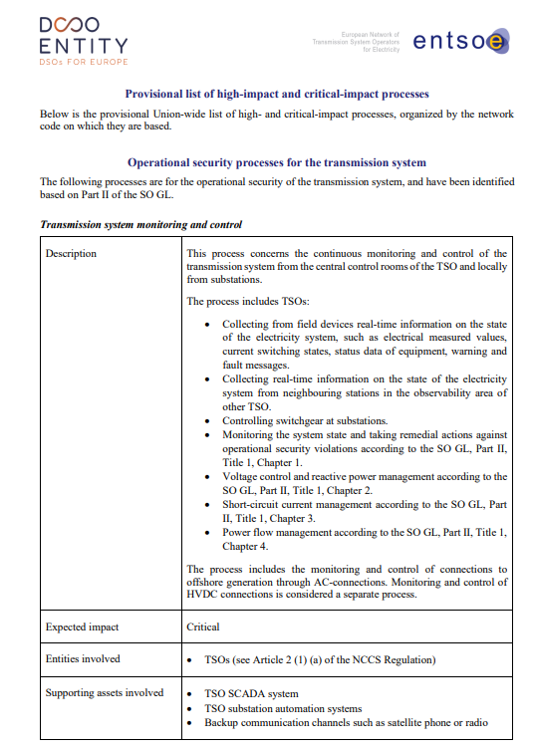
Q#2 Potential Impact?
https://www.entsoe.eu/network_codes/nccs/
End 2024: Provisional list of Union-Wide high-impact and critical-impact processes
~2026: Union-wide risk assessment (Final / mandatory)
Provisionnal process list
Critical-Impact
Processes
High-Impact
Processes
Low-Impact
Processes
Monitoring and control of the distribution grid
Congestion management for the distribution grid
Human Ressources
Management
Operational monitoring and control of the distribution grids by the DSOs through their SCADA system, and the attached substation automation and distribution automation systems.
Includes: maintenance + installation, updates, configuration changes during operations, and decommissioning + servers, databases, and virtualization platforms.
Active management of the load or generation on the distribution grid to ensure that the power on the grid stays within the capacity. This includes the use of demand response or curtailment of generation
…..
Maximum electrical power (load and generation) connected to the distribution grid that can be controlled through the DSO SCADA system.
Maximum electrical power (load and generation) of the devices that can be controlled for congestion management.

Slide 25
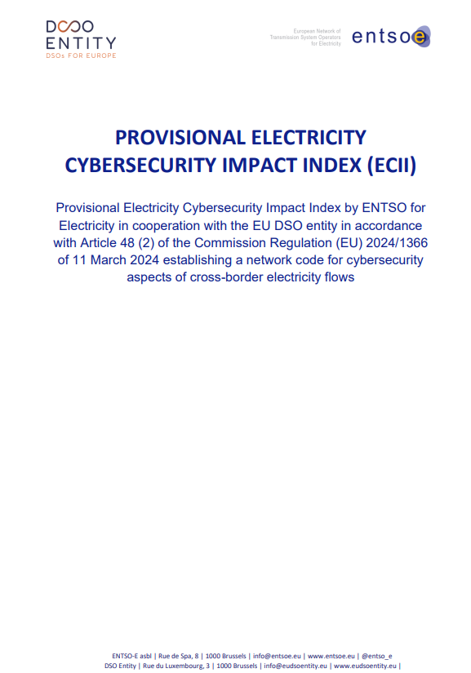
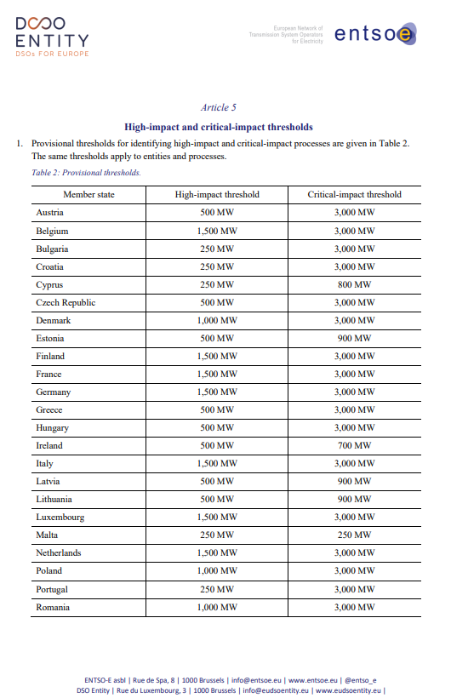
Q#2 Potential Impact?
https://www.entsoe.eu/network_codes/nccs/
Provisionnal process list
Critical-Impact
Processes
High-Impact
Processes
Low-Impact
Processes
Monitoring and control of the distribution grid
Congestion management for the distribution grid
Human Ressources
Management
Operational monitoring and control of the distribution grids by the DSOs through their SCADA system, and the attached substation automation and distribution automation systems.
Includes: maintenance + installation, updates, configuration changes during operations, and decommissioning + servers, databases, and virtualization platforms.
Active management of the load or generation on the distribution grid to ensure that the power on the grid stays within the capacity. This includes the use of demand response or curtailment of generation
…..
Maximum electrical power (load and generation) connected to the distribution grid that can be controlled through the DSO SCADA system.
Maximum electrical power (load and generation) of the devices that can be controlled for congestion management.
End 2024: Provisional electricity cybersecurity Impact Index
~2026: Union-wide risk assessment (Final / mandatory)
ECII
High Impact: >1500 MW to ≤3000 MW
High Impact: > 1500 MW
Critical Impact: More than 3000 MW

Slide 26
Q#2 Potential Impact?
Critical-Impact
Processes
High-Impact
Processes
Low-Impact
Processes
2
2
2
Critical-impact
Perimeter
3
Perimeter
Art.26.4 During the cybersecurity risk assessment phase, each high-impact and critical-impact entity shall […]
(c) classify assets according to the possible consequences when cybersecurity is compromised and determine the high- impact and critical-impact perimeter using the following steps:
  (iv) define the high-impact and critical-impact perimeters containing all high-impact and critical-impact assets respectively, so that access to the perimeters may be controlled;
Perimeter
Art.26.4 During the cybersecurity risk assessment phase, each high-impact and critical-impact entity shall […]
(c) classify assets according to the possible consequences when cybersecurity is compromised
Low-imapct
Perimeter
High-impact
Perimeter

Slide 27
Q#2 Potential Impact?
Article 5
Determination of the potential impact of the cyber-attack
[Entities] shall determine the potential impact of the cyber-attack as follows:
  Low potential impact: Any asset affected by the cyber-attack belongs to neither high-impact nor critical-impact perimeter and cannot directly reach any assets in a high-impact or critical-impact perimeter.
  High potential impact:
    At least one asset affected by the cyber-attack belongs to the high-impact perimeter and none of them belongs to the critical-impact perimeter, or
    At least one asset affected can directly reach one asset belonging to the high-Impact perimeter and not the critical-impact perimeter.
  Critical potential impact: At least one asset affected by the cyber-attack belongs to the critical-impact perimeter or can directly reach an asset belonging to the critical-impact perimeter.
Art.4
Malicious
Event
Yes or
Not sure
Cyber-
attack
Art.5
Potential
Impact
High
or
Critical
No
Low
Not reportable
To be repeated - every change (Art. 7.3)
Critical-impact
Perimeter
1
2
1
5
3
5
4
4
2
3
Low-impact
Perimeter
High-impact
Perimeter

Slide 28
Cyber-attack Classification Scale Methodology
Article 37 (8)
The TSOs, with the assistance of the ENTSO for Electricity, and in cooperation with the EU DSO entity shall develop a cyber-attack classification scale methodology by 13 June 2025. The TSOs, with the assistance of the ENTSO for Electricity and the EU DSO entity may request the competent authorities to consult ENISA and their competent authorities responsible for cybersecurity for assistance in the development of such classification scale.
4
1
The methodology shall provide the classification for the gravity of a cyber-attack according to five levels, the two highest levels being ‘high’ and ‘critical’. The classification shall be based on the assessment of the following parameters:
  (a) the potential impact considering the assets and perimeters exposed determined in accordance with Article 26(4), point (c); and
  (b) the severity of the cybersecurity incident.
2
3

Slide 29
Q#3 Severity?
Article 6
Estimation of the severity of the cyber-attack
The [Entity] shall estimate the severity of the cyber-attack:
  A cyber-attack with low severity means that the attacker is trying to get access to one or more assets.
  A cyber-attack with a high severity means that the attacker has at least limited access to one or more assets which could lead to a critical severity;
  A cyber-attack with a critical severity means that more than one asset is impacted by lateral movement, or the attacker appears to be able to interrupt the process or perpetuate actions on one or multiple assets to destabilise the entity;
Position in the kill chain
Art.4
Malicious
Outlook / worst case scenario
Event
Yes or
Not sure
Cyber-
attack
Art.5
Potential
Impact
High
or
Critical
Art.6
Severity
High
or
Critical
No
Low
Low
Not reportable
To be repeated - every change (Art. 7.3)

Slide 30
Cyber-attack Classification Scale Methodology
Article 37 (8)
The TSOs, with the assistance of the ENTSO for Electricity, and in cooperation with the EU DSO entity shall develop a cyber-attack classification scale methodology by 13 June 2025. The TSOs, with the assistance of the ENTSO for Electricity and the EU DSO entity may request the competent authorities to consult ENISA and their competent authorities responsible for cybersecurity for assistance in the development of such classification scale.
4
1
The methodology shall provide the classification for the gravity of a cyber-attack according to five levels, the two highest levels being ‘high’ and ‘critical’. The classification shall be based on the assessment of the following parameters:
  (a) the potential impact considering the assets and perimeters exposed determined in accordance with Article 26(4), point (c); and
  (b) the severity of the cybersecurity incident.
2
3

Slide 31
Q#4 the gravity (result of the Q#1-3)
Position in the kill chain
Inform Autority
Art.4
Malicious
Outlook / worst case scenario
4h
Event
Yes or
Not sure
Art.5
Potential
Impact
Art.6
Severity
Art.7
Incident
Gravity
Inform SPOC
No
Cyber-
attack
High
or
Critical
High
or
Critical
High or
Critical
Low
Low
To follow
Medium or
Important
Reportable Cyber-Attack
Not reportable
To be repeated - every change (Art. 7.3)

Slide 32
Cyber-attack Classification Scale Methodology
Article 37 (8)
The TSOs, with the assistance of the ENTSO for Electricity, and in cooperation with the EU DSO entity shall develop a cyber-attack classification scale methodology by 13 June 2025. The TSOs, with the assistance of the ENTSO for Electricity and the EU DSO entity may request the competent authorities to consult ENISA and their competent authorities responsible for cybersecurity for assistance in the development of such classification scale.
4
1
The methodology shall provide the classification for the gravity of a cyber-attack according to five levels, the two highest levels being ‘high’ and ‘critical’. The classification shall be based on the assessment of the following parameters:
  (a) the potential impact considering the assets and perimeters exposed determined in accordance with Article 26(4), point (c); and
  (b) the severity of the cybersecurity incident.
2
3

Slide 33
Questions
4

Slide 34
Public consultation questions
Topic | Question
Completeness | Title 2 describes the methodology for determining if a cyber attack is reportable under the NCCS. Is the methodology clear and does it meet all requirements and objectives for the cyber-attack classification scale methodology in the NCCS? If not, please explain how the cyber-attack classification scale methodology can be improved.
Generic | Do you consider that your internal CSIRT understand the CACS methodology for operational use? If not, what is unclear?
Generic | During a crisis, do you think your operational team under pressure, will be able to use it without any issue? If not, please explain what can be improved.
Estimation of the root cause | Is the estimation of the root cause clear? If not, please explain how the estimation of the root cause can be improved.
Determination of the potential impact of the cyber attack | Is the determination of the potential impact clear? If not, please explain how it can be improved.
Estimation of the severity of the cyber-attack | Is the estimation of the severity clear? If not, please explain how it can be improved.
Cyber-attack gravity classification | Is the definition of the gravity clear? If not, please explain how it can be improved.
Process diagram and matrix | Annex I contains the diagram of the classification process and the gravity matrix. the diagrams clear, complete and at the right level of detail? If not, please explain which fields you would like to add or remove.
Other | Do you have any other comments on the cyber-attack classification scale methodology?

Slide 35
Next steps
5

Slide 36
Agenda from now to the submission
Oct – Nov 2024 : Stakeholder consultation (ACER, ENISA, NCCS-NCA, CSIRTS,…)
Dec 2024 : work on the Feed-back / comments
Jan - Feb 2025: Public consultation (Jan-14 to Feb-14)
March – June (around) 2025: ENTSO-E & DSO Entity finalisation & approval
13 June 2025: Final submission
June-July (around) 2025: approval by NCCS-NCAs

