Slide 1
NCCS – Public consultation on risk assessment methodologies

Slide 2
Organisation details
Workshop planning: 1.5 hours
1h presentations & 30 min Q&A session
All participants are muted and turn the camera on only when speaking
The session will be recorded
All the questions and comments received in the MT chat will be considered after the workshop
During the Q&A the participants can raise the hand to ask a question / make a comment

Slide 3
General Background
1

Slide 4
Why a network code on Cybersecurity (NCCS)?
1
Electricity is vital for European citizens and businesses
2
The interconnected European electricity grid is unique
3
The digitalisation is creating new risks and vulnerabilities
Notes:
Why do we need a network code on cybersecurity?
Firstly, security of electricity supply has an outstanding importance for all European citizens, societies and industrial sectors. The ongoing transition of the electricity sector towards decarbonization, decentralization and digitization requires additional measures to safeguard security of electricity supply in the years to come.
Secondly, the intercontinental European electricity grid has a unique characteristic, as through cascading effects in case of a cyber-attack, each EU Member State could be affected by the weakest actor.
Finally, the digitalization of legacy systems used in the electricity sector is creating new risks and new vulnerabilities in an increasingly complex environment. It is therefore clear that prevention and management of electricity crises related to cyber-attacks require a common framework of rules and coordinated procedures, allowing EU Member States and other actors of the electricity sector to coordinate their cybersecurity efforts and solidarity across borders.
In this context, the EU adopted the NCCS, which is part of a wider EU effort to promote digitalized, green and resilient energy systems.

Slide 5
What is the NCCS' Regulatory Background?
Delegated Act by the European Commission → directly applicable and legally binding in all EU Member States.
NCCS lays down sector-specific rules for cybersecurity aspects of cross-border electricity flows.
NCCS complements other European cyber security legislations (e.g. NIS-2), whenever cross-border electricity flows are concerned.
Notes:
The NCCS is a European regulation, adopted as a delegated act by the European Commission, which is directly applicable and legally binding in all EU Members States.
It complements other European cyber legislations regarding the electricity sector (e.g. the NIS-2 Directive), whenever cross-border electricity flows are concerned.

Slide 6
Which entities are in scope of the NCCS?
(Article 2)
NIS 2
Producers
The code shall apply to:
High-impact entities: entity that carries out a process with a high electricity cybersecurity impact
Critical-impact entities: entity that carries out a business process with a critical electricity cybersecurity impact
Suppliers
DSOs
No measures
TSOs
NEMOs
Aggregators
Classification by Competent Authority (Article 24)
Demand response providers
Storage providers
High-impact entities
Operators of recharging points
Electricity
Balancing responsible parties
Organized market places
ENTSO-E
DSO entity
RCCs
Critical-impact entities
ICT
Critical ICT service providers
MSSPs
Others through delegation
Notes:
The NCCS’ obligations apply to entities defined as “high-impact” or “critical-impact entities” the classification of which depends on how severely a potential cyber-attack affecting the entity’s processes and related assets could compromise cross-border electricity flows.
To assess this impact, the NCCS provides the basis for specific methodologies with thresholds and parameters in order to identify the processes, supporting assets and operating entities that could possibly affect cross-border electricity flows.
Potential actors from the electricity sector that might, in principle, qualify as high-impact or critical-impact entity are listed in Art. 2.(Read some of them out loud) The entities involved in the delivery of those processes will then be obliged to implement the obligations set out in the NCCS.

Slide 7
Who is responsible for the governance of the NCCS?
National Level:
Regional Level:
EU Level:
National Competent Authorities (NCAS)
Regional Coordination Centers (new)
ENTSO-E
DSO ENTITY
National Regulatory Authorities (NRAs)
ACER
NIS Competent Authorities
ENISA
Competent Authorities for Risk Preparedness (RP-NCAs)
Dg energy
Competent Authorities Responsible for Cybersecurity (CS-NCAs)
Dg connect
Computer Security Incident Response Teams (CSIRTs)
NEMOS
Energy related bodies
Cybersecurity related bodies
Notes:
The implementation and execution of the NCCS involves various authorities and institutions at national and European level.
Each EU Member State must designate a national authority in charge of the NCCS. This authority is called the NCA (National Competent Authority for the NCCS). The respective NRA (National Regulatory Authority) for energy acts as NCA by default and may delegate powers to other national authorities. All 27 NCAs will jointly approve the Terms, Conditions and Methodologies foreseen under the NCCS, such as the High-impact and Critical-impact processes.
At regional level, the Regional Coordination Centers will be involved in the NCCS tasks.
At European level, ENTSO-E and DSO Entity are responsible for proposing Terms, Conditions and Methodologies foreseen in the NCCS, as well as prepare reports and cybersecurity exercise scenarios. ACER, supported by ENISA, monitors the proposals approved by all NCAs together.

Slide 8
Which cybersecurity aspects does the NCCS cover?
Cyber Risk Assessment
Supply Chain Security
Common Electricity Cybersecurity Framework
Information Sharing
Notes:
The NCCS's main objective is to guarantee the security and resilience of cross-border electricity flows, while also fostering collaboration on cybersecurity matters in the electricity sector among EU Member States.
To achieve this, the NCCS addresses several key areas, including:
The performance of cyber risk assessments
The definition and implementation of minimum and advanced cybersecurity controls
The development of supply chain security recommendations
The sharing of information in case of cyber-attacks, vulnerabilities or threats

Slide 9
How and until when will the NCCS be implemented?
2024 | 2025 | 2026 | 2027 | 2028 | 2029 | 2030 | 2031 | 2032 | 2033
YEAR 1 |  | YEAR 2 |  | YEAR 3 |  | YEAR 4 |  | YEAR 5 |  | YEAR 6 |  | YEAR 7 |  | YEAR 8 |  | YEAR 9
DEVELOP
Provisional documents (ECII, Processes and standards) –Art. 48
Competent authority designation -Art.4
DEVELOP
APPROVE
Risk assessment methodologies –Art.18(1)/8
DEVELOP
APPROVE
Union-wide risk assessment (including ECII & Thresholds) –Art.19
HI/CI entities notification –Art.24(6)
Entity risk assessment –Art.27(1)
Develop
IS Common Tool Feasibility study –Art.37(9)
Member State risk assessment –Art.20(2)
DEVELOP
APPROVE
Cyber-attack classification scale methodology –Art.37(8)
Regional risk assessment –Art.21(2)
APPROVE
Regional risk mitigation plan –Art.22(1)
APPROVE
Cross border risk assessment report –Art.23(1)
APPROVE
Minimum and advanced cybersecurity controls –Art.29(1)
included supply chain controls –Art.28(4)
APPROVE
Proposal for the ECSMM –Art.34(1)
Implement minimum and advanced cybersecurity controls – Art.29(1) + supply chain
Cybersecurity management system – Art.32(1)
Demonstrate compliance – Art.31(1)
X
European level
Incident, threat & vulnerability sharing framework -Art.37 & 38
X
NATIONAL LEVEL
Develop
develop
Crisis management and Response plan -Art.41
X
Entity level
SCENARIO
PREPARATION
EXERCISE
Entity or national exercises -Art.43
SCENARIO
PREPARATION
EXERCISE
Regional or cross-regional exercises -Art.44
Notes:
The NCCS will introduce robust cybersecurity measures and effective methodologies to mitigate the risks related to cross-border electricity flows.
These are the main milestones of the NCCS’ implementation process::
Before the end of 2024 the NCAs should be designated in each EU Member State. And at the beginning of 2025, the provisional ECII & thresholds should let them designate the first high-impact & critical-impact entities. These entities can on voluntary basis, start applying the NCCS.
In 2028, high-impact & critical-impact entities will be officially notified, according to the result of the first Union wide risk assessment.
These entities will have to perform during the first year a risk assessment, that NCAs will use as input to consolidate a national risk assessment. In 2027, minimum and advanced cybersecurity controls will be defined and approved by NCAs and high-impact & critical-impact entities will have to implement them in 2028 through a cybersecurity management system that will have to be verified for critical-impact entities in 2030.
Cybersecurity exercises will be organised at entity or national level in 2028, and at regional or cross-regional level in 2029 and every three years thereafter.

Slide 10
Risk Assessment Processes
2

Slide 11
Cybersecurity risk assessment cycle
Union-wide cybersecurity risk assessment
(Art. 19)
Definition of minimum and advanced cybersecurity controls (Art. 29, 33)
Union-wide risk assessment report
ECII and thresholds to identify high-impact entities & critical-impact entities
Union-wide high-impact processes and critical-impact processes
Comprehensive cross-border electricity cyber security risk assessment report (Art. 23)
Regional cybersecurity risk assessment
(Art. 21)
Regional cybersecurity risk assessment report
Regional cybersecurity mitigation plan (Art. 22)
Identification of high-impact entities and critical-impact entities
(Art. 24)
Member State cybersecurity risk assessment (Art. 20)
Member State cybersecurity risk assessment report
Entity level risk assessment report
Cybersecurity risk management at entity level
(Art. 26)
List of selected controls
Risk estimate for high-impact and critical-impact processes – risk impact matrix
List of critical ICT service providers for critical-impact processes
Notes:
This is an overview of all the risk assessment processes that are defined in the network code, and the outcomes of each process.
The assessments for all the levels shall :
Evaluate the possible consequences of cyber-attacks affecting the operational security of the electricity system and disrupting cross-border electricity flows
not consider the legal, financial or reputational damage of cyber-attacks.

Slide 12
Cybersecurity risk assessment cycle
RISK ASSESMENT METHODOLOGIES
Union-wide cybersecurity risk assessment
(Art. 19)
Definition of minimum and advanced cybersecurity controls (Art. 29, 33)
Union-wide risk assessment report
ECII and thresholds to identify high-impact entities & critical-impact entities
Union-wide high-impact processes and critical-impact processes
Comprehensive cross-border electricity cyber security risk assessment report (Art. 23)
Regional cybersecurity risk assessment
(Art. 21)
Regional cybersecurity risk assessment report
Regional cybersecurity mitigation plan (Art. 22)
Identification of high-impact entities and critical-impact entities
(Art. 24)
Member State cybersecurity risk assessment (Art. 20)
Member State cybersecurity risk assessment report
Entity level risk assessment report
Cybersecurity risk management at entity level
(Art. 26)
List of selected controls
Risk estimate for high-impact and critical-impact processes – risk impact matrix
List of critical ICT service providers for critical-impact processes
Notes:
Nine months after the entry into force of the NCCS, ENTSO-E and EU-DSO entity shall submit a proposal for the cybersecurity risk assessment methodologies at 3 different levels :
Union level, regional level and Member State level. This is what we are asking your opinion on in this public consultation.

Slide 13
Cybersecurity risk assessment methodologies (Art. 18)
f
Timeline
Levels
Outcome
13 March 2025
ENTSO-E
in cooperation with DSO Entity
in consultation with the NIS Cooperation group
Union-wide
Cybersecurity risk assessment methodologies at Union, regional and member state level shall include:
Regional
A list of cyber threats to be considered, including supply chain threats
Member State
The criteria to evaluate the impact of cybersecurity risks as high or critical using defined thresholds for consequences and likelihood
An approach to analyse the cybersecurity risks coming from legacy systems, the cascading effects of cyber-attacks and the real-time nature of systems operating the grid
An approach to analyse the cybersecurity risks coming from the dependency on a single supplier of ICT products, ICT services or ICT processes
A risk impact matrix to measure the consequences and likelihood of a cyber-attack
Notes:
The cybersecurity risk assessment methodologies shall include
A list of cyber threats to be considered
The criteria to evaluate the impact of cybersecurity risks as high or critical using defined thresholds for consequences and likelihood
An approach to analyse the cybersecurity risks coming from legacy systems, the cascading effects of cyber-attacks and the real-time nature of systems operating the grid
An approach to analyse the cybersecurity risks coming from the dependency on a single supplier of ICT products, ICT services or ICT processes.
The cybersecurity risk assessment methodologies shall assess cybersecurity risks using the same risk impact matrix.
This matrix shall measure the consequences of cyber-attacks and the likelihood of an incident

Slide 14
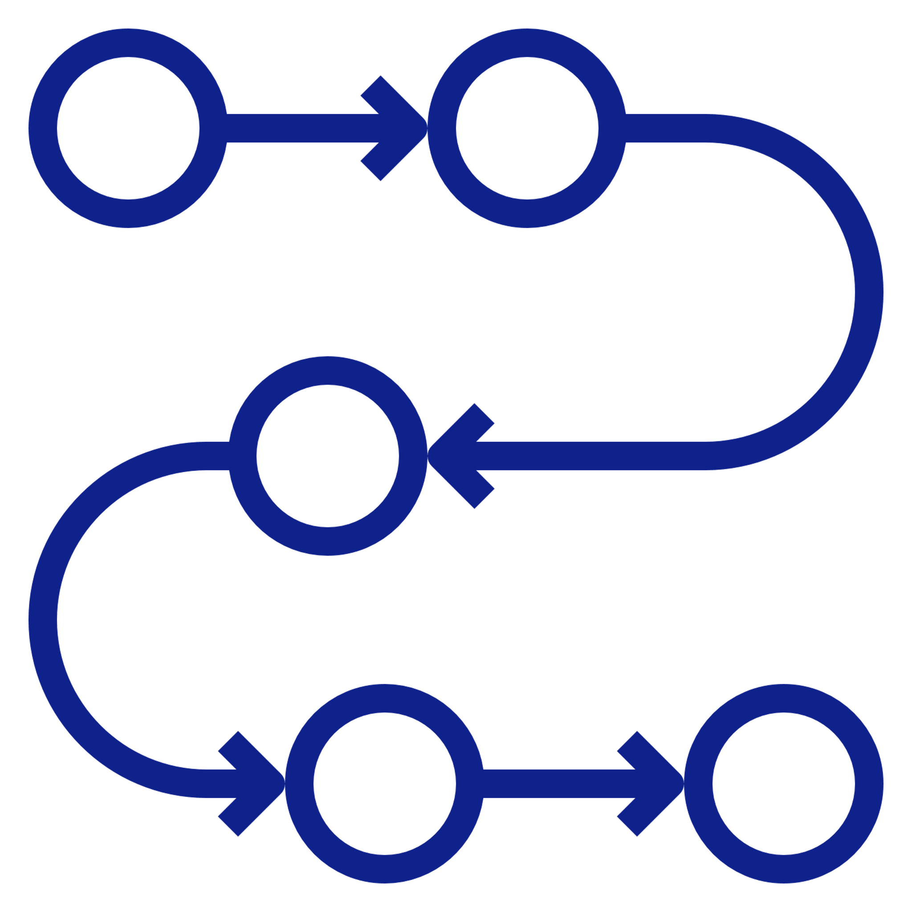
Union-wide cybersecurity risk assessment (Art. 19)
f
Timeline
STEPS of the PROCESS
Outcome
Mid-June 2026
Every 3 years
Identify processes that could affect the operational security of the electricity system;
Union-wide cybersecurity risk assessment report:
Risk impact matrix
High-impact and critical-impact processes with:
Assessment of consequences of possible cyberattacks
Electricity cybersecurity impact index (ECII)
High-impact and critical-impact thresholds
Determine the consequences of a cyber-attack
Identify the Union-wide high-impact and critical-impact processes
Define the ECII and high-impact and critical-impact thresholds
Notes:
The first cybersecurity risk assessment to perform is at Union-wide level and also to draw up a draft Union-wide cybersecurity risk assessment report. It corresponds to the Article 19 of the NCCS.
This action has to be done within 9 months after the approval of the risk assessment methodologies and every three years thereafter.
The goal is to identify, analyse, and evaluate the possible consequences of cyber-attacks affecting the operational security of the electricity system and disrupting cross-border electricity flows.
The Union-wide cybersecurity risk assessment consists of four steps:
identify processes at the electricity sector level that could affect the operational security of the electricity system;
determine the possible consequences of a cyber-attack compromising the confidentiality, integrity or availability of the information used in them;
identify the Union-wide high-impact and critical-impact processes; and
define the Electricity Cybersecurity Impact Indices (ECII) and high-impact and critical-impact thresholds.
The Union-wide cybersecurity risk assessment results are formalized in a report that contains the following information:
the Union-wide high-impact processes and the Union-wide critical-impact processes;
a risk impact matrix
an assessment of the possible consequences of a cyber-attack
the ECII and high-impact and critical-impact thresholds

Slide 15
Identification of high-impact and critical-impact entities
(Article 2)
NIS 2
Producers
Union wide cybersecurity risk assessment report (Art 19)
Electricity cybersecurity impact index (ECII)
High-impact & Critical-impact thresholds
Suppliers
DSOs
No measures
TSOs
NEMOs
Aggregators
Classification by Competent Authority (Article 24)
Demand response providers
Storage providers
High-impact entities
Operators of recharging points
Electricity
Balancing responsible parties
Organized market places
ENTSO-E
DSO entity
RCCs
High-impact and critical-impact entities can be:
Entities in Member State
Non-EU entities active in Member State
Entities that fall in scope due to aggregated risk
Critical-impact entities
ICT
Critical ICT service providers
MSSPs
Others through delegation
Notes:
Each competent authority shall identify, by using the ECII and high-impact and critical-impact thresholds included in the Union-wide cybersecurity risk assessment report, the high-impact and critical-impact entities in its Member State that are involved in the Union-wide high-impact and critical-impact processes.
Each competent authority shall, within nine months after being notified by ENTSO-E and EU DSO entity of the Union-wide cybersecurity risk assessment report, and in any case no later than 48 months after entry into force, notify to the entities on the list that they have been identified as a high-impact or critical-impact entity

Slide 16
Entity cybersecurity risk assessment (Art. 26 and 27)
f
Timeline
STEPS of the PROCESS
Notification of high and critical-impact entities + 12 months
Every 3 years
Defining the scope: High-impact processes, critical-impact processes or other processes
Evaluating cybersecurity risks by prioritizing them
Defining the criteria for risk evaluation and acceptance in accordance with the risk impact matrix (Art. 19)
Establishing an entity-level risk mitigation plan
Deciding whether to accept the residual risk based on risk acceptance criteria
Identify cybersecurity risks by considering cyber threats, vulnerabilities, cyber-attack scenarios, Union-level risk evaluations
responsible
Outcome
Critical-impact entity
High-impact entity
Analyzing likelihood and consequences of cybersecurity risks using risk impact matrix
Entity-level cybersecurity risk assessment report:
List of controls and status
Estimate of the risks according to impact matrix
List of critical ICT service providers (for critical-impact processes)
Classify assets according to consequences of a compromise and determine high-impact and critical-impact perimeter using the ECII

Slide 17
Member State cybersecurity risk assessment (Art. 20)
f
Timeline
input
Outcome
Mid-March 2030
Every 3 years
High-impact and critical-impact entities’ risk assessment reports
Risk preparedness plan (Art.10 (EU)2019/941)
Member state cybersecurity risk assessment report:
For each high-impact and critical-impact business process:
Implementation status of minimum and advanced cybersecurity controls
Cyberattacks reported in the previous three years
Summary of the cyber threat information
Estimate of the risks of a compromise of the confidentiality, integrity and availability for information and relevant assets
Additional entities identified as high-impact or critical-impact
STEPS of the PROCESS
responsible
Determining the implementation status of the minimum and advanced cybersecurity controls
Competent Authorities (NCCS-NCAs)
Competent Authorities for Cybersecurity (CS-NCAs)
* ENTSO-E and DSO Entity may request additional information
Aggregating the risk analysis results from the risk assessments at entity level
Summarizing the information on cyberattacks and threats gathered
Recommending additional cybersecurity controls
Notes:
Within 21 months after the notification of the high-and critical-impact entities and every three years after that date, and after consulting the CS-NCA responsible for electricity, each competent authority, supported by the CSIRT, shall provide a Member State cybersecurity risk assessment report to the ENTSO for Electricity and the EU DSO entity.
The goal of the member state cybersecurity risk assessment is to identify, and analyse, the risks of cyber-attacks affecting the operational security of the electricity system and disrupting cross-border electricity flows in one member state.
The cybersecurity risk assessment at member state level consists of four steps:
determine the implementation status of the minimum and advanced cybersecurity controls;
aggregate the risk analysis results from the risk assessments at entity level to determine the consequences and likelihood of a compromise of the confidentiality, integrity or availability of the information used in them;
summarize the information on cyber-attacks and threats gathered pursuant Article 38(3) and (6) of the NCCS; and
recommend additional cybersecurity controls to mitigate high and critical risks to ENTSO-E and DSO Entity.
The member state cybersecurity risk assessment results are formalized in the member state cybersecurity risk assessment report.
The information needed to perform the member state level risk assessment is derived from the entity level cybersecurity risk assessments. In particular, all high-impact and critical-impact entities will report to their competent authority the identified risks according the same risk impact matrix, defined during the Union-wide risk assessment.
The competent authority will aggregate the risks derived from the entity level cybersecurity risk assessments to assess the overall risk in the member state.

Slide 18
Regional cybersecurity risk assessment (Art. 21)
f
Timeline
STEPS of the PROCESS
input
Mid-December 2030
Every 3 years
Aggregating the risk analysis derived from the member state RCA
Union-wide cybersecurity risk assessment reports
Member State cybersecurity risk assessment reports
Regional electricity crisis scenarios (Art. 6 (EU)2019/941)
Evaluating these risks analysed in the previous step
responsible
Determining the cybersecurity threats that lead to high and critical risks;
Outcome
TSOs (with ENTSO-E)
in cooperation with DSO Entity
in consultation with relevant Regional Coordination Centre
Determining minimum and advanced cybersecurity controls to mitigate the risks;
Regional cybersecurity risk assessment report (for each system operation region):
Identify, analyse, and evaluate the risk of cyber-attacks affecting the operational security of the electricity system and disrupting cross-border electricity flows
Determining the applicability of the min. and adv. cybersecurity controls to SOR
Notes:
The regional cybersecurity risk assessment is the last step in the risk assessment cycle.
Within 30 months after the notification of the high-and critical-impact entities and every three years after that, ENTSOE & EU DSO entity and in consultation with the NIS Cooperation Group, shall draw up a regional cybersecurity risk assessment report for each system operation region.
While the Union-wide risk assessment only considers consequences, the goal of the regional risk assessment is to identify, analyse, and evaluate the risks of cyber-attacks affecting the operational security of the electricity system and disrupting cross-border electricity flows.
The regional risk assessment is the basis for several other documents:
The regional risk mitigation plans (Article 22 of the NCCS)
The comprehensive cross-border electricity cybersecurity risk assessment report (Article 23 of the NCCS)
Updates of the minimum and advanced cybersecurity controls (Article 29), including the controls in the supply chain (Article 33)
Cybersecurity procurement recommendations (Article 35).
The regional cybersecurity risk assessment consists of five steps:
aggregate the risk analysis derived from the member state risk cybersecurity assessments to determine the consequences and likelihood of a compromise of the confidentiality, integrity or availability of the information used in them;
evaluate these risks analysed in the previous step ;
determine the cybersecurity threats that lead to high and critical risks;
determine minimum and advanced cybersecurity controls to mitigate the risks;
determine the applicability of the minimum and advanced cybersecurity controls to system operations regions.

Slide 19
Regional cybersecurity risk mitigation plans (Art. 22)
f
Timeline
SUBMITTED TO
By 2030/2031
Every 3 years
TSOs
National competent authorities
Electricity Coordination Group (can propose amendments)
responsible
Outcome
TSOs (with ENTSO-E)
in cooperation with EU DSO entity
in consultation with Regional Coordination Centres and the NIS Cooperation Group
Regional cybersecurity risk mitigation plan (for each system operation region):
Identify, analyse, and evaluate the risk of cyber-attacks affecting the operational security of the electricity system and disrupting cross-border electricity flows
Notes:
ENTSOE shall submit the regional risk mitigation plans to the relevant transmission system operators, to the competent authorities, and to the Electricity Coordination Group who may recommend amendments
The TSOs, with the assistance of ENTSOE & EU DSO entity and in consultation with the NIS Cooperation Group shall update the regional risk mitigation plans every three years

Slide 20
Comprehensive cross-border electricity cybersecurity risk assessment report (Art. 23)
f
Timeline
SUBMITTED TO
By 2031
Every 3 years
Electricity Coordination Group
Outcome
Regional cybersecurity risk mitigation plan (for each system operation region):
Union-wide high-impact and critical-impact processes
Current cyber-threats
Cyber-attacks at union level
Implementation status of cybersecurity measures and information flows
Supply chain risks
Results from regional and cross-regional exercises
responsible
TSOs (with ENTSO-E)
In cooperation with EU DSO entity
in consultation with the NIS Cooperation Group
in consultation with entities in scope of NCCS

Slide 21
Next steps
Workshop recording will be available on ENTSO-E’s website
2nd Workshop: December 2nd between 9:00 and 10:30 am CET
Public consultation will close on December 5th 2024
Feedback on public consultation comments to be expected in January 2025
Document will undergo internal finalisation at ENTSO-E and DSO Entity and allTSO approval
Legal deadline on 13th March 2025

Slide 22
Thank you
To learn more about NCCS, please visit the ENTSO-E website and YouTube channel.

