Slide 1


v
Uniting Europe's Energy, Today
Electricity Integration Package: status of transposition and verification
and Impact of CBAM on cross-border trades
Update by
Energy Community Secretariat
44th MESC Meeting
11 June 2026

Slide 2
Electricity Integration Package: status of the transposition and verification
EnC Countracting Party | EIP – status of incorporation into the national legislation |  | Status of verification of the compliant transposition
 | Four legal acts from CEP (ED, ER; ACER and Risk-Preperedness) – adapted versions | Five NC&GL (FCA, CACM, EBGL, SOGL and ER NC) – adapted versions
Albania | Law in the parliamentary procedure | NRA acts aimed to transpose adopted | not yet started
Bosnia and Herzegovina | Law in the parliamentary procedure | pending | not yet started
Georgia | N/A | N/A | N/A
Kosovo* | Laws in the parliamentary procedure | pending | not yet started
Moldova | full transposition notified to EnCS | full transposition notified to EnCS | in progress
Montenegro | full transposition notified to EnCS | full transposition notified to EnCS | in progress
North Macedonia | Law aimed to transpose adopted | drafting | not yet started
Serbia | full transposition notified to EnCS | full transposition notified to EnCS | EC issued opinion with recommendations
Ukraine | Law aimed to transpose adopted | pending | not yet started
Serbia
The European Commission’s opinion with recommendations communicated to Serbia on 14 May 2026.
Monetengro
The European Commission is expected to issue an opinion by mid-October.
Moldova
The European Commission is expected to issue an opinion by the beginning of November.
*This designation is without prejudice to positions on status, and is in line with UNSCR 1244 and the ICJ Advisory Opinion on the Kosovo* declaration of independence.
More information could be found on the electricity market integration webpage: https://www.energy-community.org/topics/electricity/market.html

Slide 3
Athens Electricity Forum – key market-coupling related conclusions
The Forum reconfirmed the accelerated market integration of the Energy Community Contracting Parties in the EU single energy market as a shared priority. Market coupling will be a flagship achievement in this regard.
The EnC Contracting Parties are encouraged to ensure compliant transposition of the Electricity Integration Package to receive a positive opinion under the verification process set up by the Directorate-General for Energy of the European Commission and the Energy Community Secretariat. This will open the 18-month road to Contracting Parties’ adherence into single day-ahead and single intraday coupling (SDAC/SIDC).
The Forum welcomed the work carried out by EU NEMOs to complement the MCO IP with an impact assessment, as well as the information that the MCO IP is planned to be formally resubmitted to ACER in June this year.
Considering the current progress of the transposition and the MCO IP approval timeline, the Forum expressed concern that the next attainable go-live window for EnC Contracting Parties’ integration into SDAC will be shifted to Q1 of 2029.
Detailed conclusions can be found on the following link: https://www.energy-community.org/events/2026/06/AF.html
*This designation is without prejudice to positions on status, and is in line with UNSCR 1244 and the ICJ Advisory Opinion on the Kosovo* declaration of independence.

Slide 4
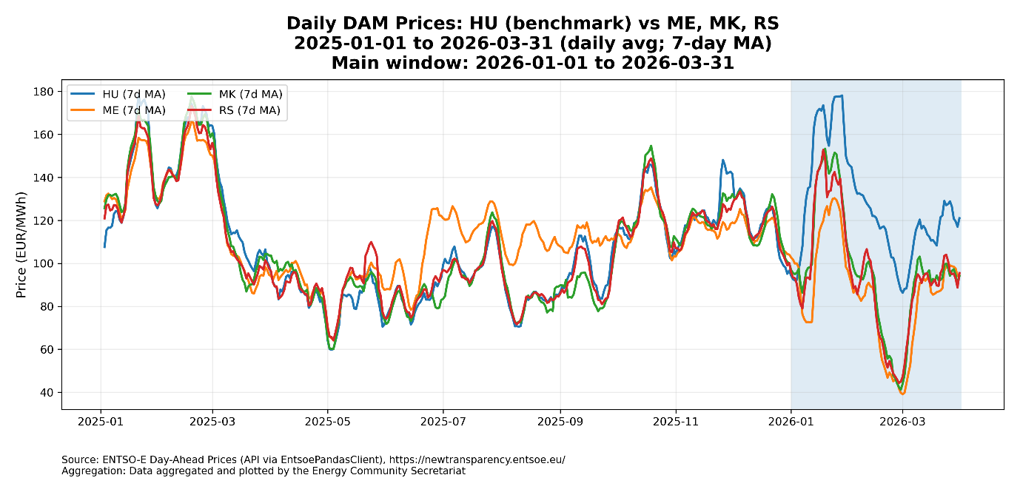
ELECTRICITY MARKET MONITORING Q1 2026
Q1 2026 preliminary CBAM findings – disruption in the regional electricity market
Five findings, one signal: EU–WB6 day-ahead trading disrupted with CBAM entry into force on 1 January 2026.
THE FIVE PRELIMINARY FINDINGS
THE PICTURE: DAILY DAY-AHEAD PRICES, 2025 → Q1 2026
1
Price divergence
EU–WB6 DA spread widened to >30 €/MWh — 2–3× the 2025 level. Capacity allocated, arbitrage not priced in.
2
Loss of price correlation
WB–HU price correlation collapsed from >0.80 to ≈0 in early January; partially recovered at the end of Q1 2026; SEEPEX volumes −11%.
3
WB6-EU trade reduction
Total WB6↔EU trade −25%, driven by EU→WB6 imports collapsing 40.7%; trade rerouted via CBAM-free corridors.
4
Schedule vs physics
Commercial schedules diverged from physical flows: AL→GR scheduled +4,100 MWh/d but physical flows fell.
5
Default factors bite
Albania (zero default factor) became the regional CBAM-free gateway; Montenegro’s 73.78 €/MWh surcharge erased its 43 €/MWh spread.
HU and WB6 zones tracked each other through 2025 (avg spread 5–15 €/MWh). From 1 Jan 2026 alignment broke: HU rose to ~170 €/MWh while WB6 fell to ~40 €/MWh.
HEADLINE NUMBERS
Price spread
Commercial exchange
Price correlation
Default factors
>30 €/MWh
−25%
≈ 0.0
€73.78 vs €0/MWh
Average Q1 2026 EU–WB6 day-ahead spread (2–3× the 2025 average level)
Total WB6↔EU commercial trade vs Q1 2025 (EU→WB6 imports −40.7%)
WB6–HU price correlation in early Jan 2026 (was >0.80 throughout 2025)
CBAM cost in €/MWh: ME exports vs AL exports (Q1 2026 EU ETS price)
Source: ENTSO-E Transparency Platform · Aggregation by the Energy Community Secretariat · Read more

Slide 5
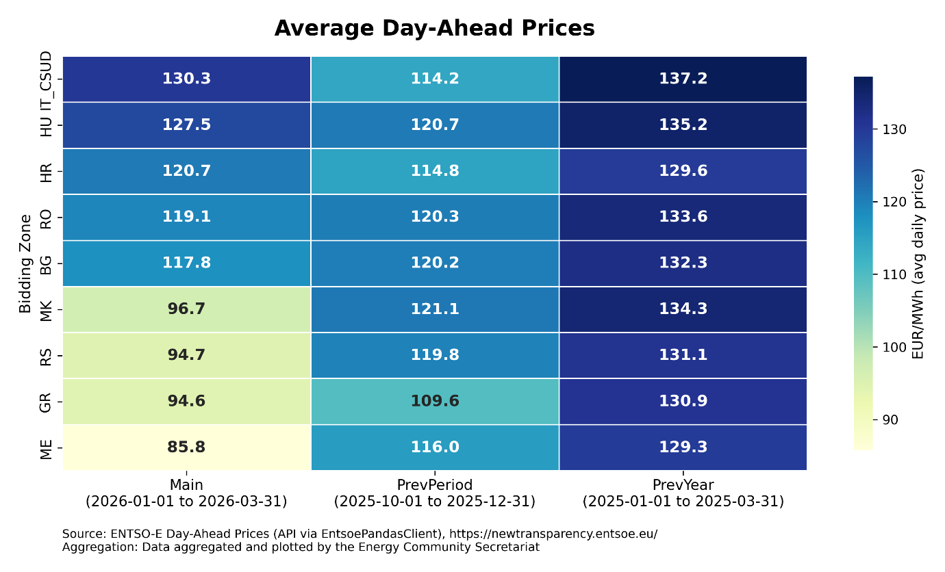
ELECTRICITY MARKET MONITORING Q1 2026
EU neighbours feel the impact — market frictions and system risk
AVERAGE DAY-AHEAD PRICES: EU NEIGHBOURS vs WB6
FROZEN ARBITRAGE: EU MARKETS LOSE ACCESS TO LOW-COST ELECTRICITY
Higher-priced IT, RO, BG, HR and HU could not benefit from cheaper WB6 electricity despite a >€30/MWh spread — 2–3× the 2025 level.
Commercially scheduled WB6↔EU exchanges fell 25% in Q1 2026; EU→WB6 imports collapsed by 40.7%, and transit-based trading via WB6 became commercially unattractive.
Cross-border capacity allocated >95%, yet auction clearing prices did not track the widened day-ahead spreads — the CBAM surcharge absorbed the arbitrage margin.
CASE IN POINT | MONTENEGRO → ITALY (IT-CSUD)
Widest spread in the region: ~€43/MWh favouring exports from Montenegro to southern Italy.
ME default emission factor (0.979) implies a CBAM cost of €73.78/MWh — wiping out the price advantage.
Scheduled flows ME→IT-CSUD fell ~2,100 MWh/day; physical flows fell ~1,400 MWh/day. The Italian market — with gas-driven prices above €130/MWh — got no relief.
OPERATIONAL RISK: SCHEDULES AND PHYSICS DIVERGE
Commercial schedules diverged sharply from physical flows: AL→GR scheduled +4,100 MWh/d, but physical flows fell; loop flows persist along the WB6 South–North corridor.
Withdrawal of commercial transit has not eliminated physical loop flows, only made them less predictable for TSOs. The 2024 ME–AL 400 kV blackout illustrates the stakes.
Higher system-operation costs ultimately translate into higher network tariffs in both EU Member States and Energy Community Contracting Parties.
EU benchmarks at €118–130/MWh; WB6 zones €30/MWh lower — Greece aligned with WB6 on strong hydro.
STRATEGIC
CONCLUSION
The current design of CBAM risks creating barriers precisely when Europe’s energy future needs stronger cross-border cooperation. To keep market integration and decarbonisation reinforcing one another, climate policy and market design must converge through clearer transit rules, fair treatment of renewable exports, alignment with market coupling, and timelines linked to EU accession.
Source: ENTSO-E Transparency Platform · Aggregation by the Energy Community Secretariat · Read more

Slide 6




THANK YOU!
energy-community.org
Energy Community Secretariat
Am Hof 4, Level 5, 1010 Vienna, Austria

