Slide 1
Social welfare benefits assessment
11/06/2026 MESC meeting

Slide 2
Overview
The objective of the project is to estimate the benefits resulting from market integration, and losses due to integration delays.
The purpose of this market monitoring analysis is two-fold:
  quantify the value of market integration (i.e. benefits, delays, and additional welfare deriving from further market integration)
  support a prompt implementation of market integration projects
What is in scope? Approximately 20 projects
How to estimate welfare gains?
Quantitative when possible: TSO results from parallel runs and external sources as preferred option; otherwise, other quantitative assessments (e.g. estimates of cost-saving, in-house simulations, etc.) as alternative option.
Qualitative when necessary: some projects have specific complexities, making the estimate of welfare gains more challenging.
Publication:
November 2026 - ACER Market Monitoring Report

Slide 3
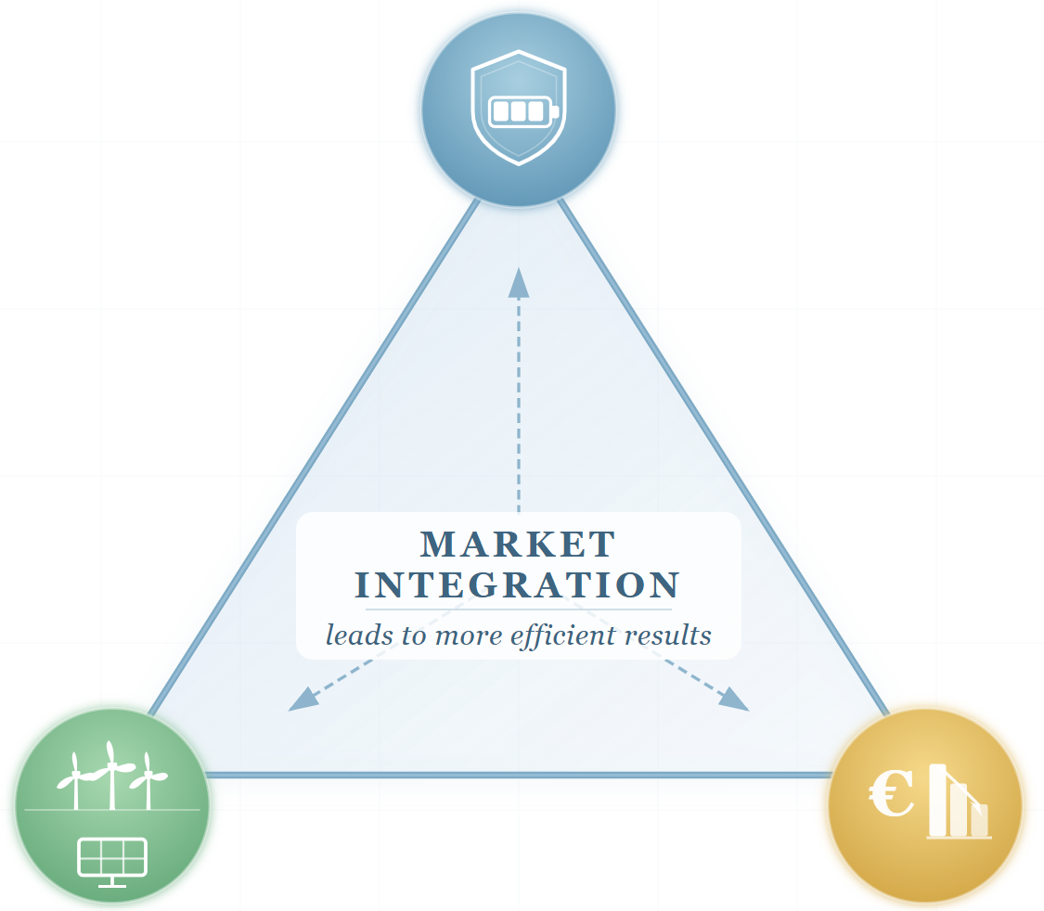
The European market integration process: a keystone of affordable and resilient electricity
In recent years, EU electricity markets have faced multiple challenges, from geopolitical crises to the pandemic, yet have demonstrated strong resilience
Market integration has played a key role in mitigating these impacts by:
  supporting energy affordability
  advancing sustainability goals
  strengthening security of supply
Further unlocking the potential of market integration will enhance the efficiency and performance of EU electricity markets

Slide 4
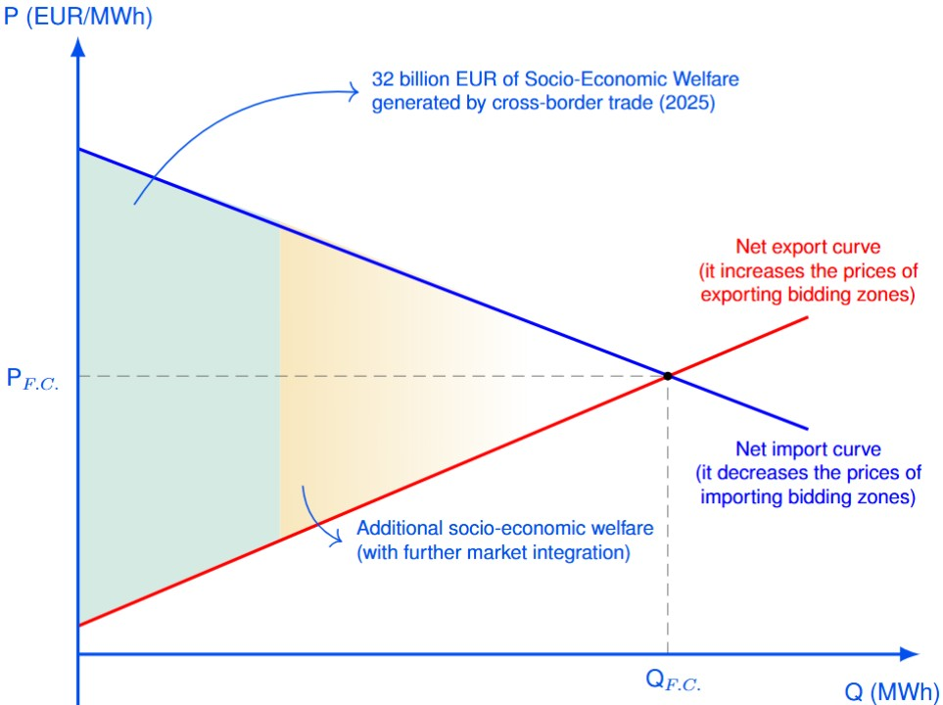
Interpreting socio-economic welfare values
The socio-economic welfare generated by cross-border trade was approximately 32 billion EUR (in 2025)
According to ACER’s assessment, the 10 analysed projects generate approximately 5 billion EUR (~15% of the total value of cross-border trade)
The total value cleared by SDAC (in the order of magnitude of 4 trillion EUR) is not a meaningful comparison with the value generated by cross-zonal trade
Most value in SDAC is generated by matching inflexible consumption and generation, which bid at the cap and floor respectively
As an example, an increase (or decrease) in the maximum (or minimum) clearing price will increase the total value cleared by SDAC, without a material impact on the price formation or the quantity exchanged
Explanatory figure: socio-economic welfare stemming from cross-border trade and market integration
Source: ACER
Note: F.C. stands for Full Convergence
Source: 32 billion EUR was estimated by TSOs and NEMOs as the difference between isolated (zero exchange) and coupled markets (in 2025). “TSOs Interconnect Markets: Benefits of SDAC Market Coupling in 2025”

Slide 5
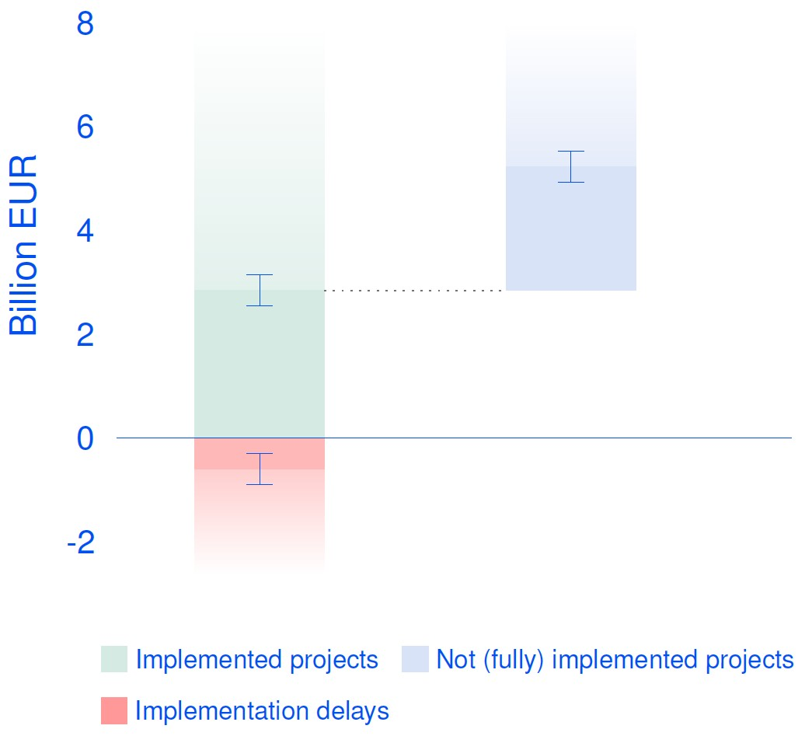
Further unlocking the potential of market integration
Over the past years, a multitude of market integration projects have been delivered, and generate significant benefits every year
On the other hand, implementation delays cause substantial losses, and slow down the market integration process. Prompt implementation of projects is key to avoid welfare losses
There are several projects that are expected to go-live in the upcoming future, which will bring additional benefits and further strengthen the efficiency of the EU internal electricity market
Socio-economic welfare stemming from market integration (10 projects only) – 2025 (billion EUR)
Cumulative losses from 2020 to 2025 ~ 8 billion EUR
Source: ACER
Note: Calculations are based on assumptions, subject to limitations, and are intended to provide only an indicative estimate. Ongoing methodological improvements may result in revisions in future assessments. Moreover, please note that socio-economic welfare is a metric for market efficiency expressed in monetary units and should not be interpreted as actual monetary gains (or losses).

Slide 6
List of market integration projects
10 market integration projects considered:
  Nordic flow-based in SDAC
  Core flow-based in SDAC
  TSOs accession to IGCC
  Market-based allocation (Nordic CCR)
  70% requirement (estimate for Core CCR only)
  TSOs accession to MARI
  TSOs accession to PICASSO
  ROSC-RDCT (Central Europe CCR)
  Integration of Energy Community in SDAC
  Italy North flow-based in SDAC (Central Europe CCR)
The actual list of market integration projects is much longer:
  Long-term flow-based (Core CCR)
  Advanced hybrid coupling (Core CCR)
  15-minute MTUs
  Coordinated validation (Core CCR)
  …
Socio-economic welfare stemming from market integration – 2025 (billion EUR)
Source: ACER
Note: Calculations are based on assumptions, subject to limitations, and are intended to provide only an indicative estimate. Ongoing methodological improvements may result in revisions in future assessments. Moreover, please note that socio-economic welfare is a metric for market efficiency expressed in monetary units and should not be interpreted as actual monetary gains (or losses).

