Slide 1
Measures to increase cross-zonal capacities and flexibility in SEE+
Energy Union Task Force
MESC 10/02/2026
Disclaimer: Work in progress

Slide 2
Introduction to EUTF assessment
Interactions with NRAs, MPs, EUTF:
EUTF task for ACER: explore the feasibility of implementing measures to increase cross-zonal capacities and flexibility
Driven by price spikes in SEE (during summer 2024):
  Primary focus is SEE+; assessing short-term measures to prevent or mitigate their reoccurrence.
Also proposing mid- and long-term measures applicable to the entire EU.
09/12/2025 – CACM TF first discussion
11/02/2026 – AEWG discussion
25-26/02/2026 – Workshop with NRAs on draft assessment
9 March 2026 – EU TF presentation; preliminary assessment
10/02/2026 – MESC discussion
03/12/2025 – MESC introduction to mandate
19/11/2025 – AEWG introduction to mandate
12/01/2026 – AEWG update
End-April 2026 – Delivery of final assessment
27/01/2026 – CACM TF discussion
Interactions with TSOs and RCCs:
  Questionnaire with the TSOs and RCCs in December/
  Discussion with TSOs and RCCs at regular meetings, including sharing of best practices.
    1st working meeting with TSOs and RCCs on 18 December
    2nd working meeting with TSOs and RCCs (30/01)
    3rd working meeting with TSOs and RCCs (23/02)
    4th working meeting with TSOs and RCCs (TBC)
  SEE+: CEE and SEE (i.e. from AT and SK to GR)

Slide 3
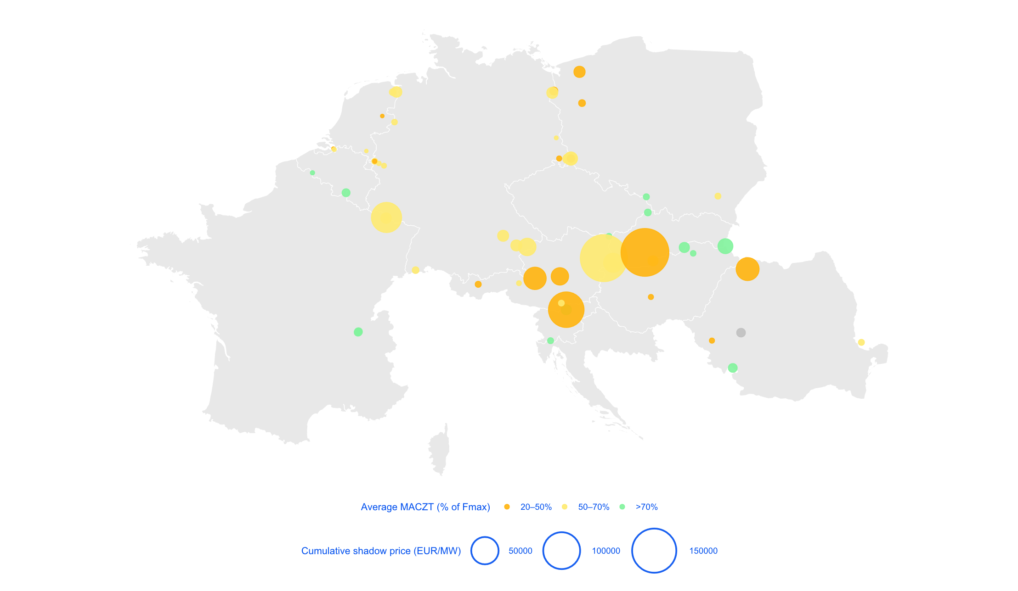
What prevented more exchanges towards SEE?
Network elements in Core flow-based market coupling preventing additional exchanges to CEE-SEE during the evening peaks (18:00 to 22:00 CEST) - July to September 2024
Electricity exchanges within the EU are the outcome of a welfare optimisation, within the limits of the network constraints defined by TSOs.
In Summer 2024, available capacity in several network elements proved insufficient to accommodate the need for exchanges towards SEE.
TSO | Network element | Market impact (EUR/MW) | Average MACZT (% of Fmax)
SK | V.Dur - Levice 1 | 186k | 48%
AT | Neusiedl - Wien Suedost | 180k | 60%
AT-SI | Obersielach - Podlog | 102k | 51%
DE-FR | Ensdorf - Vigy | 68k | 69%
RO | Transf. Rosiori | 36k | 43%
AT | Tauern - Weissenbach | 34k | 47%
Source: ACER calculation based on JAO Publication Tool data.
Note: Market impact is defined by the shadow price (i.e. gain in economic surplus from relaxing a capacity constraint by 1 MW).
MACZT: Margin available for cross-zonal trade.
Interactive map:

Slide 4
Proposed measures: summary table work in progress
# | Group: | Measure: | Short description: | Relevant where:
1 | Low-cost investments | Dynamic line rating | Dynamic line rating (DLR) application in real time. Once available in real time, DLR consideration in capacity calculation. | All
2 | Low-cost investments | Upgrading of conductors | Replacing conductors with high-temperature low-sag (HTLS) technologies to increase ampacity. | All
3 | OPC | Outage planning coordination: adaptable & with capacity calculation | Integrating a dimension of capacity calculation in yearly outage planning coordination (OPC). Introducing flexibility in outage planning in case of severe market congestion on CNECs. | All
4 | CC | Improving 70% derogations | Short term: Dynamic requirements per CNEC and MTU, considering remedial actions potential Medium term: Accelerating ROSC and RDCT Cost Sharing to avoid loop flow-based derogations. | Core
5 | CC | Curative remedial actions in real time and capacity calculation | Curative remedial actions (cRA) to be considered in real time and then modelled in capacity calculation | All
6 | CC | Improved grid modelling | Applying common Net position Forecast (NPF) for IGM building Exchange & usage of most representative individual grid models (IGM) among CCRs Unique common grid model (CGM) at least per synchronous area for capacity calculation | CE, SEE
7 | Infrastructure | Network flexibility investments | PSTs, grid booster batteries, SSSCs | All
8 | Infrastructure | Reprioritise investments | Where needed, reprioritise network investments based on observed congestion | All
9 | 3rd countries | Market coupling extension | Extension of SDAC/SIDC/IDAs to EnC countries | SEE+
10 | Market | General market design improvements | Extending flow-based regions & advanced hybrid coupling at perimeters Structural decrease of excessive loop flows (LT continuation of No. 4) Flow based calculation and allocation at intraday and balancing Removing barriers to participation in wholesale markets (i.e. storage and demand response) | All
Note: In yellow, concrete improvements potentially implemented in the short- and mid-term.

Slide 5
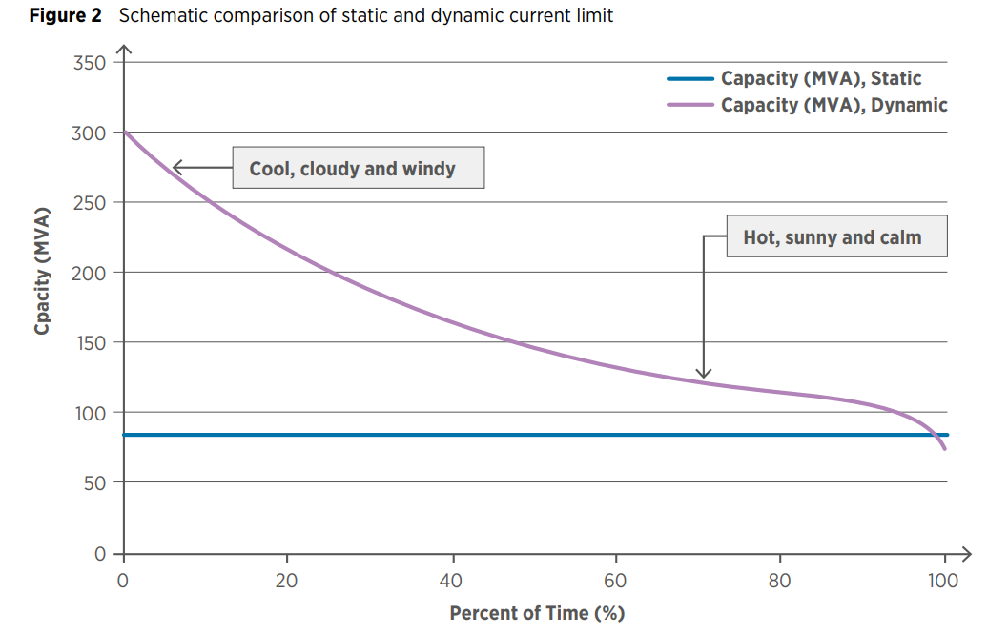
1. Dynamic line rating (DLR)
Background
Traditional static ratings of OHLs are based on conservative estimates and worst-case scenarios.
Under more favourable conditions (such as lower temperatures and higher wind speeds), ampacity can be safely increased.
By increasing the ampacity of existing lines under favourable conditions, DLR can reduce the need for building new transmission lines.
For DLR to increase cross-zonal trade, it needs to be modelled in capacity calculation (i.e. forecasting meteorological conditions in D-2).
Exemplary figure on functioning of dynamic line rating
Source: IRENA brief

Slide 6
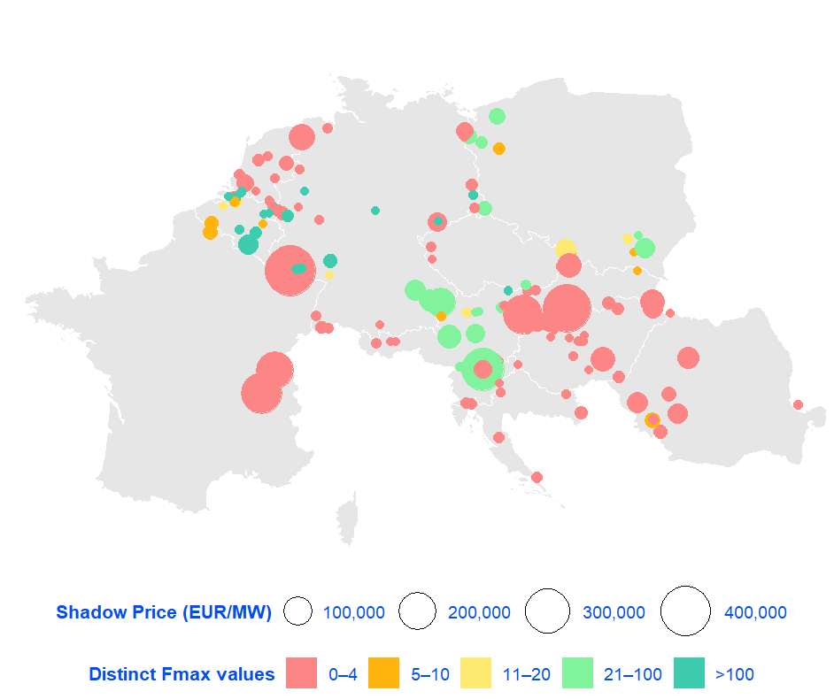
1. Dynamic line rating (DLR)
Assessment of current practices in Core FBMC
Usage of dynamic line rating in Core capacity calculation on congested CNEs - 2024 (EUR/MW)
Fmax reported in day-ahead capacity calculation can serve to estimate the usage of DLR on every CNE.
CNEs with high cumulative shadow price present the largest potential benefit from DLR introduction in capacity calculation.
The figure represents to what extent the rating of congested CNE in 2024 was dynamic:
  4 or less distinct Fmax values over the year indicates fixed ratings for at least each season.
  TSOs operating cross-border CNEs often use different ratings for the same element, with the most restrictive of the two being relevant.
Source: ACER calculation based on JAO Publication Tool data. Only power lines with non-zero shadow price are considered, excluding transformers.

Slide 7
1. Dynamic line rating (DLR)
Proposals
Prioritise the implementation of dynamic line rating on highly congested network elements, where potential market gains outweigh implementation costs.
  In preparation for Summer 2026: Where possible, accelerate plans for DLR rollout in CE-SEE (e.g. in SK, HU, RO, HR, GR).
Once DLR is available in real-time processes, make sure it is reflected as such in capacity calculation.
  SI to incorporate dynamic line rating (already used in real-time) into capacity calculation.
On cross-border lines, ensure that rating of power lines is coordinated between the two TSOs operating the border.
  E.g. AT-SI cross-border lines only having DLR from the AT side.
Source: ACER calculation based on JAO Publication Tool data.

Slide 8
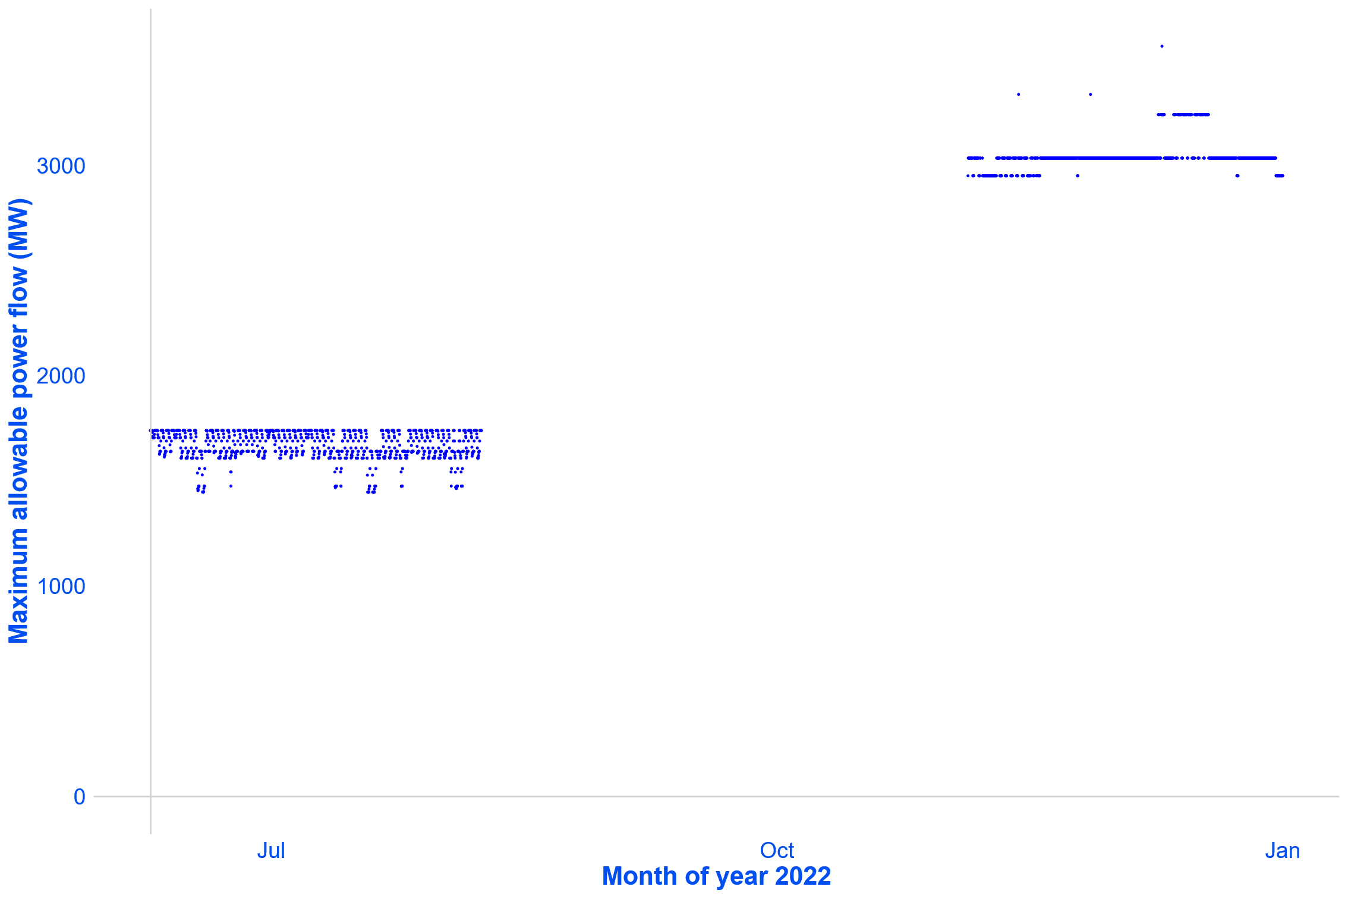
2. Upgrading of conductors
Background and proposals
Replacing existing overhead line conductors with high-temperature low-sag (HTLS) conductors allows to increase ampacity (up to 100%).
Reusing existing towers and right-of-way usually results in faster and less costly build-out.
    TSOs report that works on reinforcing pylons and/or on adjacent substations may be needed, leading to longer project times.
PROPOSAL:
TSOs to consider upgrading conductors on existing overhead lines as an alternative to building new lines, in particular on highly congested CNECs with low Fmax.
Impact on Fmax of upgrading the conductor of cross-border line Avelgem - Avelin (MW)
Fmax increase
Maintenance

Slide 9
3. Outage Planning Coordination (OPC)
Background
Currently, OPC process is organised per OPC areas
  different processes per RCC, even within the same CCR
Transmission elements planned outages are assessed on yearly level
  with security analysis (load flow, n-1)
  no estimation of impact of certain outages on cross-zonal capacity
Grid analyses additionally on week ahead level
  without dedicated week-ahead grid modelling (using adjusted Y models)
  resulting in potential adjustments of maintenance plans, only in the event of n-1 violations
  however, no adjustments in the case of highly limiting network elements

Slide 10
3. Outage Planning Coordination (OPC)
Proposals
Including assessment of cross-zonal capacity during OPC at least at yearly level:
  As foreseen by the Electricity Regulation (Annex I, 10.1.)*
  Potentially resulting of shifting outages to less congested weeks.
  Already on-going process improvement at TSCNET to include an optimisation function to maximise cross-zonal capacity in OPC, though so far not considering shifting of outages.
Introducing flexibility in weekly outage planning in case of severe market congestion on CNECs:
  Flagging flexible outage plans already at yearly level.
  Monitoring of severe market congestion (i.e. high shadow price) on CNECs at week-ahead level, assessing impact of outages on the congested lines -> potentially leading to shifting of outages planned for next week
* “Each RCC shall carry out regional OPC (…), while maximising the capacity of the interconnectors and the transmission systems affecting cross-zonal flows.”

Slide 11
4. Improving 70% derogations
Improvement of derogation requests
Derogations are granted yearly in 6 Core Member States, with most citing the presence of excessive loop flows and the lack of a coordinated congestion management framework.
Over the last weeks, ACER has been collaborating with Core NRAs to improve 70% derogation requests for 2026.
AT, BE, NL and PL apply dynamic targets based on forecasted loop flows.
RO and SK: commitment to implement dynamic targets as well.
  Transitory period to assess and implement dynamic targets: by Summer 2026.
  Goal: At least all flows stemming from internal transactions shall be tested against a TSO’s RDCT potential. Whenever RDCT potential is insufficient to secure calculated capacities, these are to be reduced via validation.
Mid-term: Prioritise the implementation of ROSC and RDCT Cost Sharing, to avoid derogations on the grounds of excessive loop flows
RDCT = Redispatching and countertrading.

Slide 12
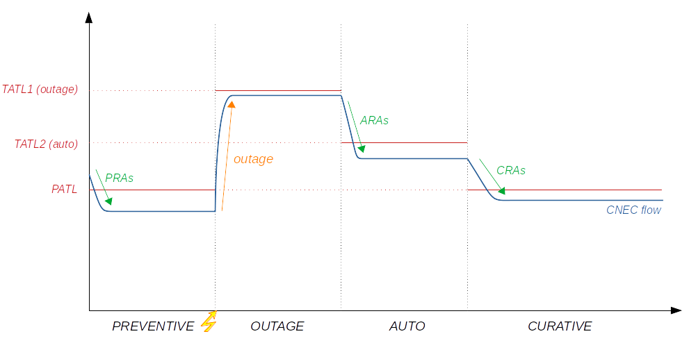
5. Use of curative remedial actions (cRA)
Background
TSOs may rely on PSTs and topological remedial actions to redirect power flows. These actions can be:
  Preventive: activated before an N-1 outage so that, even after the outage, flow remains below Fmax.
  Curative: activated only in the event of an N-1 outage, allowing for a temporary overload of the line until the action is triggered.
Curative RAs need to be available with certainty and be triggered automatically or within minutes after the outage occurs.
By modelling curative RAs in capacity calculation, thermal ratings of affected CNEs can be increased up to the temporary limit (TATL), increasing offered capacity.
Proposal to more widely design and implement curative remedial actions in capacity calculation, prioritising those affecting highly congested network elements.
Exemplary figure on functioning of preventive and curative remedial actions
Fmax = Maximum allowed flow on a network element
RA = Remedial action

Slide 13
5. Use of curative remedial actions (cRA)
Proposals for Core CCR
TSOs regularly considering a given curative RA in real time processes, should aim to include those also in capacity calculation (where feasible).
All remedial actions modelled as preventive RAs in capacity calculation to be also considered as curative RAs.
TSOs that don’t define curative RAs to at least allow for temporary limits (TATL) on CNEs affected by cRAs of neighbouring TSOs.
  E.g. Elia allowing for 110% of Fmax for RTE’s cRAs.
Ensuring curative RAs are considered more effectively in capacity calculation.
  E.g. RTE cRAs seemingly only activated 1-2% of MTUs in Core FBMC. For other TSOs, even less.
  NRAO optimisation based on full flow-based domain neglects most cRAs.
    The cRAs far away from the CNEC with lowest RAM relative are not considered, though they can have positive effect in their vicinity

Slide 14
6. Improvement of grid modelling
Proposals
Improvement proposals:
Applying common Net position Forecast (NPF) for building individual grid models (IGM):
  for all TSOs, or at least for Continental Europe.
Exchange and merging of most representative individual grid models among CCRs:
  in particular D-2 forecast models used for day-ahead capacity calculation.
Unique Common Grid Model (CGM) to be used for capacity calculation:
  In the first step: for Central Europe, ECE, SEE and EE.
  End target: pan European CGM.

Slide 15
7-10. General proposals
Overview
Beyond concrete improvements to capacity calculation and allocation processes, other longer-term market design improvements in South-East Europe will be promoted within this process, such as:
  Extension of market coupling to Energy Community bidding zones;
  Implementation of flow-based market coupling in South-East Europe; and
  Removing barriers to participation in wholesale markets, to harness flexibility of distributed generation assets and demand response.
Additionally, we intend to highlight the need for further investment in infrastructure and flexible generation capacity in South-East Europe.

Slide 16
Thank you.
Any questions?
The contents of this document do not necessarily reflect the position or opinion of the Agency.

Slide 17
Back-up slides

Slide 18
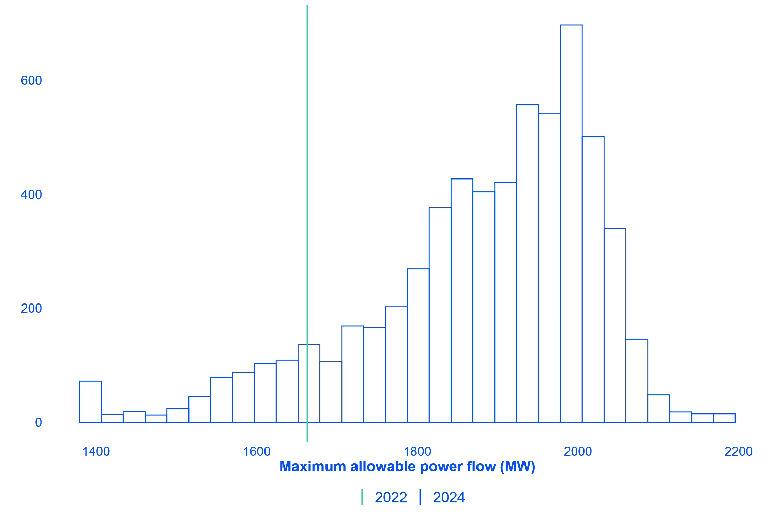
1. Dynamic line rating (DLR)
Example of DLR implementation
Examples of past implementation can serve as reference as to the expected gains of DLR implementation in capacity calculation.
CNE ‘Hradec-Mirovka‘, operated by CEPS, moved from a fully fixed rating in 2022 to a dynamic rating in 2024. This resulted in:
  89.65% of MTUs with higher Fmax.
  Fmax on average 12.95% higher.
  Maximum increase of Fmax of 31.21%.
DLR also reveals instances where fixed rating overestimated the ampacity of the line, contributing to grid security.
Example of implementation of dynamic line rating in capacity calculation on CNE Hradec - Mirovka (MW)
Source: ACER calculation based on JAO Publication Tool data.

Slide 19
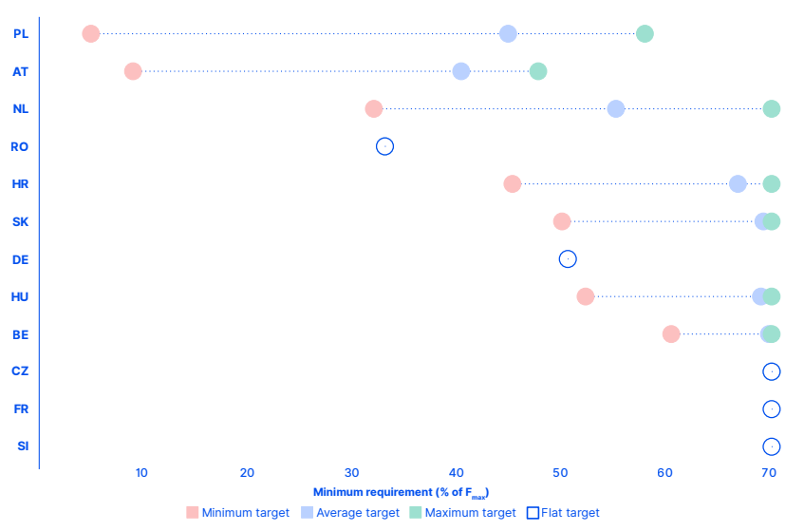
4. Improving 70% derogations
Status of 70% target derogations in Core
Minimum requirements for cross-zonal trade in the Core capacity calculation region per Member State – 2024 (% of Fmax)
Derogations are granted yearly in 6 Core Member States, with most citing the presence of excessive loop flows and the lack of a coordinated congestion management framework.
AT, BE, NL and PL derogations allow to ‘discount’ excessive loop flows from capacity requirements.
Other derogations introduce a blanket requirement (covering all CNECs and/or MTUs), regardless of forecasted non-allocated flows and local RA potential.
Note: Loop flows correspond to unscheduled physical electricity flows stemming from internal trading that travel through neighbouring transmission networks.

Slide 20
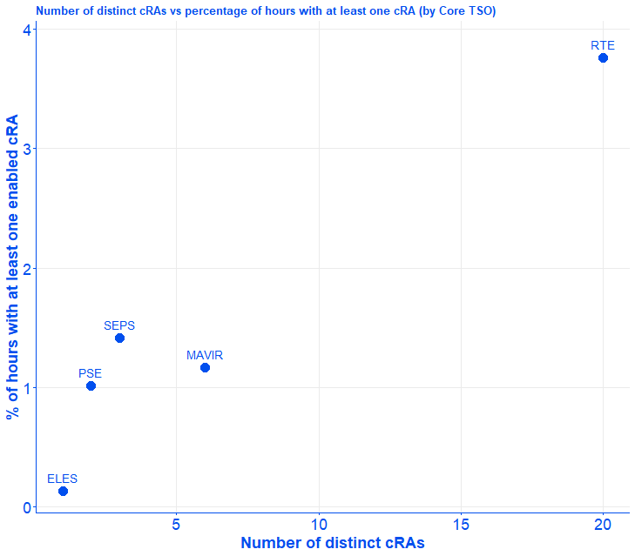
5. Use of curative remedial actions (cRA)
Curative remedial actions - Findings from Core CCR
Curative RAs in Core FBMC are modelled and optimised through NRAO. TSOs need to explicitly make available non-costly curative RAs for specific contingencies.
Optimisation function maximises relative RAM on the CNE with lowest relative RAM.
A given cRA may also impact CNEs introduced by a neighbouring TSO, provided that they share the contingency.
CNECs affected by a given cRA are duplicated in CC, representing the CGM status before and after the application of the cRA.
Both ‘before cRA’ and ‘after cRA’ status may end up being pre-solved.
Usage of curative remedial actions in Core capacity calculation per Core TSO – 2023-2025
Fmax = Maximum allowed flow on a network element
RA = Remedial action

Slide 21
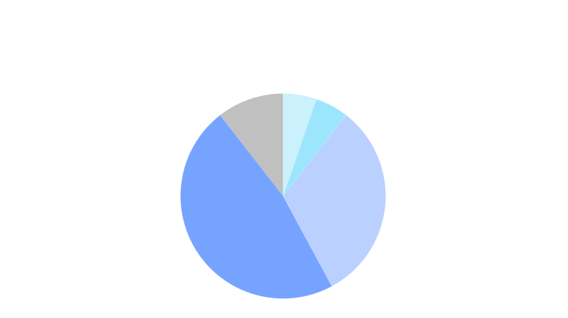
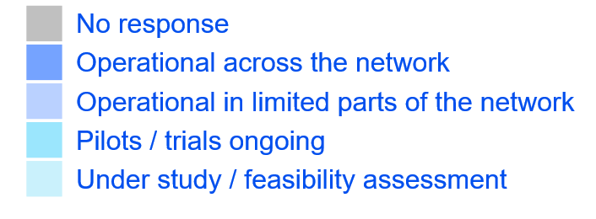


5. Use of curative remedial actions (cRA)
cRA – current practices
TSOs provided a summary of their current practices with regards to curative remedial actions, both in real-time practices and capacity calculation:
  75% of TSOs report using curative RAs in real time operation.
  50% of TSOs report considering curative RAs in capacity calculation.
Some TSOs report using curative RAs in real time processes, but do not consider those in capacity calculation.
Wider usage of curative RAs observed in SWE and Nordic CCRs, with more limited rollout in Core and SEE.
Reported usage of curative RAs in real-time processes
DE (50Hz), BG
DE (TenneT)
DE (Transnet BW)
AT, DE (Amprion),
HR, HU, PT, SI
BE, CZ, DK,
ES, FR, GR, LT,
RO, SE
Reported usage of curative RAs in capacity calculation
AT, BE, BG, CZ, GR,
DE (Amprion, TenneT,
Transnet BW),
HR, RO
DK, ES, FR, HU,
LT, PT, SE, SI
DE (50Hz)
RA = remedial action

Slide 22
6. Improvement of grid modelling
CGM improvement roadmap from Core TSOs
  2025
  2026
  2027
  Q4
  Q1
  Q2
  Q3
  Q4
  Q1
  Development 1 UA/MD DACF model split
went live on 20/01/2026
  Split of joint UAMD DACF model into single UA and single MD model
  Development 2 Core & Italy North common D-2 CGM
  Core & Italy North common D2CF CGM creation; pre-requisite for Central Europe CCR
  Development 3 Integration of D2CF models of Balkan TSOs
  a) Agreeing and signing of NDA
  b) Testing and quality assessment
  c) Balkans D2CF implementation
  Development 4 Integration of D2CF models of UA and MD
  a) UA and MD adherence to NDA
  b) Testing and quality assessment
  c) UA and MD D2CF implementation
  Development 5 Extension of NPF to further non-Core BZs
  Development of NPF for all BZs in D2CF CGM
  Development 6 Country GLSK for non-Core TSOs
  Switching from load only shifting to prop. to gen&load shifting for non-Core TSOs
  Development 7 Target flow for (AT) PSTs*
  Implementation of target flow solution for (AT) PSTs
  Development 8 Integration of German HVDCs
  Modeling of Inner German HVDCs
  Development 9 Integration of Ireland**
  Integration of Ireland D2CF in CGM
* exact timeline and geographical scope is subject to further technical assessment
**to be confirmed in February '26 once further assessing vendor and TSO readiness
Developments related to ACER recommendation
Other Developments

