Slide 1
3.3 Improving decoupling processes status
10 February 2026
MESC

Slide 2
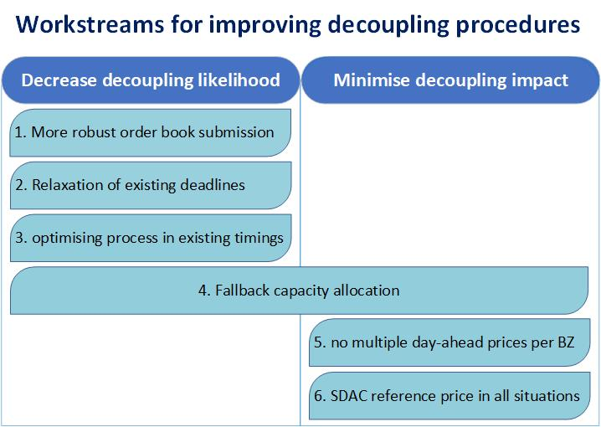
Discussed topics

Slide 3
Topics
Topic
WS 3: Optimise existing SDAC and SIDC timings and procedures Optimise existing timings
WS 1: Minimise the likelihood of partial decoupling due to failed submission of order books in time Daily pre-order book submission test More robust local trading system (LTS)
WS 2: Relax existing deadlines Relaxing the 15:30 deadline
WS 4: Fallback capacity allocation Continuous SIDC as the fallback solution for DA capacity allocation WS 6: Ensuring a single SDAC reference price in every bidding zone in all situations - Develop a single SDAC price solution for the case of full decoupling
WS 5: Preventing multiple SDAC prices in a bidding zone

Slide 4
WS 3 - Optimise existing SDAC and SIDC timings and procedures
Objective: optimise the existing SDAC and SIDC procedures
Decreasing the likelihood of decoupling to happen
Removing obsolete and/or unnecessary steps
Gain additional time for resolving the issue before partial/full decoupling
Continuous exercise by MCSC
MCSC will report on improvements every 6 months
SDAC status
Procedure steps and timings optimised for the 15‘MTU go-live
Next report in June
SIDC
Impact of partial decoupling deadlines on IDA cancellation

Slide 5
WS 1 - Minimise the likelihood of partial decoupling
NEMOs support ACER‘s proposal to implement daily orderbook pre-check
Objective: early detection of local NEMO(s) issues and allocating additional time for resolution
Each NEMO generates a “test” order book, validating LTS and OBK functionality
Daily process in production to create a test OBK before 11:00 CET (under discussion), allowing early detection and fixes
No change for market participants activities before GCT
NEMOs additionally work on harmonisation of the LTS site architecture setup
Objective: increase the robustness of local NEMOs‘ LTS and IT environments
Main site setup: primary and secondary sites with quick failover
Disaster recovery site in a different location

Slide 6
WS 1 - Minimise the likelihood of partial decoupling
ACER proposes additional measure to prevent decoupling to happen
Central Backup Trading System (CBTS) used by NEMOs in case of local issues
Backup order submission in case of local NEMO‘s issues cannot be resolved
Independent system, isolated from NEMO’s local development, implementation, testing and deployment processes (provided by SMCO)
Orders will be submitted to CBTS only when NEMO local LTS is not available (not a daily process)
CBTS is operated by NEMOs operators, in case NEMO uses it for the backup process.
CBTS is not replacement for NEMOs’ local backup systems – additional backup
Further work to advance the design and implementation of this solution during next workshop

Slide 7
WS 2 - Relax existing deadlines
TSOs are assessing the feasibility of revising the nomination deadlines to maximum 16:00 in case of risk of decoupling
Normal day scenario remains the same, the change is only applicable for „problematic“ day
TSO prerequisite for the change
Implementation of Intraday continuous market as fallback for the failed SDAC processes
NEMOs and TSOs are still to determine how to use additional 30 minutes
TSOs are investigating the impact on:
Cross-zonal scheduling processes
Generation and consumption schedules
Other national processes (IGM building, national scheduling etc.)
When final design is available, TSOs will organise consultation with market participants

Slide 8
WS 4 and 6 - Fallback capacity allocation with single price per bidding zone
Continuous SIDC as the fallback solution for DA capacity allocation
Dedicated tests to provide assurance on XBID ability to manage load as fallback system will be available in next 6 months
NEMOs and TSOs are further discussing how to allocate additional 30 minutes due to a shift of nomination deadline shift to 16:00 (see previous WS 2)
NEMOs and TSOs designed the procedural timing overview for the new process
MCSC is further discussing the possibility to harmonise and implement the continuous intraday market as fallback mechanism for SDAC decoupling (see next slide)
MCSC designed a DA reference price mechanism, based on the continuous trades executed in case of decoupling

Slide 9
WS 4 and 6 - Fallback capacity allocation with single price per bidding zone
 | Shadow Auctions via JAO
 | Capacity goes to Intraday market*
 | Always remains coupled through regional DA coupling**
 | None
* | PL-LT (LitPol Link) capacity goes back to interconnector owner
** | Nordic-Baltic borders (NordBalt & EstLink) always remain coupled through Nordic-Baltic regional DA coupling

Slide 10
WS 5 - Preventing multiple SDAC prices in a bidding zone
Core NEMOs and TSOs are implementing Volume Allocation as an alternative for Local Auctions when partial decoupling happen
With Volume Allocation, the SDAC price for a NEMO that is partially decoupled in a bidding zone is the same as the SDAC price for the NEMO that has remained coupled in that bidding zone.
ACER was informed that Nord Pool will implement Volume Allocation as fallback mechanism for the Core Bidding Areas in January.
Other Core MNA NEMOs will implement Volume Allocation in production shortly after the relevant MNA are approved.
RISK – in case of partial decoupling today, there will be two SDAC prices for the MNA bidding zone with one nemo decoupled (except Nord Pool)

