Slide 1


v
Uniting Europe's Energy, Today
Electricity Integration Package: status of transposition and verification
and Impact of CBAM on cross-border trades
Update by
Energy Community Secretariat
43rd MESC Meeting
10 February 2026

Slide 2
EIP transposition – current status
Energy Community Contracting Party | Status of legal acts transposing fully/partially the Electricity Integration Package
 | Electricity Directive (EU) 2019/944 | Electricity Regulation (EU) 2019/943 | Risk-Preparedness Regulation (EU) 2019/941 | ACER Regulation (EU) 2019/942 | Commission Regulation (EU) 2015/1222 (CACM) | Commission Regulation (EU) 2016/1719 (FCA) | Commission Regulation (EU) 2017/2195 (EBGL) | Commission Regulation (EU) 2017/1485 (SOGL) | Commission Regulation (EU) 2017/2196 (ERNC)
Albania | drafting | drafting | drafting | drafting | adopted | adopted | adopted | adopted | adopted
Bosnia and Herzegovina | in the parliamentary procedure | in the parliamentary procedure | in the parliamentary procedure | in the parliamentary procedure | in the parliamentary procedure | pending | pending | pending | pending
Georgia | drafting | drafting | adopted | N/A | N/A | N/A | N/A | N/A | N/A
Kosovo* | drafting | drafting | drafting | drafting | drafting | pending | pending | pending | pending
Moldova | adopted | adopted | adopted | adopted | adopted | adopted | adopted | adopted | adopted
Montenegro | adopted | adopted | adopted | adopted | adopted | adopted | adopted | drafting | drafting
North Macedonia | adopted | adopted | adopted | adopted | adopted | drafting | drafting | drafting | drafting
Serbia | adopted | adopted | adopted | adopted | adopted | adopted | adopted | adopted | adopted
Ukraine | in the parliamentary procedure | in the parliamentary procedure | in the parliamentary procedure | in the parliamentary procedure | in the parliamentary procedure | pending | pending | pending | pending

Slide 3
Verification of EIP transposition – current status
Serbia:
Verification process was officially initiated on 22 October 2025;
EnCS communicated its assessment to the European Commission on 16 December 2025;
In line with the agreed verification process, the European Commission has five months to review the completeness and conformity of national transposition and implementing measures with the EU acquis and issue an opinion.
Moldova:
Concordance tables for the adopted acts are being developed by the Moldovan stakeholders;
Formal submission of the documentation required to begin the verification process is expected in the second half of February 2026.

Slide 4
        Preliminary observations of the CBAM Impact on Market Integration
(Analysis window: 1–31 January 2026)
Increase of price spread between EnC WB6 and neighbouring EU DAMs
During January 2026, average day-ahead prices in EnC WB6 markets (SEEPEX, MEMO, MEPX) were consistently below those in HUPX, OPCOM, CROPEX and IBEX; excluding Greece, the average price spread was around 25–35 EUR/MWh.
Notable changes in regional cross-border trading patterns
Scheduled commercial flows increased on EU–EU and EnC–EnC borders, while flows between EU and EnC markets generally declined, with some border-specific deviations.
Greece as a regional exception
The Greek market remained largely long and export-oriented over the period, resulting in comparatively lower DAM prices and limiting divergence vis-à-vis neighbouring WB6 markets.
Preliminary signals require continued monitoring – EnCS to monitor and report regularly
Although the observation window is limited, the combined price and flow developments suggest early pressure on cross-border market integration and merit close monitoring in the coming period.

Slide 5
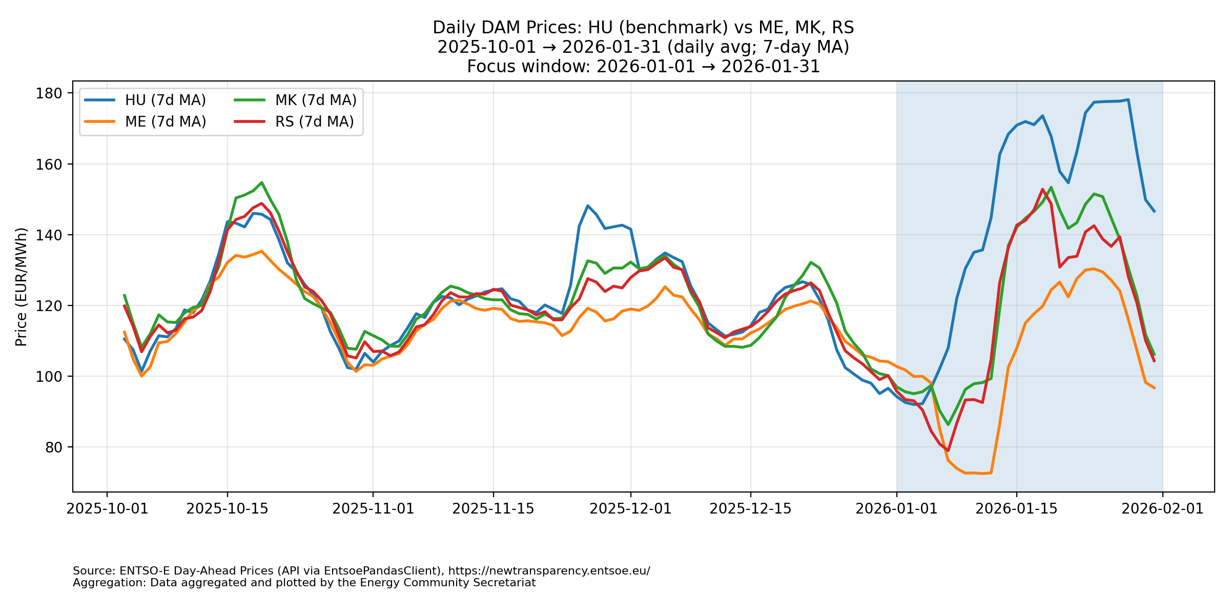
        CBAM Impact on DAM Price Convergence

Slide 6
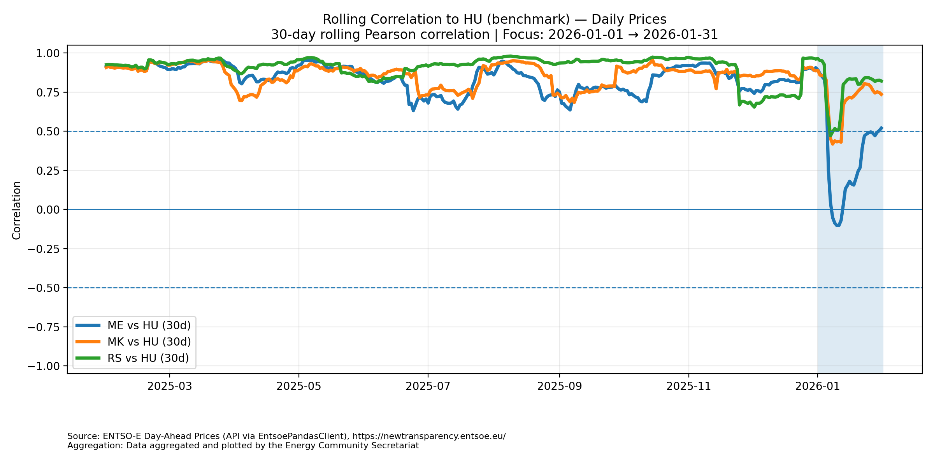
        CBAM Impact on DAM Price Convergence

Slide 7
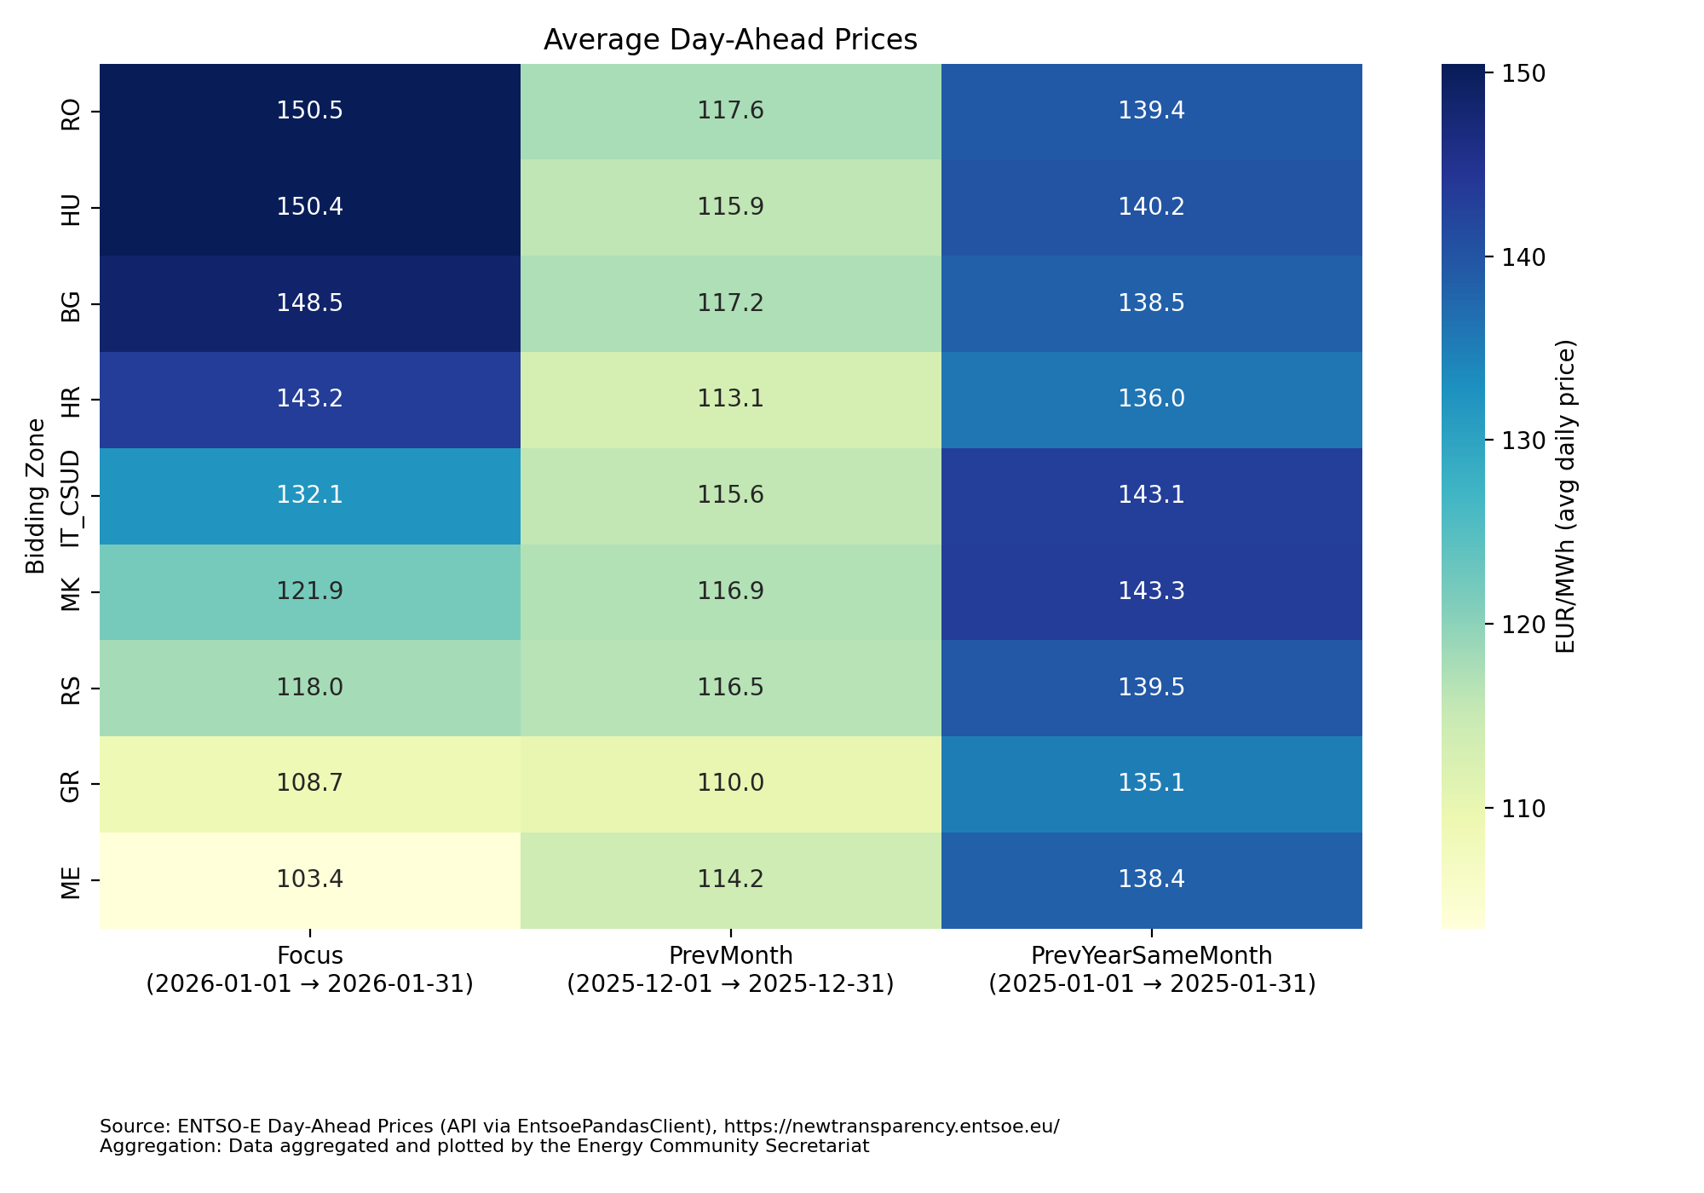
        CBAM Impact on DAM Price Convergence

Slide 8
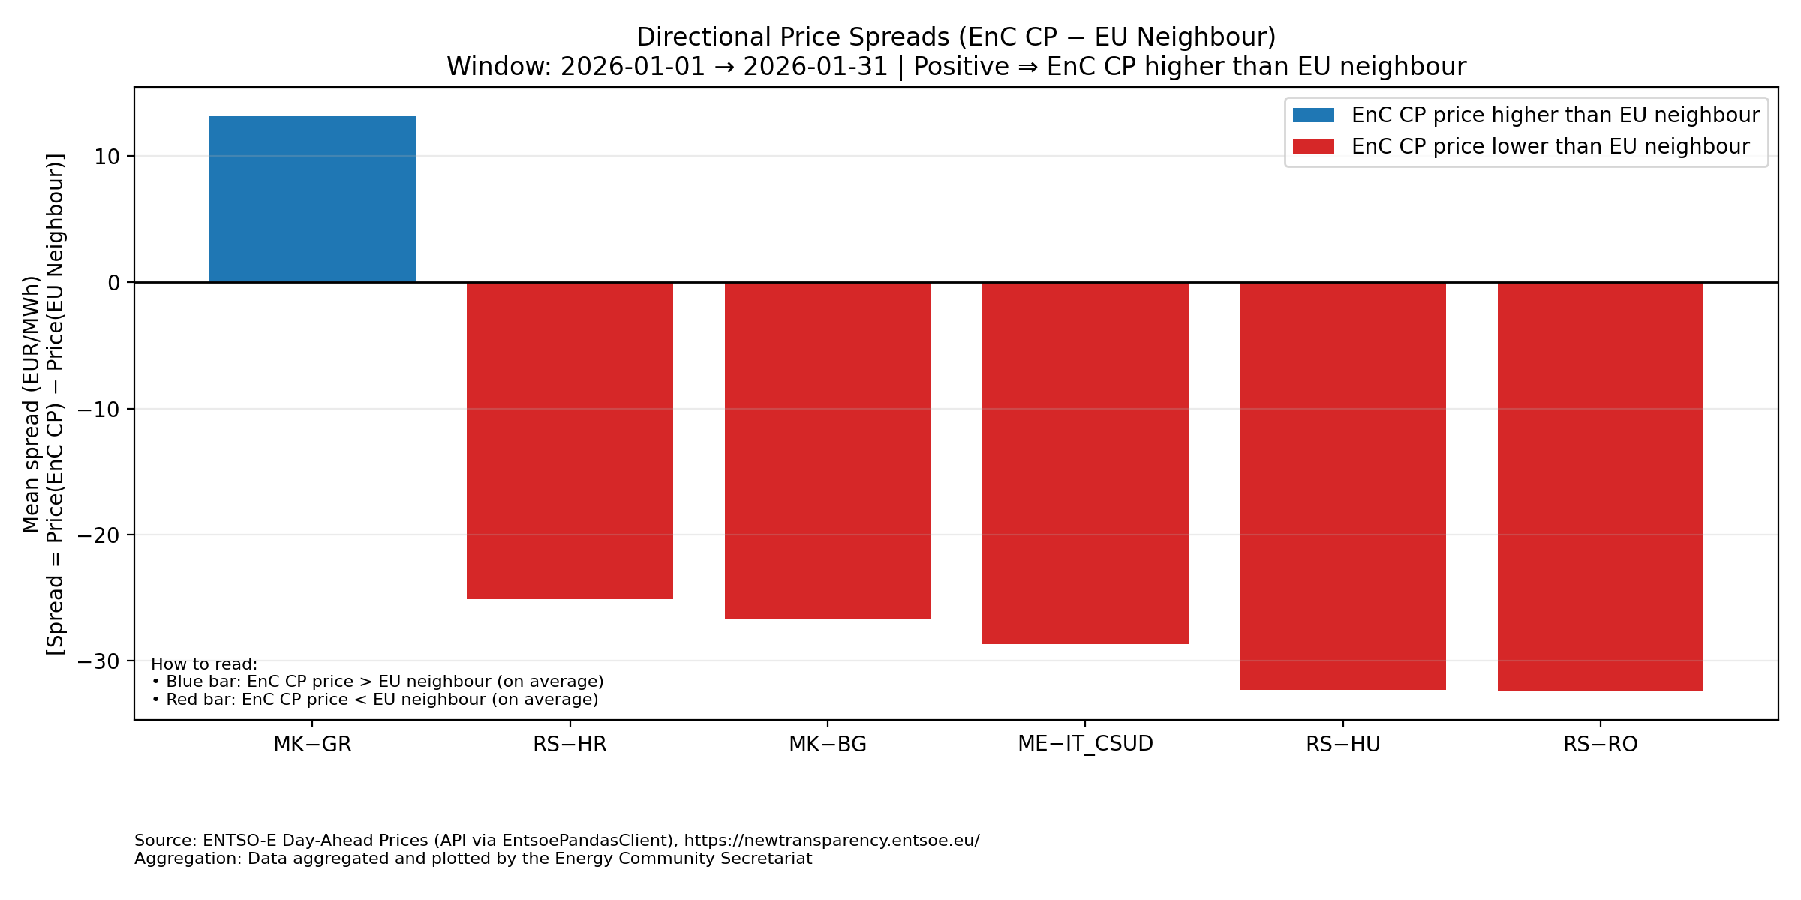
        CBAM Impact on DAM Price Convergence

Slide 9
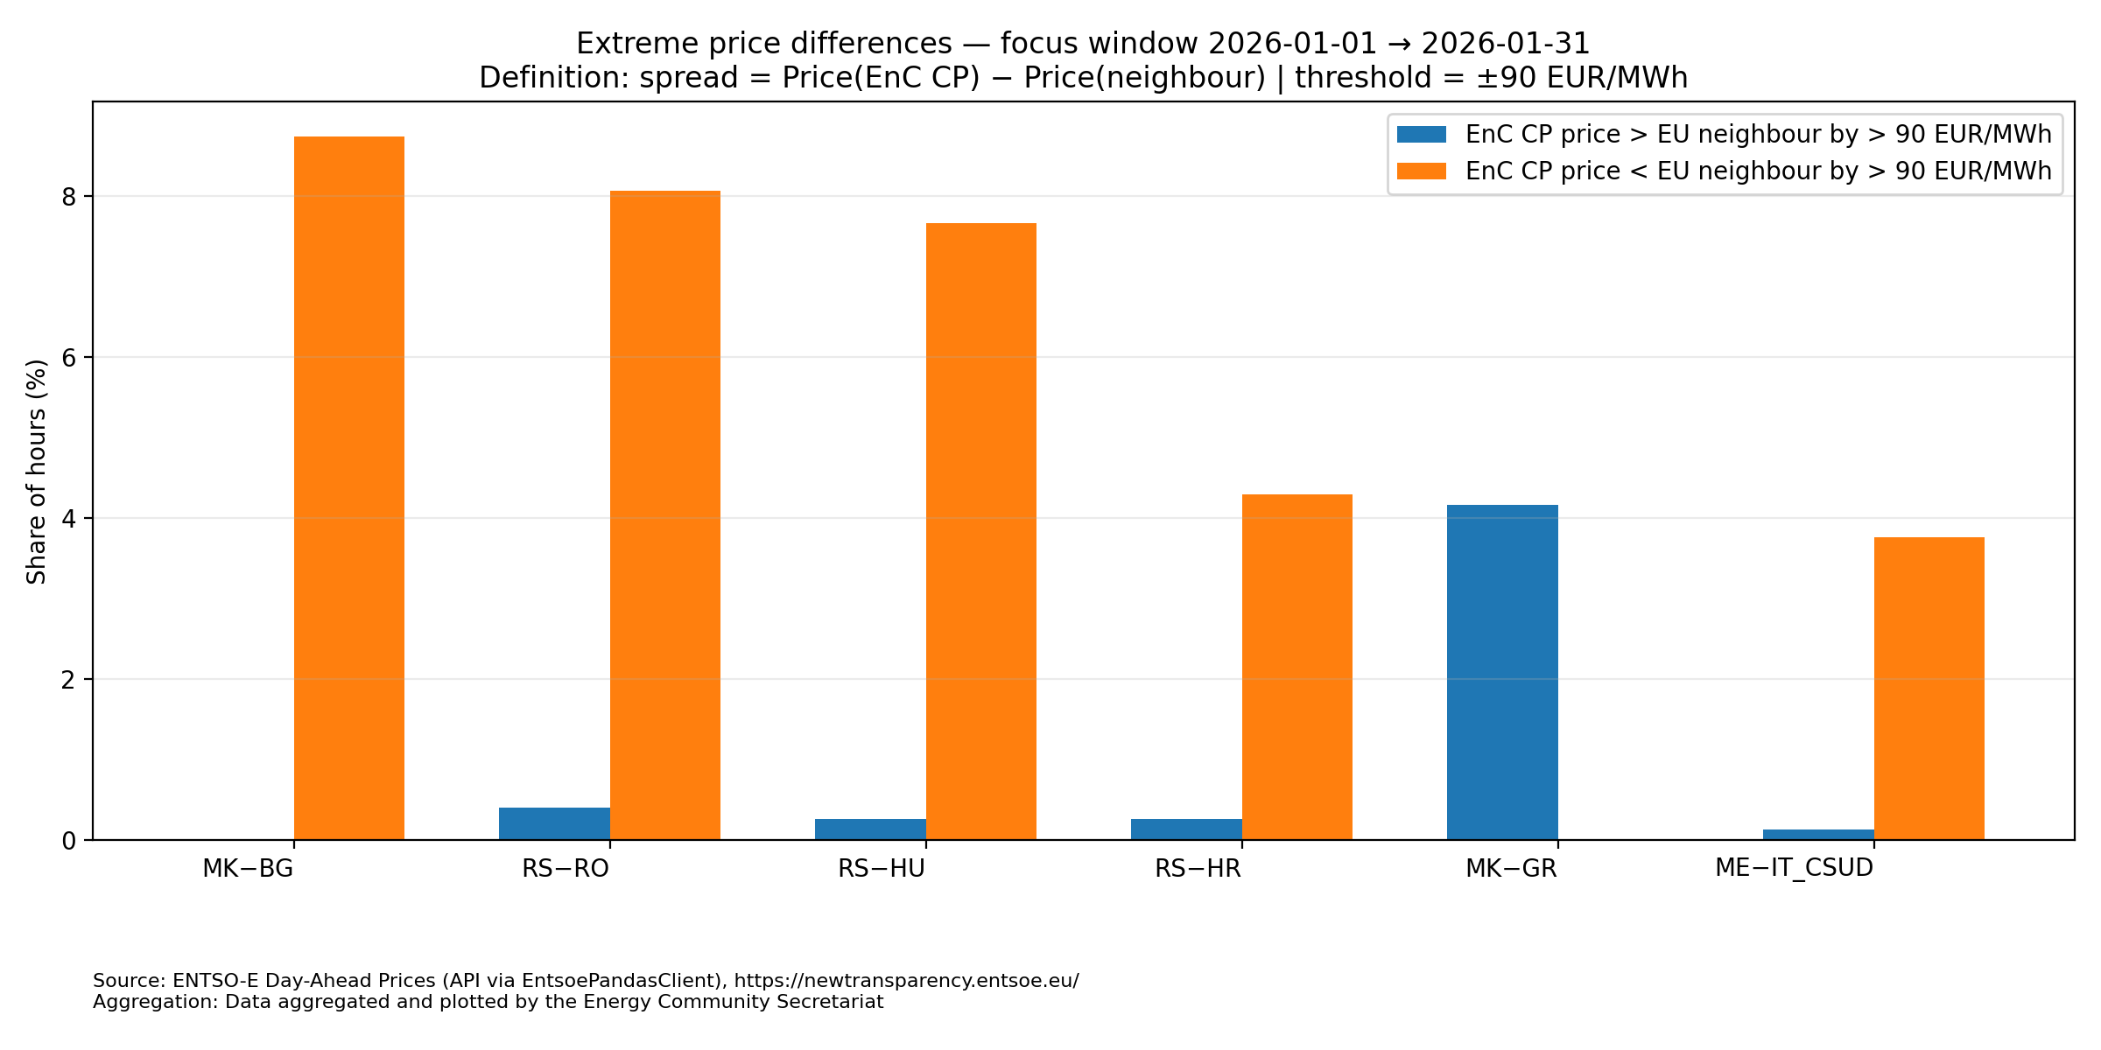
        CBAM Impact on DAM Price Convergence

Slide 10
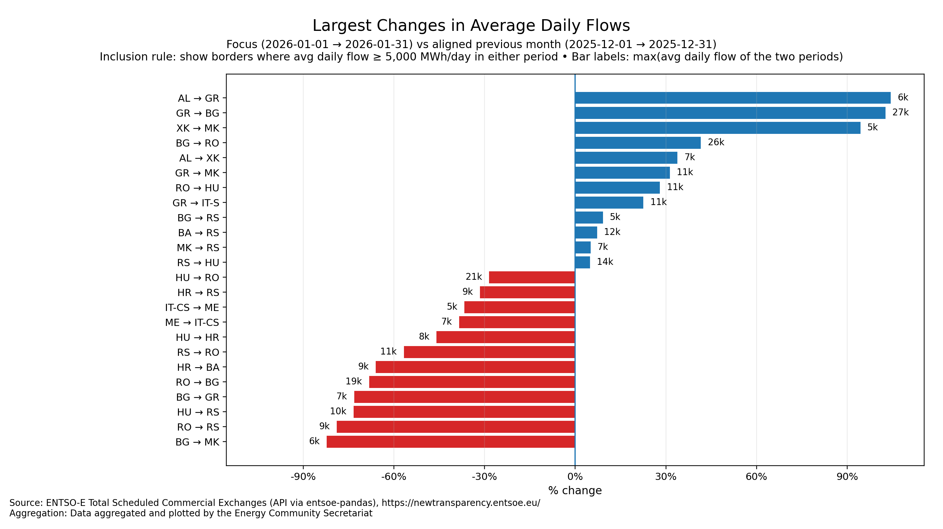
        CBAM Impact on Scheduled Commercial Flows

Slide 11
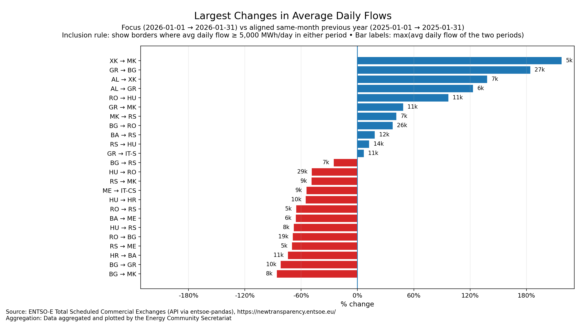
        CBAM Impact on Scheduled Commercial Flows

Slide 12




THANK YOU!
energy-community.org
Energy Community Secretariat
Am Hof 4, Level 5, 1010 Vienna, Austria

