Slide 1
Update on Balancing Platforms
December 3rd, 2025
MESC

Slide 2
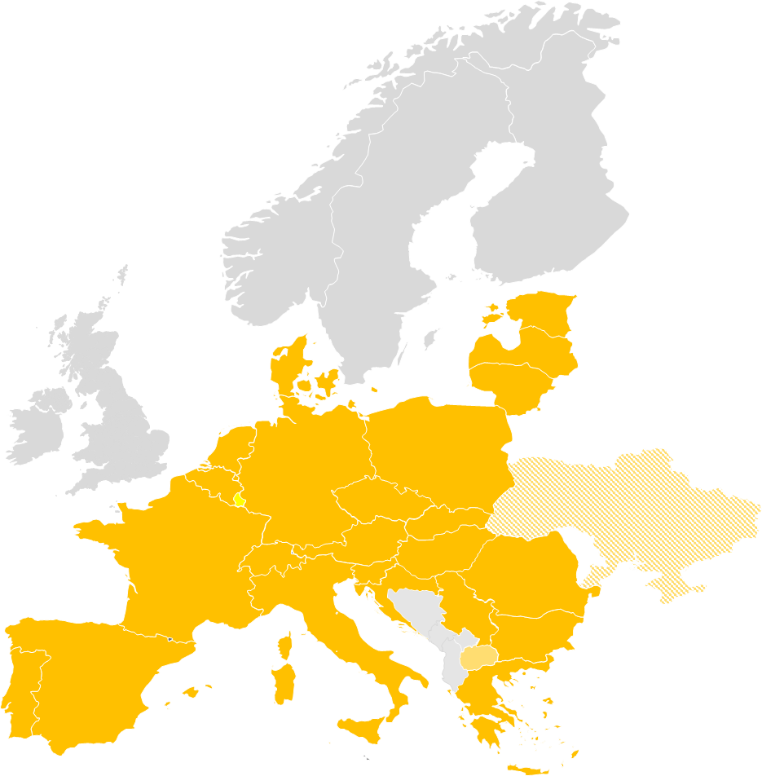
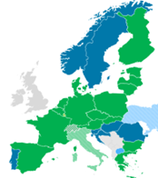
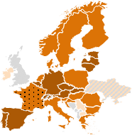
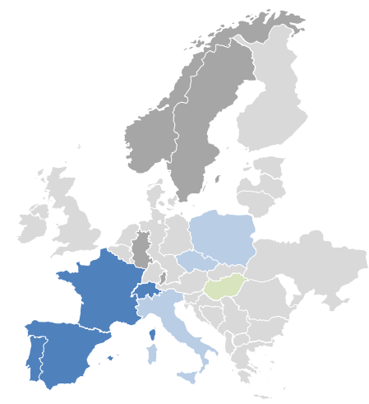
Introduction
Overview on current status of European Balancing Platforms
 | IGCC | PICASSO | MARI | TERRE
Balancing Service | Imbalance Netting | aFRR | mFRR | RR
Participants
Target area | Continental Europe | ≥ Continental Europe | ≥ Continental Europe | ≥ RR TSOs
Business go-live | 2021/06/24 (operational since 2011/10/01) | 2022/06/22* | 2022/10/05* | 2020/09/29*
Status
Highlights | Economic surplus of around 313 Mio. € in Q1/Q2 2025 | Economic surplus of more than 351 Mio € in 2025 until end of July. | Economic surplus of ~82 Mio. € in 2025 until end of September. | Economic surplus of 284 Mio. € in 2025 until end of September. TERRE will be concluding its operations by the end of 2025.
* Date as of when cross-border exchanges were possible due to the neighbouring TSO joining. The technical go-live of the platform was earlier.
  European market design has significantly changed the local procurement rules.
  In 2024 all platforms together achieved an economic surplus of more than 1,450 Mio. €

Slide 3

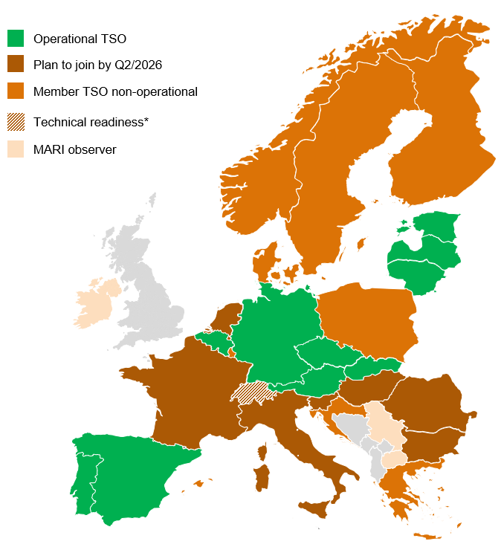
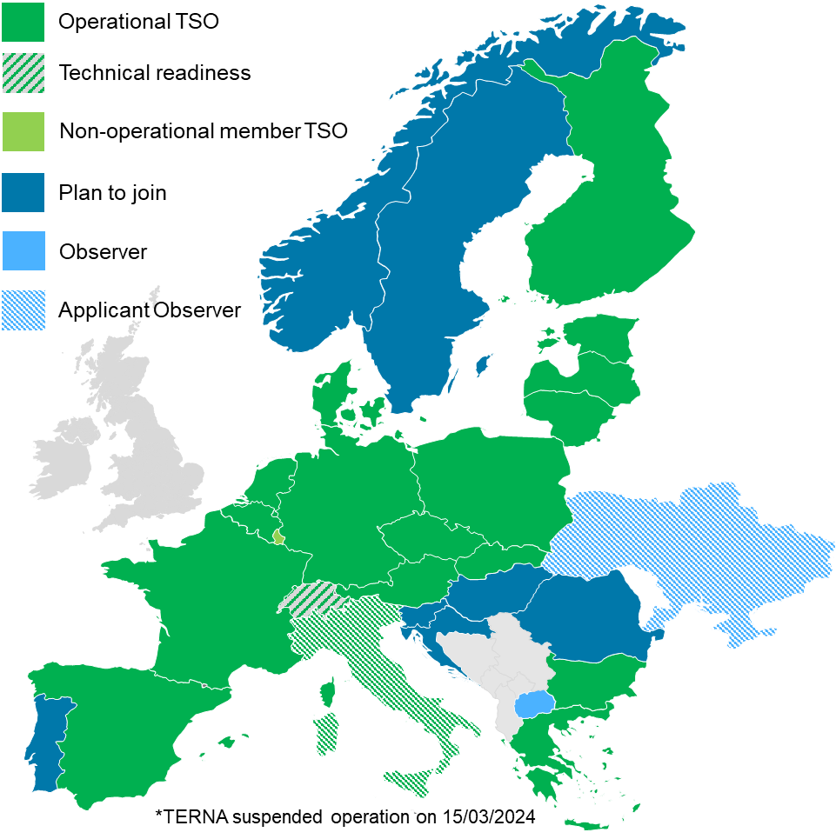

Recent developments and updates
Updates
Accession to MARI in 2025
  May:
    Elia (Link to communication)
  Expected in December
    TenneT NL
Accessions to PICASSO in 2025
  February to July
    ESO (Link to communication), Litgrid (Link to communication), ADMIE (Link to communication), Fingrid (Link to communication), RTE (Link to communication), AST (Link to communication), ELERING (Link to communication), Red Eléctrica (Link to communication) and PSE (Link to communication)
  November: TERNA
https://www.entsoe.eu/network_codes/eb/mari/
https://www.entsoe.eu/network_codes/eb/picasso/
🗓️BP workshop recording: Here

Slide 4
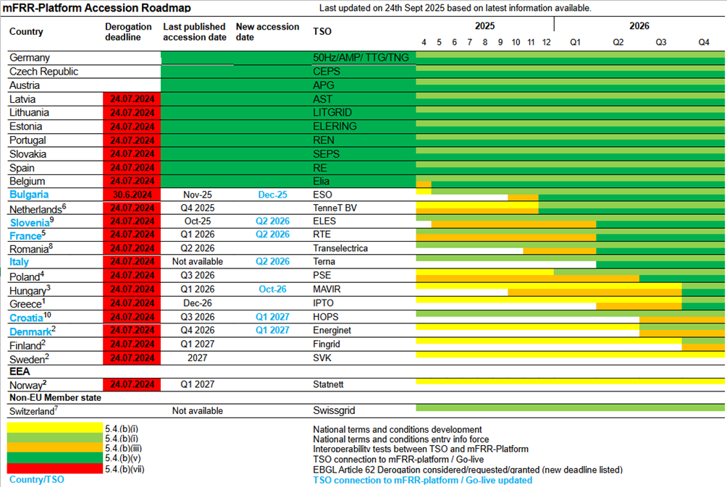
Recent developments and updates
Update of the accession roadmaps MARI
Background: Accession Roadmap based on 01.10.2025 published version

Slide 5
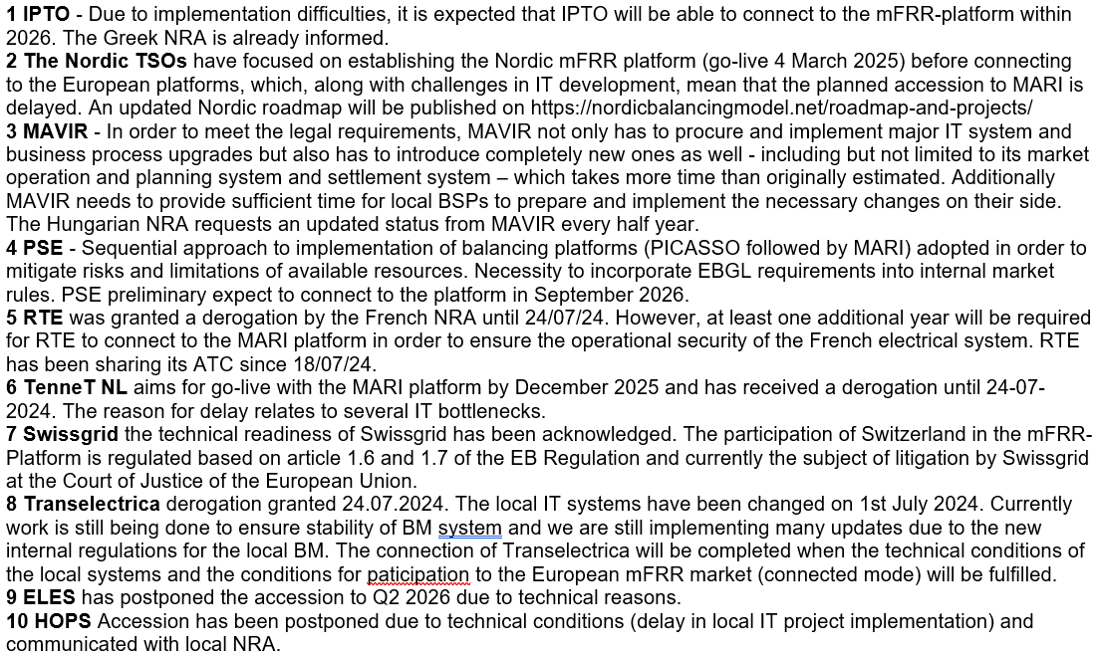
Recent developments and updates
Update of the accession roadmaps MARI
Background: Accession Roadmap based on 01.10.2025 published version / footnotes

Slide 6
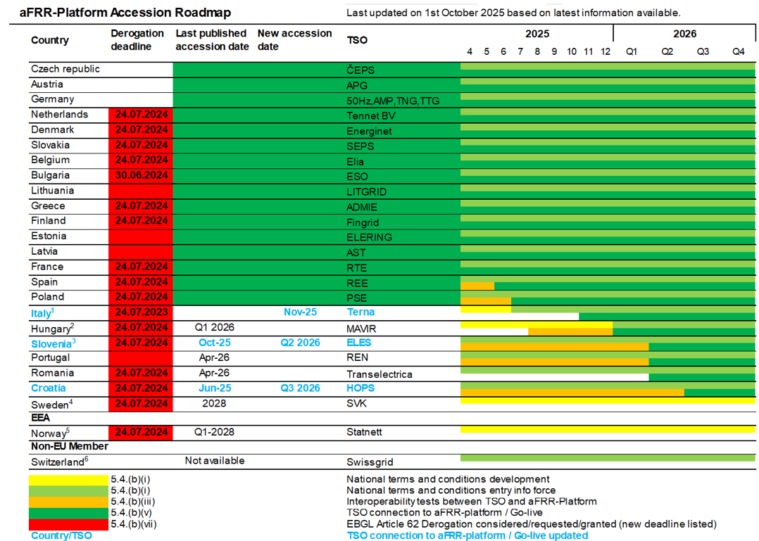
Recent developments and updates
Update of the accession roadmaps PICASSO
Background: Accession Roadmap based on 01.10.2025 published version

Slide 7
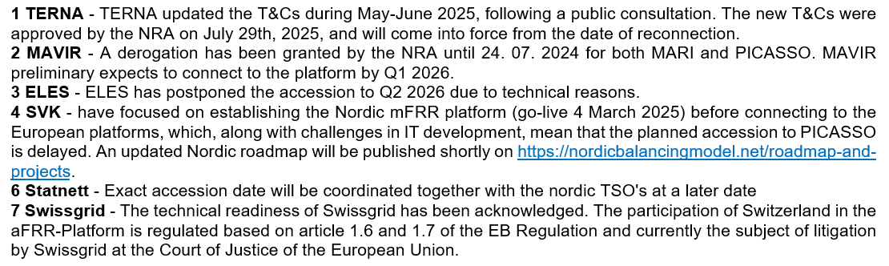
Recent developments and updates
Update of the accession roadmaps PICASSO
Background: Accession Roadmap based on 01.10.2025 published version footnotes

Slide 8
PICASSO Price incident
Status update (1/2)
On 23.10. from 00:00 until 10:45 an incident occurred on the German procurement system for aFRR bids, hosted by 50Hertz. This incident led to an erroneous local merit order list (LMOL) that was transferred to PICASSO. As the bids were still based on the definition of the aFRR standard product, the aFRR energy bids were included in the common merit order list (CMOL) of PICASSO. The bug affected only bids submitted to the procurement system as a "default bids" that were not changed by BSPs during the aFRR energy auction and only affected the bids in negative direction.
The timeline of the incident:
22.10.2025 With the start of the energy auction for aFRR, payment direction of bids in negative direction was transferred from “grid-to- provider” (negative sign) to “provider-to-grid” (positive) sign. If the bid wasn’t changed during the energy auction, this sign change remained incorrect until gate closure time
23.10.2025 00:00 First ISP including the erroneously bids were provided to PICASSO. Bids were placed at the beginning of the CMOL in negative direction and activated. As a consequence, the Cross border marginal price (CBMP) in negative direction had in some MTUs a high value with positive sign (meaning payment direction “provider-to-grid”).
23.10.2025 08:16 After receiving notifications from TSOs and Market participants, 50Hertz informed the BSPs about the bug and asked to correct the bids
23.10.2025 10:45 First ISP with no erroneously submitted aFRR energy bids.
After careful investigation and consideration, the PICASSO platform has decided to correct the affected CBMP prices in the period from 23.10.25 00:00 to 23.10.25 10:45 in negative direction.

Slide 9
PICASSO Price incident
Status update (2/2)
The correction is done in accordance with the requirements of EBGL and the approved methodology of the Implementation framework for the European platform for the exchange of balancing energy from frequency restoration reserves with automatic activation. According to Article 30(3)(b) EBGL, the methodology for pricing of cross-zonal capacity used for exchange of balancing energy must be based on the actual prices for balancing power provided by activated balancing bids.
The CBMP in negative direction will be corrected based on the following criteria:
Correction is done to the uncongested areas containing the German LFC block
if the CBMP in negative direction is higher than the first non-German Bid in the CMOL (negative direction)
The CBMP will be corrected based on the published and approved pricing rules of PICASSO, replacing the erroneous submitted aFRR energy bids of the German LFC block with the price of the first non-German aFRR energy bid in the CMOL (negative direction). To reflect the activation of the erroneous submitted bids, this Price is increased by 0.01 €/MWh. This correction will also affect the full-netting price, meaning the CBMP that is applied in situation with no aFRR bids selected by PICASSO. Those situations are indicated by a valid CBMP in positive and negative direction. As this CBMP is based on the first bids in the CMOL in positive and negative direction, this CBMP will also be corrected.
PICASSO has already implemented immediate solutions to avoid the incident in the future. A major investigation of the incident and possible additionally mitigating measures is being analysed to improve the system and avoid similar situations in the future. As such the handling of this incident will not set precedens for future similar situation as PICASSO will, based on this incident develop a procedure to be used in the future.

