Slide 1
PCG workshop on mitigation measures for improving decoupling processes
MESC
3rd DECEMBER 2025
Internal

Slide 2
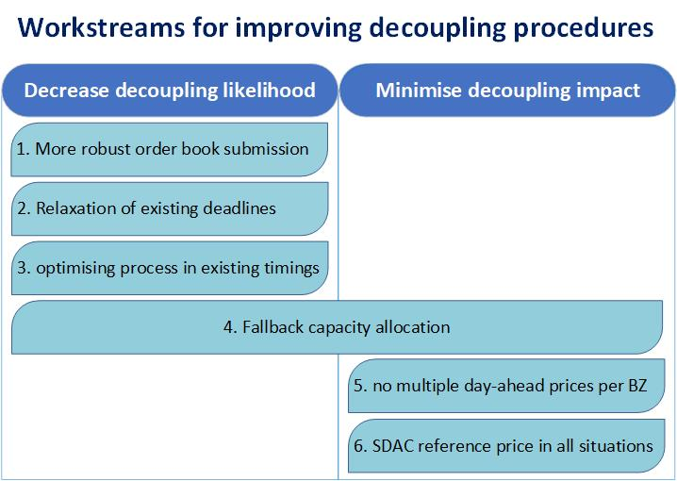
Discussed topics

Slide 3
Action points
Action 1 | NEMOs to analyse, agree and propose the concrete set of measures to improve the robustness of the LTS and daily operation to ensure an alternative way for central systems to receive orders.
Action 2 | ACER to elaborate further on the proposal for alternative order flow with centralised solutions (i.e. further work on option 3 discussed the meetings on 01/10/24 and 04/02/25).
Action 3 | Individual experts from TSOs and NEMOs are invited to provide to ACER informal proposals for improvements of SDAC and SIDC procedures via e-mail.
Action 4 | ACER to send an e-mail request to MCSC chair and to NC chair for obtaining access to relevant procedures on regular basis.
Action 5 | TSOs and NEMOs to provide report on the optimisation of procedures and proposal for further improvements of SDAC, SIDC, ANDOA and ANIDOA procedures on bi-annual basis, together with the updated, unredacted set of all procedures.
Action 6 | NEMOs and TSOs to provide a more detailed draft design of the future continuous intraday fallback mechanism, including regions/borders with intraday trading or current fall-back mechanism, reasons for non-harmonised fallback proposal and high-level timings and order of events after partial or full decoupling deadlines for each set of borders and bidding zones.
Action 7 | TSOs, if applicable for the BZ, (in coordination with NEMOs) to draft and propose to NRAs the amendments (or draft new, where applicable) to the MNA arrangements as soon as possible.
Action 8 | TSOs and NEMOs to allocate sufficient resources to implement the changes proposed with highest priority and to present the roadmap for implementation until the next meeting.
Action 9 | NEMOs and TSOs to provide a more detailed proposal for definition of SDAC prices in case of new fallback capacity allocation under Work stream 4. This is to complement the Action point 6.

Slide 4
Thank you. Any questions?
The contents of this document do not necessarily reflect the position or opinion of the Agency.

