Slide 1


v
Uniting Europe's Energy, Today
Transposition of the Electricity Integration Package - update
Update by
Energy Community Secretariat
42nd MESC Meeting
3 December 2025

Slide 2
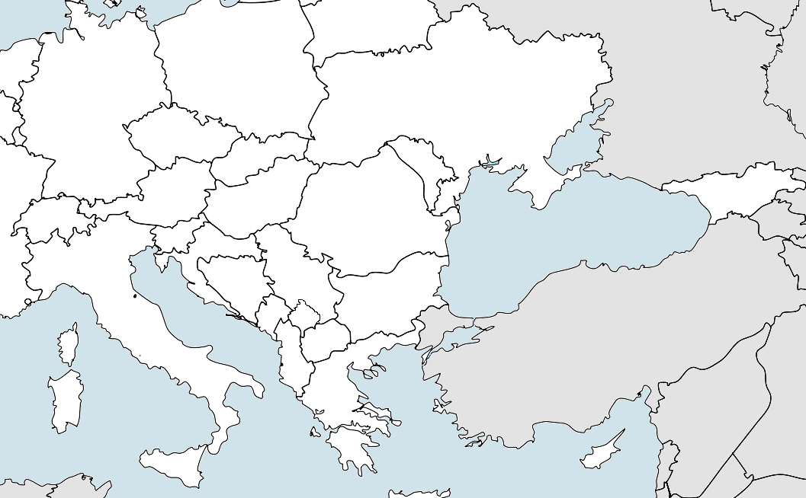
Current status of the transposition
Serbia and Moldova are the only two Contracting Parties that have adopted a set of legal acts aimed at transposing the Electricity Integration Package fully.
Serbia completed the adoption of the respective legislation aimed at transposing EIP in August 2025—the amendments to the Energy Law, as well as six governmental decrees. The verification process was officially initiated on 22 October 2025. Finalisation of the EnCS assessment is planned in early December.
Moldova completed the adoption at the beginning of November 2025—the new Electricity Law and five Network Codes and Guidelines approved by the regulatory authority, ANRE. Translation of legal acts is ongoing and the concordance tables are to be developed.
Source of the photo: https://www.freeworldmaps.net/europe/blank_map.html

Slide 3
Current status of the transposition
North Macedonia and Montenegro adopted laws aimed at transpositing part of Electricity Integration Package.
North Macedonia adopted the Amendments to the Energy Law—aimed at transposing Regulation 2019/941, Regulation 2019/942, Regulation 2019/943, Directive 2019/944 and most of Commission Regulation 2015/1222—in May 2025. Work on adopting the remaining legal acts from the EIP is ongoing.
Montenegro adopted the new Energy Law—aimed at transposing Directive 2019/944—in March 2025. The remaining legal acts of EIP are to be transposed mainly through the Law on Cross-Border Exchanges in Electricity and Natural Gas, which is. currently being finalised and expected to be adopted still this year. The EnCS issued a support letter for its adoption
Source of the photo: https://www.freeworldmaps.net/europe/blank_map.html

Slide 4
Current status of the transposition
Albania, Bosnia and Herzegovina, Georgia, Kosovo* and Ukraine still have not adopted laws targeting the transposition of the Electricity Integration Package.
In Ukraine, the draft Law passed the first reading in the Parliament in July 2025. The Energy Committee is currently finalising the draft Law for the second reading.
In Bosnia and Herzegovina, the draft Law was not adopted under the urgent procedure in the Parliament on 15 October 2025 as expected, but is now in the regular procedure.
In Albania, the draft Law amending the Public Sector Law is currently under public consultation. In the meantime, regulations aimed at transposing CACM, EBGL and FCA were adopted by the Albanian regulatory authority.
In Georgia and Kosovo*, relevant laws are still in the drafting phase.
Source of the photo: https://www.freeworldmaps.net/europe/blank_map.html

Slide 5




THANK YOU!
energy-community.org
Energy Community Secretariat
Am Hof 4, Level 5, 1010 Vienna, Austria

