Slide 1
Update on Balancing Platforms
October 15th, 2025
MESC

Slide 2
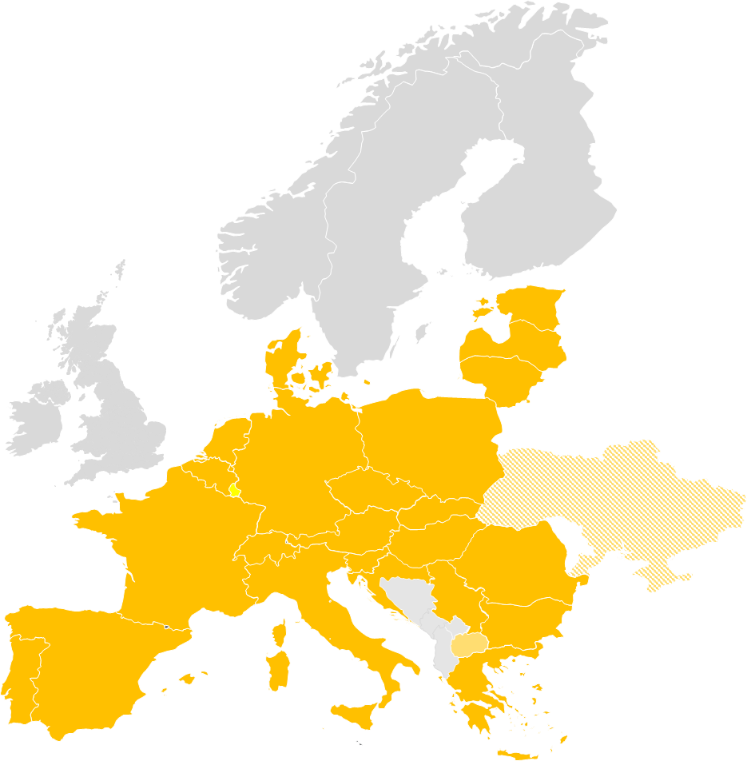
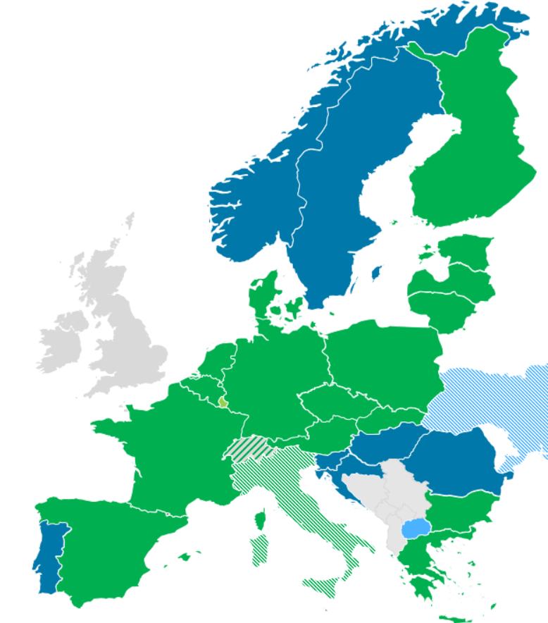
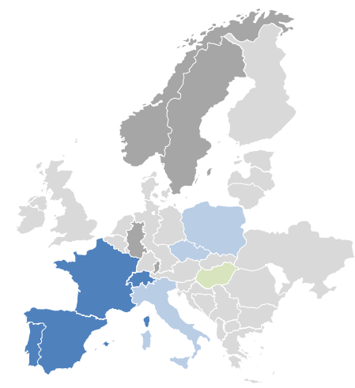
Introduction
Overview on current status of European Balancing Platforms
 | IGCC | MARI | PICASSO | TERRE
Balancing service | IN | mFRR | aFRR | RR
Participants
Target area | Continental Europe | ≥ Continental Europe | ≥ Continental Europe | ≥ RR TSOs
Go-live | 24/06/2021 & operational since 01/10/2011 | 05/10/2022* | 22/06/2022* | 29/09/2020*
Status
Highlights | Economic surplus of ~389 Mio. € until end of August 2025 | Economic surplus of ~78 Mio. € in 2025 until end of August 2025. | Economic surplus of ~ 280 Mio € in 2025 until end of August 2025 | Economic surplus of 284 Mio. € in 2025 until end of September.
* Date as of when cross-border exchanges were possible due to neighbouring TSO joining. Technical go-live of platform was earlier.
  European market design has significantly changed the local procurement rules.
  In 2024 all platforms together achieved an economic surplus of more than 1,450 Mio. €

Slide 3


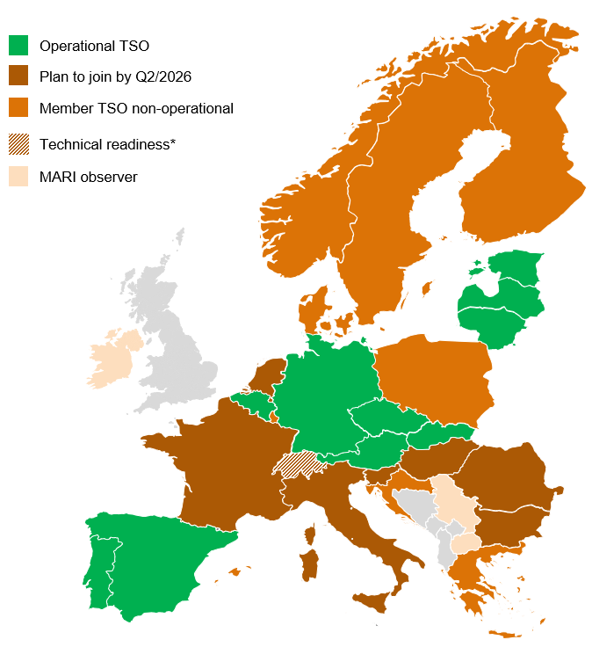
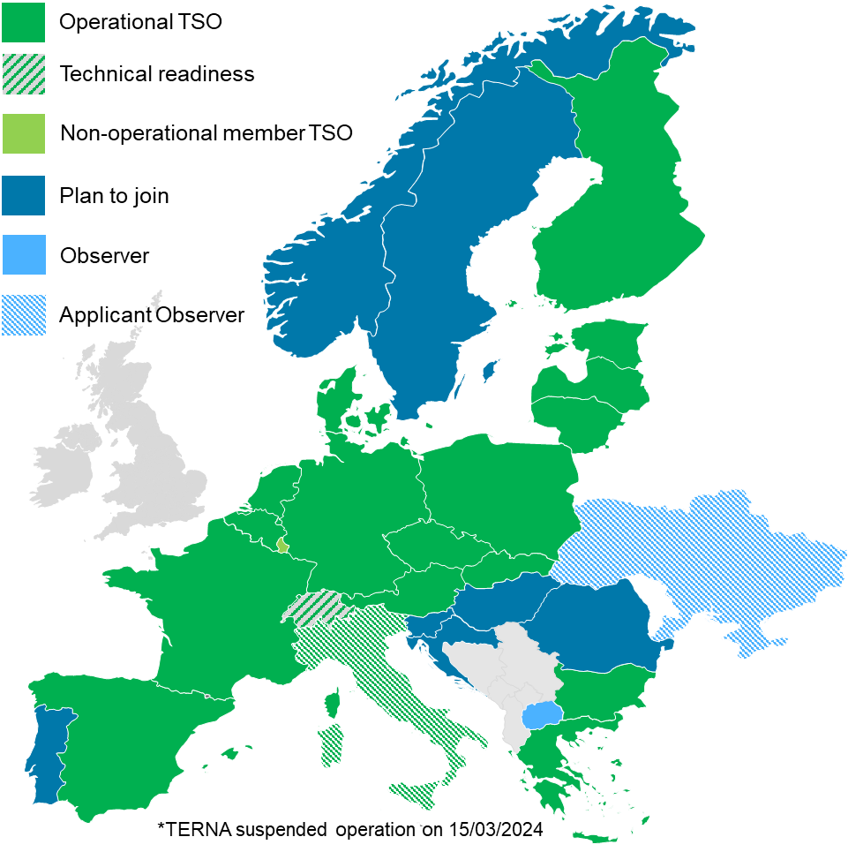
Recent developments and updates
Updates
Accession to MARI in 2025
  May:
    Elia (Link to communication)
  Expected in December
    ESO
    TenneT NL
Accessions to PICASSO in 2025
  February to July
    ESO (Link to communication), Litgrid (Link to communication), ADMIE (Link to communication), Fingrid (Link to communication), RTE (Link to communication), AST (Link to communication), ELERING (Link to communication), Red Eléctrica (Link to communication) and PSE (Link to communication)
  Expected in November: TERNA
🗓️Save the date: 2025 Balancing platforms stakeholders' workshop invitation

Slide 4
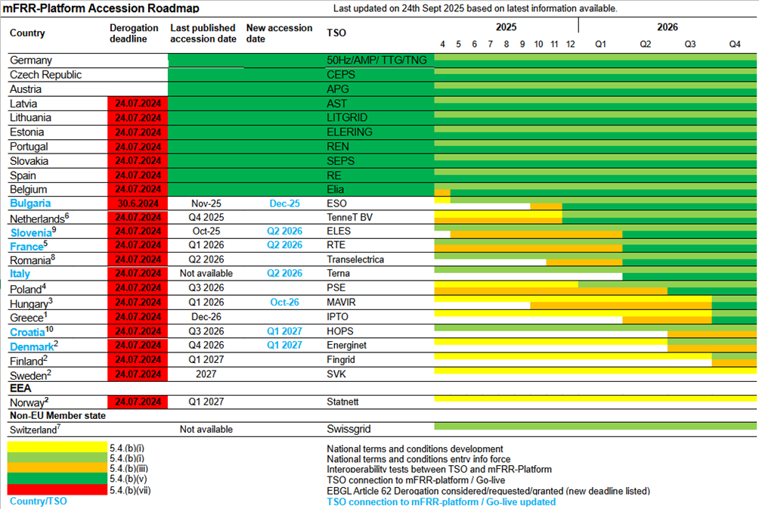
Recent developments and updates
Update of the accession roadmaps MARI
Background: Accession Roadmap based on 01.10.2025 published version

Slide 5
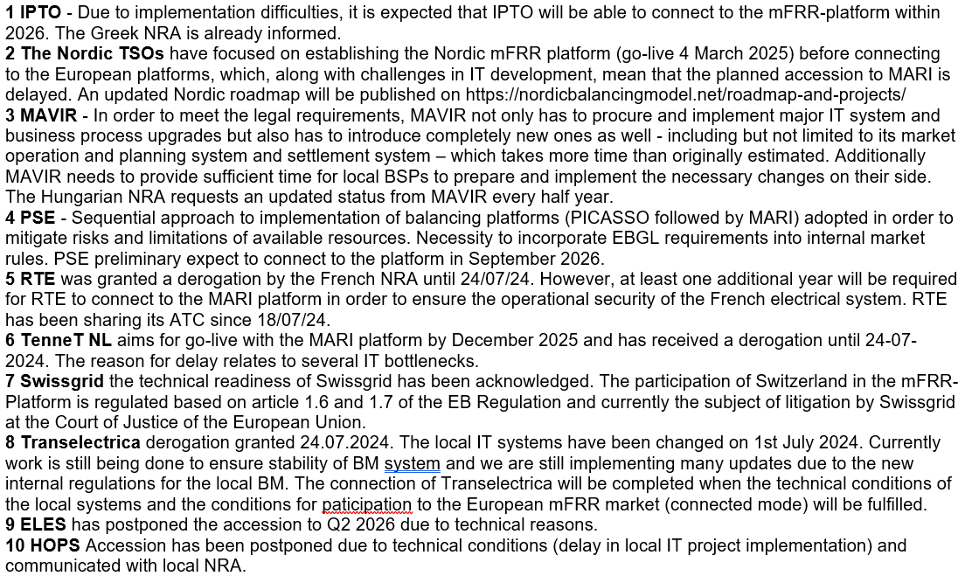
Recent developments and updates
Update of the accession roadmaps MARI
Background: Accession Roadmap based on 01.10.2025 published version / footnotes

Slide 6
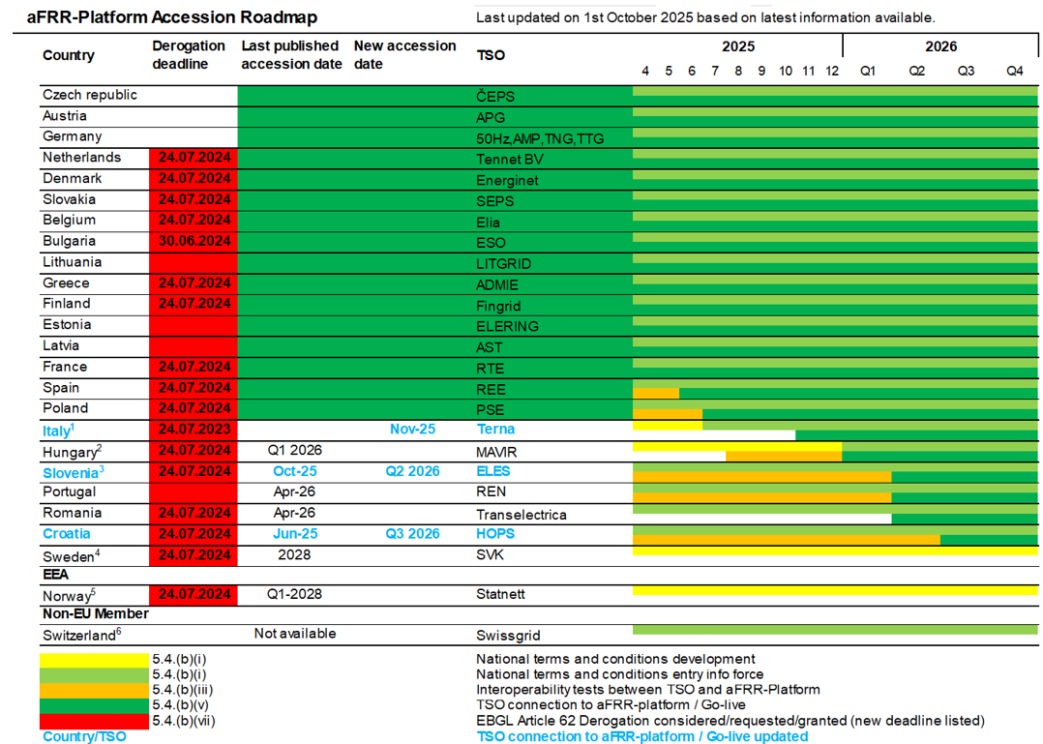
Recent developments and updates
Update of the accession roadmaps PICASSO
Background: Accession Roadmap based on 01.10.2025 published version

Slide 7
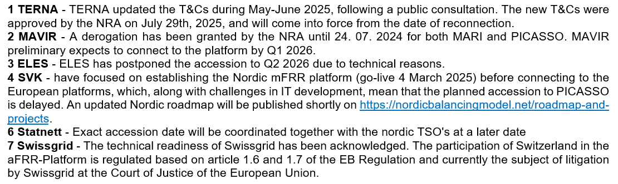
Recent developments and updates
Update of the accession roadmaps PICASSO
Background: Accession Roadmap based on 01.10.2025 published version footnotes

