Slide 1


v
Uniting Europe's Energy, Today
Energy Community – update
Update by
Jasmina Trhulj, Energy Community Secretariat
41st MESC
15 October 2025

Slide 2
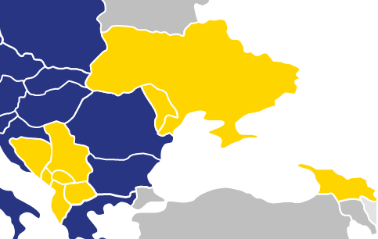
Electricity Integration Package - transposition
The draft Electricity Market Law consolidated by the Energy Committee, aimed at transposing EIP, adopted in the first reading by the Parliament on 22 July 2025
Comments provided by the UA stakeholders and the EnCS are being considered by the WG organized by the Energy Committee for the finalization of the draft Law
Ukraine
RA – Q4 2025
Serbia
RA – Dec 24
Amendments to the Energy Law and Governmental Decrees aimed at transposing all 9 legal acts of the EIP adopted;
Serbia still to submit final concordance tables, but the unofficial assessment of compliance initiated by EnCS
The Electricity Law adopted and in force as of August 2025
NC&GL drafting finalized, supported by EnCS, expected to be approved by ANRE by end of November;
Moldova – by mid-April Gov to submit the law to Parliament
Draft Law approved by the Council of Ministers in July 2025;
Currently in the parliamentary procedure;
ECS reviewed draft Laws on Energy and Electricity in November 2024
No follow up activities reported, process slowed down after elections
Kosovo*
RA – June 25
Drafting ongoing based on the version submitted by EnCS/EU4Energy to the Ministry in Sep 2024
Finalisation slowed down
Bosnia and Herzegovina
The Energy Law adopted in March 2025
The Law on XB is being finalized following EnCS review in August 2025; new version submitted to the EnCS
Georgia
The Energy law adopted in May 2025
NC&GLs still to be fully transposed
North Macedonia
RA – Dec 25
Montenegro
RA – Dec 24
A draft Power Sector Law in consultation;
EnCS submitted its comments on 21 July;
CACM Regulation adopted by ERE in April 2025
Albania
RA – June 25

Slide 3
EIP verification - overview
Verification process, scope and steps, outlined in the letter shared with PHLG members by EnCS/EC on 7 August 2025 and presented in detail at EnC JET meeting on 1 October 2025
Key elements:
Purpose: compliance assessment for adherence to market coupling
Scope: Electricity Integration Package, including all 9 legal acts as adopted by the Ministerial Council of the Energy Community in December 2022
Parties involved: Contracting Party, EnC Secretariat and European Commission
Official start: upon submission of all the laws and regulations transposing all 9 legal acts, including tables of concordance of appropriate quality and in English language and confirmation that any national measures that may conflict with a provision of a respective EU act are either repealed or amended to ensure its compliance with the relevant provision thereof.

Slide 4
EIP verification – steps
Step 1
Submission of Laws and Regulations
Step 3
Opinion by DG ENER
Step 4
Notification of the Contracting Party
Step 2
Review by the Secretariat

Slide 5




THANK YOU!
energy-community.org
Energy Community Secretariat
Am Hof 4, Level 5, 1010 Vienna, Austria

