Slide 1
ACER 2025 MMR on cross-zonal capacities and congestion management
Key findings
MESC – 03/07/2025

Slide 2
Scope and structure
Third publication in the 2025 series of ACER electricity wholesale market monitoring reports.
Covering the topic of cross-zonal capacities and congestion management in the EU.
Developed in cooperation with EU TSOs (data collection, joint workshop) and NRAs.
New areas of focus:
Market congestion: Quantifying the market impact of limitations in cross-zonal trade.
First assessment on MACZT in Nordic and Core intraday flow-based.
Assessment of the impact of different bidding zone configurations on 70% implementation.
Report publication is planned for end-August / beginning of September.
1. Quantifying the cost of market congestion
2. Monitoring of the margin available for cross-zonal trade in 2024
3. Build, pay, split: Progress and challenges

Slide 3
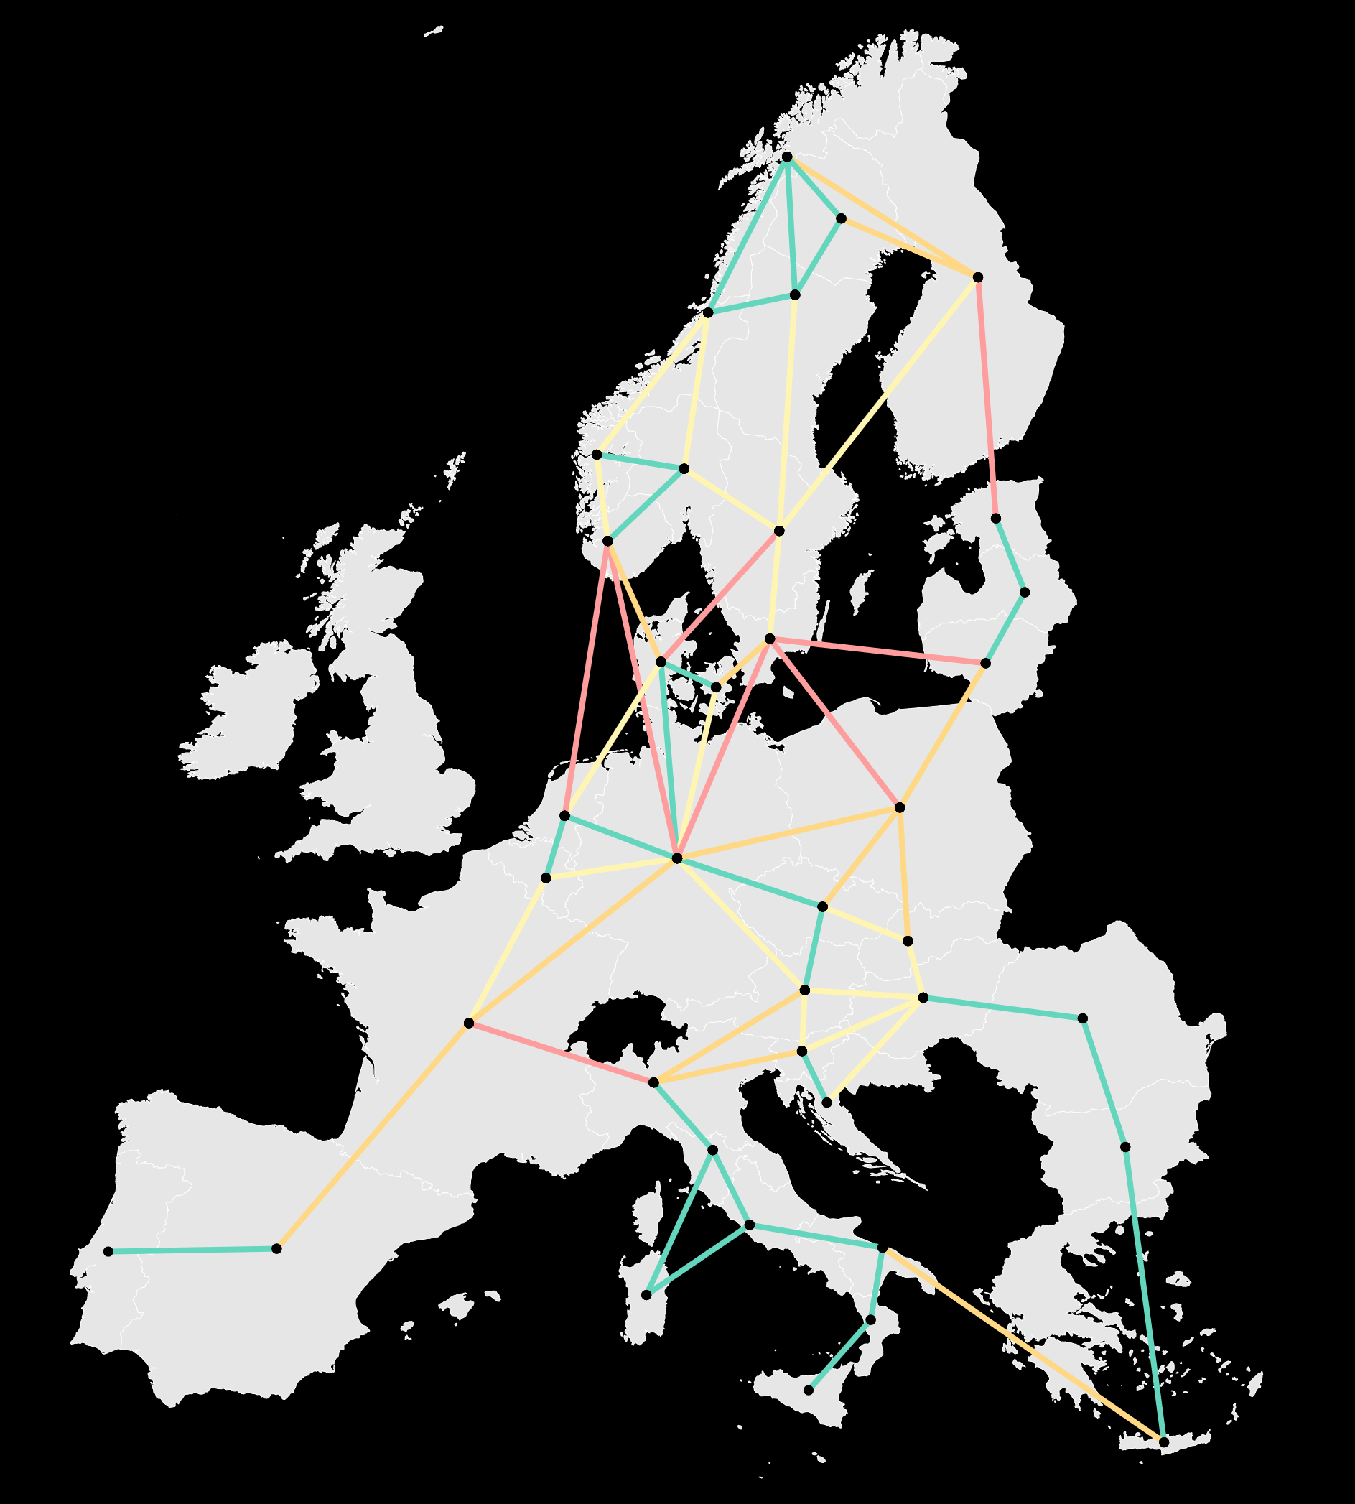
Significant bottlenecks remain across the EU
A highly integrated market ensures the most efficient use of the available resources in the EU, facilitating RES penetration and protecting consumers from price volatility.
In 2024, highly congested borders remained across the EU. Price differences between bidding zone borders reveal insufficient cross-zonal capacity to address all the needs for exchanges.
Further integrating electricity markets calls for addressing bottlenecks, by relieving market congestion through continued improvement of capacity calculation and allocation methods.
The minimum 70% requirement, introduced to address the discrimination of cross-zonal over internal trade, is the main regulatory tool to increase capacities in the short term.
Average price difference per bidding zone border in Single Day-Ahead Coupling – 2024 (EUR/MWh)
Note: Price spreads are categorised as follows <10 EUR/MWh, 10-20 EUR/MWh, 20-30 EUR/MWh, >30 EUR/MWh, for the purpose of the figure.

Slide 4
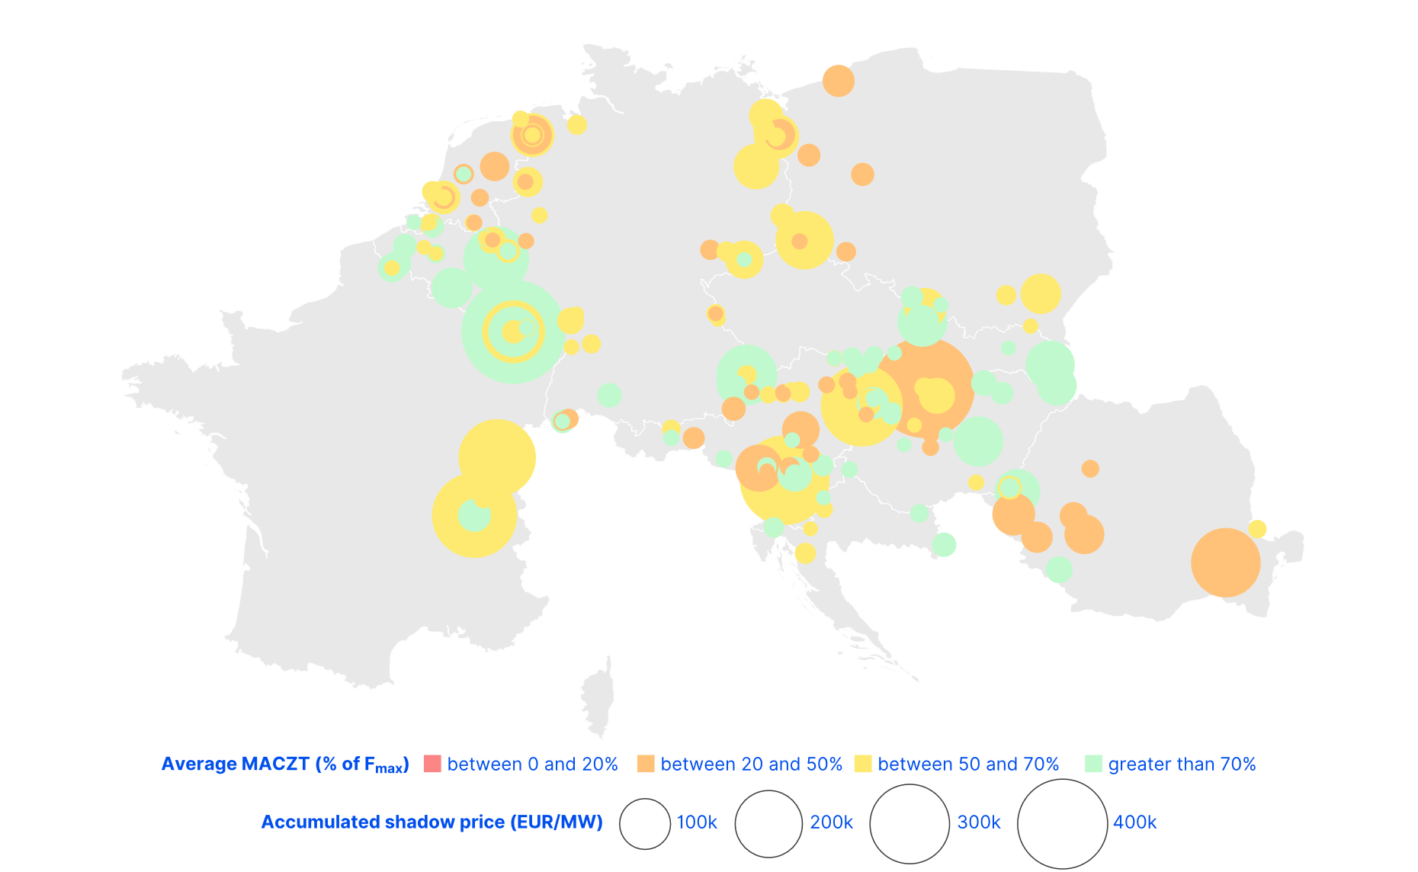
Quantifying the cost of market congestion
Market congestion in the Core CCR weighted by the accumulated shadow price and categorised by margin available for cross-zonal trade – 2024 (EUR/MW and % of Fmax)
The market clearing algorithm quantifies the value of market congestion on every pair of network elements (i.e. CNEC) in Core flow-based market coupling.
The monitoring of these elements indicates where cross-zonal capacity constraints most limited additional welfare.
In 2024, the most limiting bottlenecks in the Core region were recorded in:
France - Spring capacity reductions.
Austria and Slovakia - Summer high evening prices in CEE-SEE.
Note: Average MACZT of all active CNEs in the Core CCR based on JAO Publication Tool data, weighted by their accumulated shadow price, in 2024.
CNEC = Critical Network Element with Contingency
Notes:
This represents the potential welfare gains from relaxing each capacity constraint by a single MW.

Slide 5
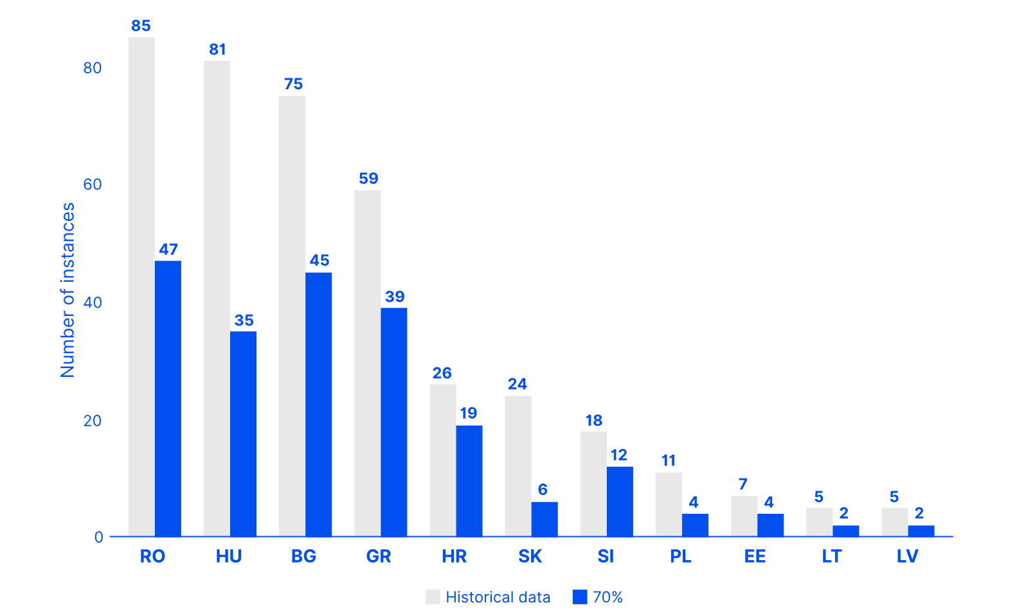
Relieving market congestion mitigates price spikes
Count of instances of day-ahead prices above 400 EUR/MWh in select EU bidding zones, compared to the counterfactual analysis – July to September 2024 (number of instances)
To illustrate the role of cross-zonal trade in providing flexibility to the market, ACER simulated different capacity levels within the Core CCR, linked to the on-going implementation of the minimum 70% requirement.
Increased cross-zonal capacity in major bottlenecks of Austria and Slovakia would have significantly mitigated high-price instances in Summer 2024 in CEE-SEE, in some cases removing more than 50% of instances.
The full implementation of the 70% requirement in the Core CCR would have yielded surplus gains of EUR 340 million in 2024, with EU consumers being most at gain through lower prices and reduced volatility.
Note: This simulation is performed for informational purposes only. The implementation of the minimum 70% requirement, without parallel structural mitigation measures, would potentially result in increased congestion management costs.
Notes:
Relieving congested elements allows for further cross-zonal trade and thus a more optimal dispatch of the EU electricity market.

Slide 6
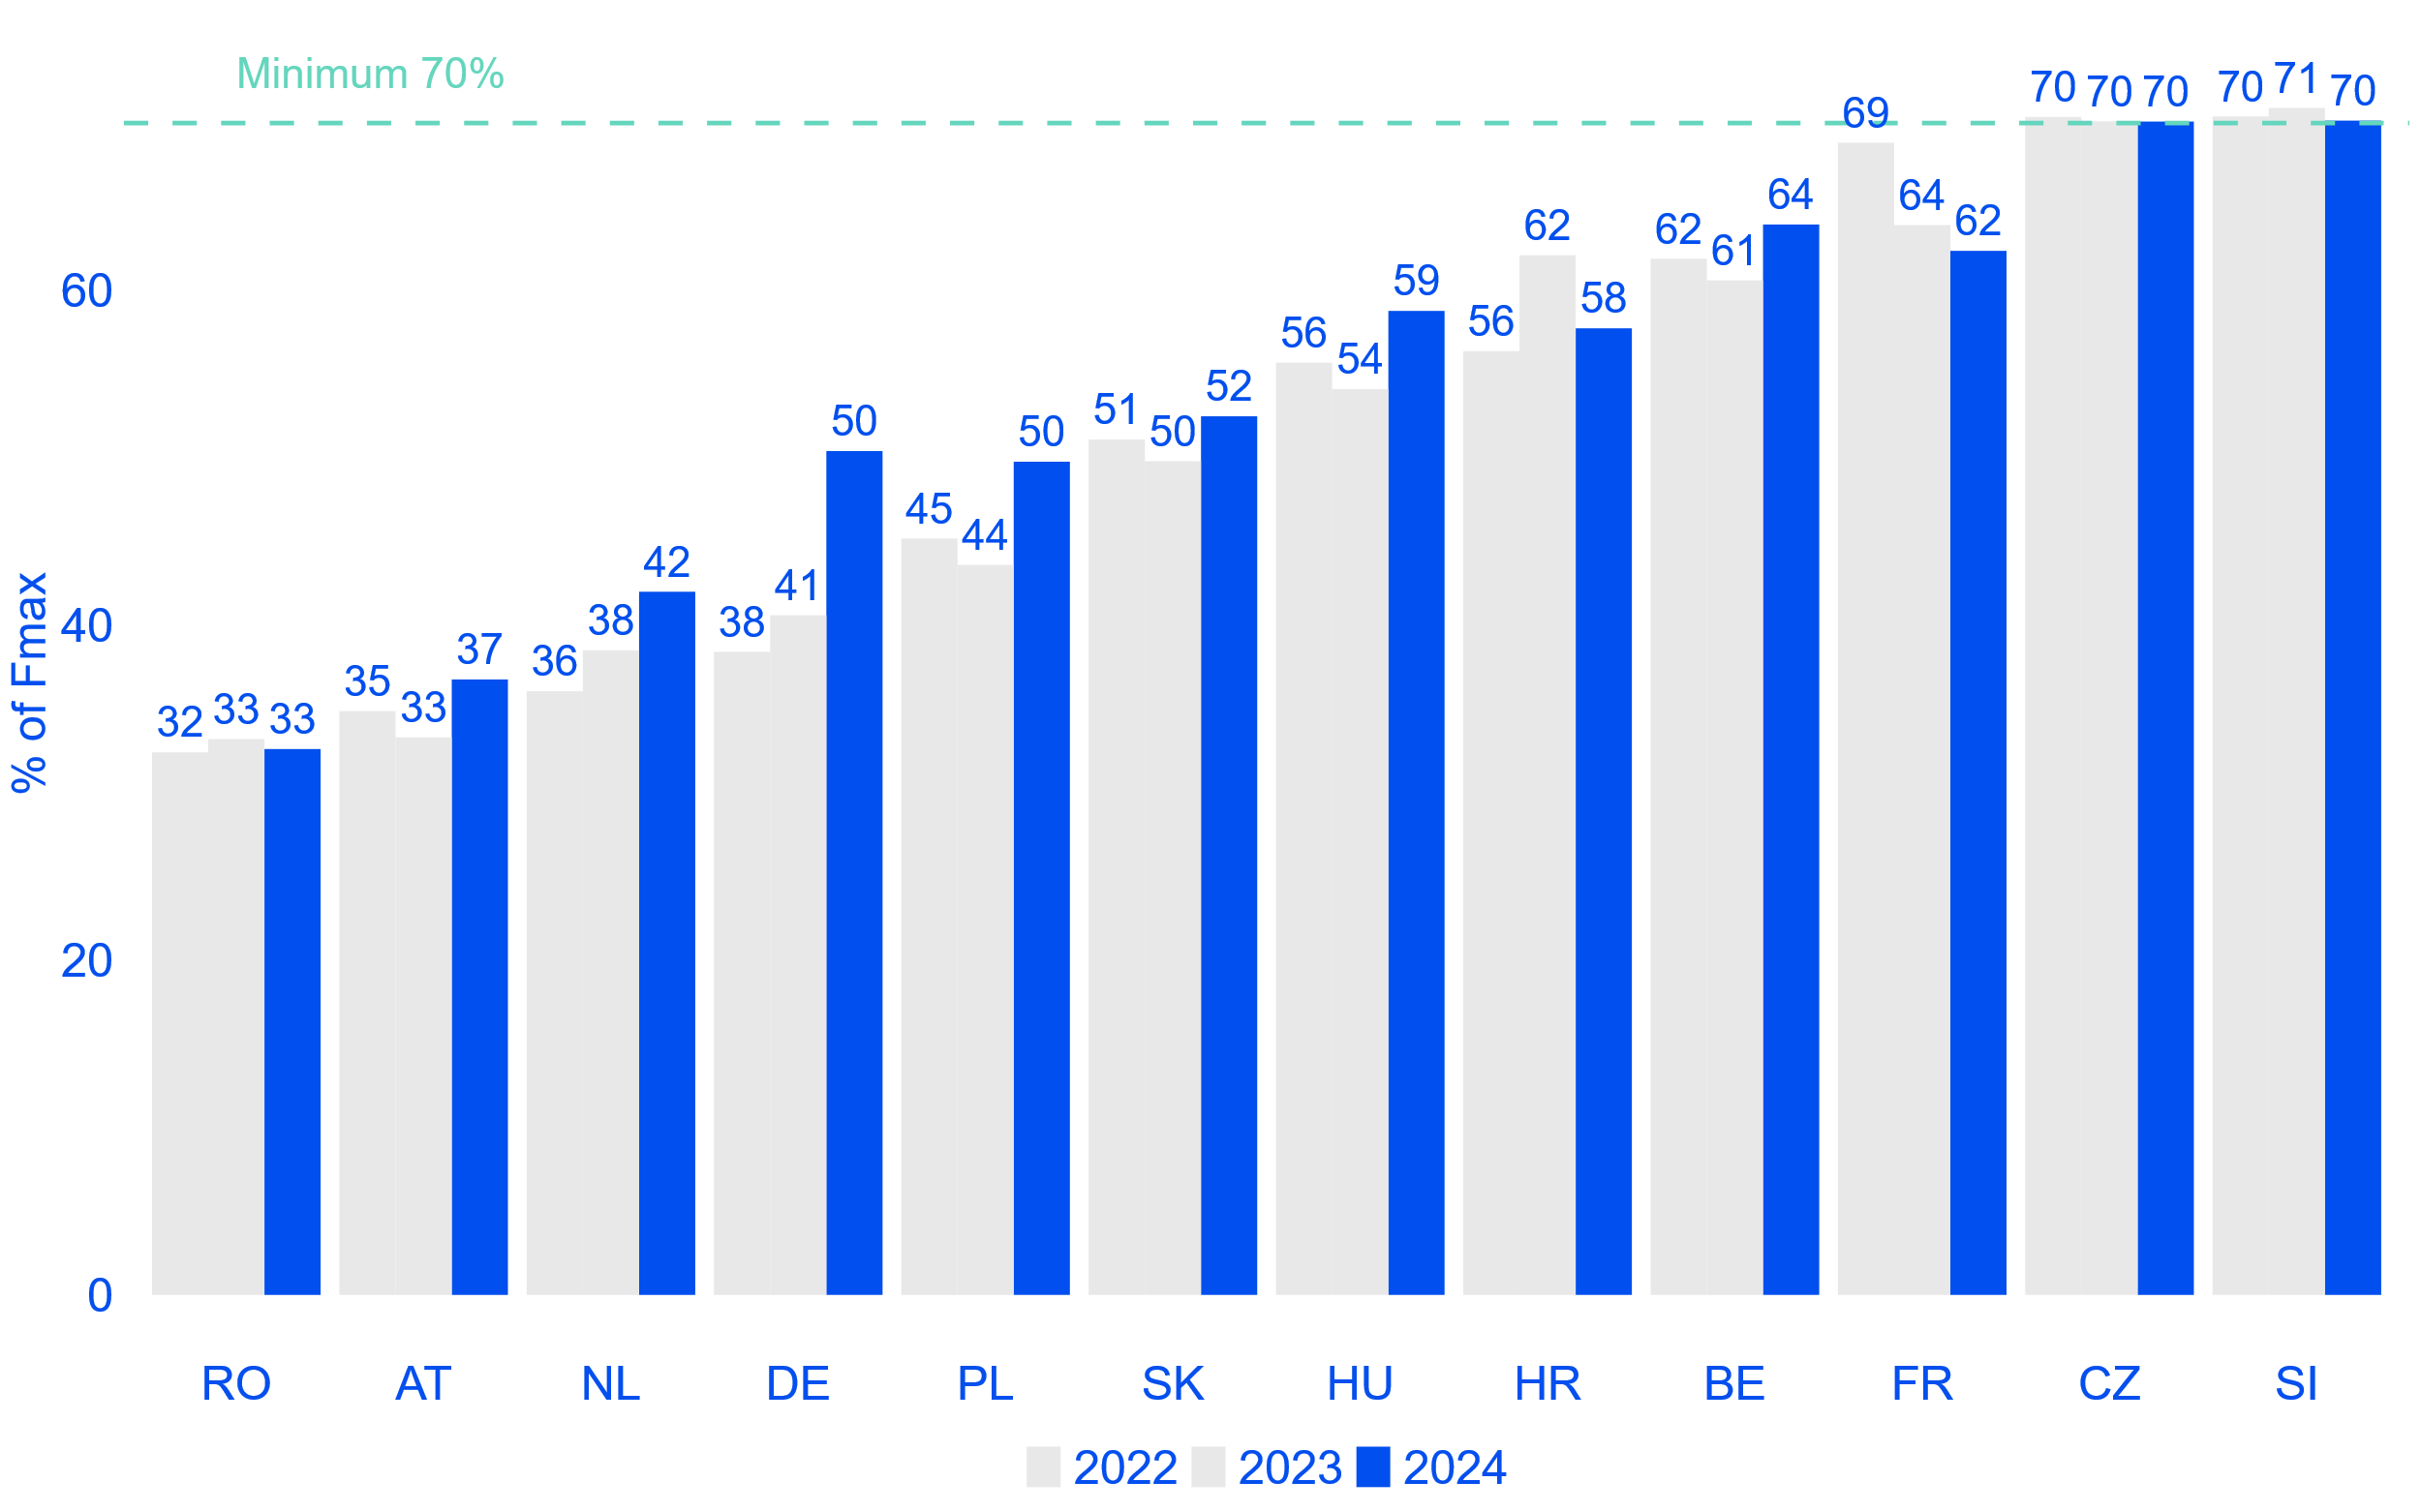
Derogations limit progress in the Core region
Average minimum hourly margin available for cross-zonal trade in the Core capacity calculation region per Member State – 2022-2024 (% of Fmax)
In 2024, improvements towards 70% implementation were recorded in some Core Member States (such as DE, PL or HU).
However, derogations from the applicable requirements are granted yearly in 6 Core Member States. Main reason alleged is the presence of excessive loop flows and the lack of coordinated congestion management framework to adequately address them.
Interim targets are generally met. These may be defined dynamically based on the forecasted loop flows, leading to very low requirements on specific CNECs and hours.
The need for such derogations prevents faster progress in implementing the 70% requirement in the Core region.
Note: MACZT values are computed accordingly to the principles described in ACER Recommendation 01/2019 and the agency’s methodological paper on estimating the MACZT and practical note on monitoring the MACZT.

Slide 7
Virtual capacities have knock-on effects on intraday
The ACER report monitors margins of capacity offered in intraday (since Core IDCC(b) go-live).
In day-ahead, TSOs rely on remedial actions to guarantee the applicable cross-zonal capacity requirements. These are the so-called ‘virtual capacities’. TSOs highlighted the technical difficulty to rely on remedial actions to secure a specific level of cross-zonal capacity in intraday, under current conditions.
Monitoring results show a drop of intraday MACZT for Member States most reliant on virtual capacities in day-ahead.
Average breakdown of $F_{max}$in the Core day-ahead and IDCC(b) domains, based on the CNECs with lowest MACZT in IDCC(b) – June to December 2024 (% of Fmax)
Cross-zonal capacity
Unavailable for cross-zonal trade
Note: Figure displays the average breakdown of $F_{max}$ for the CNECs having the lowest MACZT values in IDCC(b) in the Core CCR, compared to their flow components in day-ahead.

Slide 8
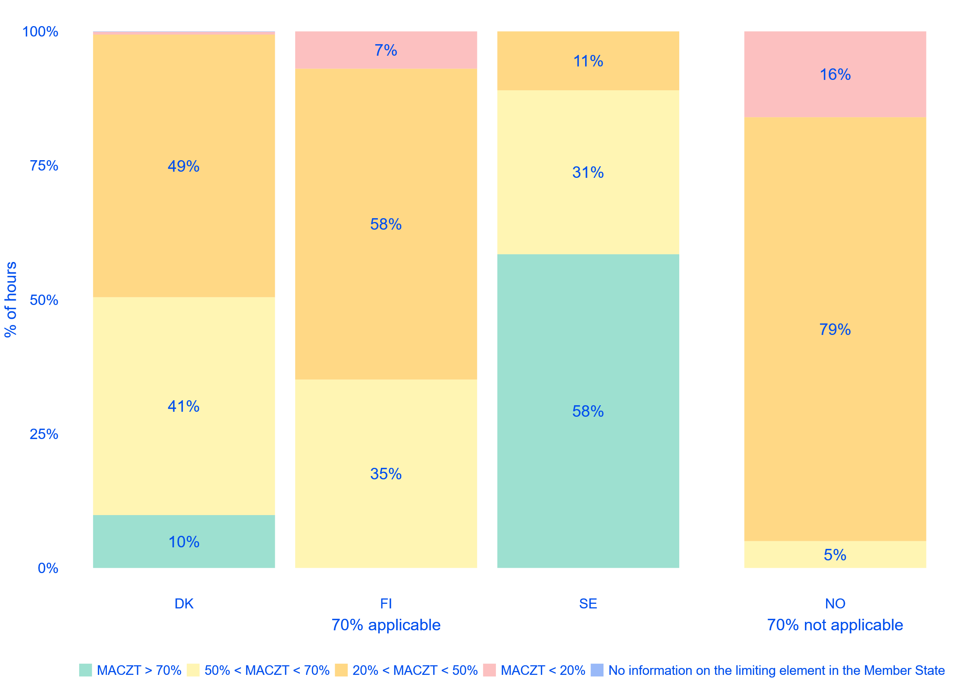
Min. 70% requirement in Nordic flow-based
Percentage of hours when the minimum hourly MACZT was above 70%, or within predefined ranges, in the Nordic CCR for each Member State – 29/10/2024 to 31/12/2024 (% of hours)
In October 2024, Nordic TSOs implemented flow-based market coupling. This allows for an assessment of the 70% fulfilment on all CNECs.
Two major differences compared to the Core CCR apply in the Nordic CCR:
No derogation nor action plan is in place in the Nordic CCR: The minimum 70% requirement is applicable today*.
The Nordic CCM does not the consider the use of virtual capacities to fulfil 70%.
MACZT results show that Nordic TSOs are not yet fulfilling 70%. In some cases, such as FI, this may be due to a few internal CNECs without significant market impact.
Note: In Norway, the Clean Energy Package is pending incorporation into the EEA Agreement.
CCR = Capacity Calculation Region, CCM = Capacity Calculation Methodology, MACZT = Margin Available for Cross-zonal Trade

Slide 9
Build, pay, split: Trade-offs moving forward
The ACER report analyses the main on-going processes linked to the implementation of the 70% requirement:
Upwards trend in RDCT volumes, which may be further exacerbated by increasing cross-zonal capacity requirements without parallel structural measures.
Impact on intraday capacities.
Lack of coordination processes.
Delays in major infrastructure projects aimed at addressing internal congestion.
Ensuing high loop flows will remain an issue.
More granular bidding zone configurations would increase ‘natural’ levels of MACZT and reduce congestion management needs by ~50%.
Some CNECs would still require local actions to fulfil 70%.
Evolution of volume of remedial actions activated in the EU and Norway – 2021-2024 (TWh and billion EUR)
Note: Natural MACZT excludes the contribution of virtual capacities to reach the applicable cross-zonal capacity requirements.
RDCT = Redispatching and Countertrading

