Slide 1
Proposal for Amendment to the CCR definition
June 2025

Slide 2
Content of final CCR proposal
Summary
The proposal consists of:
Definition of CE CCR following CORE and IN CCR merger
Definition of an interim East-Central Europe CCR (ECE CCR) consisting of EMS, CGES, NOSBiH and neighbouring EU TSOs, only for the day-ahead timeframe,
Definition of SEE CCR, attributing the non-EU and EU borders with the EnC TSOs to the existing SEE CCR,
Definition of IT-ME CCR (default EnC CCR), and
Definition of Eastern-Europe CCR (EE CCR – default EnC CCR).
The conditions for East-Central Europe CCR to move to CE CCR in future are: (1) full transposition of the electricity integration package into national law by all Energy community Contracting Parties of the CCR ECE as required by Decision 2022/03/MC-EnC of the Ministerial Council of the Energy Community, and (2) the full implementation of the day-ahead capacity calculation processes according to Article 20 (1) CACM by the capacity calculation regions set out in Article 7 and Article 11a and (3) the participation of the CCR ECE’s TSOs in the single day-ahead coupling as set out in Article 8 (1) CACM.
The condition for the 3 non-EU TSOs (MEPSO, OST, KOSTT) to join SEE CCR is the full transposition of the electricity integration package into national law by all Energy community Contracting Parties of the CCR SEE as required by Decision 2022/03/MC-EnC of the Ministerial Council of the Energy Community.

Slide 3
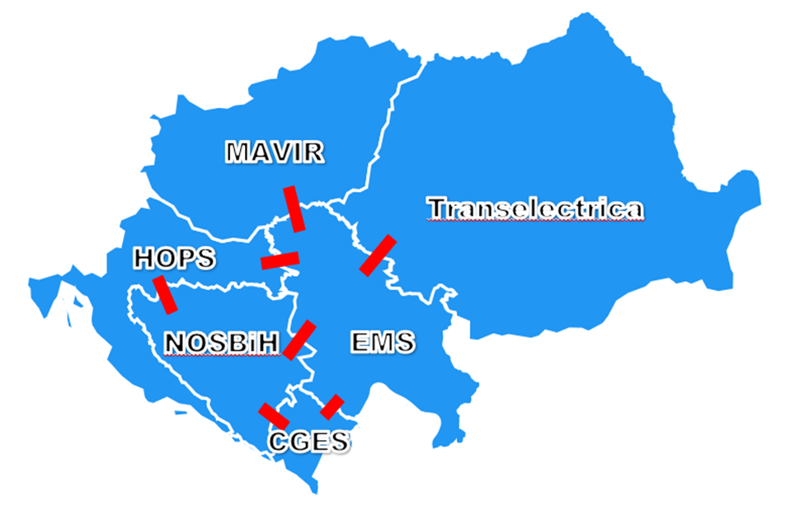
Interim East Central Europe CCR

Slide 4
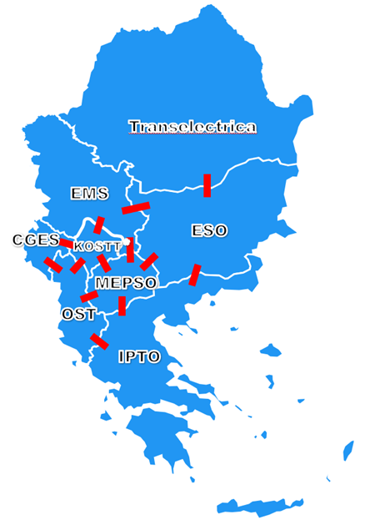
South-East Europe CCR

Slide 5
Italy-Montenegro (ITME) CCR

Slide 6
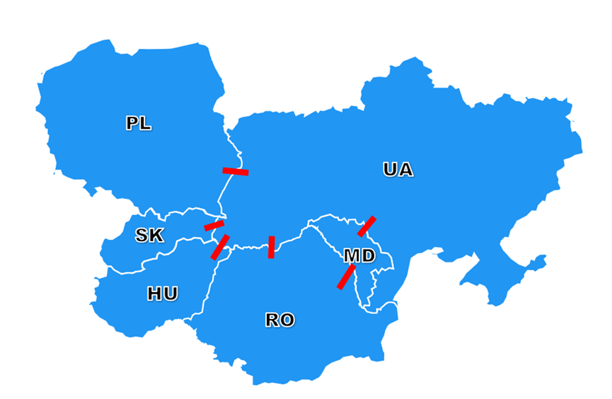
Eastern Europe (EE) CCR

