Slide 1
Update on Balancing Platforms
December 3rd, 2024
MESC

Slide 2
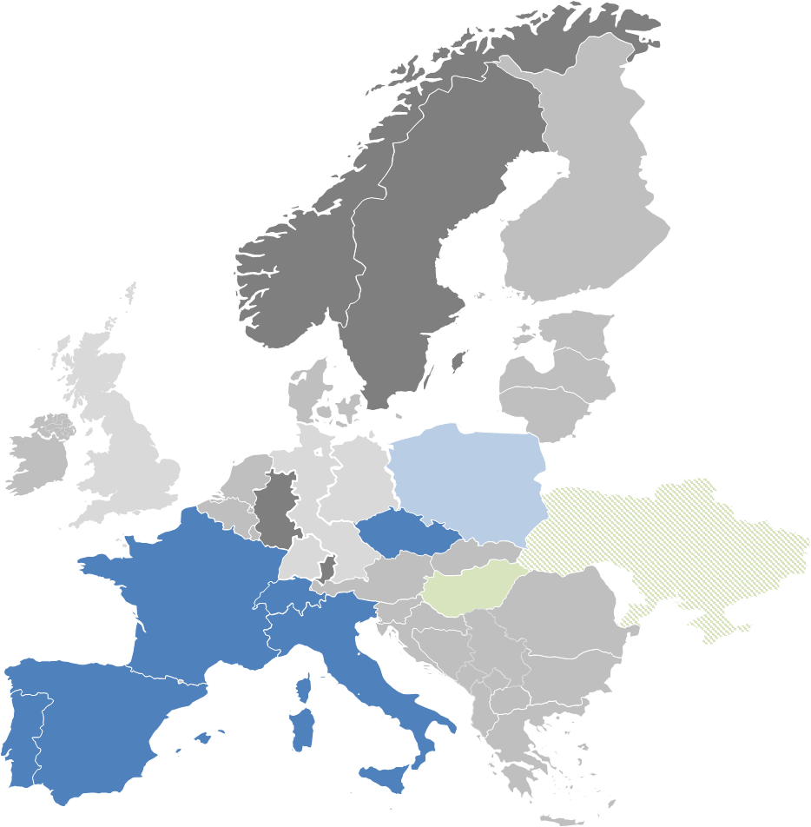
Introduction
Overview on current status of European Balancing Platforms
 | IGCC | MARI | PICASSO | TERRE
Balancing service | IN | mFRR | aFRR | RR
Participants
Target area | Continental Europe | Europe | ≥ Continental Europe | ≥ RR TSOs
Go-live | 24/06/2021 & operational since 01/10/2011 | 05/10/2022* | 22/06/2022* | 29/09/2020*
Status
Highlights | Economic surplus of around 666 Mio. € in Q1 – Q3/24 | Economic surplus of 3.5 Mio. € until end of August 2024 | Economic surplus of more than 105 Mio. € until end of September 24 | Economic surplus of nearly 410 Mio € until October 2024
* Date as of when cross-border exchanges were possible due to neighboring TSO joining. Technical go-live of platform was earlier.
European domestic market (at least) for balancing energy has been established in 2022.
European market design has significantly changed the local procurement rules.

Slide 3
Recent developments and updates
Updates
Go-lives at MARI
The Baltics TSO Elering, AST and Litgrid successfully accessed the MARI platform on October 2nd, 4th and 8th, 2024.
Thereby, the Estonian, Lithuanian, and Latvian national markets are connected to the MARI platform in accordance with the EB Regulation, allowing now interchanges of balancing energy from mFRR.
Link to the 241010_Communication_note_Baltic_TSOs__Elering__AST_and_Litgrid__go-live.pdf
Go-lives at PICASSO
On 11. October, Energinet.dk joint PICASSO with both LFC-Areas EnDK1 and EnDK2, also the first exchange of aFRR took place between different synchronous areas. Due to several operational and technical issues, the go-live procedure lasted from 2nd October to 11th
On 17. October, TenneT NL joint PICASSO. The first attempt on the 15th October was stopped due to a configuration issue.
On 5. November, SEPS joint PICASSO
Link to the press release: PICASSO_press_release_platform_accession_Energinet_and_TenneT_NL.pdf
PICASSO_press_release_platform_accession_SEPS_for_ENTSO-E.pdf
.

Slide 4
Recent developments and updates
Updates
Elastic demand in PICASSO
With the Go-live of PICASSO, the first TSO is using the “elastic demand” concept.
The mathematical description of the elastic demand is included in the public AOF description of PICASSO:
Data View
The publications related to the elastic demand are available on the TransnetBW Homepage:
PICASSO - Ancillary Services - Energy Market – TransnetBW
Public Stakeholder Workshop
The annual Balancing platforms stakeholders' workshop will take place on 11th December, from 1pm to 4 pm.
Balancing platforms stakeholders' workshop
.

Slide 5
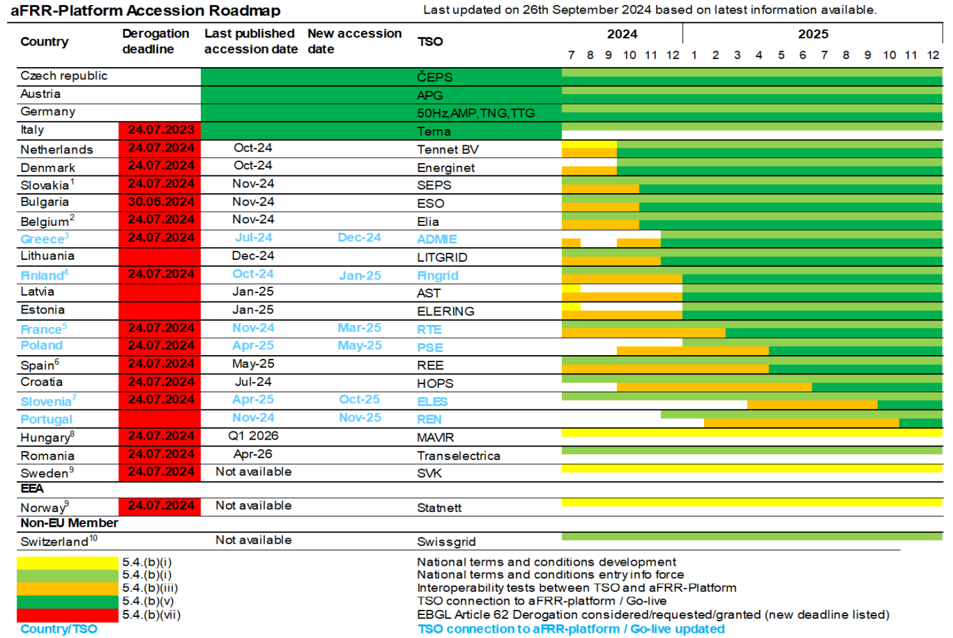
Recent developments and updates
Update of the accession roadmaps PICASSO
Background: Accession Roadmap based on 26.9. published version
PICASSO_12th_Accession_roadmap_ext.pdf

Slide 6
Recent developments and updates
Update of the accession roadmaps PICASSO
Background: Accession Roadmap based on 26.9. published version / footnotes

Slide 7
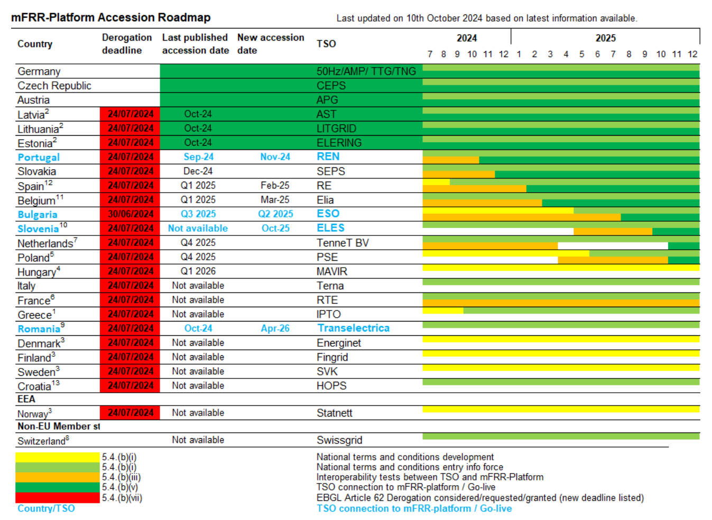
Recent developments and updates
Update of the accession roadmaps MARI
Background: Accession Roadmap based on 10.10 published version MARI_Accession_roadmap_OCT_2024.pdf

Slide 8
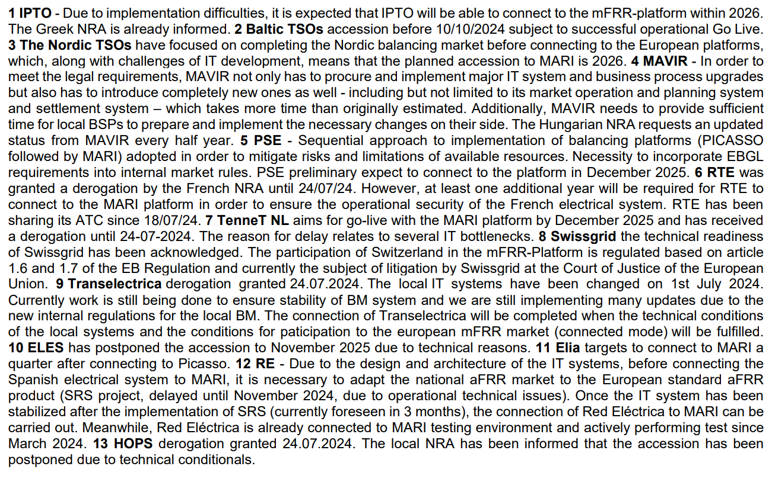
Recent developments and updates
Update of the accession roadmaps MARI
Background: Accession Roadmap based on 10.10. published version / footnotes

Slide 9
Recent developments and updates
Update of the accession roadmaps MARI
Red Electrica acceleration of accession to MARI:
At the request of the NRA, RE from Spain intends to access the mFRR platform already in December 2024 and not in February 2025, as stated in the published accession roadmaps. RE has already informed local stakeholders
Sharing of ATC (from RTE) is allowing participation of RE and REN in exchanges of balancing energy with other MARI operational TSOs (APG, German TSOs, CEPS).

