Slide 1
Transparency Platform updates (WG MIT)
MESC Meeting
03/12/2024

Slide 2
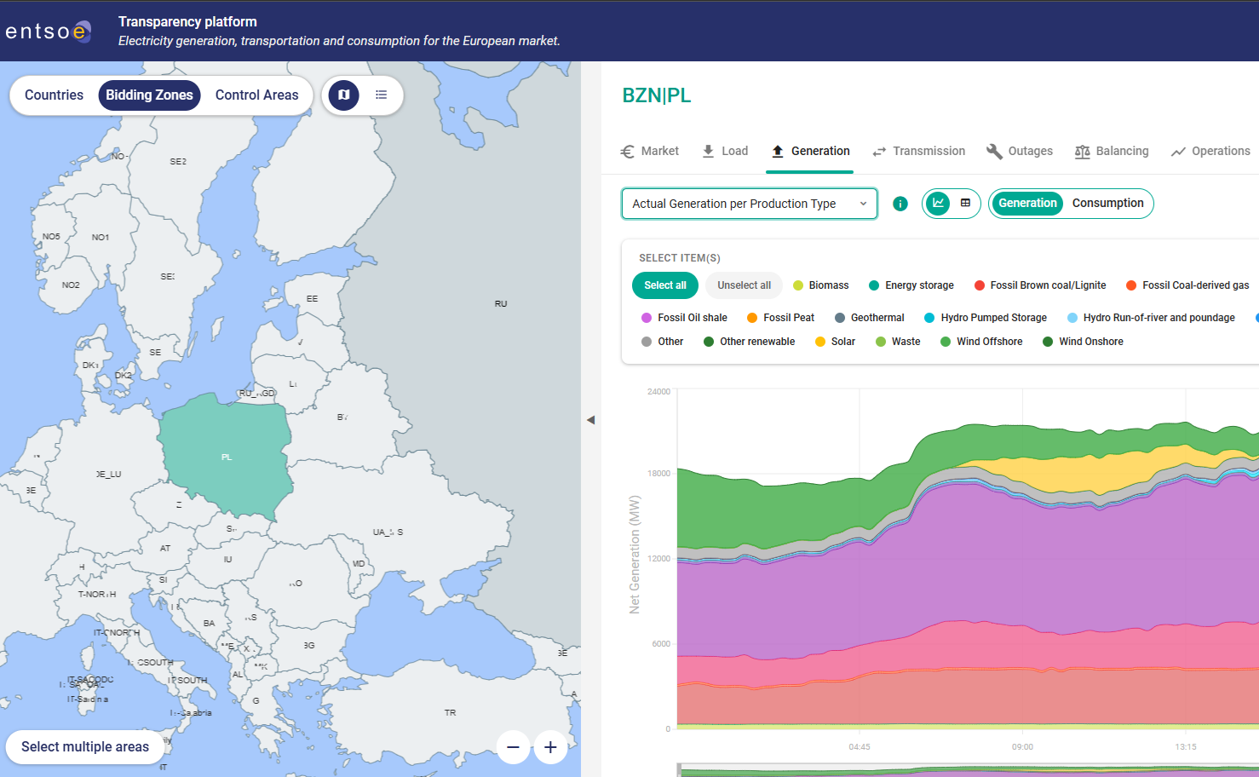
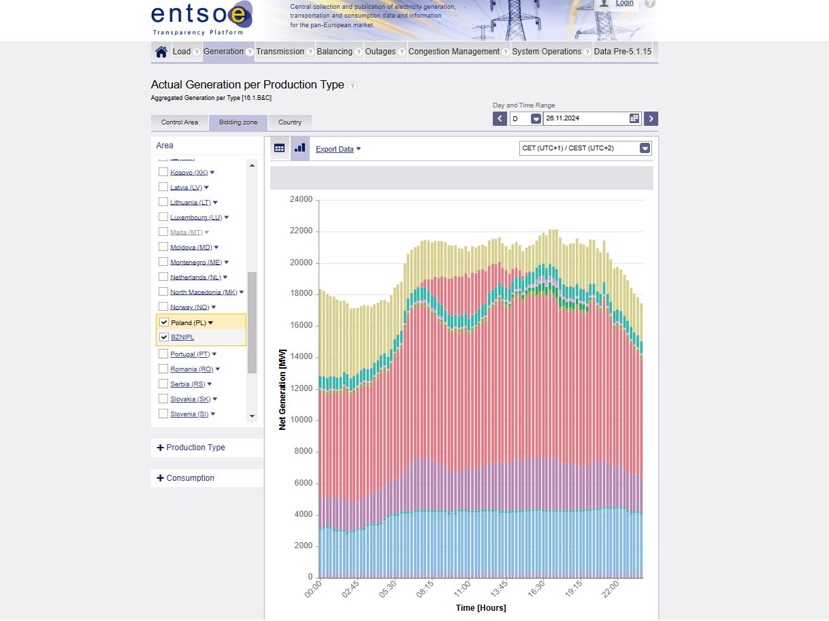
TP Vision & TP Redesign – GUI Changes
New
Legacy

Slide 3
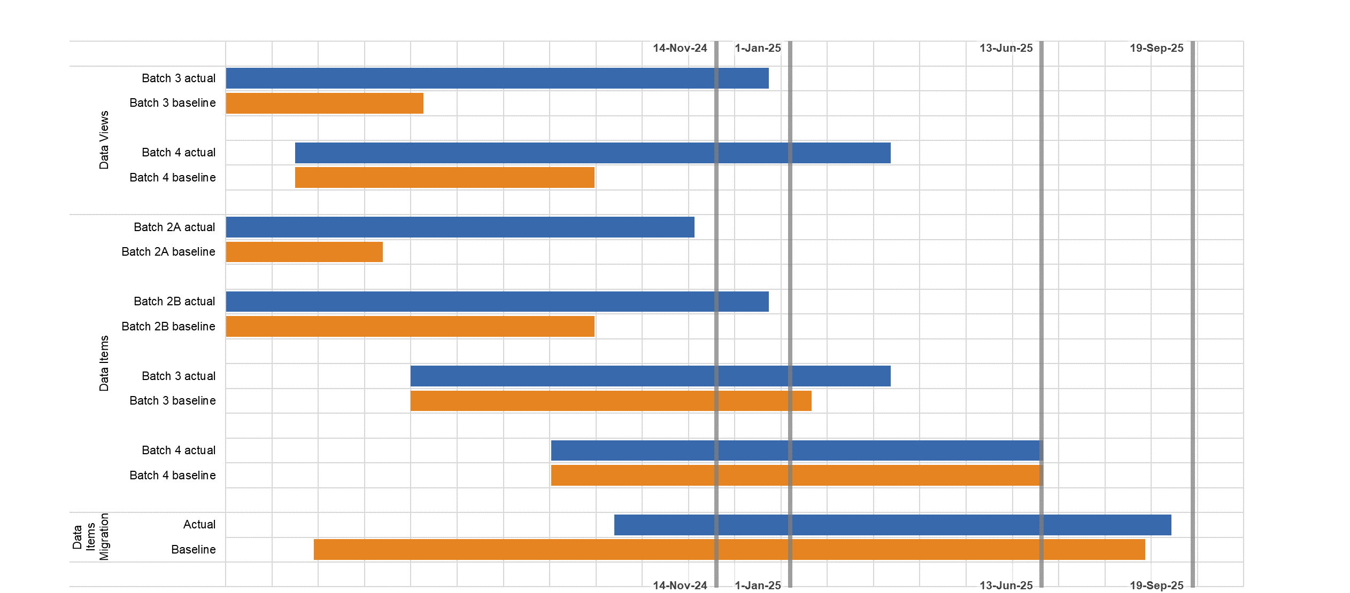
TP Timeline
New GUI

Slide 4
Functional Release in Production since June 2024
New GUI (Data Views) 1/2
Restriction | Domain | Data View Name
Public screens | Market | Implicit Allocations – Net Positions
 |  | Day-ahead Flow-based Allocations
 | Generation | Installed Capacity per Production Type & Production Unit
 | Transmission | Transmission/Cross-border Capacity of DC Links – Intraday Transfer Limits
 |  | Redispatching Internal
 |  | Redispatching Cross Border
 |  | Cost of Congestion Management
 |  | Countertrading
 |  | Expansion and Dismantling Projects
 | Outages | Aggregated Unavailability of Consumption Units
 |  | Unavailability in Transmission Grid
 |  | Unavailability of Offshore Grid
 |  | Fall-backs
 | Balancing | Financial Expenses and Income
 |  | Elastic Demands
 |  | Balancing Border Capacity Limitations
 |  | Permanent Limitations to Cross-border Capacity on HVDC Lines
 |  | Exchanged Prices & Volumes
 |  | Changes to Bid Availability
 |  | Current Balancing State

Slide 5
Functional Release in Production since June 2024
New GUI (Data Views) 2/2
Restriction | Domain | Data View Name
Public screens | Balancing | Changes to Bid Availability
 |  | Current Balancing State
 |  | Use of Allocated Cross Zonal Capacity
 |  | Imbalance
 |  | Aggregated BIDs of Balancing Reserve Capacity
 |  | Prices of Activated Balancing Energy
 |  | FCR Amount and Shares
 |  | Actual Capacities and Outlook on FRR and RR
 |  | Sharing of RR and FRR
 |  | Sharing of FCR between Synchronous Areas
 |  | Exchanged Reserve Capacity
 | Operations | Results of the Criteria Application Process
Restricted screens | CACM | Curtailment
 | FSKAR | Settlement Prices

Slide 6
Functional Release in Production since June 2024
Data Items
Original Data Item Name | New Data Item Name
Day-ahead Prices [12.1.D] | Energy Prices [12.1.D]
Intraday Flow-based Allocations [11.1] | Flow-based Allocations [11.1]
Day Ahead Flow-based Allocations [11.1]
Total Capacity Already Allocated [12.1.C] (intraday) | Total Capacity Already Allocated [12.1.C]
Total Capacity Already Allocated [12.1.C] (daily)
Total Capacity Already Allocated [12.1.C] (weekly)
Total Capacity Already Allocated [12.1.C] (monthly)
Total Capacity Already Allocated [12.1.C] (quarter yearly)
Total Capacity Already Allocated [12.1.C] (yearly)
Total Capacity Already Allocated [12.1.C] (other)
Implicit Allocations - Congestion Income [12.1.E] (intraday) | Congestion Income [12.1.E]
Implicit Allocations - Congestion Income [12.1.E] (daily)

Slide 7
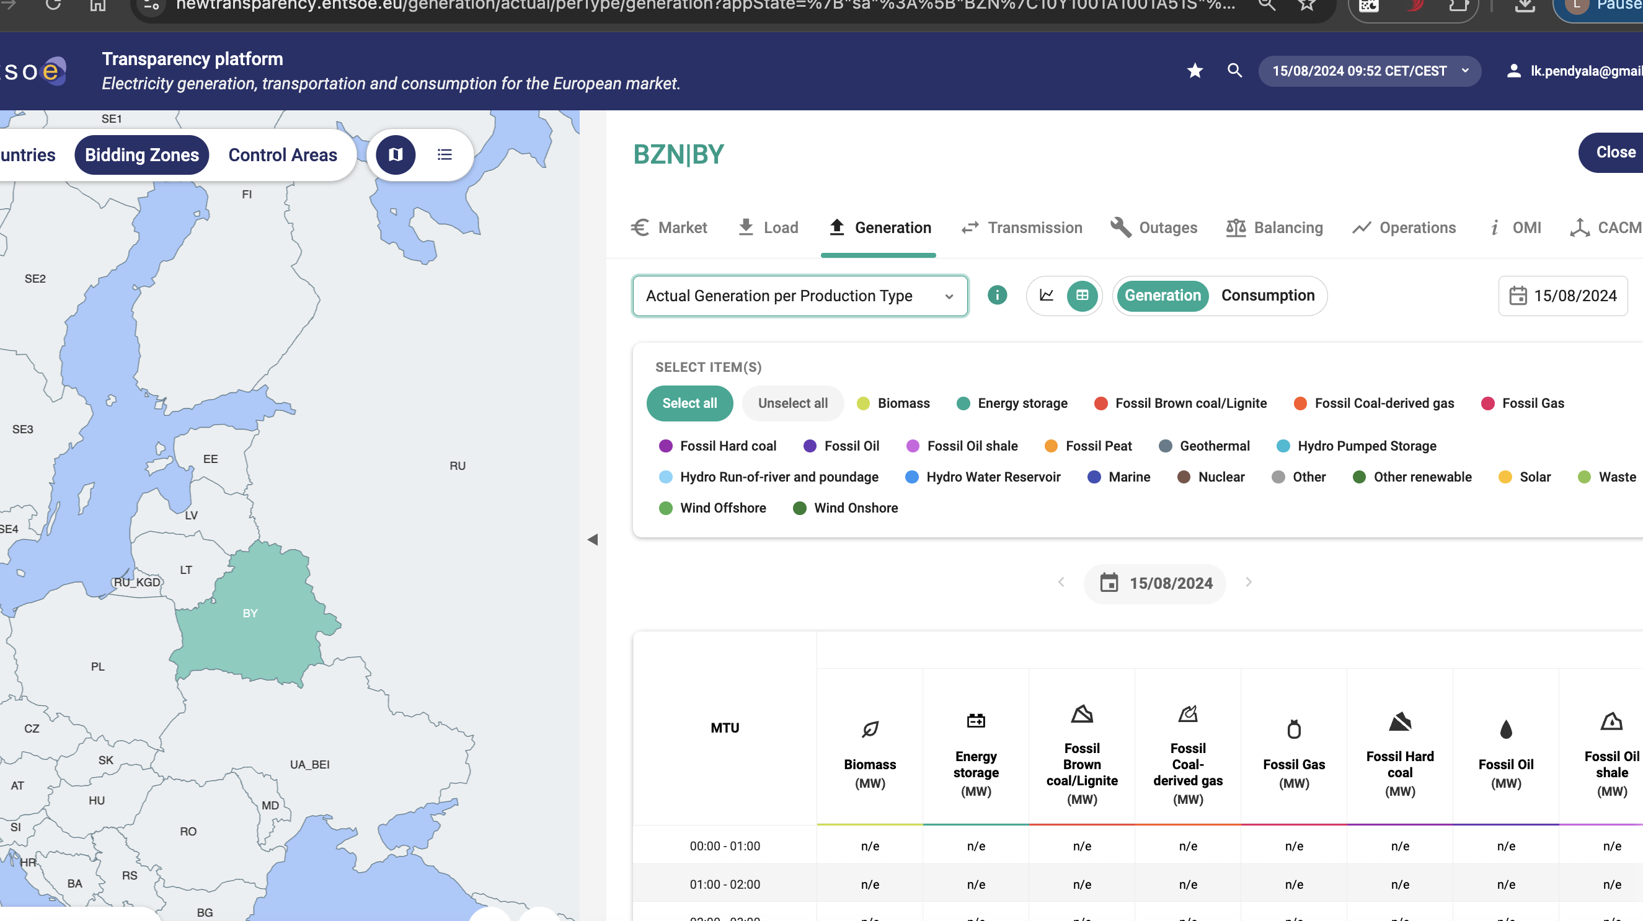
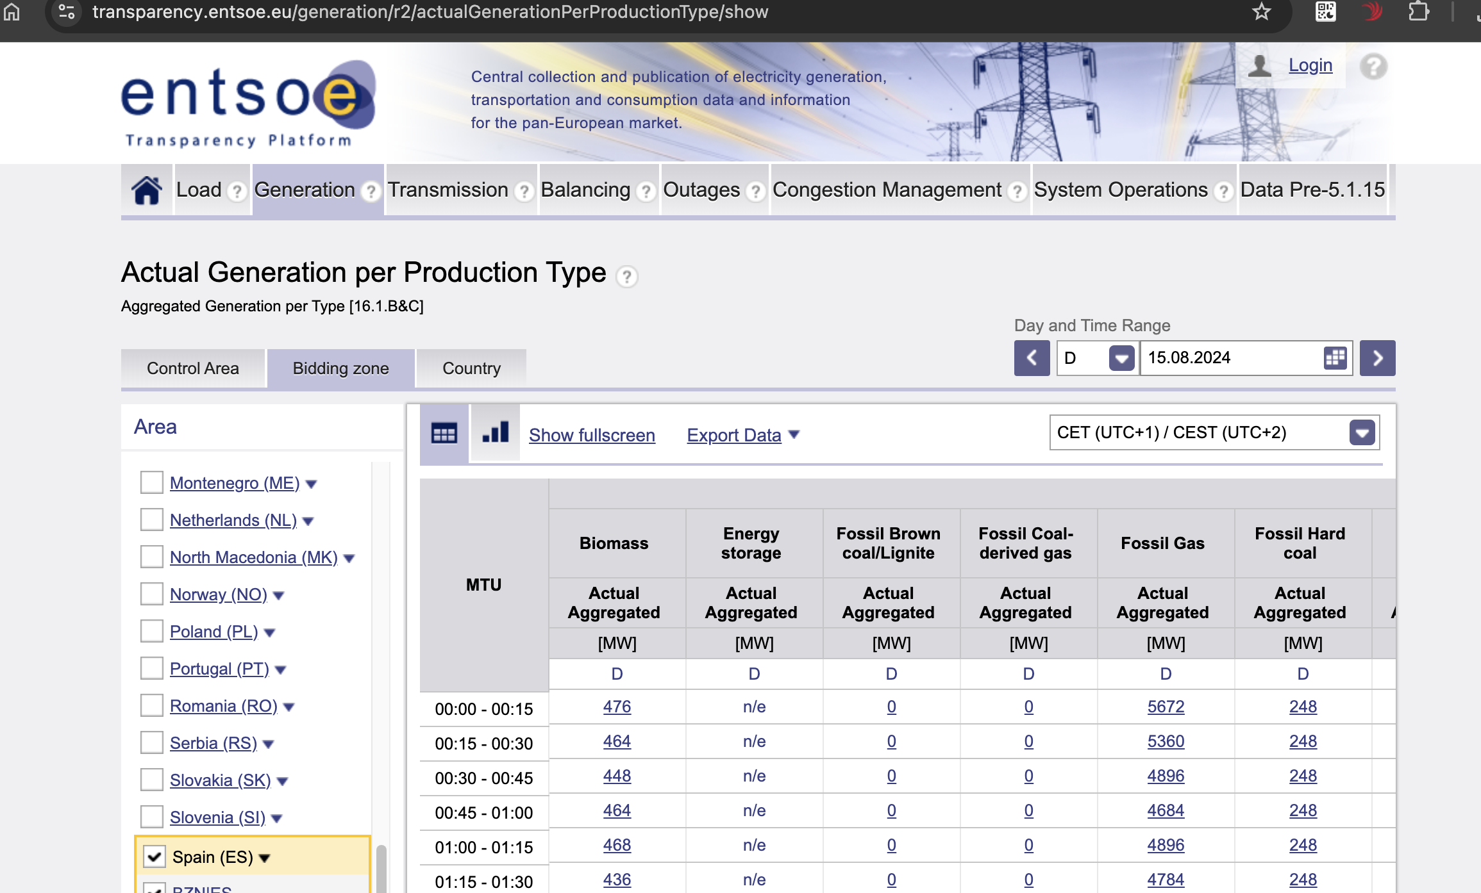
Functional Release in Production since June 2024
Other
Message Board
Implementing support for the higher version 1.1 of bid availability document introduced by MoP v3r3 incl.
Energy prices - alternative Data Provider
New 100MB Flow Based
Energy Storage

Slide 8
Functional Release in Production since June 2024
Inventory List
Issues with Data Items Energy Prices
Description | Action | Created | Updated
NEW GUI - issues when different time zone is selected | Hot Fix planned to be applied beginning of Dec. | 11.10.24 15:45 | 25.11.24 08:56
Unexpected error | Hot Fix planned to be applied beginning of Dec. | 03.10.24 14:03 | 05.11.24 13:23
Incorrect Area in Allocation instance | Hot Fix planned to be applied beginning of Dec. | 19.09.24 17:37 | 16.10.24 10:35
Migration - Energy Prices [12.1.D] - PROD | Hot Fix planned to be applied beginning of Dec. | 09.09.24 20:37 | 25.10.24 14:38
Inventory List
Issues with Data Items Commercial Schedules
Description | Action | Created | Updated
Invalid data aggregation related to configuration links functionality | The Commercial Schedules [12.1.F] data for the interval 05.11.2024 – 26.11.2024 will be re-published | 05.11.24 | 28.11.24

Slide 9
TP Vision 2030 – Updates
Improve Data Quality
Continuous improvement of the data quality on the platform
Improve Data Quality
01
02
Reinvent Mobile App Creating an accessible mobile app that displays energy related data in a modern way on your mobile phone
Reinvent Mobile App
Enhance User Engagement
03
Enhance User Engagement
Enhancing the interaction, knowledge exchange and participation of the user base on the ETP

Slide 10
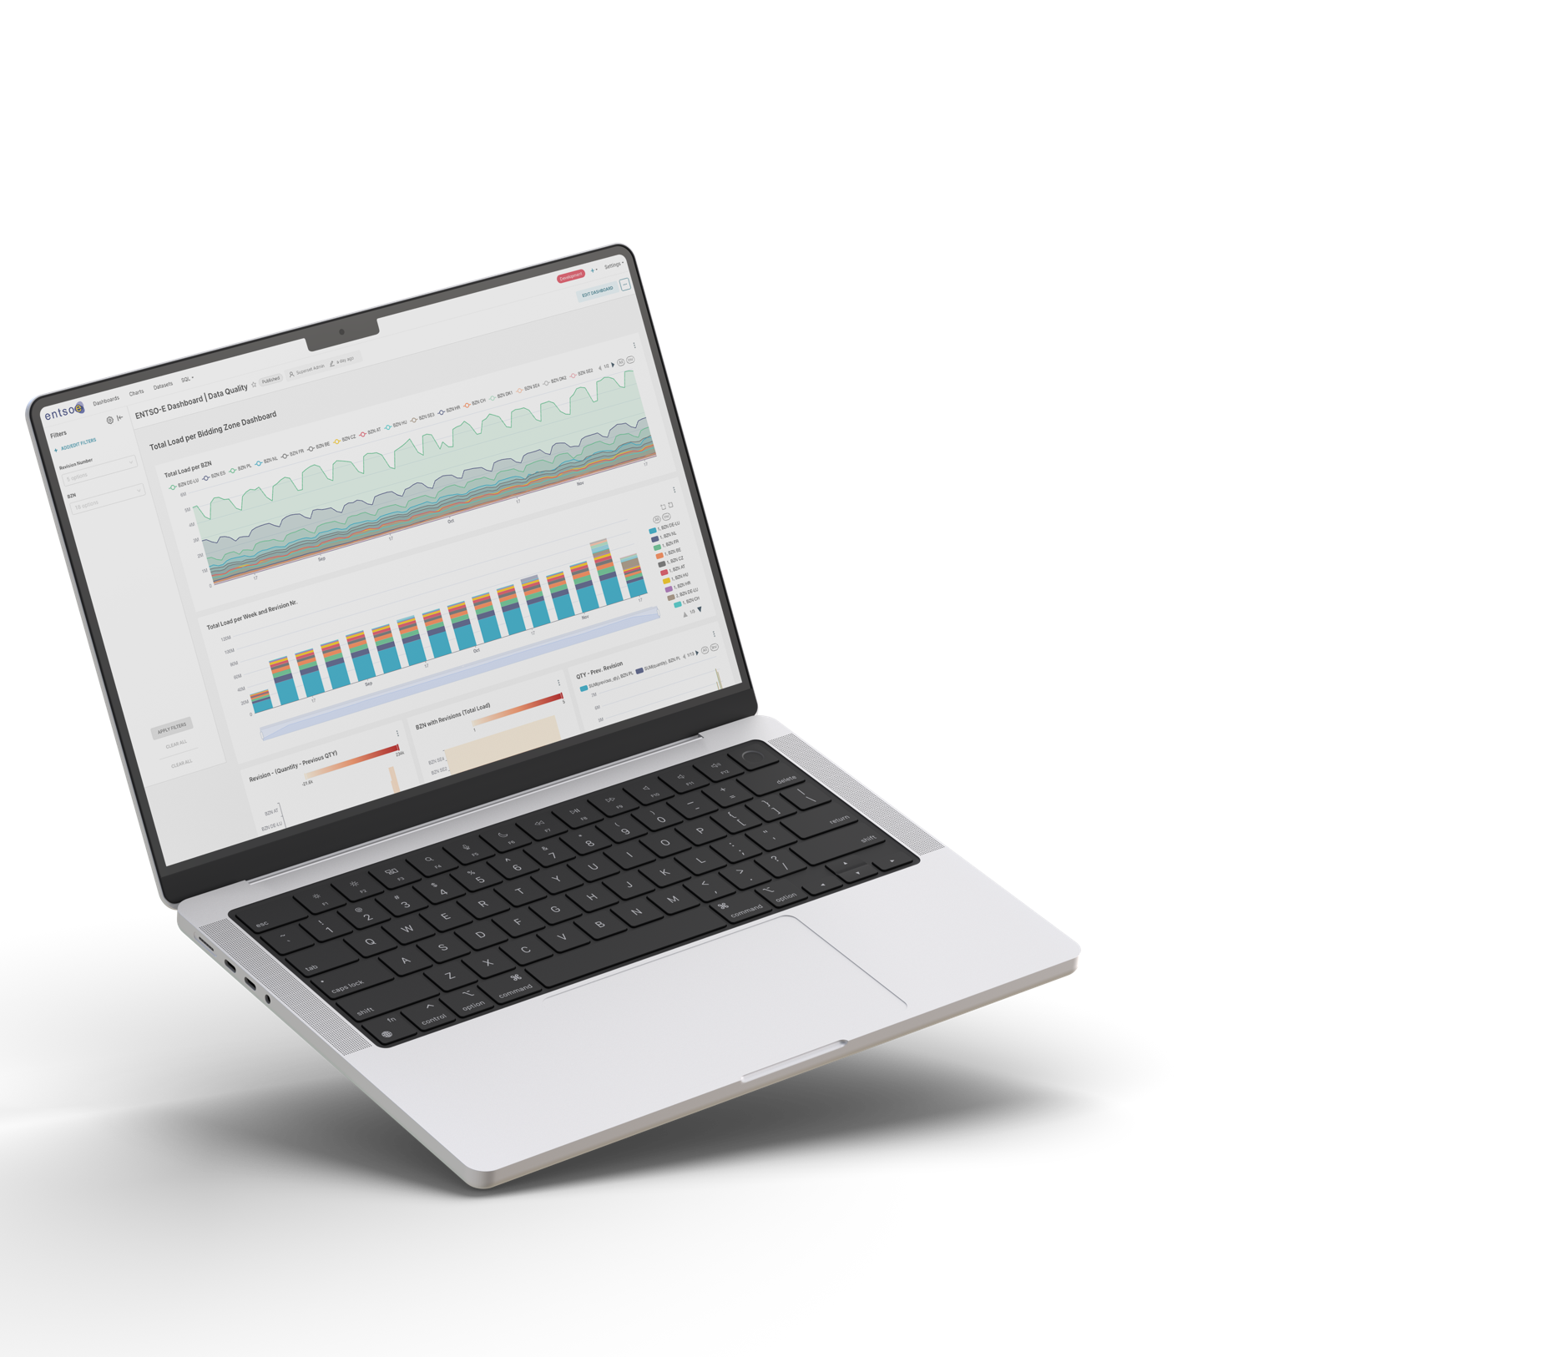
Data Quality Enhancement
ENTSO-E is continuously working to improve the data quality on the platform, as the data exchanged via the platform is invaluable. As the transparency platform is fed by many data providers, it is a challenge to ensure high quality and consistency of the data.
Various projects are being implemented to ensure data quality. These include the following
Ensuring the completeness of data and timely data delivery (i.e. by GC time at the latest).
Carrying out automatic quality checks based on the Memorandum of Understanding so that errors in the delivered data can be identified and flagged.
Provision of automated reports and dashboards so that entities can see whether their data can be read and processed.
Updating the quality checks which are done internally to assess the data quality on the platform as part of the Memorandum of Understanding.
Together with the IT team, measures are currently being implemented to make the provision of data by primary and secondary data providers more visible in the data quality dashboards.

