Slide 1
Update on Balancing Platforms
October 8th, 2024
MESC meeting

Slide 2
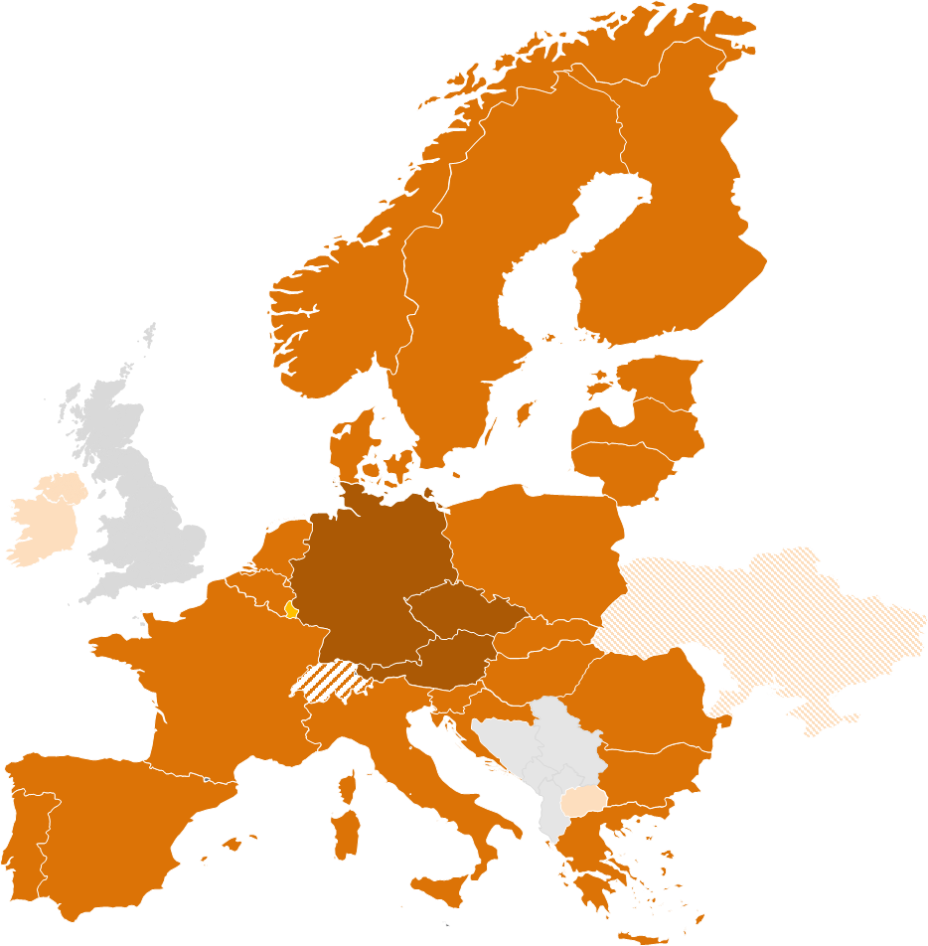
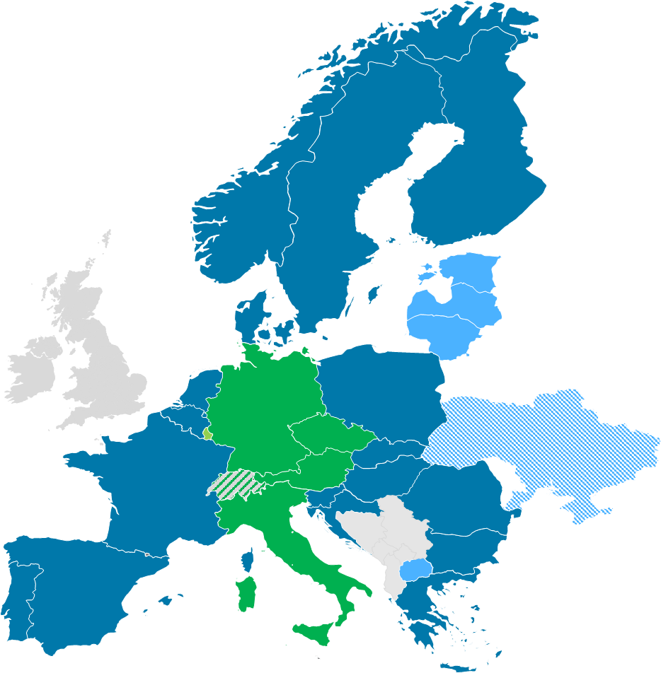
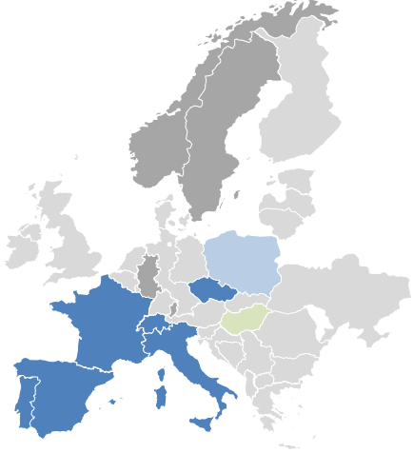
Introduction
Overview on current status of European Balancing Platforms
 | IGCC | MARI | PICASSO | TERRE
Balancing service | IN | mFRR | aFRR | RR
Participants
Target area | Continental Europe | Europe | ≥ Continental Europe | ≥ RR TSOs
Go-live | 24/06/2021 & operational since 01/10/2011 | 05/10/2022* | 22/06/2022* | 29/09/2020*
Status
Highlights | Economic surplus of around 583 Mio. € in Q1 and Q2/24 | Economic surplus of 3.5 Mio. € until end of August 2024 | Economic surplus of more than 98.8 Mio. € end of August 2024 | Economic surplus of more than 337 Mio € until end of August 2024
* Date as of when cross-border exchanges were possible due to neighboring TSO joining. Technical go-live of platform was earlier.
European domestic market (at least) for balancing energy has been established in 2022.
European market design has significantly changed the local procurement rules.

Slide 3
Recent developments and updates
Updates
Implementation of HPMM at aFRR platform level (CMBP calculation)
Status Update:
PICASSO has developed the necessary changes to the AOF and the aFRR pricing algorithm.
Go-live of the aFRR CBMP change took place on the 5th August (see also PICASSO (entsoe.eu)), without interruption of the AOF.
First ISP with the new calculation method for CBMP started at 10:45.
First operational results show stable operation.
Elastic demand implemented in AOF but currently no application

Slide 4
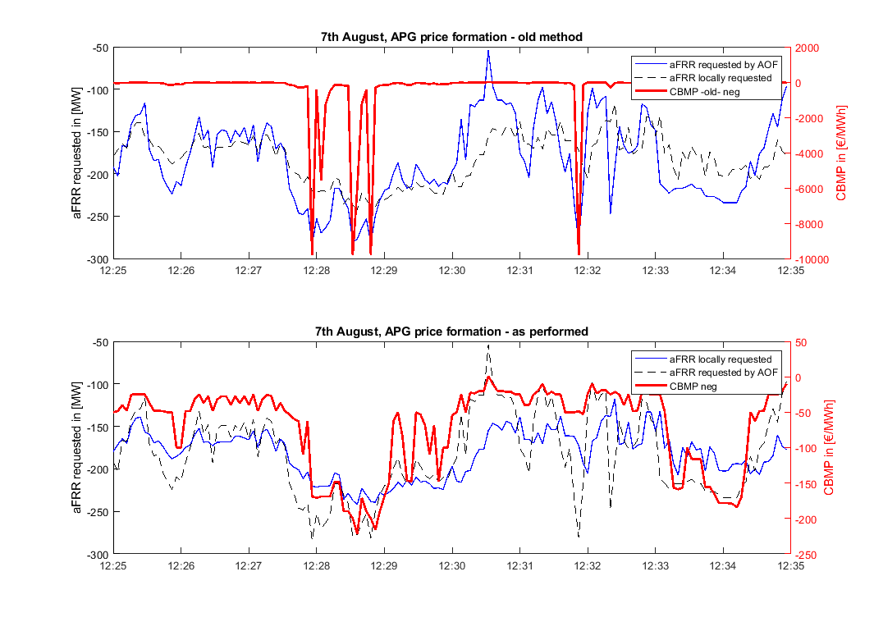
Recent developments and updates
Updates
Implementation of HPMM at aFRR platform level (CMBP calculation)

Slide 5
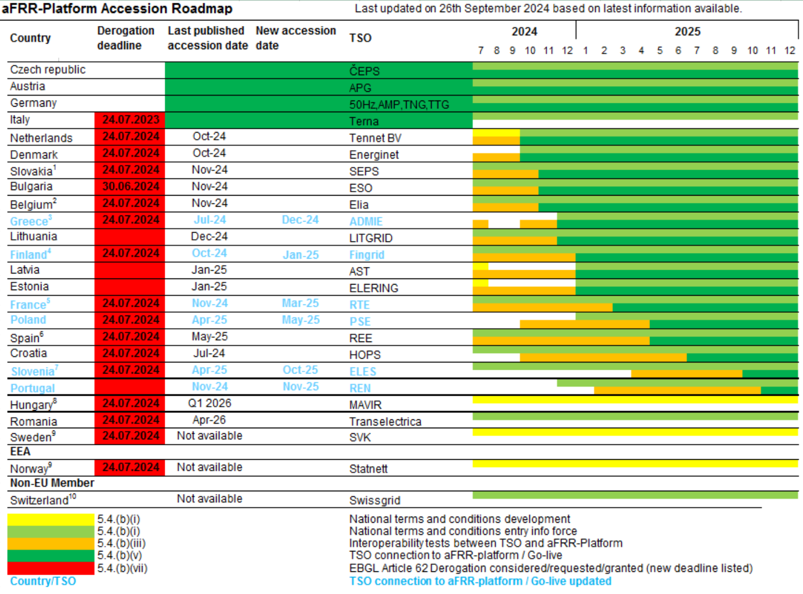
Recent developments and updates
Update of the accession roadmaps
Background: Accession Roadmap based on version published on 10.10

Slide 6
Recent developments and updates
Update of the accession roadmaps
Background: Accession Roadmap based on version published on 10.10

Slide 7
Recent developments and updates
Update of the accession roadmaps – aFRR / PICASSO
Concerning accessions in 2024:
Energinet: 2024/10/08
TenneT NL: 2024/10/15
SEPS: 2024/11/05
ELIA: November 2024
ADMIE: November/December 2024
ESO: November/December 2024
Litgrid: December 2024
Fingrid: January 2025

Slide 8
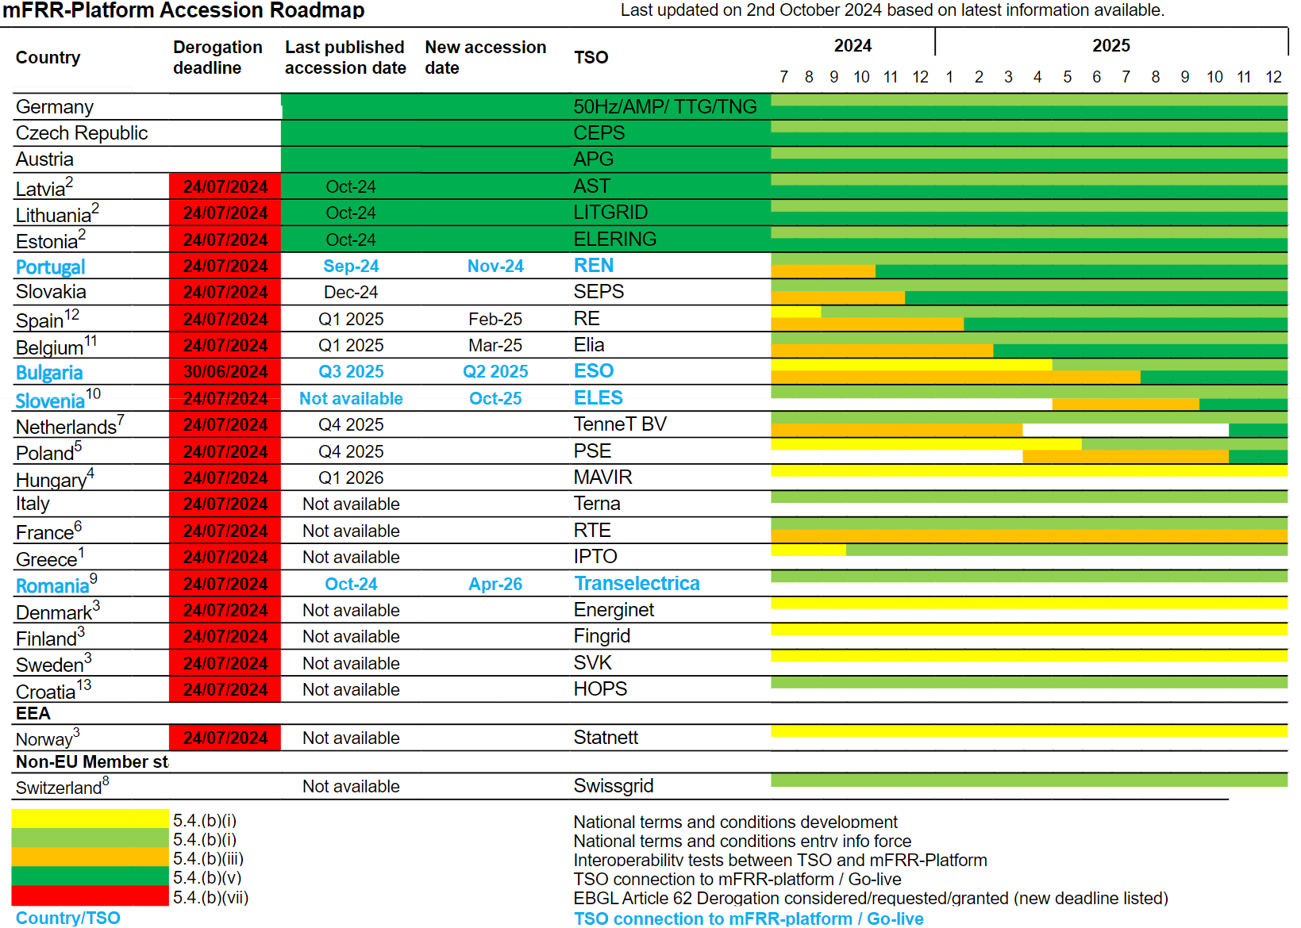
Recent developments and updates
Update of the accession roadmaps
Background: Accession Roadmap based on version published on 10.10

Slide 9
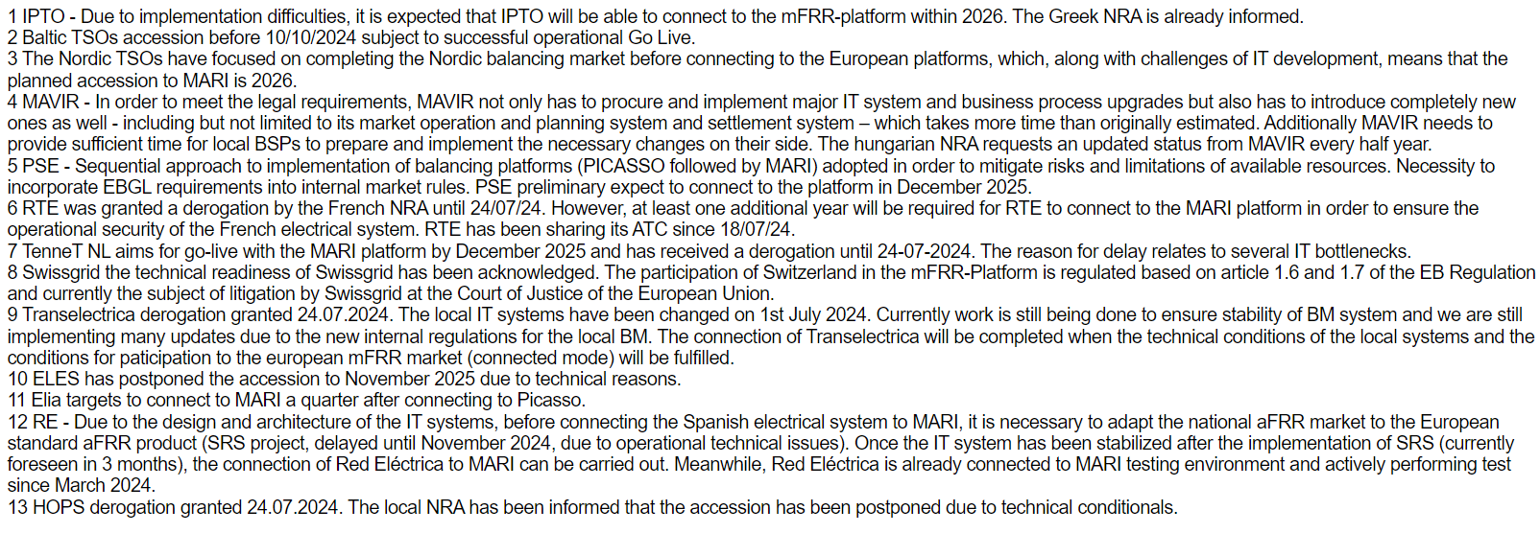
Recent developments and updates
Update of the accession roadmaps
Background: Accession Roadmap based on version published on 10.10

Slide 10
Recent developments and updates
Update of the accession roadmaps – mFRR/MARI
Concerning accessions in 2024:
Elering: 2024/10/02
AST: 2024/10/04
Litgrid: 2024/10/08
REN: 2024/11/28
SEPS: 2024/12/03

Slide 11
Annex - Operational Results
October 8th, 2024
MESC meeting

Slide 12
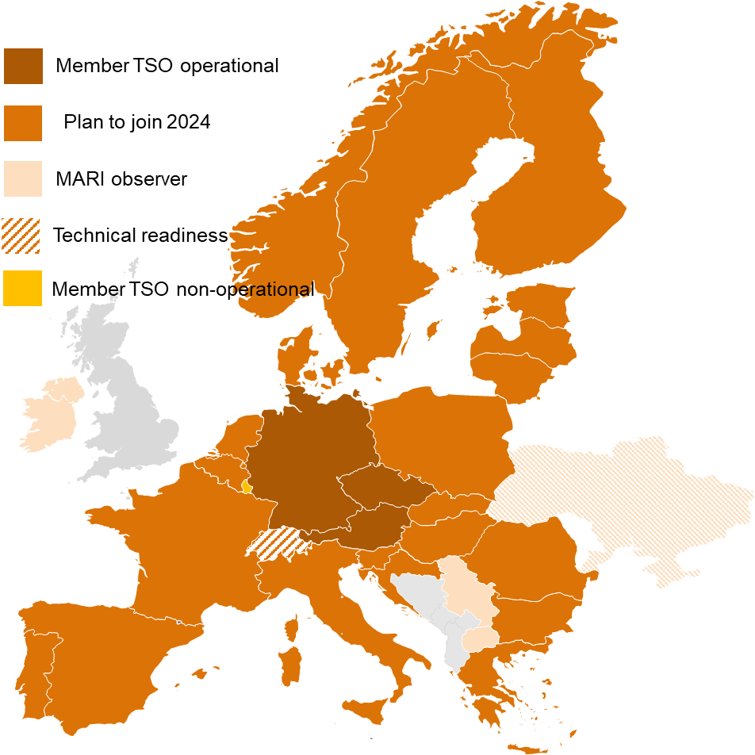
Manually Activated Reserves Initiative (MARI)
Overview
Project “Manually Activated Reserves Initiative” (MARI) has been set up already in 2017 to provide the basis for a European mFRR platform.
Currently, 29 TSOs from 26 countries have joined the project (Creos as non-operational member only).
Start of dry-run (CEPS) on 2022/07/18
Technical go-live on 2022/09/15
First TSOs (CEPS and German TSOs) joined on 2022/10/05.
Relevant Features
Counter activation of mFRR balancing energy for economic optimization
mFRR balancing energy bids can be activated either for balancing or (locally) for system constraints purposes
Direct and scheduled activation
Availability since operation currently at 99.96 % (unavailabilities currently being investigated)
Road to individual TSOs go-live will also continue in 2024.
* based on the current accession roadmap which includes additional information and risks on the planning

Slide 13
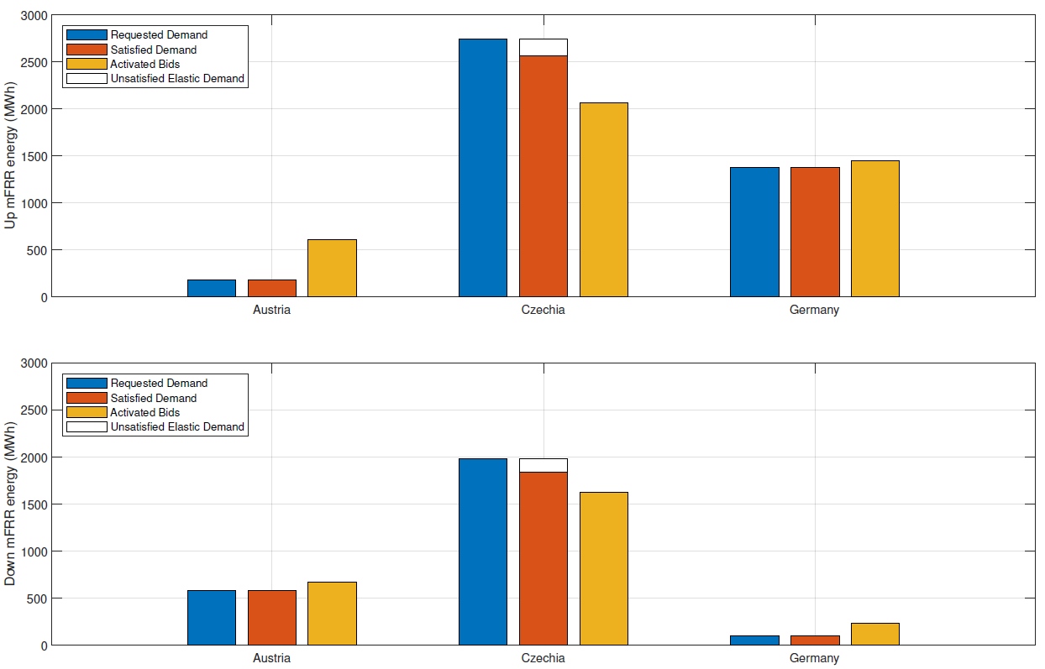
Operational Platform Reporting
Based on operational data from 01.06.2024 to 31.08.2024
mFRR requested and activated via MARI
Price elastic demand is applied by CEPS
Compared to Q1/2024, activation of upward demand has slightly decreased in all countries.

Slide 14
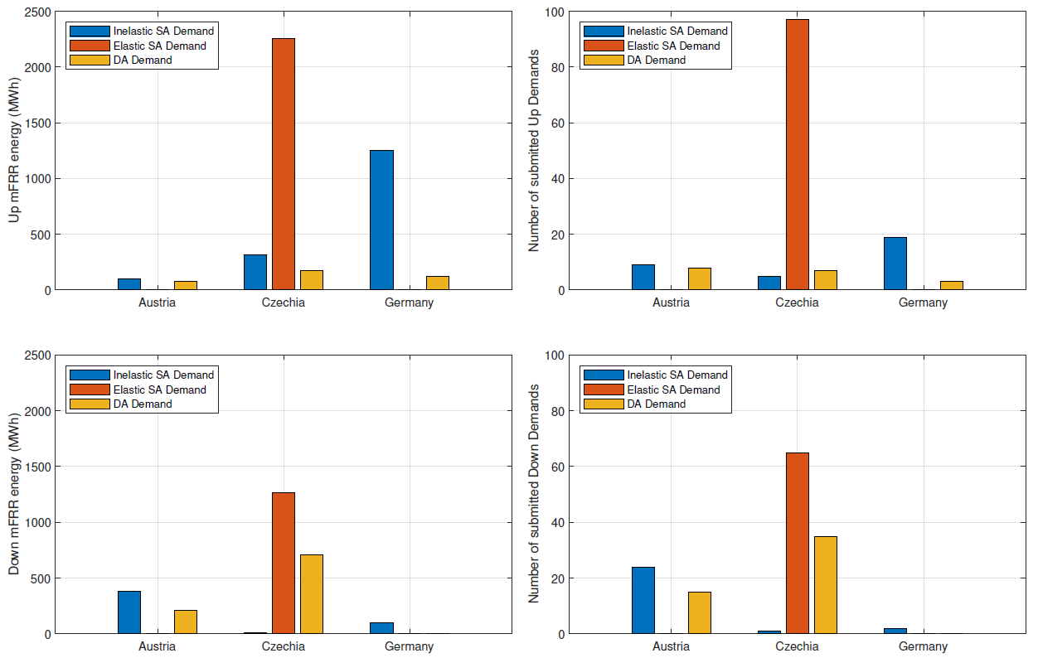
Operational Platform Reporting
Based on operational data from 01.06.2024 to 31.08.2024
mFRR Demand
Quite small amounts of activation in average compared to CMOL volume
The probability of occurrence of high prices can be assumed as low – only two price incident in Q2 and Q3.
Notes:
DE: DA+ 158 DA- 292 SAin+ 243 SAin- 220
CZ: DA+ 91 DA- 95 SAin+ 77 SAin- 81 SAel+ 63 SAel- 96

Slide 15
Operational Platform Reporting
Based on operational data from 01.06.2024 to 31.08.2024
Economic surplus MARI
Calculation of economic surplus as comparison between actual mFRR activation with a reference scenario (same bids, demands and market design) but without exchange of balancing energy
Economic surplus (without pricing unsatisfied demand) sums up to 0.8 Mio. € from June to August 2024.
Including unsatisfied demand economic surplus is 1.1 Mio. € for the same period in time.
Unsatisfied price inelastic demand due to exceeding demand in Czechia (not covered in decoupled simulations)
Economic surplus generated by MARI by type
Unsatisfied demand (price elastic)
m. €
Unsatisfied demand (price inelastic)
Congestion income
Consumer rent
Producer rent
Country

Slide 16
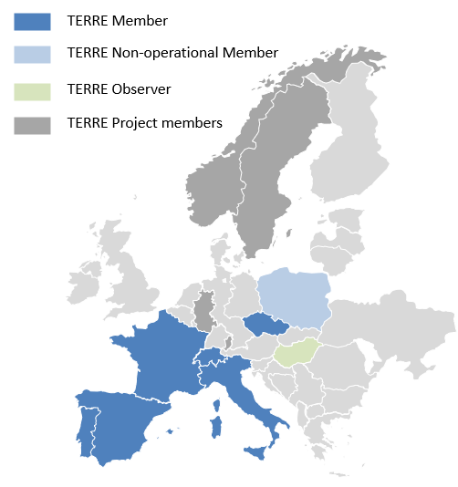
Trans European Replacement Reserves Exchanges (TERRE)
Last main milestones
The “Trans European Replacement Reserves Exchanges” platform include:
6 operational members: REN (Portugal), Red Electrica (Spain), RTE (France), Terna (Italy), Swissgrid (Switzerland), CEPS (Czech Republic)
One non-operational member: PSE (Poland) which is expected to connect in 2024.
Two observers: Mavir (Hungary) and ENTSO-E
Relevant update
Exchanges with RR NRAs to properly close the TERRE project at end 2025 are still ongoing, a RR IG meeting will be organized in October.
CEPS was disconnected from the LIBRA platform on the 1st of July and will become observer of the project on the 1st of January 2025.

Slide 17
Market Results from June to August 2024
TERRE Economic surplus from June to August 2024
TERRE platform provides important financial benefits for all countries involved in the project, more than 33 million € per month on average from June to August 2024.

Slide 18
Operational Platform Reporting
Based on operational data from 01.06.2024 to 31.08.2024
TERRE Operational results
Important volumes of bids, demands and activated bids are processed by the TERRE platform each month: on average more than 11 millions of MWh in both directions.
Globally, volume of bids is much more important than demands which conduct to a high rate of demands fulfilled by the TERRE platform (the difference is due to unsatisfied inelastic demands).
The number of activated volumes was on average around 250 000 MWh in positive direction and 350 000 MWh in negative direction.
The TERRE platform was available during this period.

Slide 19
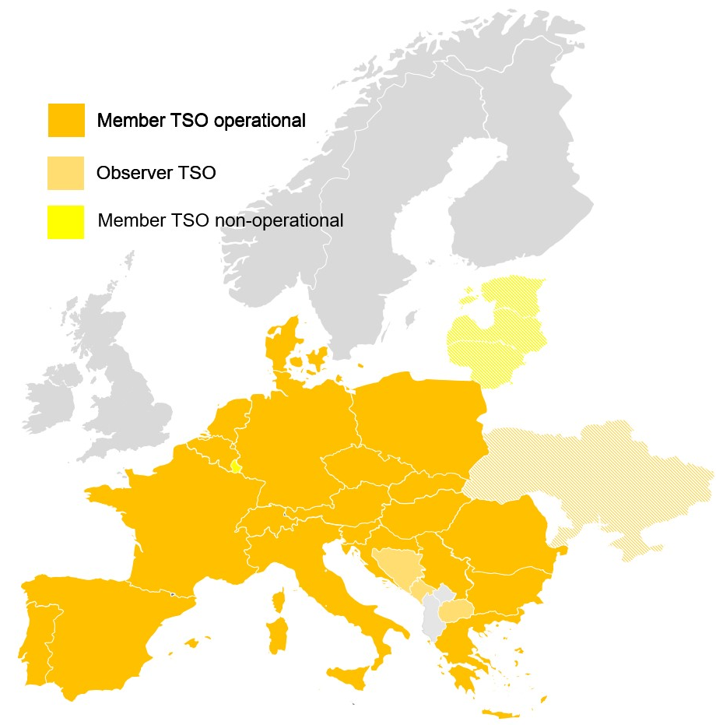
Market Results
Important achievements in IGCC
All TSOs with the obligation to connect as a result of the EB Regulation are connected to IGCC*.
IGCC is the first Balancing Platform to achieve this objective.
IGCC has 27 members in total, out of which
24 are operational members and
3 are observers.
With the go-live of ESO in March, all EU-TSOs are connected and can net their imbalances.
Historical evolution (starting in 2010):
Outlook 2024: planning of the accession of the Baltic TSOs to IGCC ongoing

Slide 20
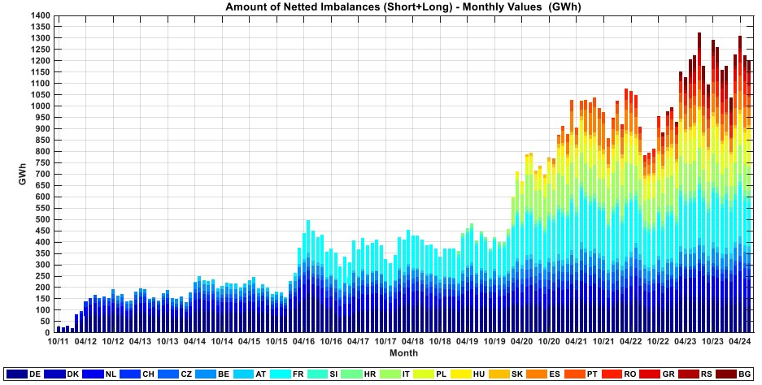
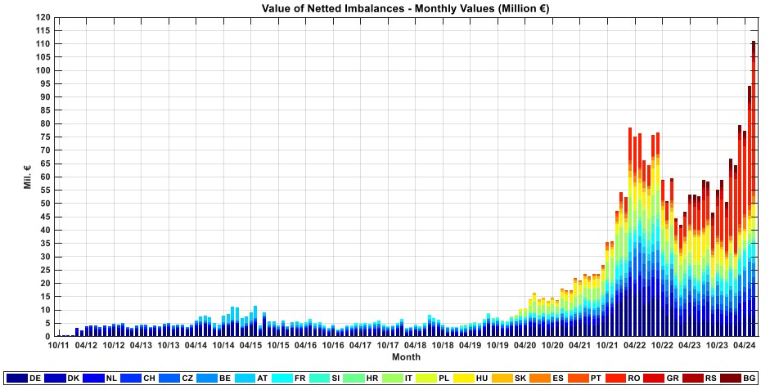
Market Results including Q2/2024
Imbalance Netting Energy Exchanges in IGCC
The quarterly energy savings have reached around 3735 GWh in Q2/2024.
After a temporary drop due to the PICASSO go-live and subsequent increase due to the remaining accessions, the netted imbalances reached a stable level and follows again the usual sessional fluctuations.
The value of quarterly energy savings have reached around 282 million € in Q2/2024. New record value was achieved in June with 110 million € mainly driven by very high prices for balancing energy in Romania.
Aggregated savings of the IGCC since 2011 are roughly 2.9 billion €

Slide 21
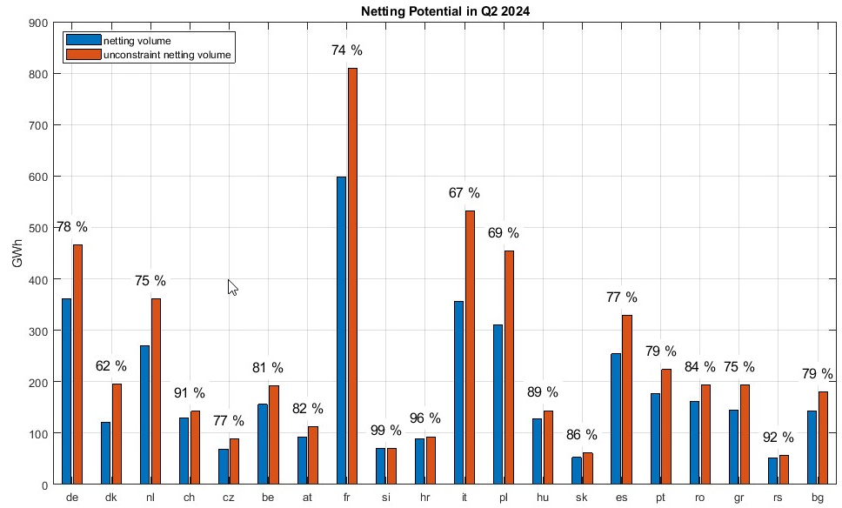
Market Results for Q1/2024
Imbalance Netting Energy Exchanges in IGCC
The theoretical netting potential in Q1 2024 reached almost 4.9 TWh in total. 76 % of this total potential was used by the IGCC, the rest was not used due to limited transmission capacity
Due to the proportional distribution of netting potential and maximization of netting, network constraints can lead to a netting volume that is larger than the unconstraint netting (see LFC area C in the example)
A
ATC 0
B
C
Demand: 100 MW
unconstr. Netting: -50 MW
Netting: 0 MW
Demand: -100 MW
unconstr. Netting: 100 MW
Netting: 100 MW
Demand: 100 MW
unconstr. Netting: -50 MW
Netting: -100 MW

Slide 22
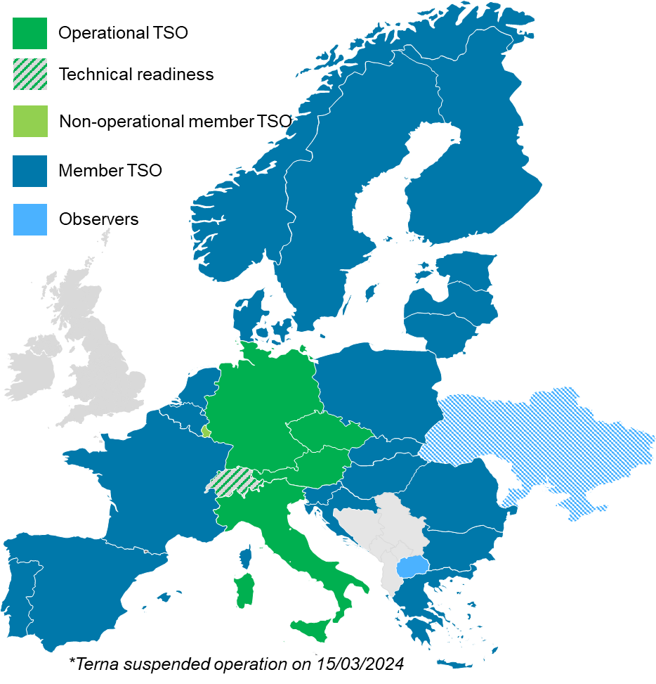
Platform for the International Coordination of automated Frequency Restoration and Stable System Operation (PICASSO)
The “Platform for the International Coordination of Automated Frequency Restoration and Stable System Operation” (PICASSO) has been endorsed by all TSOs in 2017 as implementation project for the European aFRR platform pursuant to GL EB.
Currently. 26 TSOs from 23 countries have joined the project. 4 TSOs and ENTSO-E are observers.
Successful go-live on June 1st, 2022 with CEPS as first operational member, earlier than required by the regulation
First exchange of energy on June 22nd, 2022, after APG and the 4 German TSOs joined the platform, on 19th July TERNA joined.
On 15th March, TERNA suspended its operation.
The remaining Member TSOs will gradually join the platform
Relevant Features
The PICASSO Platform establishes a European domestic energy market for aFRR energy, based on a common standard product.
PICASSO fosters operational stability by coordinating the activation of aFRR.
Using a market time unit of 4 seconds. The PICASSO optimizer has performed more than 7.8 Mio. market clearings per month 100 % availability.
The PICASSO IT solution is also used for the International Grid Control Cooperation (IGCC), which is closely interacting with the PICASSO Optimization to maximize the economic surplus while ensuring that the netting potential of all IGCC TSOs is used.

Slide 23
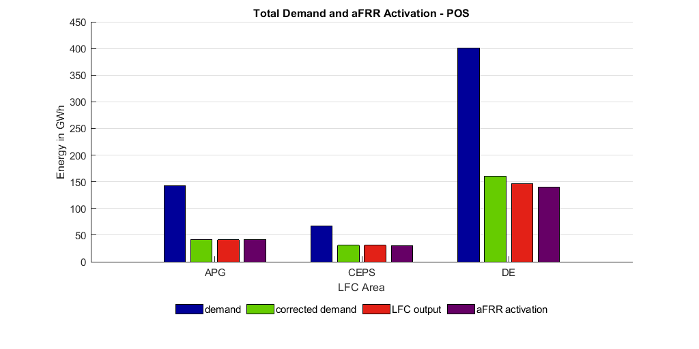
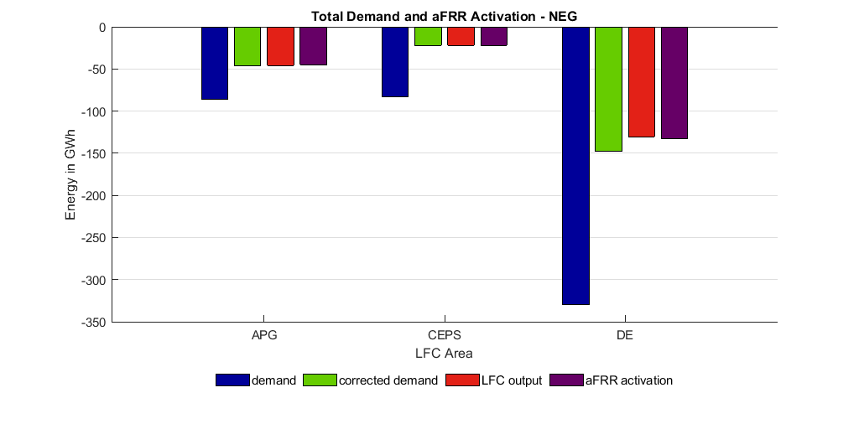
Operational Platform Reporting
Based on operational data from 01.06.2024 to 31.08.2024
Demand and activation
Graph shows the aggregated energy amounts for the 3 PICASSO LFC areas and the German LFC-block covering the period from 2024/06/01 to 2024/08/31.
The effect of the optimization steps is clearly visible:
The aFRR demand (blue) submitted to the platform is for most of the LFC areas much higher than the corrected demand (green) calculated by the platform (→ Netting within the PICASSO region and the IGCC)
There is a decrease visible between the corrected demand (output of PICASSO), the local LFC output and the activated aFRR by the BSP due to the dynamic behavior of the involved components.

Slide 24
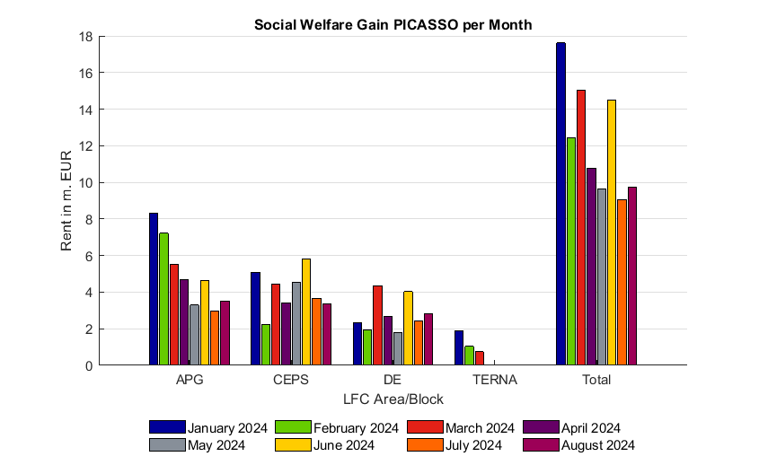
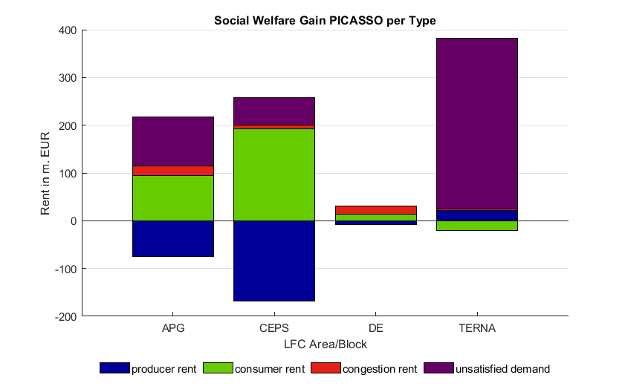
Market Results until End of August 2024
Economic surplus PICASSO
Economic surplus PICASSO per month
Economic surplus is calculated by comparing the actual activation of aFRR to a reference scenario with the same bids, demands and market design, but without international interchange.
Economic surplus from January 2024 until September 2024 was around 98 Mio. € (without additional satisfaction of demand). See next slide for details regarding the additional demand satisfaction
Economic surplus higher for small LFC areas, that get access to a much larger market via PICASSO
Economic surplus PICASSO per type

Slide 25
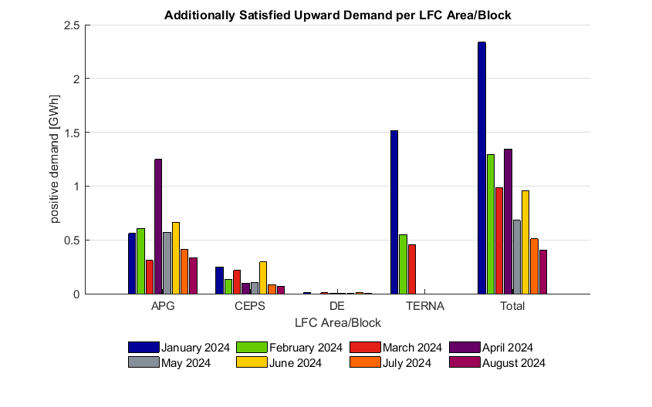
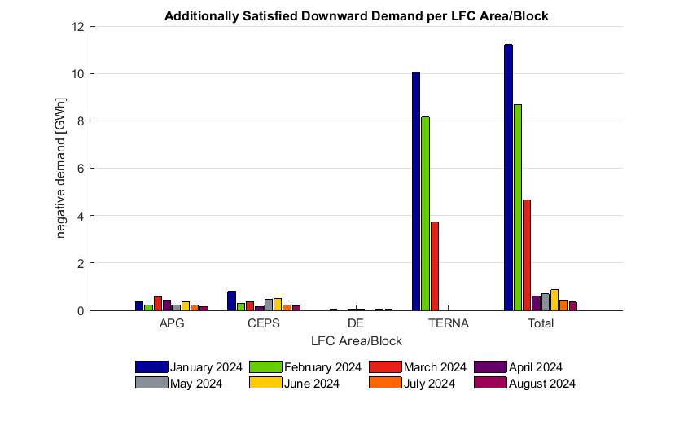
Market Results until end of August 2024
Based on operational data from 01.01.2024 to 31.08.2024
Additional demand satisfaction in PICASSO
Since the PICASSO allow TSOs to access more aFRR balancing energy reserves than they’ve locally procured, it can lead to additional demand satisfaction through aFRR than would locally possible. Furthermore, it allows to activate more aFRR in relation to other products, which can benefit FRCE quality. Therefore, PICASSO improve the frequency quality, while decreasing system imbalances (FRCE) and contributing to the security of supply.
The monetary value of the additionally satisfied demand has not been included in the economic surplus gains but is shown as explicit contribution to the security of supply in terms of energy.
Each TSO is responsible for maintaining balance in his LFC area and has to take measures to resolve insufficient satisfaction of FRR demand in his LFC areas to secure stable operation. Therefore, exchanges via PICASSO and IGCC platform cannot be considered as guaranteed.

