Slide 1
Long-term flow-based allocation
MESC, 8 October 2024

Slide 2
LTFB: compliance assessment
In February 2024 TSOs concluded that the LTFBA implementation deadline of Nov'24 is not feasible and decided to put the project on hold
Also, despite the legal obligation from 6 methodologies and messages by the Core NRAs and the CACM TF insisting on the continuation of implementation efforts, TSOs voted against a continuation of implementation project in July 2024
With a letter of 17/09/2024 ENTSO-E informed ACER and NRAs about TSOs’ intentions regarding the implementation of LTFBA:
No intention to implement the approved all TSOs LTFBA methodologies
No intention to implement the approved Core LT CCM, but intending to propose an amendment towards using cNTC (based on FB extraction)
TSOs deciding on the non-fulfilment of legal obligations may provide a dangerous precedence which scrutinises the role of:
Regulators being the ones to consider/weight stakeholders’ interests and approve methodologies accordingly
TSOs providing a public service obligation which is executed in accordance with legal requirements

Slide 3
LTFB: ACER’s simulations
ACER performed extended simulations of Core LT flow-based Y auctions in 2023 and 2024
Data inputs:
Actual NTC auction results from yearly 2023 and 2024 auctions (JAO)
Presolved 2023 and 2024 FB domains provided by the Core TSOs
Actual bids from yearly 2023 and 2024 auctions (JAO)
Scenarios:
0. NTC: NTC-based yearly auctions, as performed by JAO
FB_mR20: minRAM = 20% Fmax
FB_ mR30: minRAM = 30% Fmax
FB_ mR40: minRAM = 40% Fmax
FB_ mR20+NTCi minRAM = 20% Fmax + Historical NTC inclusion
FB_ mR30+NTCi: minRAM = 30% Fmax + Historical NTC inclusion
FB_ mR40+NTCi: minRAM = 40% Fmax + Historical NTC inclusion
FB_ mR20+NTCi-0.5DEAT: minRAM = 20% Fmax + Historical NTC inclusion, with 50% DE-AT NTC inclusion
FB_ mR30+NTCi-0.5DEAT: minRAM = 30% Fmax + Historical NTC inclusion, with 50% DE-AT NTC inclusion
FB_ mR40+NTCi-0.5DEAT: minRAM = 40% Fmax + Historical NTC inclusion, with 50% DE-AT NTC inclusion
Historical NTC inclusion means that FB domain is expanded to contain NTC domain actually offered in a given year

Slide 4
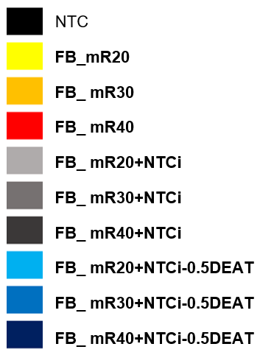
Summary
2023
Economic surplus [EUR]
Total allocated quantities [MW]
2024

Slide 5
Accepted quantities (summed export/import)
2023:
2024:

Slide 6
Takeaways
TSOs flow-based simulations showed low capacities on many borders – the main reason was that offered capacity in FB was significantly lower than in current NTC
ACER simulations ensure comparable NTC and FB domains and the FB results are much better (much less borders with low capacities)
ACER invites Core TSOs to ensure the offered FB domain is of similar size to current NTC domain
However, ACER is strongly against the intentions to convert FB domain to NTCs
Coordinated NTC will not be able to demonstrate higher economic efficiency and more total allocated capacities
The work on Coordinated NTC will be a waste of precious resources and time (approval not guaranteed)
Coordinated NTC is a classic quota system with arbitrary split of common goods among MSs
Competition between the borders is an essential feature of EU’s internal market principles – it does not guarantee minimum capacities, but ensures on average the lowest prices for consumers on the forward market
Finally, stopping the implementation of LT FB based on the actual six decisions leads to a dangerous legal precedent where TSOs take the role of regulators to balance stakeholders’ interests

Slide 7
Backup slides

Slide 8
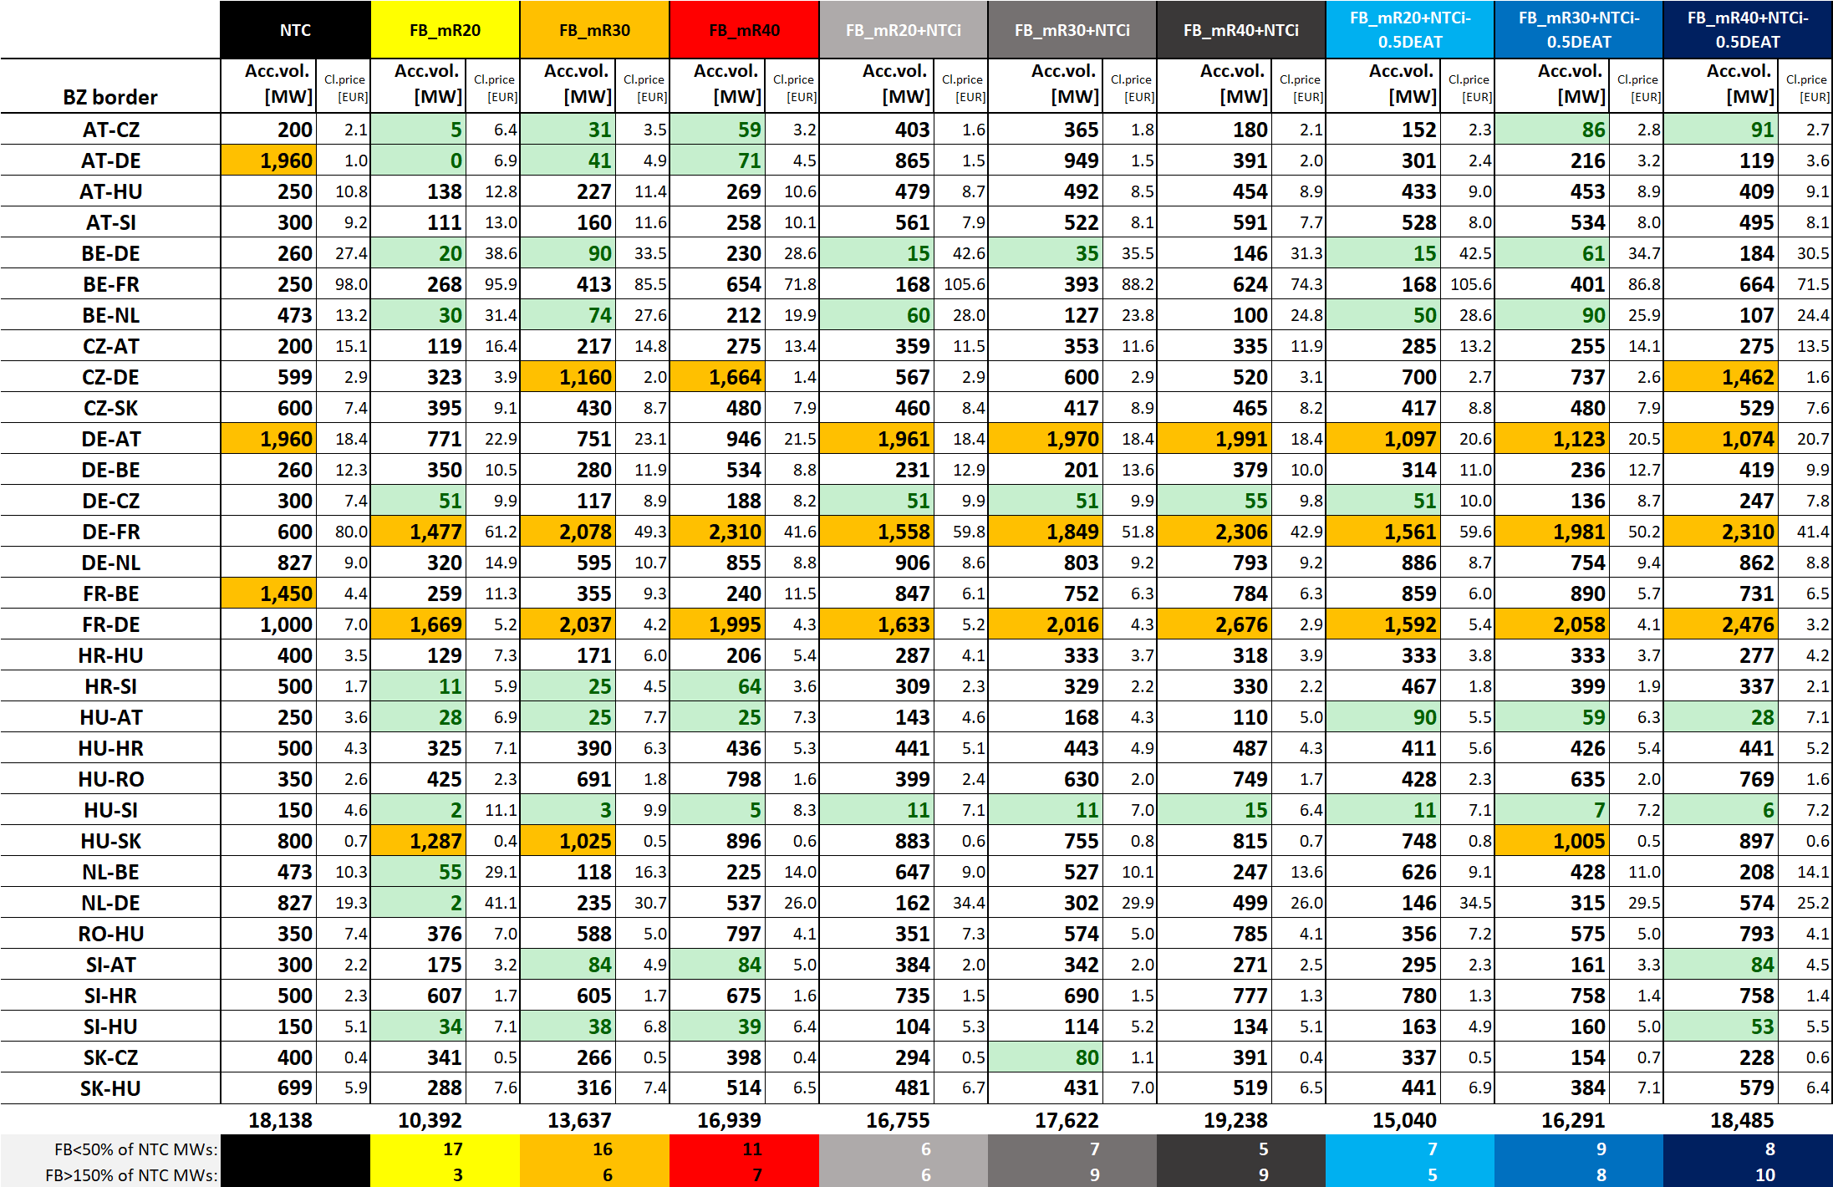
2023: Accepted quantities

Slide 9
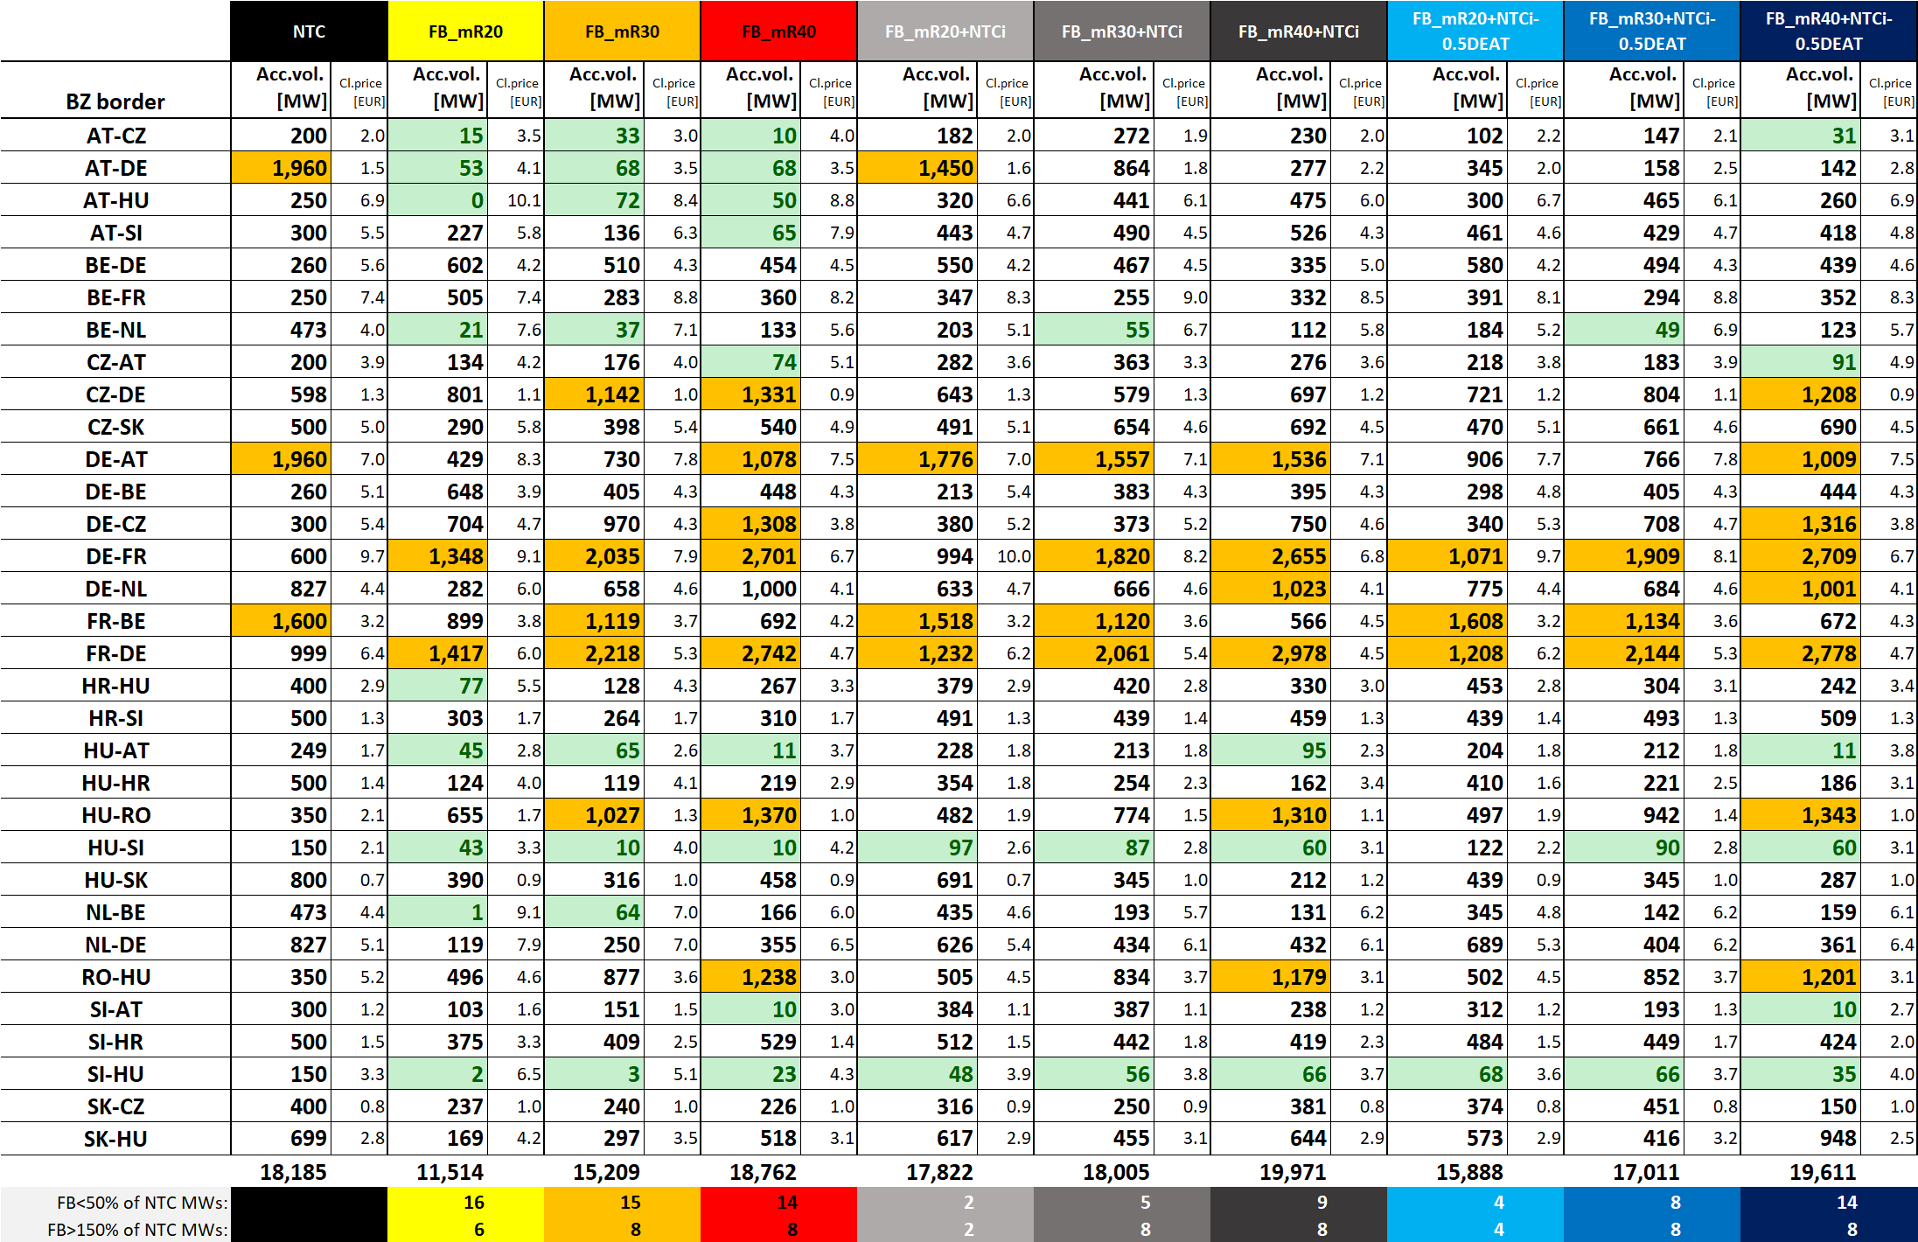
2024: Accepted quantities

