Slide 1
MESC: Bidding Zones Review Study
8 October 2024

Slide 2
Status update Bidding Zones Review Study
Date to deliver the BZR: December 2024 (both regions)
Next Consultative Group meeting: 5 November (presentation of some quantitative results and publication of the presentation)
Public consultation: ended (46 responses)
Public webinar to present results: End December 24

Slide 3
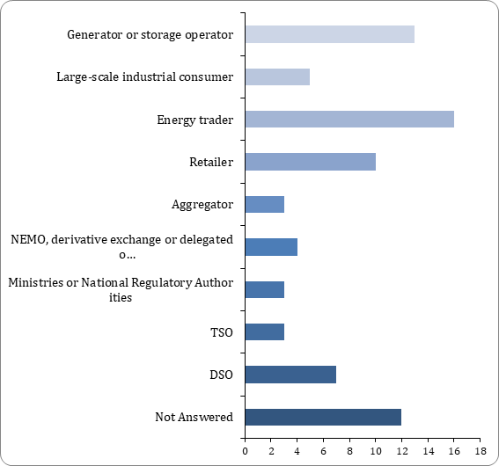
BZ Review - Public Consultation: status and next steps
46 responses have been received through the consultation tool, some send (additional) material through e-mail
All-TSO BZTF is looking into the responses together with Compass Lexecon
Responses through e-mail will not be considered as a formal response to the PC, but TSOs will strive to consider these responses as much as possible, to the extend they cover the questions in the PC
Based on the responses an update of the Liquidity report and the Transition Costs report will be made
Overview of the responses per category of stakeholder is provided on the right

