Slide 1
Update on the amendment of the algorithm methodology for co-optimisation: The consultancy study on the expected welfare benefits
MESC meeting
13 June 2024

Slide 2
Introduction

Slide 3
The study: Goal and team composition
Goal: Quantify the potential welfare gains, relative to the status quo, of a move towards co-optimisation and estimate what fraction of these benefits can be reaped by the market-based approach, to support the ongoing R&D activities on the implementation of co-optimisation in SDAC
Team composition:
Contractor: Anthony Papavasiliou (National Technical University of Athens, Greece) and Daniel Avila (Université Catholique de Louvain, Belgium)
ACER internal project team: Marco Pavesi, Martin Viehhauser, Mathieu Fransen

Slide 4
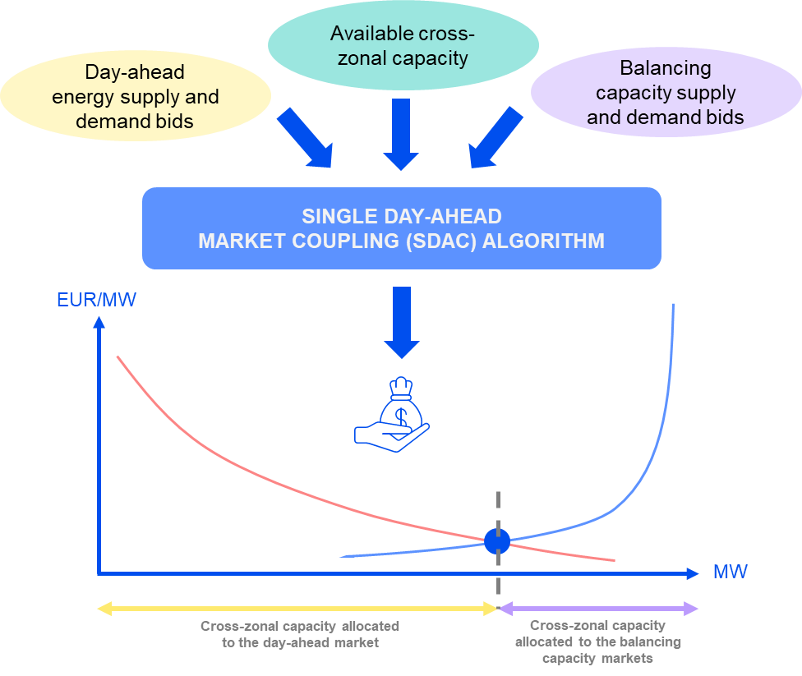
Co-optimisation: Joint day-ahead clearing of balancing capacity and energy
Co-optimisation covers two aspects: i) allocation of cross-zonal capacity; ii) optimisation of reserve and energy markets
Co-optimisation overcomes the drawbacks of market-based allocation regarding forecast errors and coordination inefficiencies
Co-optimisation allows the liquidity of the day-ahead market to also be directly accessible to balancing capacity markets
The allocation of cross-zonal capacity for balancing aims to facilitate the cross-border trade of balancing energy in PICASSO, MARI and TERRE

Slide 5
Key aspects of the modelling
Two-stage model: day-ahead market first, followed by a real-time balancing market
15’ MTU
Unit-based model, where commitment is the decision to turn on/off the unit
Accurate modelling of technical constraints (min and max output, min up and down times, ramp rates and planned outages) and economic characteristics of power generation units
Covering both aFRR and mFRR, upward and downward
Deterministic requirement enforced (for market-based and co-optimisation)
Perfect competition and truthful bidding → welfare impacts of improved competition in balancing capacity markets are not quantified
Additional welfare gains from sharing of reserves not captured

Slide 6
Results

Slide 7
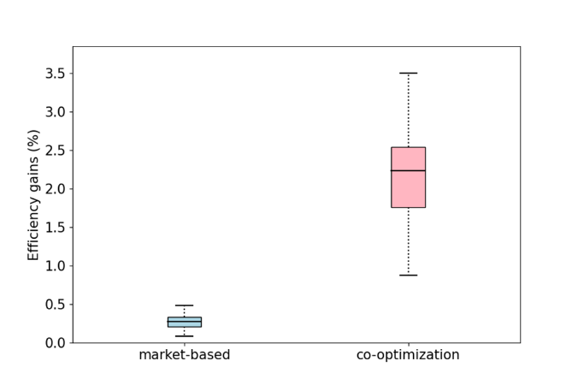
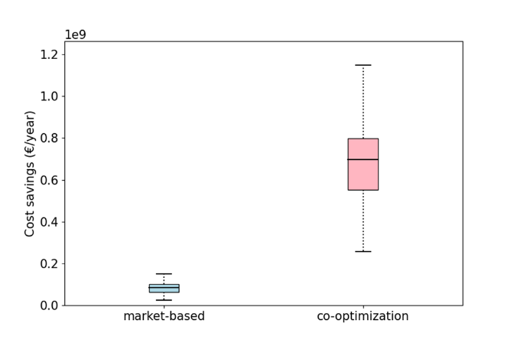
Cost comparison of alternative designs
Costs are assessed in the real-time balancing module, not in day-ahead
2% welfare gains with co-optimisation (678 MEUR/year for Core → ~1.3 BEUR/year for the EU)
0.3% welfare gains with market-based (84 MEUR/year for Core → ~160 MEUR/year for the EU)

Slide 8
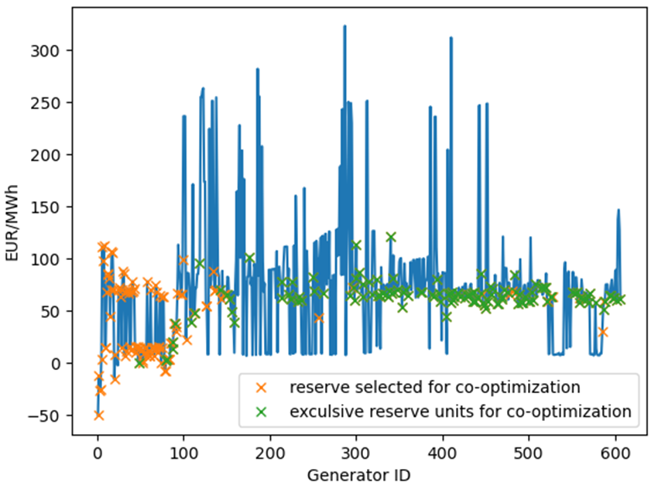
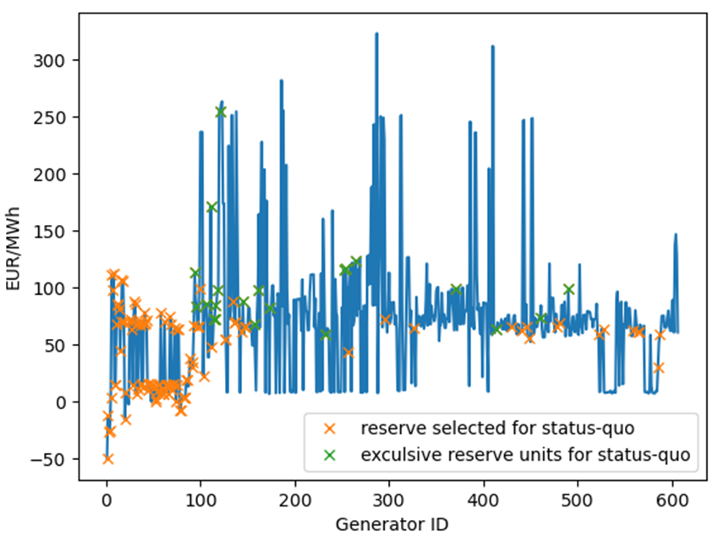
The role of fixed costs
Units are ordered on the x-axis by increasing fixed cost
Co-optimisation allows an allocation of balancing capacity for units with relatively high fixed costs by considering them only once and allowing those units to cover both needs

Slide 9
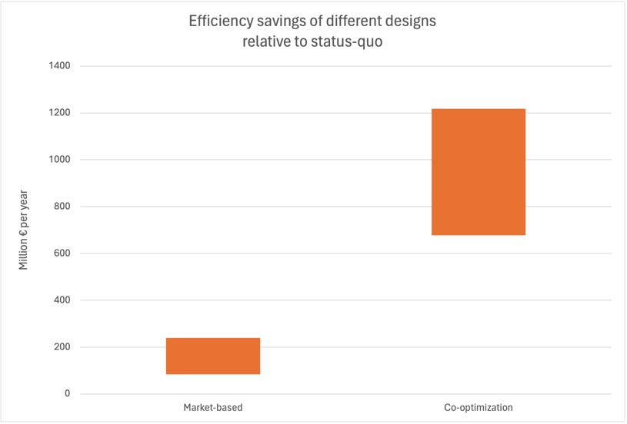
The role of intraday adjustments
The sequential clearing models benefit from a significant reallocation of unit setpoints between day-ahead and real time
Major reshuffling of setpoints between day-ahead commercial positions and real-time physical positions places a big burden on intraday adjustments and may, to a certain extent, be over-optimistic
In day-ahead, the co-optimisation model achieves efficiency gains of ~4% relative to status-quo and market-based achieves ~1% welfare gains compared to status quo
This is equivalent to assuming an ideal scenario without any imbalance in real-time

Slide 10
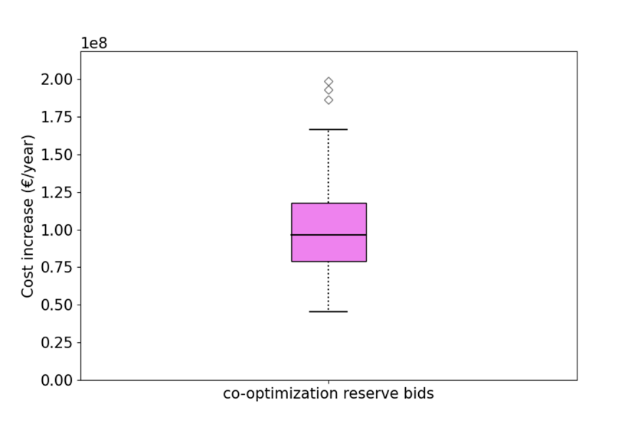
Sensitivity analysis: Explicit bidding for balancing capacity in co-optimisation
Increase of real-time costs by 100 MEUR/year compared to the ‘pure’ co-optimisation model → Loss of 15% of the expected welfare gains

Slide 11
Next steps

Slide 12
Process and timeline for ACER Decision
28 November 2023: Initiation of the procedure
27 May 2024: Publication of the consultancy study
18 January – 20 February 2024: Public consultation
End of June – September 2024: Approval process
1 February 2024: Public webinar
27 May – 19 June: Public consultation on the study’s findings
10 June: Public webinar on the consultancy study

Slide 13
Thank you for your attention!

