Slide 1
ENTSO-E report: 70% monitoring
MESC 13 June 2024

Slide 2
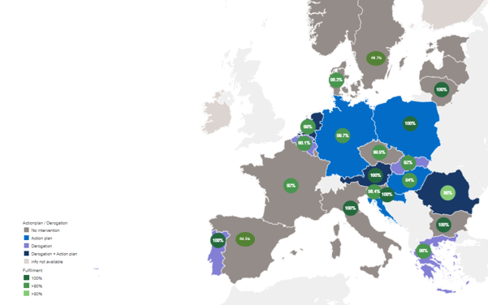
CEP 70 % requirement – Current situation A fully integrated market: clear improvements and still some way to go
Most of the countries are on their way to offering 70%.
Ongoing enhancements towards a more integrated & efficient Euopean electricity market:
Reminder: 70% are not an ‘absolute target’ as deviations for reasons of operational security are legally permitted. TSOs have the legal duty to reconcile it with physical reality
Electricity Regulation foresees possibility to deviate from the 70% rule by the need to ensure operational grid security
If needed, such capacity reductions result from the mandatory validation step in capacity calculation
Capacity reduction is a last resort measure in case there are insufficient remedial actions to secure the grid
Average share of MTUs during which the transitional minimum capacity has been reached in 2023 by MS

Slide 3
CEP 70% requirement – CACM 2.0 TSOs call for prudence when it comes to applying the requirement in the intraday timeframe: operational security is at stake
Provision of sufficient cross-zonal capacity for Intraday is crucial for a well-functioning market and RES integration
TSOs provide sufficient cross-border capacities following their action plans & derogations (where applicable) - for all time frames
TSOs firmly believe that repeating 70% to Intraday will not help to reach that ambition
Offering 70% in DA is often realized by offering virtual capacities to the market
Yet, an application to the ID timefame is not possible:
No equivalent coordination process for RAs after closure of ID market
Dimishing pool of RAs availble to TSOs to maintain operational security as security processes move closer to RT operation
Liquidity of the ID market is not homogeneous, with much more trading interest visible close to RT operation and limited interests many hours in advance
In RT operation, other technical aspects (such as reactive power control and voltage regulation) gain importance and need to be considered when taking RAs.
→ Physical capacity cannot be increased beyond the security limits.

Slide 4
CEP 70% requirement - Future perspective: where are we heading to?
The electricity regulation allows to realize 70% by choosing VCs/redispatch
For several countries, 70% is ensured by application of VCs. VCs need to be realized physically by costly RA
Yet, the Electricity regulation allows MSs to choose the path of redispatch (‚pay option‘)
The concept of 70% in ID cannot be technically reconciled with this path.
A reconfiguration of bidding zones may reduce the role of VCs and loop flows, but it is not a silver bullet solution.
There is no proof a zonal model can enable 70% without the use of virtual capacity
Some derogations are in place, whose justification (i.e. excessive loop flows) is likely to be required also in 2026+
The implementation of important processes (as the coordinated validation of capacities and the Regional Operational Security Coordination incl. Cost Sharing) will remove the need for these derogations
Yet, technical challenges are making the realization of these processes unlikely before end of 2025
However, TSOs are not automatically not compliant with CEP70
Electricity Regulation allows for derogations where necessary to maintain operational security
A deviation from the 70% during CC is always justified as last resort measure to maintain operational security.
CACM 2.0 must not pre-empt the long-term solution how to align markets with physics, likely to be found in a structural market reform. TSOs are keen to continue a constructive debate.

Slide 5
Annex: list of abbreviations
CEP: Clean energy package
DA: Day-Ahead
ID: Intraday
MS: Member state
MTUs: Market Time Units
RAs: Remedial Actions
RT: Real Time
VCs: Virtual Capacities

