Slide 1
Project prioritisation 2024
MESC meeting
13 June 2024

Slide 2
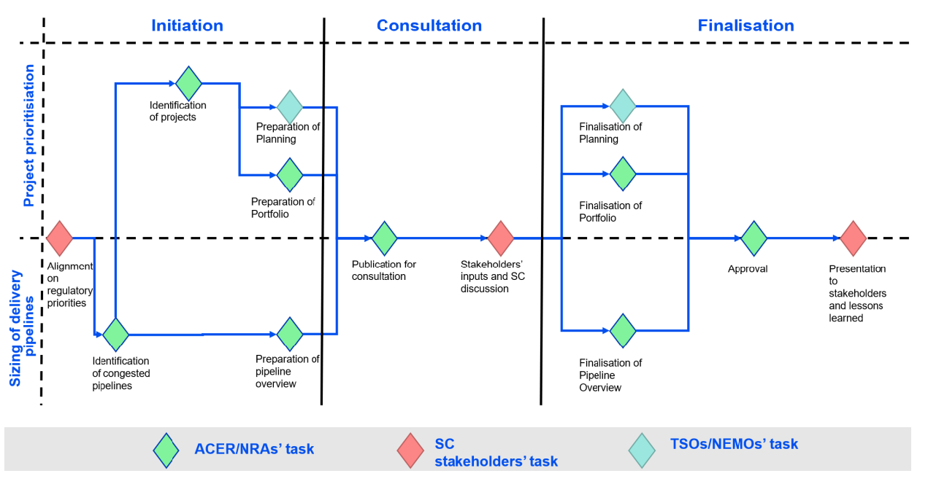
Background: Steps, division of tasks and deliverables
Deliverable 1: The Regulatory Projects Planning (PowerPoint slides)
Deliverable 2: The Regulatory Projects Portfolio (Excel file)
Deliverable 3: The Overview of Regulatory Projects Pipelines (Excel file)

Slide 3
How the process unfolded
6 March – 2 April: MESC consultation on the available draft deliverables:
Regulatory projects portfolio and overview of regulatory projects pipelines (Excel file prepared by ACER and NRAs)
Regulatory projects planning for the Core TSOs pipeline (prepared by Core TSOs)
5 responses received
Since the regulatory projects plannings for the other three pipelines (SDAC, SIDC and Nordic TSOs) had not been provided in time for the MESC consultation, ACER had initially decided to run a follow-up MESC consultation (3 weeks long) on the remaining deliverables
In subsequent exchanges with the Nordic TSOs and SDAC and SIDC representatives, it became clear that these deliverables, with the requested content and in the agreed format, would not have been provided in the foreseeable future
Given these developments, on 22 May ACER sent an email to MESC members informing them that this year’s prioritisation exercise will conclude only with the ACER-NRAs and Core TSOs deliverables

Slide 4
Feedback from market participants on ACER-NRAs deliverables
3 responses from market participants: Europex, Energy Traders Europe, Eurelectric
High-level comments:
All Regulations should be in scope, not only on CACM-related projects
National and regional projects are not considered
An assessment of the costs and/or efforts to implement the respective projects is missing
The benefits are described and weighted in a qualitative manner only
Some further reasoning might be needed to justify the assigned score per criterion
Specific comments:
Other “projects” were added to the list (e.g. application of min cross-zonal capacity requirements, data quality and completeness of ENTSO-E TP and JAO, …)
Different scores proposed for some projects

Slide 5
Feedback from TSOs on ACER-NRAs deliverables
Core TSOs:
Small corrections and additions on specific projects (e.g. dependencies, duration from decision to legal deadline, provisional implementation deadline, …)
The transition to CGMES grid model needs to be considered as an additional project
The outcome of this prioritisation exercise, together with functional dependencies between projects, will be considered when defining the implementation deadline of projects that are still to be planned or are currently in the regulatory phase, e.g. Central Europe CCR or harmonised market-based allocation
Nordic TSOs:
Small corrections and additions on specific projects (e.g. long-term flow-based, harmonised market-based, …)
How to consider the impact of Hansa projects since the same RCC is involved, hence the same IT systems are used
Difficult to draft a clear time plan due to several interdependencies and related uncertainties

Slide 6
List of projects and their priority: SDAC
Project name | Project pipeline | Regulatory deadline | Legal origin of the deadline | Implementation status | Provisional implementation deadline | Qualitative project priority
Core advanced hybrid coupling for DA | CACM SDAC & TSOs capacity calculation – Core | 30 June 2025 | Core DA CCM (2nd amendment) | Implementation phase | 30 June 2025 | High
Co-optimisation | CACM SDAC |  | EB Regulation | Implementation phase (R&D) |  | High
Border and NEMO additions in SDAC | CACM SDAC |  | MCO IP / Core DA CCM | Continuous task |  | Baseload project to be organised in go-live windows

Slide 7
List of projects and their priority: SIDC
Project name | Project pipeline | Regulatory deadline | Legal origin of the deadline | Implementation status | Provisional implementation deadline | Qualitative project priority
Flow-based allocation in ID (intraday auctions) | CACM SIDC |  |  | To be started |  | High
ID CZGCT <= 30 min* | CACM SIDC | 1 January 2026 | EMD reform | To be started |  | High
Flow-based allocation in ID (continuous) | CACM SIDC | August 2023 | Algorithm methodology | Implementation phase | 2027 | Low
Border and NEMO additions in SIDC | CACM SIDC |  | MCO IP / Core ID CCM | Continuous task |  | Baseload project to be organised in go-live windows
* Added based on the feedback received in the MESC consultation

Slide 8
List of projects and their priority: Core TSOs
Project name | Project pipeline | Regulatory deadline | Legal origin of the deadline | Implementation status | Provisional implementation deadline | Qualitative project priority
Core advanced hybrid coupling for DA | CACM SDAC & TSOs capacity calculation – Core | 30 June 2025 | Core DA CCM (2nd amendment) | Implementation phase | 30 June 2025 | High
Coordinated validation in Core | TSOs capacity calculation - Core | 8 December 2025 | Core DA CCM (3rd amendment) | Implementation phase | End-2025 | High
ROSC-RDCT Core | TSOs capacity calculation - Core | i) 4 June 2023 ii) 4 June 2025 | Article 67 SOGL, Article 35 and Article 74 CACM | Implementation phase | i) Q4 2026 – Q4 2028 | High
Core-ITN merger in DA (CE CCR) | TSOs capacity calculation - Core |  | Core DA CCM | To be started |  | High
Core ID flow-based CC | TSOs capacity calculation - Core | May 2026 | Core ID CCM (2nd and 3rd amendment) | Implementation phase | May 2026 | Medium
Cross-zonal CC in balancing (BTCC) - Core | TSOs capacity calculation - Core |  | Article 37(3) EBGL | To be started | 2026 | Medium
Switzerland in Core DA CC | TSOs capacity calculation - Core |  |  | Implementation phase | End-2025 | Low

Slide 9
List of projects and their priority: Nordic TSOs
Project name | Project pipeline | Regulatory deadline | Legal origin of the deadline | Implementation status | Provisional implementation deadline | Qualitative project priority
Harmonised market-based - Nordic | TSOs capacity calculation - Nordic | 31 July 2026 | ACER Decision 11/2023 | Implementation phase | 31 July 2026 | High
Cross-zonal CC in balancing (BTCC) - Nordic | TSOs capacity calculation - Nordic |  | Article 37(3) EBGL | To be started |  | Medium
Nordic ID flow-based CC | TSOs capacity calculation - Nordic |  | Nordic ID CCM | To be started |  | Medium
ROSC-RDCT Nordic | TSOs capacity calculation - Nordic |  | Article 67 SOGL, Article 35 and Article 74 CACM | To be started |  | Medium

Slide 10
Now for a discussion…
What prevented SDAC and SIDC NEMOs and TSOs, as well as the Nordic TSOs, from providing the requested input within the agreed timeline?
How to make the exercise more effective next year?
Roadmaps prepared by NEMOs and TSOs at the end of Y-1
…

Slide 11
Thank you. Any questions?
The contents of this document do not necessarily reflect the position or opinion of the Agency.

