Slide 1
Update on the DR NC and next steps
MESC meeting
13 June 2024

Slide 2
ACER process for revision/recommendation
May-Aug
8 May: EU DSO entity and ENTSO-E submit the proposal* to ACER
Sep-Oct
5 Sep – 31 Oct: ACER public consultation
1 Oct: ACER public workshop
Nov-Dec
ACER/NRAs process public consultation comments
Jan
Feb-Mar
ACER/NRAs orientation discussion
ACER Board of Regulators meeting
Finalisation of the recommendation
Exchanges with stakeholders (drafting committee)
8 Mar: submission to the EC
ACER/NRAs revisions to the proposal
The stakeholders views on the SOs proposal are known; in case ACER identifies topics for further discussion with the drafting committee before the launch of the public consultation, ad hoc calls will be scheduled.
MESC updates: 8 Oct and 3 Dec.

Slide 3
DR NC proposal: process and submission package
Supporting document
Demand Response NC
Amendments to existing regulations
Drafting Committee process
What could be improved
- constructive environment
- open exchange
- transparent discussions
- frequent and dedicated technical workshops
- clarity on how we work together in the drafting committee
- draft text at the beginning of the process
- clarity on the final deliverables and time to discuss the whole submission package
The only document discussed in the drafting committee process was the draft DR NC; almost 60% of the documents were shared for the first time at the formal submission.
The full submission package can be found in the public consultation webpage.

Slide 4
Legal requirements for the ACER process
Article 59(11) of the Electricity Regulation
ACER shall revise the proposed NC to ensure that the NC to be adopted
complies with the relevant FG and
contributes to market integration, non-discrimination, effective competition, and the efficient functioning of the market and,
submit the revised NC to the Commission within six months of receipt of the proposal.
In the proposal submitted to the Commission, ACER shall
take into account the views provided by all involved parties during the drafting of the proposal led by the ENTSO-E or the EU DSO entity and
shall consult the relevant stakeholders on the version to be submitted to the Commission.
Ensure necessary level of harmonisation and consistency with existing legislation.

Slide 5
ACER revision dimensions
Ensure legally consistent draft
Improve drafting quality with amendments on wording, structure and clarity of legal requirements.
Ensure compliance with the framework guideline*
Some of the requirements of the DR FG are not fulfilled in the formal proposal.
Content direction
Direction in the DR NC, within the boundaries of the FG, and respecting the objectives of the Electricity Regulation.
Alignment of the proposed amendments to existing regulations
*DR FG: ACER Framework Guideline on Demand Response

Slide 6
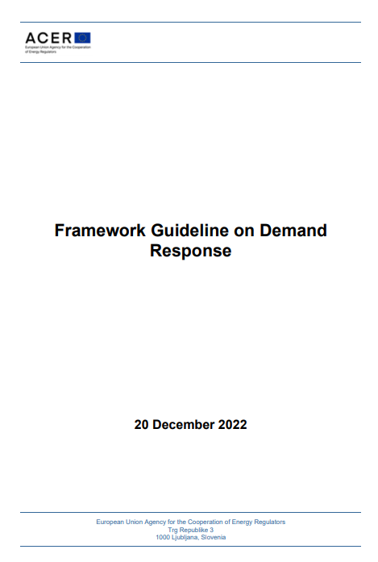
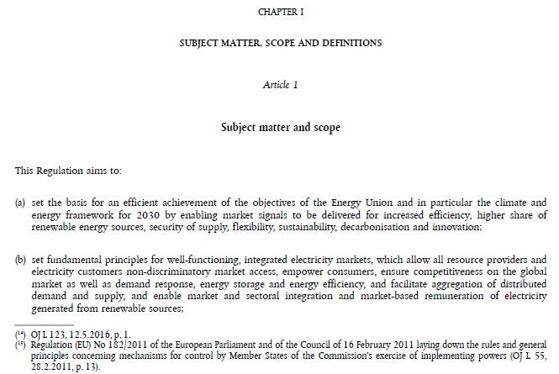
Guiding principles for ACER’s revision
Objectives of the Electricity Regulation
Target: now
Innovation: future
European
National
EU rules on DR
Relevant for the EU framework
“shall” vs “may”

Slide 7
Main objectives on specific topics
Clear requirements for the implementation of aggregation models in wholesale electricity markets.
Efficient TSO-DSO and DSO-DSO coordination for identifying and solving system issues (congestion and voltage control).
Clear requirements for the interactions between markets (incl. market-based procurement of services) to ensure overall efficient operation.
Simplification of the prequalification processes and avoiding duplications for the provision of multiple services.

Slide 8
Thank you!

