Slide 1
EG HCF proposals on RfG 2.0 legal text – ENTSOE position

Slide 2
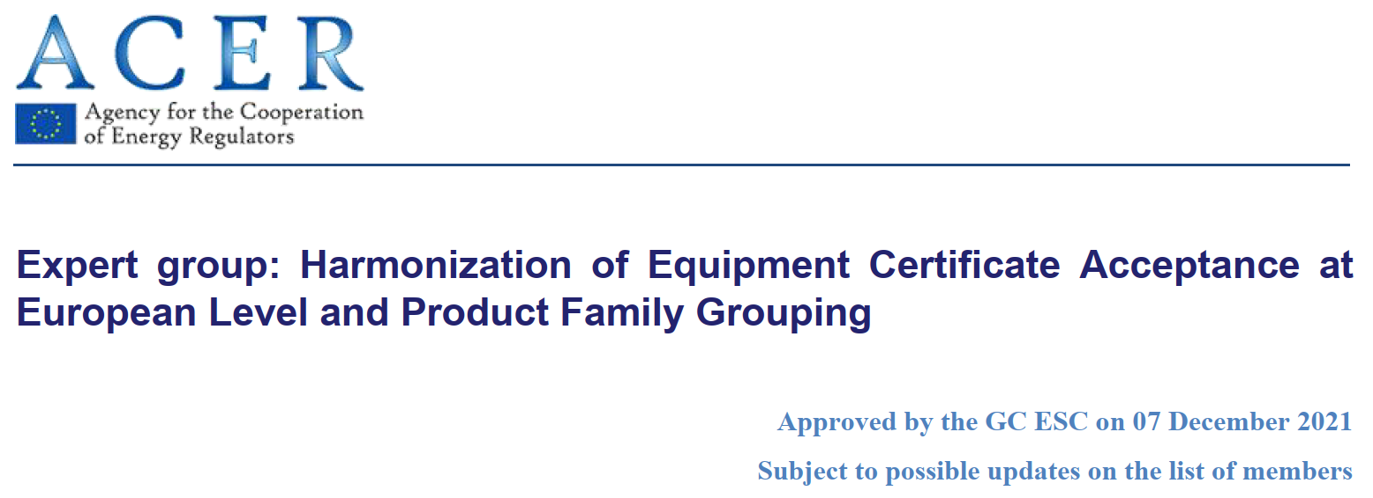
1. Sequence
EG HCF started to run on December 2021, with several participants from ENTSOE.
Final report approved by GC ESC on 16/3/2023.
May 22nd : convenor + subgroup leaders provided a list of proposals and gave a short deadline for comments (1,5 week).
StG CNC agreed on rejecting the proposals and on May 2nd ENTSOE answered EG HCF.
Reaction of EG HCF to ENTSOE on June 7th .
Link to EG HCF report in ENTSOE website

Slide 3
2. ENTSO-E acknowledges EG HCF report
ENTSO-E acknowledges the good work done by EG HCF in the report:
Compiling best practices on certification along Member States.
Gathering different stakeholders’ (Manufacturers, Certification bodies, Laboratories, TSOs and DSOs, Research Institutes…) views on certification.
Providing an exhaustive guideline on the certification process and all the necessary steps regarding PGU and components certificates (but not PGM).

Slide 4
3. ENTSO-E position on EG HCF proposals to amend legal text (formal)
The main concerns from ENTSO-E on implementing proposals in legal text, from a formal point of view:
Proposals to legal text were not discussed within EG.
Very short period provided to EG (ENTSO-E members included) to provide comments.
It should have been taken the same approach as in other EGs (CROS, ACPPM,…), discussing in detail the proposals to legal text. This discussion did not exist.

Slide 5
4. ENTSO-E concerns to EG HCF proposals to amend legal text
RfG describes technical requirements for PGMs at the connection point. The current proposals largely describe a formal process to be followed for PGUs and components (not PGMs), rather than necessary technical capabilities. RfG should only contain general provisions for the verification process. The proposed Chapter 1 is too detailed and should be part of a dedicated document or standard instead of RfG.
Currently, verification by means of a certification process, with available compliance schemes, has so far only been carried out in a very limited MS. Such level of detail and constraints may interfere in the developement of the compliance process based on certification of other MS.
Specific topics corresponding to the national certification scheme of one country e.g. prototypes and fixed values (1st set of proposals) for families, have been introduced in the proposals.
Mutual recognition of certificates would reduce testing costs, but needs to be based on equivalent requirements (equal or more onerous) and equivalent testing/simulation process. Some requirements are not that simple to compare.

Slide 6
5. ENTSO-E proposals to take on board EG HCF report outcomes
Avoid introducing such level of detail in the RfG, as indicated before, the proposals, especially the Chapter 1, much better fit into a certification procedure like TR8, NTS, IEC 61400-21, etc. but they are too detailed to be introduced in the legal text as they are proposed.
ENTSOE considers positive the harmonization of the certification process, however the detailed process must be established at national level. Thus, it could be introduced in the legal text that RSO will make public the provisions regarding the certification process, if this is the option for compliance verification selected.
Use EG HCF report as a basis to update existing Implementation Guidelines on compliance verification. The IGDs are the most suitable legal vehicle to guide TSOs on how to establish a certification process.

Slide 7
(ToR EG HCF – Targets)
Based on a common understanding of the items listed above, the objective of the EG is to:
Provide a path for the creation of EU harmonized testing strategies and proof of compliance methods as well as a proposal on key criteria to meet requirements in RfG, taking into account existing strategies in other sectors of EU regulation.
Define an approach to accept certificates at EU level for all types (A, B, C and D). This can include a set of minimum requirements on respective statements of conformity, including the option of only selective conformity and the application of component certificates.
Define a common product family definition and grouping criteria for an equipment certificate.
Provide a path for a harmonized European approach to accept validated simulation models and define their recommended scope of use to substitute equipment testing.

Slide 8
(ToR EG HCF - deliverables)

Slide 9
(EG ACPPM - ToR)

