Slide 1
DRESG 3rd Meeting–
Implementing Regulation on interoperability requirements for Demand Response
6 October2026
Paul De Wit, on behalf of the Joint Working Group of DSO ENTITY & ENTSO-E

Slide 2
Background of the work for the IR Demand Response – Legal Mandate and ENTSOE – DSO Entity JWG
Background
Joint Working Group
DSO Entity & ENTSO-E
TF1: ‘Monitoring Implementing Regulations’
DSO Entity, ENTSO-E
TF2: ‘Development of Implementing Regulations’
DSO Entity, ENTSO-E,
TF3: ‘Data Interoperability Models’
DSO Entity, ENTSO-E,
The data interoperability implementing regulation is coming from Article 24 of Directive 2019/944.
  Data interoperability for metering & consumption data ((EU) 2023/1162), customer switching, demand response & others.
To deliver the obligations in Directive 2019/944, (EU) 2023/1162 requires ENTSO-E and DSO Entity to support the European Commission in creating Implementing Regulations on Data Interoperability.
To deliver this mandate, ENTSO-E and DSO Entity created the Joint Working Group (JWG) for Data Interoperability in June 2023.
Stakeholders’ panel TF1
Stakeholders’ panel TF2
Stakeholders’ panel TF3

Slide 3
JWG Deliverables
A new Harmonized Electricity Market Role Model (HEMRM), previously done only by ENTSO-E
A JWG proposal for an Implementing Act on data interoperability requirements for demand response
(IA DR)
Guideline for the Implementing Regulation(EU) 2026/855 in customer switching data
Guideline for the Implementing Act (EU) 1162/2023 in metering and consumption data
+ 4 workshops with Member States’ representatives between 2023-2024
May 2024
March 2025
December 2025
July 2026
June 2023
September
2026
October 2024
July 2025
July 2026
A JWG proposal for an Implementing Act on data interoperability requirements for customer switching
(IA CS)
Guiding Principles for the Measurement Data Market
Implementing Guide on Customer Switching (IG CS)
Publication of the JWG repository
Useful links:
JWG repository

Slide 4

What does the IR in Demand Response do?
Continue developing a reference model that facilitates data interoperability among the Member States focused, in this case, on the information required to provide demand response.
Goal
Identification of the responsibilities associated with different roles associated to the different responsibilities
A reference model composed of roles, information flows (procedures) and minimum information requirements (information objects) for providing the services.
Obligation on the Member States to map their models against the included reference model. This information will be published in a public repository maintained by DSO Entity and ENTSO-E.
Content
NC DR
Sets overall processes
(Article 58 and 59 of Regulation 2019/943)
IR DR – Joint Working Group
Requires MS to map their legislation/implementation against set information flows(Article 23 and 24 of Directive 2019/944)
SEEG/D4E
Implementation in the European Energy Data Space.
Interactions

Slide 5
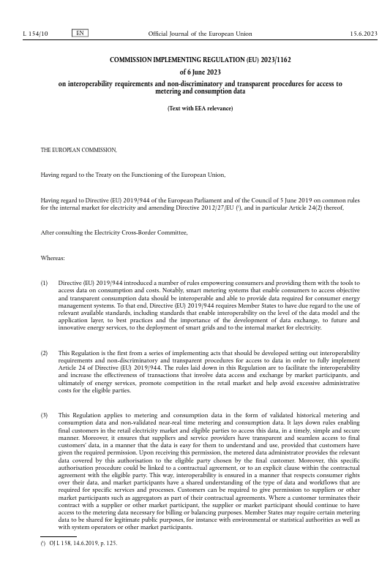


Summary of the documents – the example for metering data
Implementing regulation
Published by the European Commission – legally binding;
Introduces the reference model,
  obligations for Member States to map and submit their national process; and
  JWG to publish those mappings.
Guidelines document
Published by the European Commission – non legally binding;
Explains the reference model in the Implementing Regulation to support the Member States’ submissions.
Guide document
Published by the JWG (previously only ENTSO-E) – non legally binding;
Introduces technical requirements for the internal implementation in SOs of the requirements in the Implementing regulation.
Implementing Acts on Data Interoperability | Electricity Data Interoperability

Slide 6
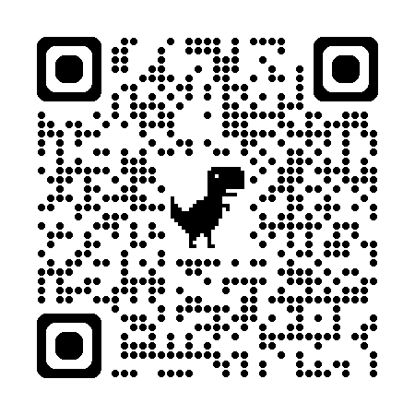
DSO ENTITY & ENTSO-E
Electricity Data Interoperability Joint Platform
Access through the QR code
Implementing Acts on Data Interoperability | Electricity Data Interoperability

Slide 7
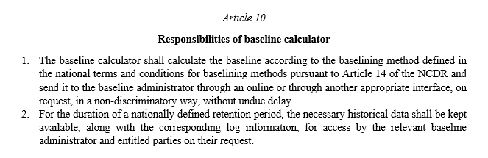
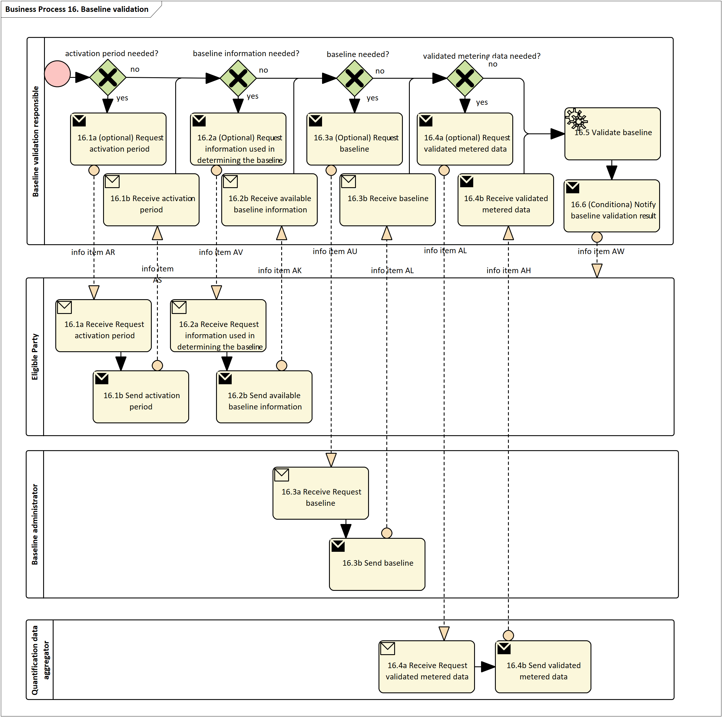
General overview of IR Demand Response – parts of the document and examples of content
Main Document
Definitions of main responsibilities
Annex
Definition of the procedures of the reference model
Role name | Role description
CU module administrator | A party responsible for a functional platform of a ‘flexibility information system’ that contains, manages, and makes available master data about controllable units. (See also NCDR, Article 2).
Name of information | Description of information exchanged
CU master data request | Entitled party | Entitled party which is issuing the information request
 | Request type | CU master data list
Request validation information | Validation result | Information about the outcome of the validation step.
Article 23
Reporting of national practices
Article 24
Tasks under the EU DSO entity and ENTSO for Electricity cooperation on data transparency

Slide 8
Overview of IR DR
Pre-qualification or Verification
Temporary limits
CU registration, update, suspension, de registration
Bidding and activation
Flexibility Information System
Delivery of the energy service
Quantification
Settlements
Baselining
SP registration, application for qualification, update, suspension, révocation de registration
SPU/SPG registration, update, suspension, de registration
Making measurement data available
Baseline data handling, calculation, and optionally validation

Slide 9
List of procedures
No. | Procedure name / Description
1 | General access to CU master data by an entitled party
2 | Controllable Unit registration
3 | Update Controllable Unit information
4 | De-registration Controllable Unit
5 | Suspension of Controllable Unit by an entitled party
6 | Re-activation of Controllable Unit
7 | Service Provider registration
8 | Service Provider application for qualification
9 | Service contract revocation by Final Customer
10 | Service contract termination by Service Provider
11 | SP Customer switching or new registration on CU
12 | Cancellation of SP registration on CU
13 | Update service provider profile information
14 | De-registration of Service Provider
15 | Suspension of SP qualification by System Operator
16 | Revocation of service provider
17 | Reactivation service provider
No. | Procedure name / Description
18 | SPU or SPG registration
19 | SPU or SPG update
20 | SPU or SPG de-registration
21 | SPU or SPG application
22 | SPU or SPG suspension
23 | SPU or SPG re-activation
24 | SPU or SPG grid prequalification
25 | SPG or SPU product prequalification
26 | SPG or SPU product verification
27 | General access to SPU or SPG master data by an entitled party
28 | Bidding and activation of active power flexibility product
29 | Temporary limits
30 | Baseline data handling
31 | Making measurement data available
32 | Quantification
33 | (Optional) Baseline Validation

Slide 10
IA DR - Roles

Slide 11
Roles
The roles are part of the reference model defined in the regulation as defined in Commission implementing regulation (EU) 2023/1162.
Each role is associated to a set of responsibilities and interactions.
In comparison to NCDR which allocated responsibilities to entities (procuring system operator, service provider … ), the definition of roles allows a more nuanced representation of the responsibilities and ensure transparency about how the responsibilities are or can be implemented at national level. This gives the Member States more possibilities to implement the functionalities according to their specific needs while maintaining the interoperability.
There are 2 roles that are generic (different from Eligible party) and should be interpreted according to each procedure:
  Entitled party
  Affected party

Slide 12
Thank you!

