Slide 1
ACER flexibility barriers report
– preliminary insights into the FNAs’ sections on flexibility barriers –
DRESG, 6 October 2026
ACER’s monitoring on barriers to non-fossil flexibility
Sensitivity

Slide 2


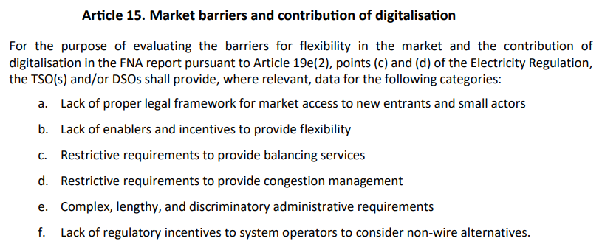

ACER’s monitoring on flexibility barriers: rationale for ACER Recommendation
ACER Regulation
Electricity Market Design (FNAs)
ACER monitoring/reporting mandates related to flexibility
  Monitor regulatory barriers for new entrants on the market and smaller market participants
  An annual ACER monitoring report
  Analyse national FNA reports and provide recommendations on removing barriers to the entry of non-fossil flexibility resources
  A biennial ACER report
One ACER report to fulfill both mandates
Ideally supported entirely by national FNA reports
2023 ACER Market Monitoring report on Demand response and other distributed energy resources: what barriers are holding them back?
2025 ACER Monitoring report on Unlocking flexibility: No-regret actions to remove barriers to demand response
2026 ACER Recommendation on NRAs’ reporting on barriers for non-fossil flexibility

Slide 3
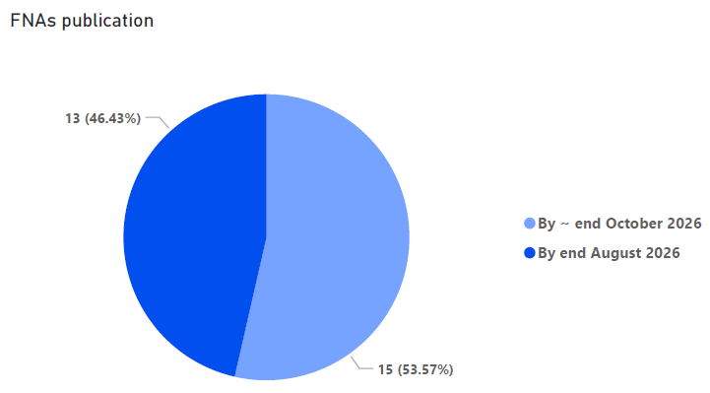
Available FNAs
13 FNAs available*
15 FNAs* missing
FNAs’ barriers chapters vary from short, high-level descriptions (mostly qualitative) to more detailed analysis
3 FNAs (SI, LT, PT) provided annex/tables with data on flexibility barriers following ACER’s Recommendation
* 13 MS have made available their FNAs to ACER as of 14 September 2026 (CY, CZ, DK, HR, LT, LV, PL, PT, SE, SI, SK, EE, IE). Expecting a separate report for Northern Ireland.

Slide 4
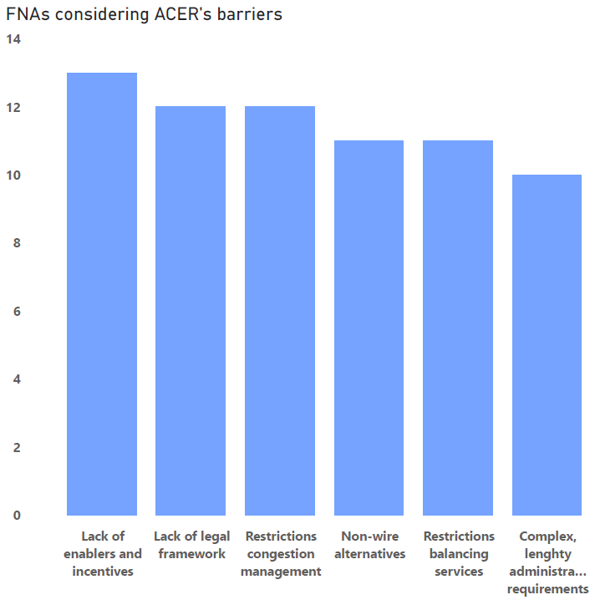
Alignment of FNAs’ barriers sections with ACER barriers and indicators*
The 13 FNAs largely structured around ACER’s BARRIERS headings … But that doesn’t mean that MS see them all as actual barriers.
INDICATORS
NOT generally structured following ACER’s indicators headings (except for SI, LT and PT)
3 FNAs
  include data or information on almost all of the 24 ACER indicators (LT, SI and PT)
  separate annex/ tables covering indicators
Remaining FNAs
  vary from giving more detailed information (but mostly qualitative) to only addressing a few of ACER’s indicators or none at all
Overall picture lacks systematic, comparable overview of MS barriers on an equal basis
Need to launch an (almost) complete data collection for many FNAs
13 FNAs from the following Member States (CY, CZ, DK, HR, LT, LV, PL, PT, SE, SI, SK, EE, IE).
*2026 ACER Recommendation on NRAs’ reporting on barriers for non-fossil flexibility, Annex

Slide 5
A first glimpse into FNAs’ flexibility barriers
1
Lack of legal framework
2
Enablers and incentives
3
Balancing services
Independent aggregation incomplete / not yet fully defined (e.g. HR,IE, LV, DK, PT, SI)
Legal provisions not fully implemented / not consistently interpreted (e.g. CY, CZ, SE, LT, IE)
Market access difficulties for co-location and energy communities (e.g. IE)
Incomplete SM rollout / interval metering (e.g. HR, CZ, PL)
Separate metering / DMDs under implementation (e.g. IE, DK, PT)
Limited time-differentiated retail contracts (e.g. PT, SI, HR, CZ, IE)
Limited time-differentiated grid tariffs (e.g. CZ, LT, DK)
Restrictive prequalification (i.e. aggregation/duration) (e.g. PT, SE, HR)
Limited participation of DERs (e.g. CY)
Persistence of (some) non-market-based balancing products (e.g.PL, PT)
4
Congestion management
5
Administrative requirements
6
Non-wire alternatives
Lack of market-based congestion management (e.g. LT, CY)
  No local flexibility markets (e.g. DK, CZ, CY, LT)
  Lack of CM products for TSOs (DK)
Reliance on FCAs over local flexibility markets (e.g. SI, HR, DK, SE)
Lengthy grid-connection procedures (e.g. HR, DK, CZ, SK)
Local market access administrative barriers (e.g. IE, SE)
Inadequate queue management (e.g. HR)
Regulatory/tariff design favours grid expansion (e.g. DK, EE, HR, PL, SE, SK, LT)
TSO/DSO asymmetry: DSOs face stronger flexibility than TSOs (e.g. LT, PT)
Note: This analysis represents just a preliminary, simplified high-level overview - and based only on the FNAs (not additional studies). Some data or information may be partial or incomplete. The barriers are structured alongside those from the ACER Recommendation on reporting on flexibility barriers.

Slide 6
Examples of additional barriers* raised at MS level
Some FNAs provide generic descriptions of additional barriers (technical etc) with few indicators:
Data system infrastructure, interoperability and visibility of grid and flex resources (AMI/ Meter data management / Market Management system / IMS (HR, SI, CY, SK, PL)
  Insufficient MV/LV operational observability and automation; lack of MMS to enable DR integration (CY); Lack of technical/digital infrastructure for independent aggregation (SE)
TSO-DSO governance and coordination gaps (EE, SE, SI)
  Clear, transparent processes are needed for efficient, non-conflicting use of flexibility resources.
Financial incentives through long-term contracts (SE, PL)
  Need to introduce multi-year contracts for the provision of regulatory services (PL);
Energy poverty and unequal ability to afford flexibility enabling technology (CZ)
  Lower-income households cannot afford flexibility-enabling technologies (solar panels, EVS, etc)
Lack of liquidity and predictability of local flexibility markets (SE, SI)
  Including high investment costs for setting up local markets; lack of CM products
Separate or integrated markets for congestion management for TSOs/DSOs
  Need for separate markets for TSO flex (SK) vs. sharing resources between TSO/DSOs (PL)
* Note: This represents just a sample of additional barriers/indicators (preliminary information). Slovenia's FNA is the only report that explicitly labels a set of “additional” country specific barriers; other barriers are drawn from content in the barriers chapter that extends beyond ACER's 24 indicators. We still need to double-check if some of these would fit under the ACER indicators.

Slide 7
Timeline ACER flexibility barriers 2026 – 2027
July 2026
FNAs submitted
January 2027
ACER Summary Report of FNAs
ACER Flexibility Team summarises the FNAs’ flexibility needs
ACER Market Monitoring Team Electricity summarises FNAs’ barriers to flexibility
2026
2027
2028
March 2026
ACER Recommendation on reporting barriers
By December 2026
ACER additional data collection to fill in gaps on FNAs’ flexibility barriers
July 2027
ACER Full Report on flexibility needs and barriers, including data analysis
ACER Flexibility Team estimates the flexibility needs in the electricity system at EU level
ACER Market Monitoring Team Electricity evaluates barriers to flexibility, focusing on issues of cross-border relevance

Slide 8
Questions
Which barriers to non-fossil flexibility you would prioritise?
Which barriers, even if reported by only a few Member States, have proven persistent over time and deserve more attention?
Which barriers are missing? What else do you expect to see in terms of barriers?

